Slide 1

WEBINAR:
Circular Economy, Circular Work?
Presentation Title:
So what does a Circular Economy Mean for the future of Work ?
Presented To: Wageindicator and #Democratizingwork
Presented By: Wairimu Mwangi - Co-founder – Loopworks Ventures
Email: Gathigia218@gmail.com
Date: 07/06/24

Slide 2
Table of Content
Kenya’s Current economic situation
Linear Economy Model - Example of a banana value chain
Why the Circular Economy?
Circular Economy Model – Unlocking work Opportunities (Example of a banana value chain)
Limitations and Recommendations

Slide 3
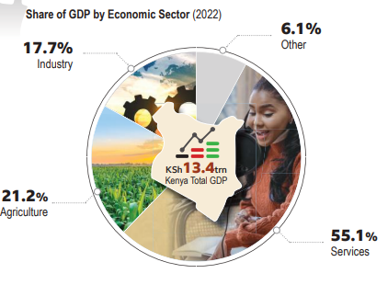
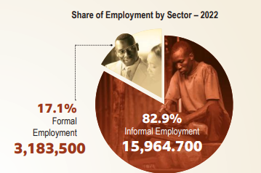
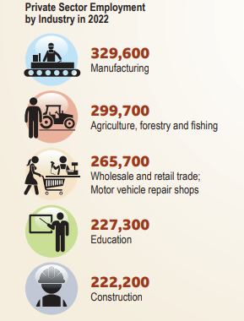
Kenya’s Current Economic Status
Kenya’s Economic Status:
GDP rate and distribution by main sectors and employment distribution rates.
Source: Economic Survey of Kenya; 2023

Slide 4
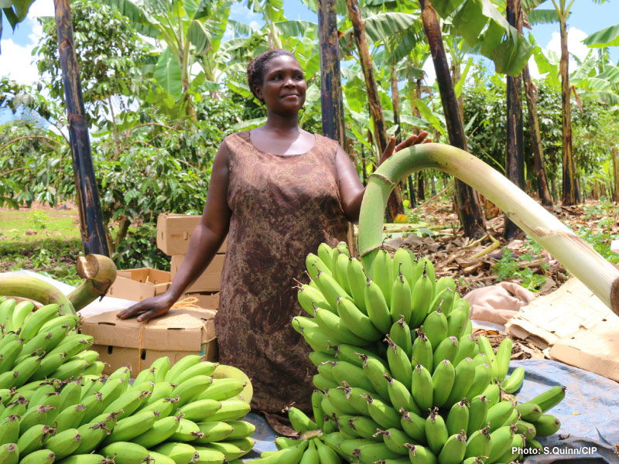
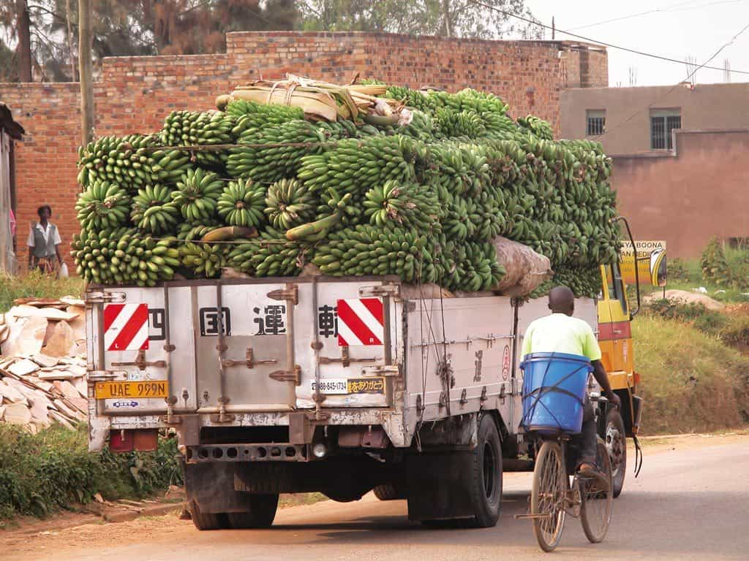
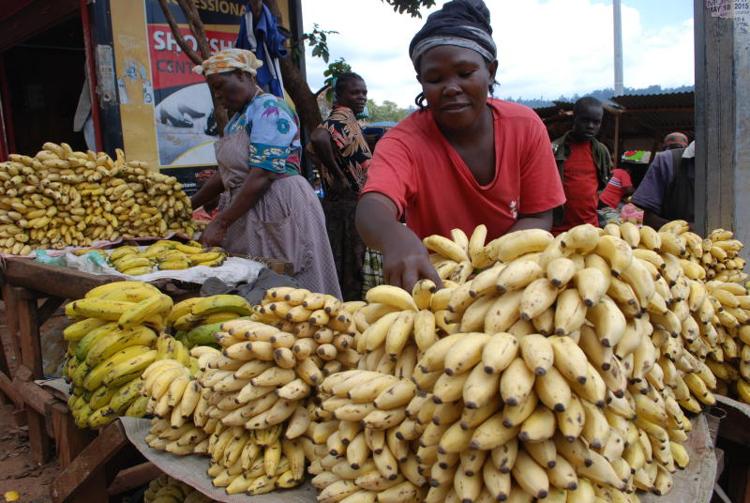
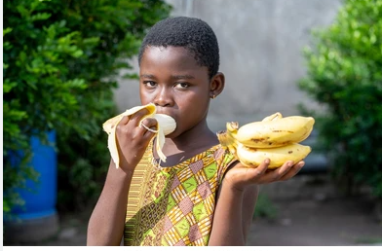
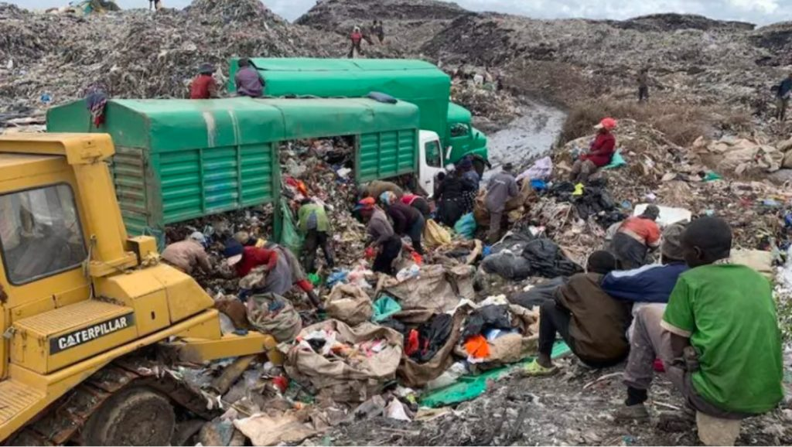
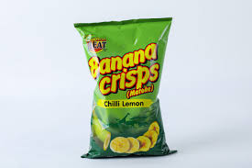
Linear Economy model:
A Banana value chain scenario
EXTRACT BANANAS
Waste –pseudostem, rhizome, bud etc
MAKE/ VALUE ADDITION
Waste –discarded fruits
USE
Waste - peels , spoilt fruits
DISCARD
Waste from each stage of the chain
WORK
TRANSPORTERS
RETAIL/SUPERMARKETS
INFORMAL WASTE PICKERS
FARMERS
Work Implications:
Less jobs along the value chain vs potential jobs
Low quality of pay /low revenues
Lots of waste generated/unoptimized resources
Unsustainable extraction compromising on future work
Fewer products generated.
INPUT PROVIDERS (CHEMICAL FERTILIZER PROVIDERS)
LARGELY CONTROLLED BY BROKERS
Minimal Value addition

Slide 5
Why Circular Economy?
The circular economy is based on 3 principles, driven by design:
Eliminate waste and pollution. (healthy environment and economy, optimized resource opportunities)
Regenerate nature.
Circulate products and materials (at their highest value)

Slide 6
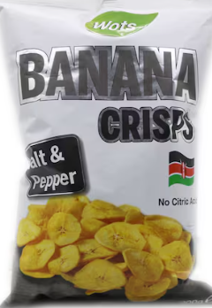




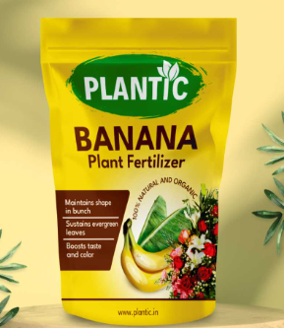

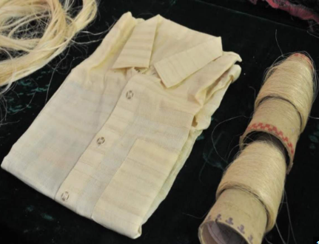

Circular Economy model- Unlocking Work Opportunities
A Banana value chain scenario
1. Regenerative Nature
3. Circulate Products & Materials at their highest value (multiplicity of Value )
2. Eliminate Waste and Pollution
Soil amendment

Slide 7
Implications of a Circular Economy on Work:
Conversion of waste into various resources
Optimized resources and material resulting into new product range and new industries
Unlocked value that translates into job opportunities (creation of new industries, expansion of existing industries and new careers)
High quality and Sustainable jobs
Regenerative ecosystem that is sustainable and supports the economic system.

Slide 8
Limitations & Recommendations
Transition to a Circular Economy model requires a System wide approach that connects the 4 main actors of the economy to co-create solutions:
1. Government/ Policy considerations – Value enablers (Creation of incentives driven approach
2. R &D - Knowledge products generators and deployment
3. Industrialists/Enterprises/Innovators – drivers of value (products, systems etc)
4. Consumers – offtakers of value

Slide 9



