Slide 1
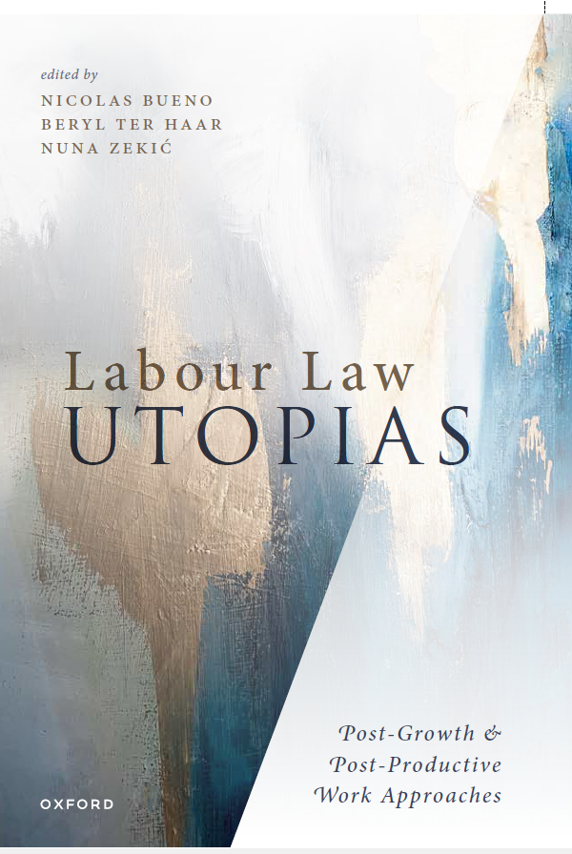
Labour Law Beyond Growth
Prof. Dr. Nicolas Bueno
November 2024
Democratizing Work Global Workshop

Slide 2
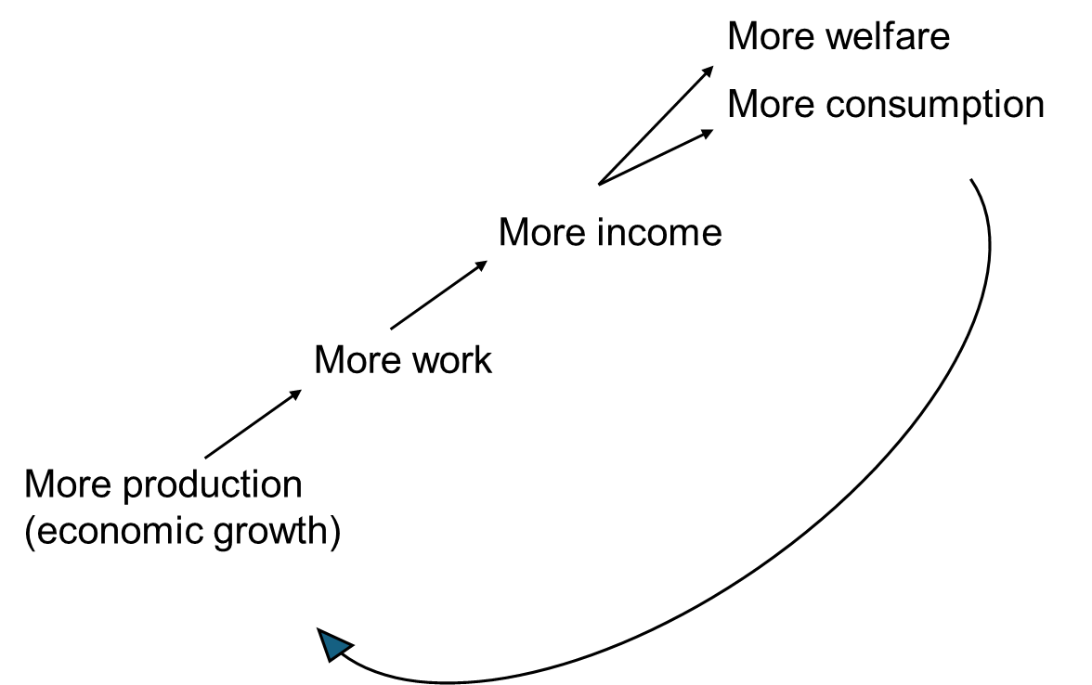
The Simple Growth Narrative
«Growth is good for workers»

Slide 3
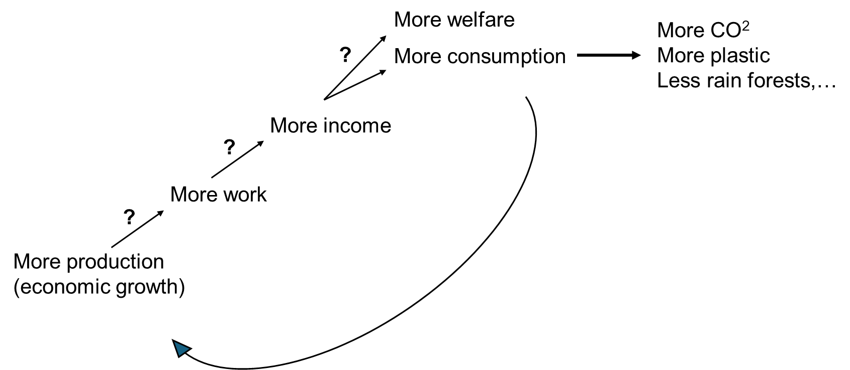
The Realistic Growth Narrative
«Growth is not necessarily benefitting workers and it is necessarily impacting the environment»

Slide 4

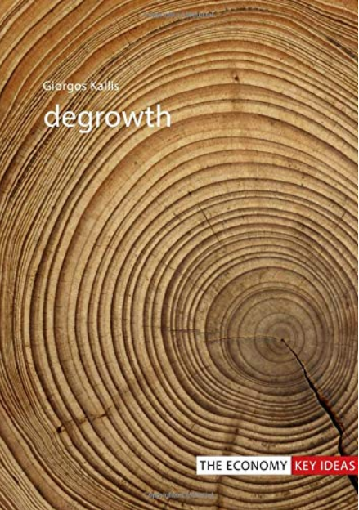
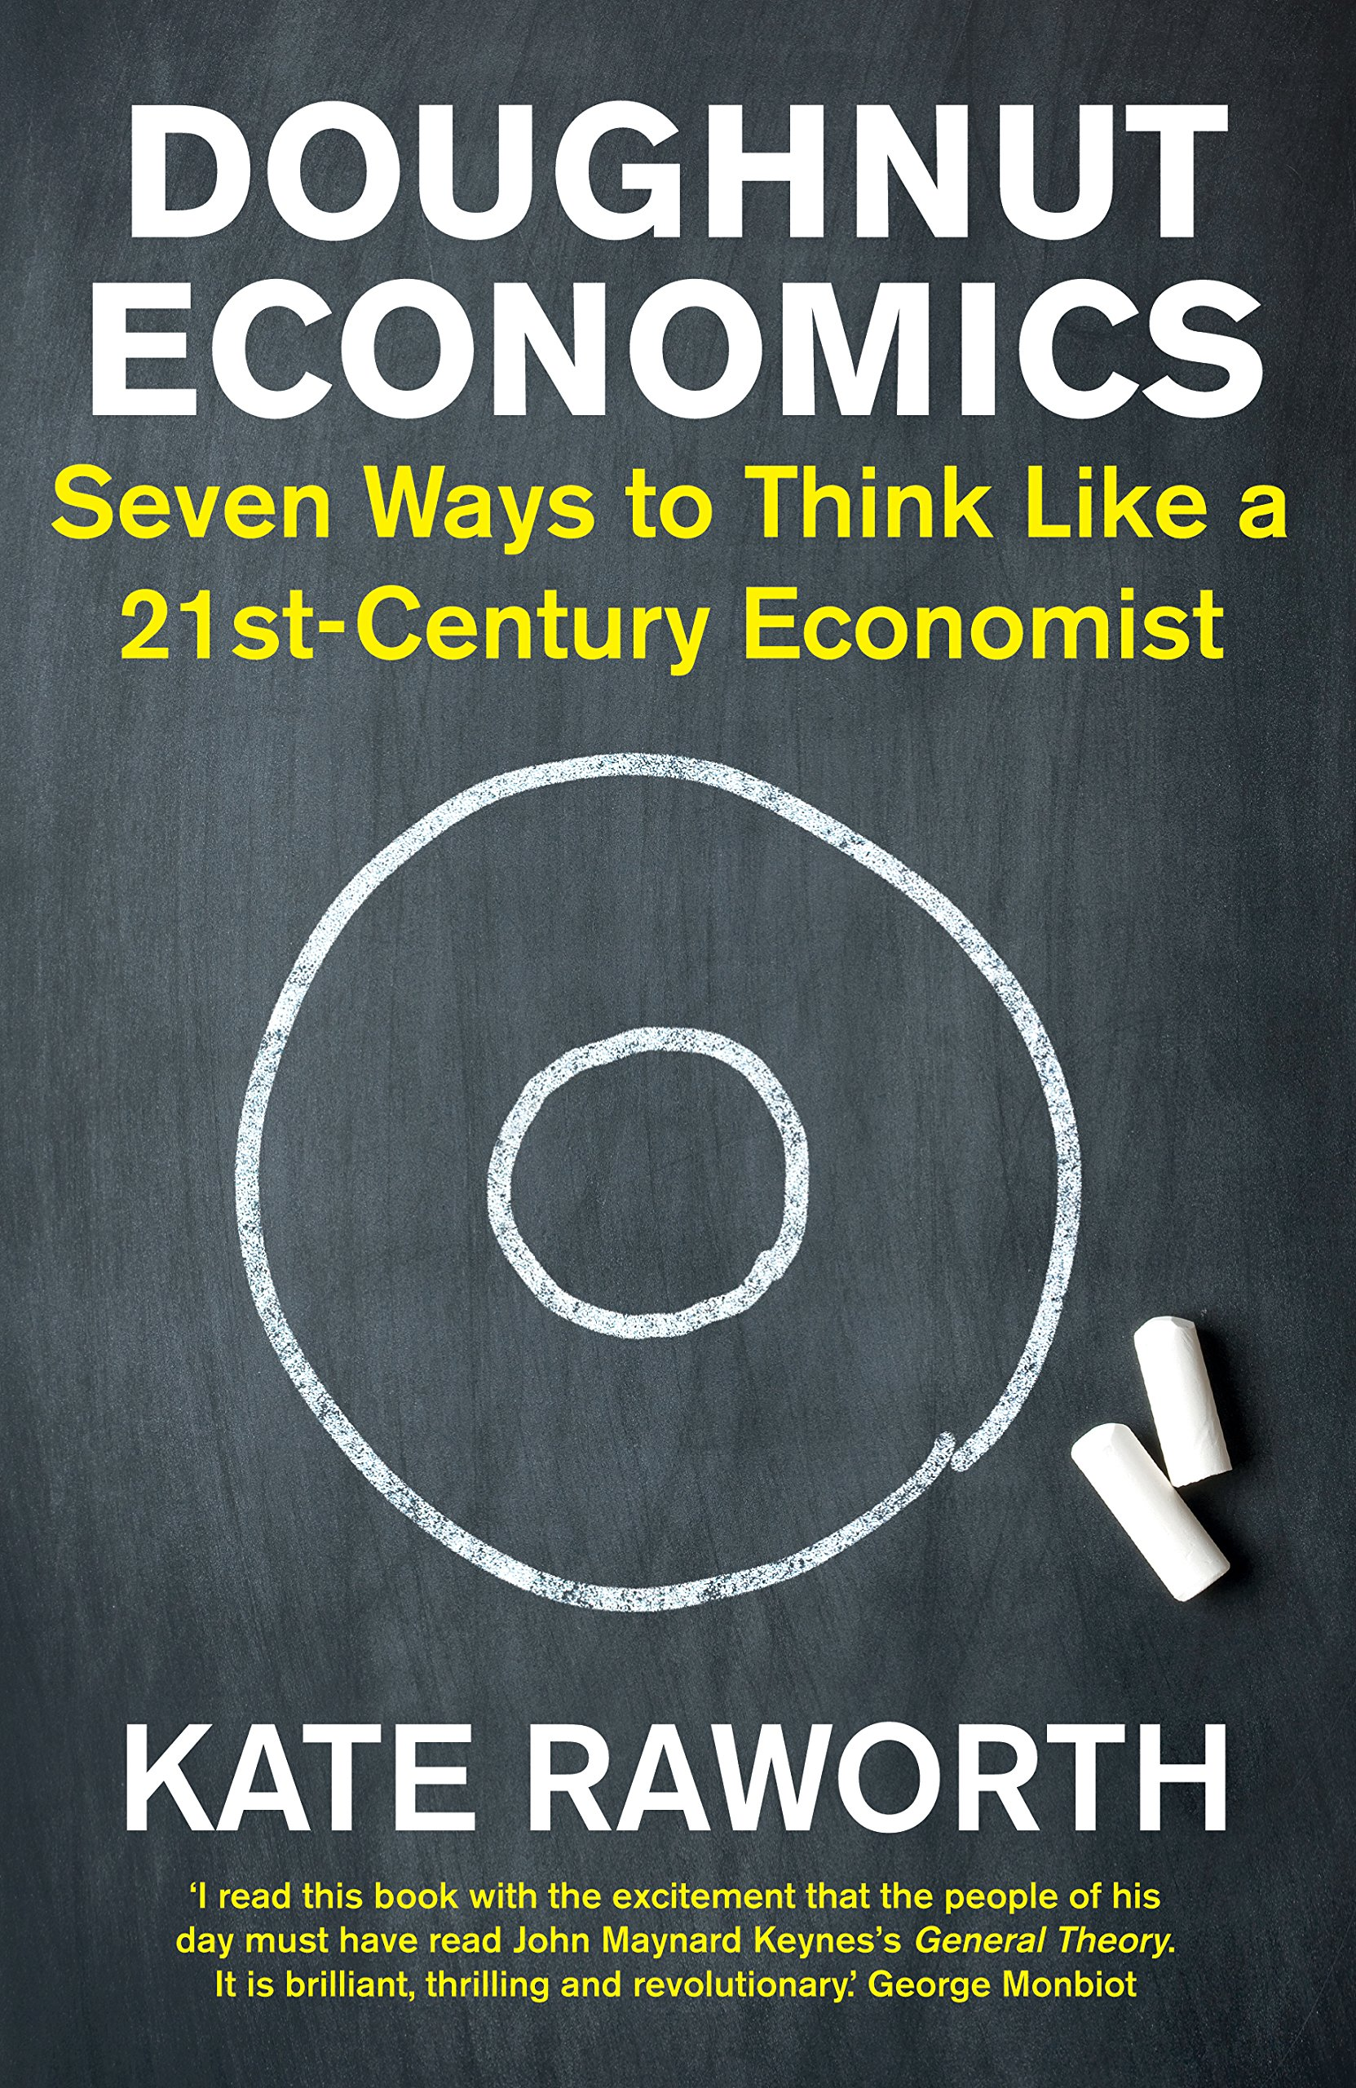
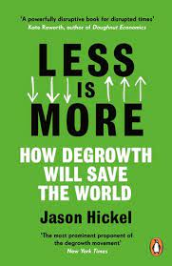

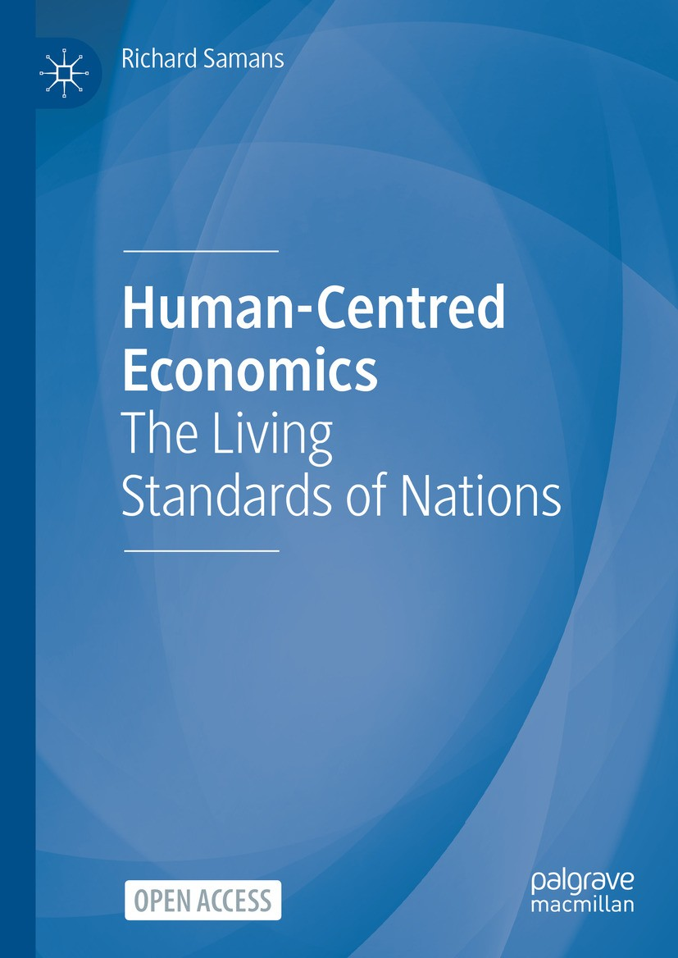
Wellbeism (Beyond Growth)
2018
2018
2021
2021
2022
2023
Economy that is efficient in terms of human and ecological wellbeing
(regardless GDP growth)

Slide 5

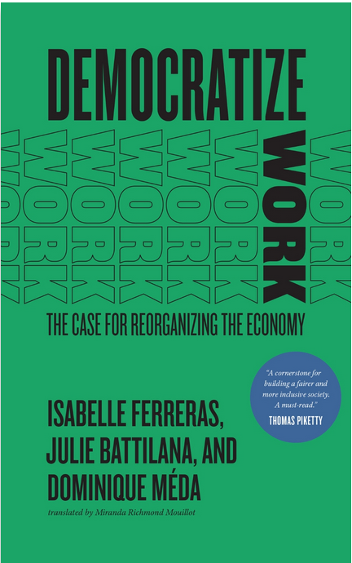
Wellbeism and Work
2021
2022

Slide 6
Wellbeism and Work
1. Rethink the value of work beyond its market value
A. Improve social and ecological efficiency of work
      Ex: green jobs and technology, care work and social innovation
B. Deter socially and ecologically damaging work
      Ex: housing price/food speculation, advertisement and comercial marketing
2. Reduce the quantity of work (increase freedom from work)
A. Decouple wellbeing from productive work
      Ex: fund welfare through wealth tax, polluting products tax (instead of income tax)
B. Reduce the economic need to work
      Ex: Reduce living costs to increase freedom from work

Slide 7
Translating Wellbeism into Law
Nicolas Bueno, Beryl ter Haar, Nuna Zekic (eds), Labour Law Utopias: Post-Growth and Post-Productive Work Approaches (OUP 2024) (open access)

Slide 8
Translating Wellbeism into Law
Now
Right to a living wage
-
-
Wellbeism
Right to a living income
in supply chains (ex: EU Directive on Corporate Sustainable Due Diligence, CSDDD)
+ Right to a just income +
unpaid care workers
underpaid workers
+ Right to a fair income +
human/ecological essential work (ILO, Value of Essential Work)
fair maximum income for top-income workers in case of human/ecological degradation

Slide 9
Translating Wellbeism into Law
Now
Right to work
Wellbeism
+ Right to work meaningfully +
Integrate value into employment policies (green jobs, care work)
Promote start-ups and innovation oriented towards wellbeing
Reduce taxes on socially/ecologically essential work
Subsidize purpose-driven companies
Promote voluntary work
Promote work opportunities to work meaningfully
Reconcile individual and societal meaningfullness

Slide 10
Translating Wellbeism into Law
Now
Right to rest
Wellbeism
+ Right to work less +
For adequately paid workers
Encourage the choice to work less in working time legislation
Check living costs (deter activities that increase living costs)
For low-income workers
Increase incomes
Check living costs (deter activities that increase living costs)
Basic income

Slide 11
To go further
Nicolas Bueno, Beryl ter Haar, Nuna Zekic (eds), Labour Law Utopias: Post-Growth and Post-Productive Work Approaches (Oxford University Press 2024) (open access)
Nicolas Bueno, The Value of Work in Labour Law, Nicolas Bueno, Beryl ter Haar, Nuna Zekic (eds), Labour Law Utopias: Post-Growth and Post-Productive Approaches (Oxford University Press 2024) 116-131, doi: 10.1093/oso/9780198889755.003.0007
Nicolas Bueno, ‘Freedom at, through and from Work: Rethinking Labour Rights’, 160 (2) International Labour Review (2021) 311-329, doi: 10.1111/ilr.12192
Nicolas Bueno, Beryl ter Haar and Nuna Zekic, ‘Labour Law Beyond Growth and Productivism: An Introduction’, in Nicolas Bueno, Beryl ter Haar, Nuna Zekic (eds), Labour Law Utopias: Post-Growth and Post-Productive Approaches (Oxford University Press 2024) 1-16, doi: 10.1093/oso/9780198889755.003.0001 (open access)

