Slide 1
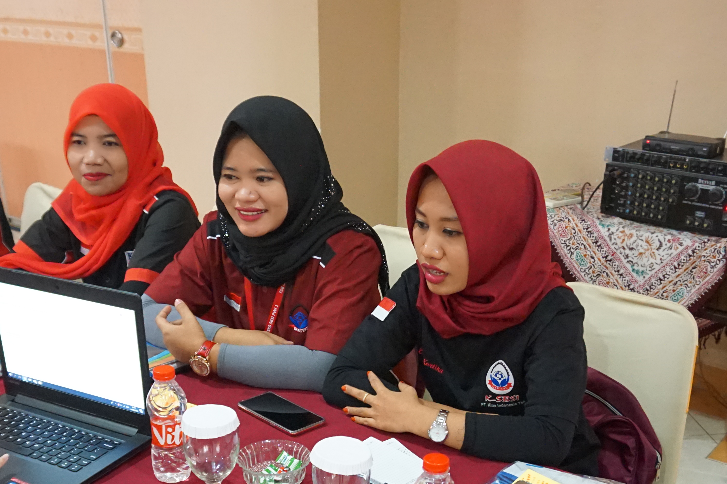


ENABLING APPAREL WORKERS AND EMPLOYERS TO CHECK, DEBATE, NEGOTIATE AND PUBLISH
WAGES AND WORKING CONDITIONS ONLINE
Nadia Pralitasari
Labour Market Transparency
at A Global Scale
Gajimu Indonesia
WageIndicator Foundation
nadiapralita@wageindicator.org

Slide 2
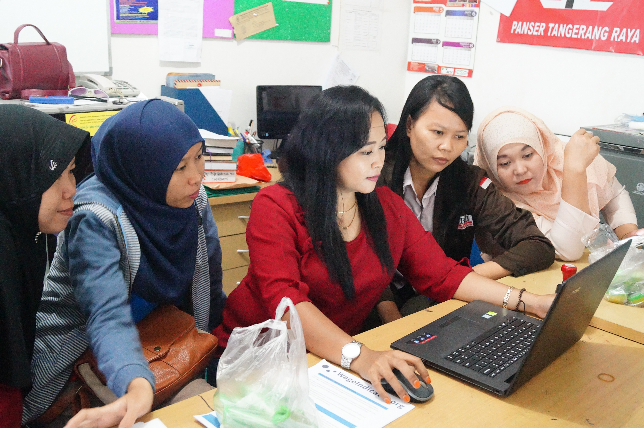
01
WAGEINDICATOR AND TRANSPARENCY
PLATFORM TO COMMUNICATE
WageIndicator provide a platform where workers and employers can communicate with general public regarding their working conditions, and stakeholders can monitor current situation and measures taken to improve the situation
01
INDIVIDUAL PERFORMANCES ON FACTORY PAGE
These factory pages show individual factory performances against 49 labour compliance measures, and presented in highly visited gajimu.com/garment
02
SUPPORTING TOOLS
Tools to find out to what extent factories comply with the labour law, and eventually guide them to achieve harmonious and effective industrial relations
03

Slide 3

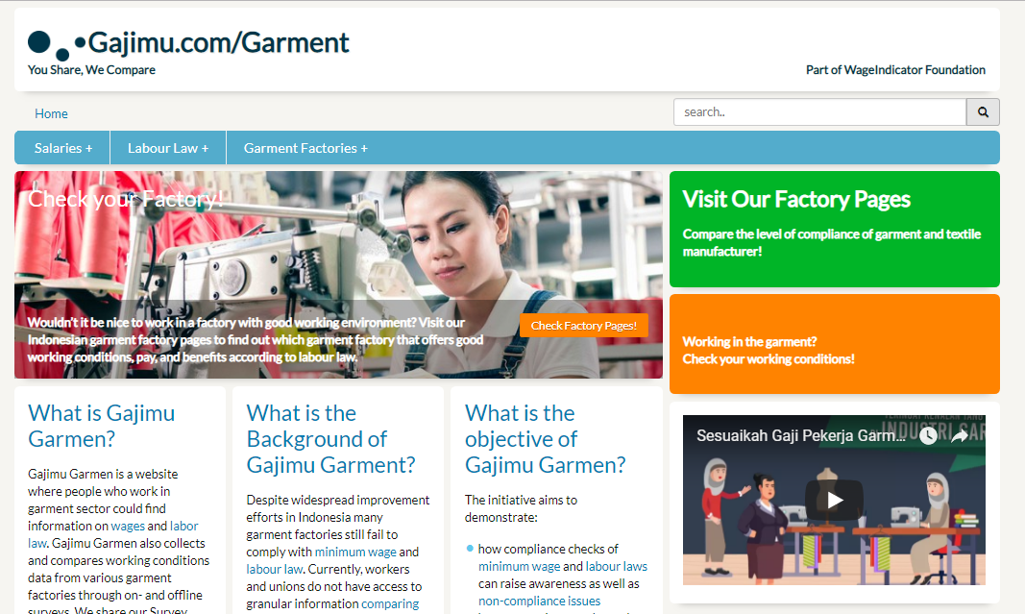
02
GAJIMU GARMENT
gajimu.com/garment is a website where workers, employers, and stakeholders in the garment or textile industry can easily and free of charge to access information about wages and national regulations, down to level of compliance with the law by individual garment factories.
+
GAJIMU GARMENT demonstrates:
How Decent Work compliance checks of minimum wage and labour laws can raise awareness
That publication of worker-reported cases of non-compliance at easily accessible Gajimu Factory Pages can provide buyers and international brands with an overview of prevailing working conditions of individual garment factories.
How comparisons and sample clauses for Collective Bargaining Agreements can result in improved working conditions on a large scale than just individual factories
OBJECTIVES

Slide 4
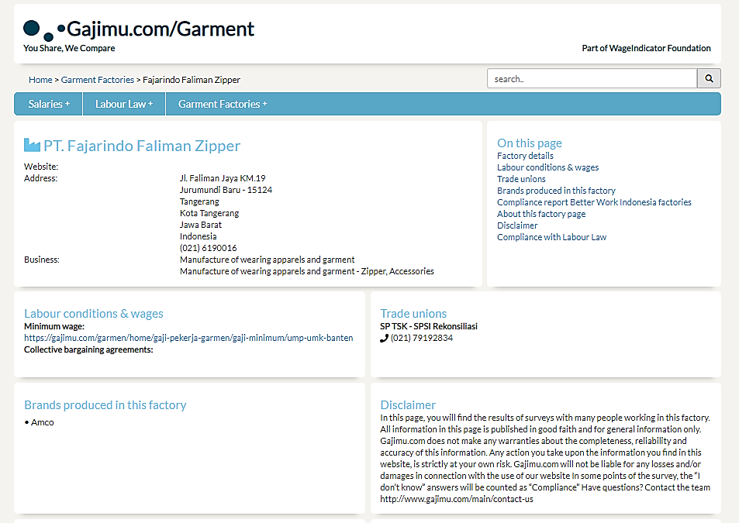
03
FACTORY PAGES
Address
Line of Business
Minimum Wage and CBA
Brands

Slide 5
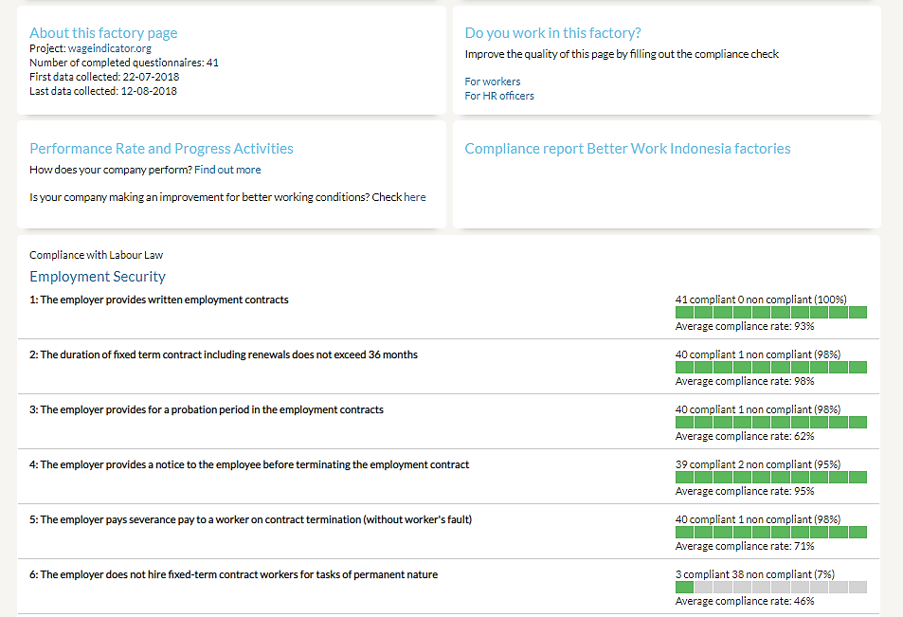
04
FACTORY PAGES
Time stamps and Survey filled
Progress Report
Compliance Measures

Slide 6
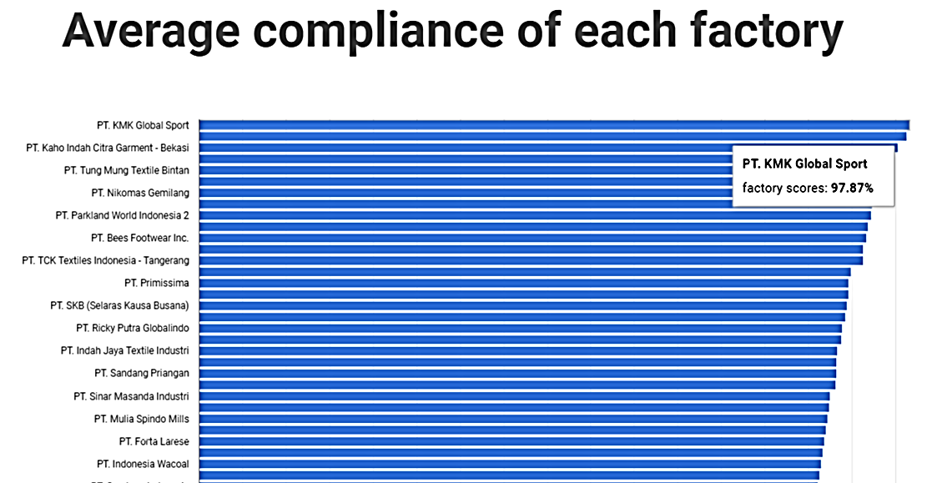
05
FACTORY PAGES GRAPH
FACTORY PERFORMANCE RATE

Slide 7
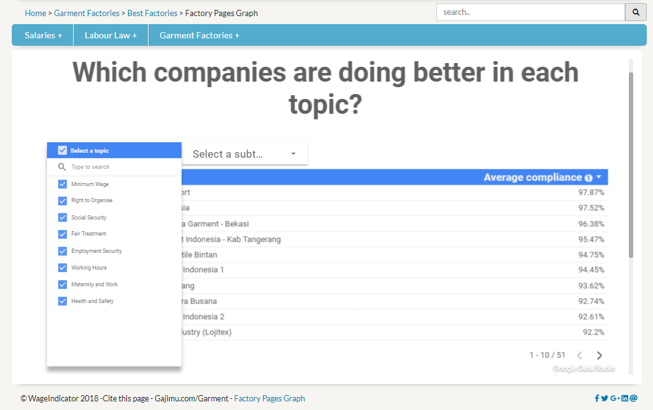
06
FACTORY PAGES GRAPH
BEST FACTORY PER TOPIC
Choose any TOPICS to display factories’ compliance measurement

Slide 8
07
WHAT WE ACCOMPLISH WITH WAGEINDICATOR SURVEY AND FACTORY PAGES?
SURVEY PROCESS AND
ACCOMPLISHMENT
More than 3800 surveys collected and 60 factories’ data available online
More workers aware at their basic rights according to the Labour Law
Effective monitoring of working conditions by workers, employers, brands, and buyers
1
3
5
DECENT WORK CHECK
SURVEY
FACTORY PAGES
WORKING CONDITION
MONITORING SYSTEM
SURVEY DATA
VERIFICATION
SOCIAL DIALOGUE AND
COLLECTIVE BARGAINING AGREEMENT
OTHER ACCOMPLISHMENT
2
Unions are trained to use the apps and conduct the surveys on their own
Trade unions use the survey as a tool to recruit new members – 1 new TU established
4
Employers and trade unions may verify the data by providing comments, clarifications, explanations of the survey results
Improvement in social dialogue – 5 factories agreed to improve (social dialogue report available online),
New Collective Bargaining Agreement (CBA) are set

Slide 9
To learn further about WageIndicator, visit :
wageindicator.org
Surveys and Factory Pages in Indonesia, visit :
gajimu.com/garment
THANK YOU
This project is possible thanks to our WageIndicator International and National team and the support of C&A Foundation

