Slide 1
Labour Rights Index 2020

Slide 2
What is Labour Rights Index?
Comparative tool, an international qualification standard
Compares labour legislation in 115 countries
Snapshot of statutory labour rights
Covers the full employment life cycle
Based on substantive elements of the ILO’s Decent Work Agenda.
10 indicators & 46 evaluation criteria
Four to five binary questions under each indicator
Each indicator represents an aspect of work important for achieving decent work
The criteria are all grounded in UDHR, five UN Conventions, five ILO Declarations, 35 ILO Conventions, and four ILO Recommendations.
The labour market regulation affecting around 80% of the 3.5 billion global labour force has been analysed and scored under the Index. The methodology involves each question/component under an indicator having a set criteria, on the basis of which scoring has been done.

Slide 3




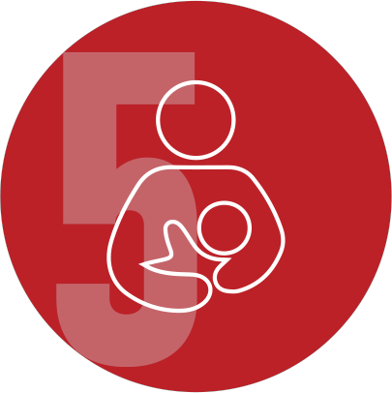



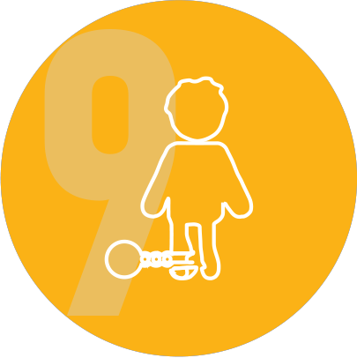

Labour Rights Index Indicators
Decent Working Hours
Family Responsibilities
Fair Remuneration
Employment Security
Maternity at Work
Social Security
Child and Forced Labour
Safe Work
Fair Treatment
Trade Union

Slide 4
Why Labour Rights Index?
Most comprehensive index on de jure labour rights yet
Repository of best practices on labour legislation at the global level
Can be used to bring much-needed labour legislation reforms in various countries
Linkage with SDGs
Progress on Target 8.8 can be measured fully through this Index
Right time to address the protection of all labour rights and measure progress of member countries (COVID-19)
Notes:
The Labour Rights Index aims at an active contribution to the Sustainable Development Goals, by providing necessary (complementary) insights into de jure provisions on issues covered in particular by SDG 8 (Decent Jobs), SDG 5 (Gender Equality), SDG 10 (Reduced Inequalities) and SDG 16 (Strong Institutions).
Target 8.8 refers explicitly to the protection of labour rights and promotion of safe and secure working environments for all workers, including migrant workers, in particular women migrants, and those in precarious employment.

Slide 5
Purpose of Labour Rights Index?
Labour Rights Index can be useful
As part of trade agreements to measure legislative performance and progress on ILO Conventions
For multilateral organizations, to use it as a part of monitoring and evaluation tool on legislative performance
As a starting point of negotiation and further reforms by the civil society organizations within the country
For Labour Ministries, for finding the best practices within their own regions and around the world
For national and transnational employers, as availability of reliable and objective legal rights information online is the first step towards compliance
For workers, to know about their labour rights around the world
Notes:
Ratings can be made prerequisites for international socio-economic agreements to ensure compliance with labour standards, similar to EU's GSP+ and USA’s GSP which require compliance in law and practice with specific labour standards in order to avail certain trade benefits through reduced tariffs.

Slide 6
Index Assumptions
The worker in question
Is skilled;
Is a minimum wage worker;
Resides in the economy's most populous province/state/area;
Is a lawful citizen (legal immigrant ) of the economy;
Is a full-time employee with a permanent contract in a medium-sized enterprise with at least 60 employees;
Has work experience of one year or more;
Is assumed to be registered with the relevant social security institution and meets all the qualifying requirements (maternity, sickness, work injury, old age pension, survivors', and invalidity benefit); and
Is assumed to have been working long enough to access leaves (maternity, paternity, parental, sick, and annual leave).

Slide 7
Index Assumptions
Standardized Assumptions
Make labour legislation comparable across countries and methodology uncomplicated.
Make labour legislation comparable across countries where different areas have different labour laws for their populations; Gives a more accurate picture of a country's labour rights.
In federal states, we have chosen the most populous area: Australia (New South Wales), Canada (Ontario), India (Uttar Pradesh), Pakistan (Punjab), and the United States of America (California)
Retains attention on the formal sector where labour laws are more applicable. The Labour Rights Index shows the statutory labour rights for the workers in formal employment relationships because this is where the labour law applies.
Informal sector workers can use the country profiles in the Index to know about basic labour rights that are available in the country and launch advocacy campaigns through their representative organizations to have access to same or similar labour rights.
Labour Rights Index is a de jure index and it measures presence or absence of relevant legislation only. While recognizing the existence of implementation gaps in legislative provisions, well-drafted and inclusive laws are still a precondition for attaining decent work.
Implementation is critical however it is difficult to take a de facto approach and measure labour rights situation across 115 economies and 46 evaluation criteria in a comparable and cost-effective way.

Slide 8
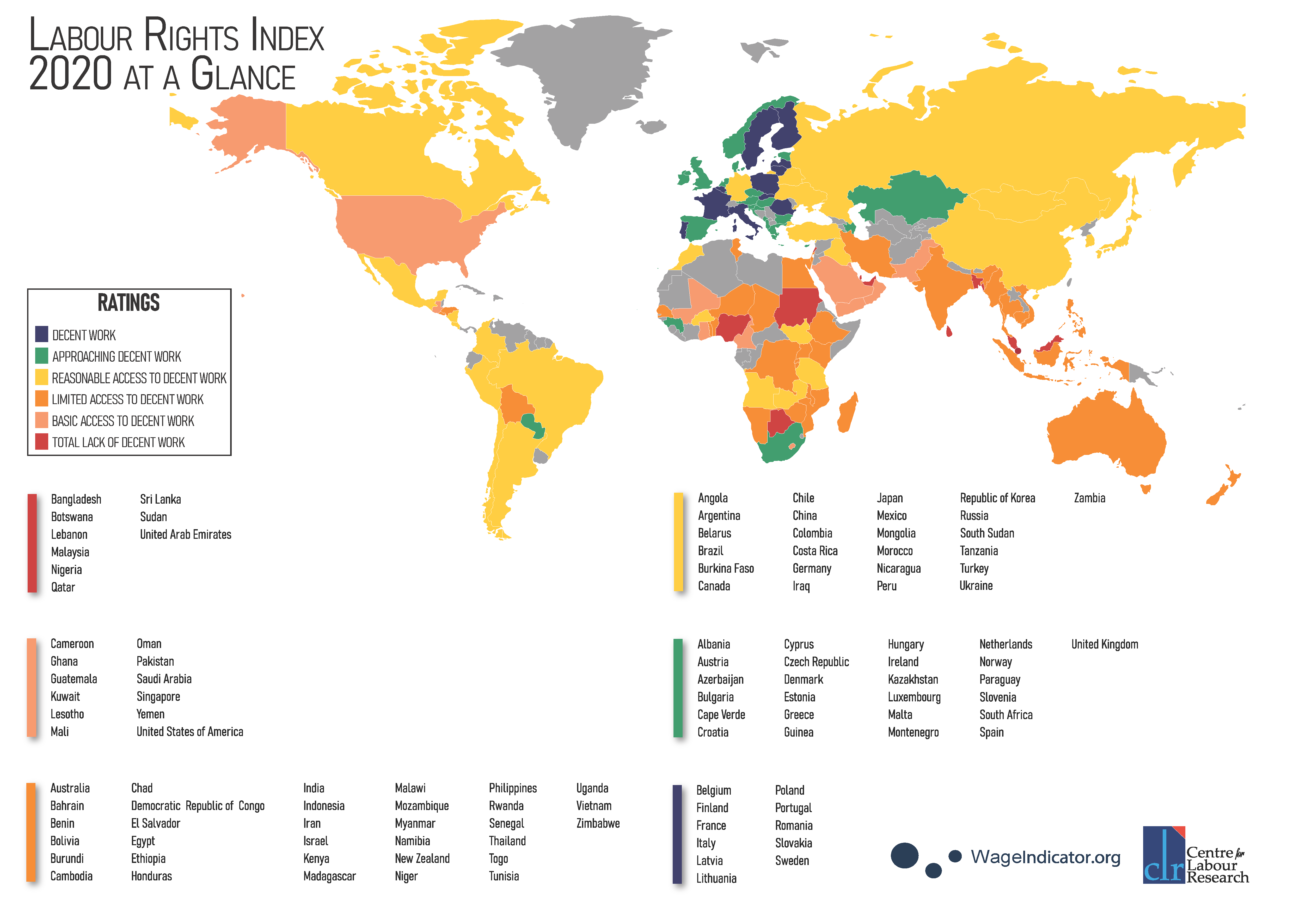

Slide 9
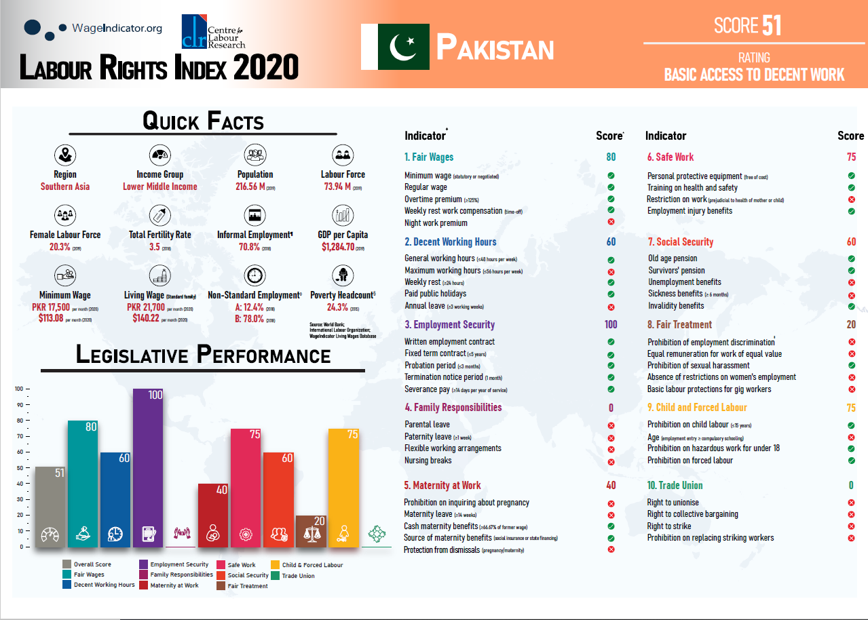

Slide 10
Social Security
Topics under this Indicator;
Unemployment Benefits
Sickness Benefit

Slide 11
Social Security - Key Findings
Unemployment Benefits
A score of 1 is assigned if legislation provides for unemployment benefit, when a worker loses employment, either through a contributory social insurance system or non-contributory universal benefits system.
A score of 0 is assigned if there is no explicit provision for a state administered unemployment benefits system or where unemployment benefits are means-tested or where only severance pay is provided.
More than 50% (62 of 115) countries provide for a state administered unemployment benefit.
Australia, Brazil and Romania have a state administered system which is means-tested.
While over 40 countries have severance pay in the event of contract termination or loss of employment, Burundi, Ghana and Singapore have neither severance pay nor unemployment benefit.
Table 42: Unemployment Benefits
Region | Means tested | Non-State Administered | State Administered | Severance Pay only | No Provision | Total Countries
Africa | - | - | 6 | 26 | 2 | 34
Americas | 1 | 3 | 5 | 6 | - | 15
Asia | - | - | 17 | 12 | 1 | 30
Europe | 1 | - | 33 | - | - | 34
Oceania | 1 | - | 1 | - | - | 2
Total Countries | 3 | 3 | 62 | 44 | 3 | 115

Slide 12
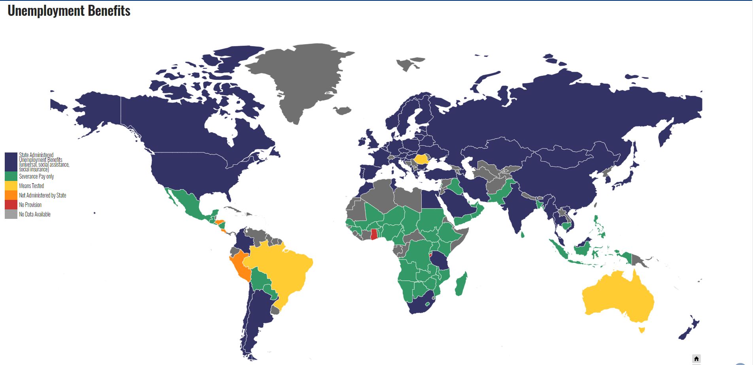

Slide 13
Social Security - Key Findings
Sickness Benefit - Duration
A score of 1 is assigned if legislation allows paid sick leave or sickness benefits for a minimum of the first six months of illness.
Nearly 65% (75 of 115) countries require a sickness benefit of at least 6 months.
36 countries require sickness benefit to last less than six months.
Burkina Faso, Ghana, Korea Rep., and Senegal do not provide any statutory sickness benefit.
Table 43.1: Sickness Benefit – Duration
Region | <6 months |  | 6 months | >6 months | No Provision | Total Countries
Africa | 13 |  | 10 | 8 | 3 | 34
Americas | 3 |  | 6 | 6 | - | 15
Asia | 17 |  | 5 | 7 | 1 | 30
Europe | 3 |  | 9 | 22 | - | 34
Oceania | - |  | - | 2 | - | 2
Total Countries |  | 36 | 30 | 45 | 4 | 115

Slide 14
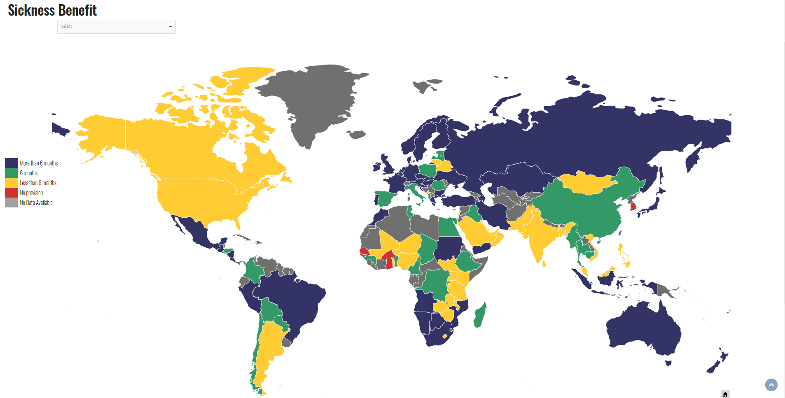

Slide 15
Social Security - Key Findings
Sickness Benefit - Source
The paid sick leave/sickness benefits must have been funded through a contributory social insurance system or universally accessible system.
36 countries make sickness benefit an employer liability i.e., require the employer to pay wages during the period of sickness.
Burkina Faso, Ghana, Korea Rep., and Senegal do not provide any statutory sickness benefit.
Table 44.1: Sickness Benefit – Source
Region | Employer Liability | State Administered Sickness Benefits (Universal, Social insurance) | No Provision | Total Countries
Africa | 21 | 10 | 3 | 34
Americas | 2 | 13 | 0 | 15
Asia | 13 | 16 | 1 | 30
Europe | - | 34 | - | 34
Oceania | - | 2 | - | 2
Total Countries | 36 | 75 | 4 | 115

Slide 16
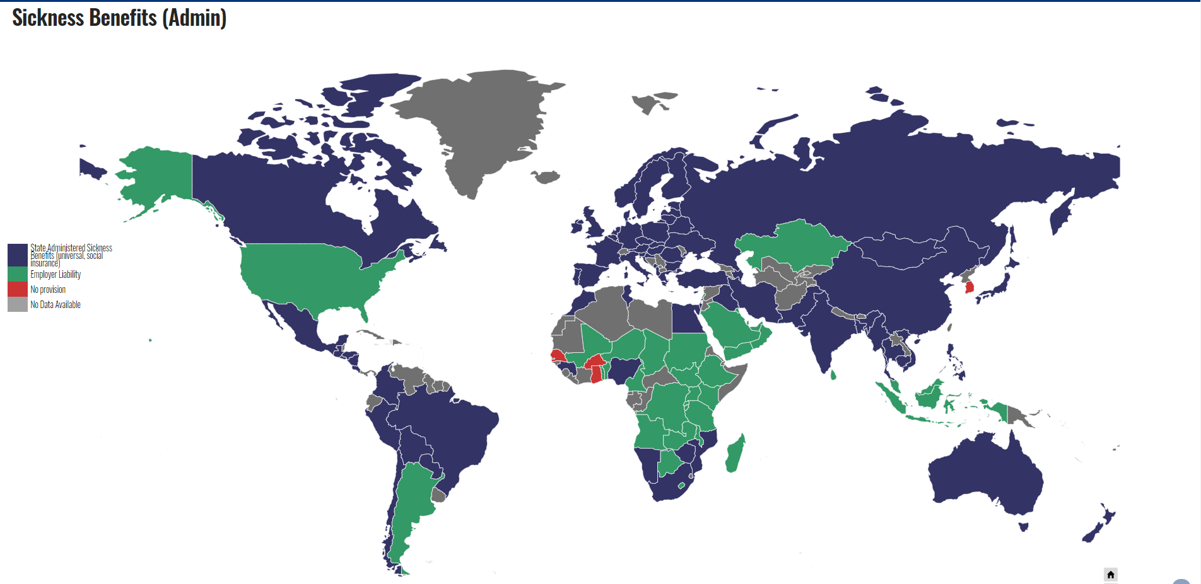

Slide 17
Fair Treatment
Topics under this indicator
Discrimination in employment matters
Equal pay for work of equal value
Basic labour protection for gig workers

Slide 18
Fair Treatment - Key Findings
Discrimination in Employment
A country must in all employment related matters have the prohibited discrimination on seven of the following 10 grounds “race, colour, sex, religion, political opinion, national extraction or social origin, age, disability and trade union membership”.
Three-fourth (86 of 115) prohibit discrimination on at least seven of the above referred ten grounds.
29 countries, of which 19 in Asia, do not prohibit discrimination in employment related matters.
Table 47.1: Discrimination in Employment
Region | Prohibition on Discrimination | No Prohibition | Total Countries
Africa | 27 | 7 | 34
Americas | 14 | 1 | 15
Asia | 11 | 19 | 30
Europe | 32 | 2 | 34
Oceania | 2 | - | 2
Total Countries | 86 | 29 | 115

Slide 19
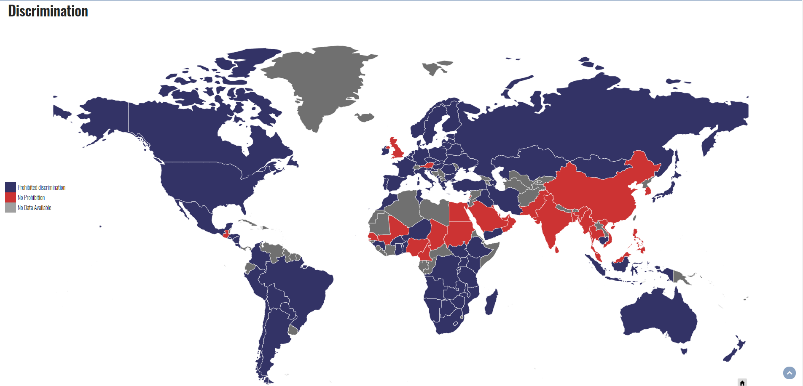

Slide 20
Fair Treatment - Key Findings
Equal Remuneration for Work of Equal Value
Legislation must mandate equal remuneration for male and female workers for work of equal value without any discrimination on the grounds of sex.
Although many countries have equal pay for equal work, legal right to equal pay for work of equal value is still absent.
In line with the provisions of ILO Convention 100, nearly 70% (79 of 115) countries require equal remuneration for work of equal value.
36 countries of which half are in Asia, have no provision on equal remuneration for work of equal value.
From Europe, there is only one country, Ukraine, with no clear provision on equal remuneration for work of equal value.
Table 48.1: Equal Remuneration
Region | Equal Remuneration for Work of Equal Value | No Provision | Total Countries
Africa | 23 | 11 | 34
Americas | 9 | 6 | 15
Asia | 12 | 18 | 30
Europe | 33 | 1 | 34
Oceania | 2 | - | 2
Total Countries | 79 | 36 | 115

Slide 21
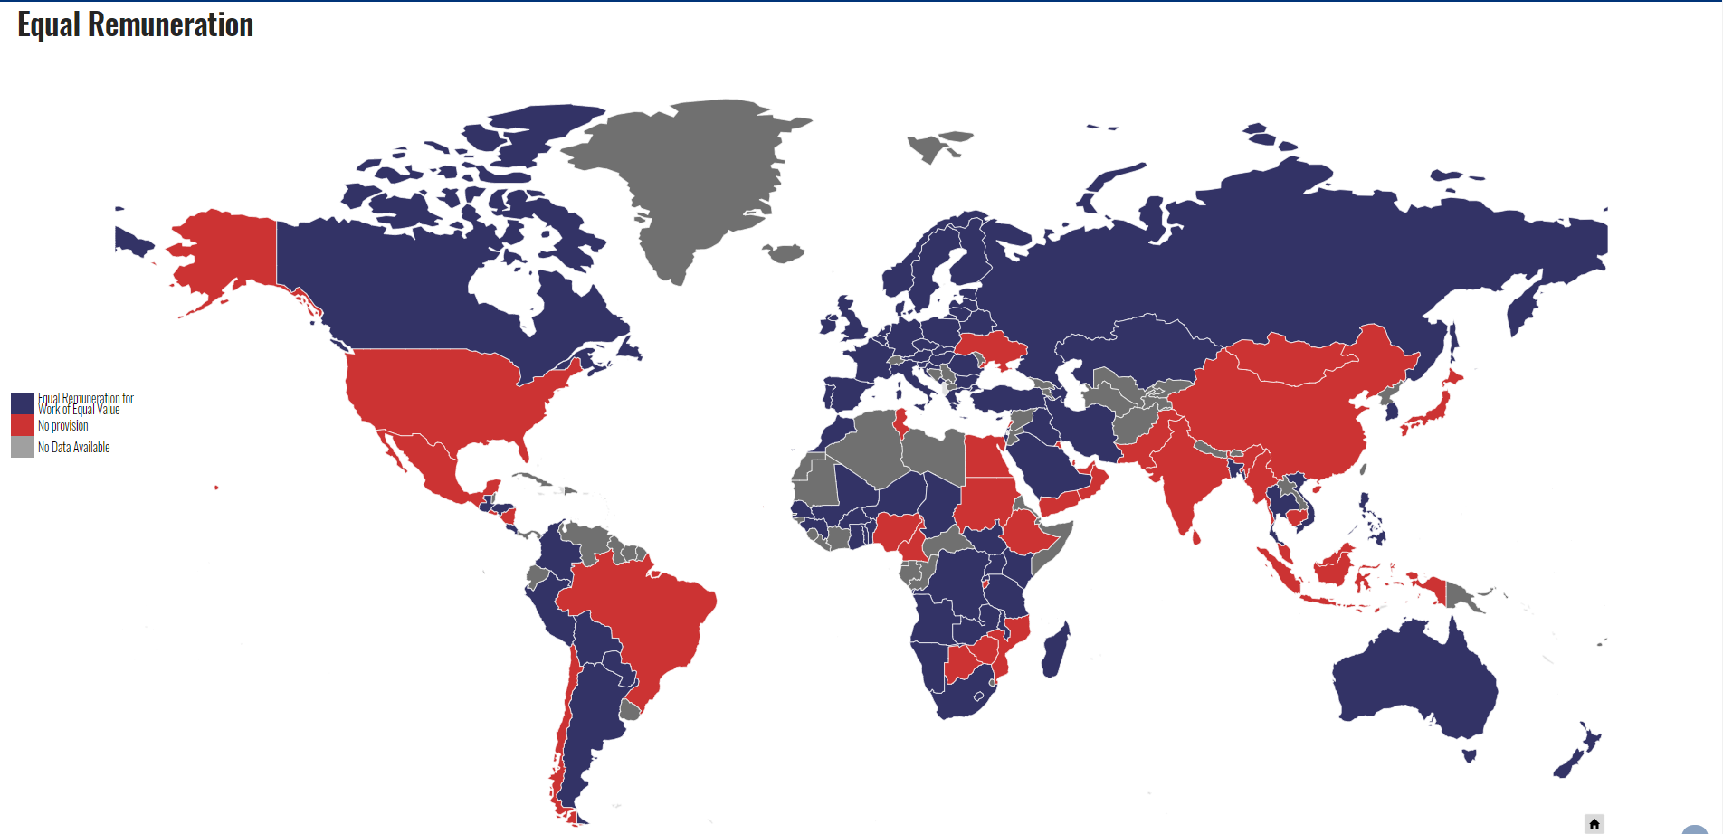

Slide 22
Fair Treatment - Key Findings
Gig Workers
For a score of 1, a country must provide at least the basic social protection (old age pension, survivors’ benefits and invalidity benefits) to the self-employed workers, and these benefits must not be linked to citizenship.
US was the only country to enact legislation granting gig workers the same access to fundamental workers’ rights, social protection, adequate living wages, decent working hours, and safe and healthy workplaces, as standard workers enjoy.
Nearly 80% (91) of countries provide basic social protection (old age, survivors’ and disability pensions) to self-employed workers.
Compulsory coverage (over 30%) and voluntary coverage (nearly 30%) of social security for gig workers are mostly spread over Europe (54%) and Africa (over 35%) respectively.
South Africa is the only African country to provide conditional coverage of social security for gig workers, while for mixed coverage, Kenya and Singapore are the only African and Asian country providing it.
Special systems for self-employed are provided in Europe (Belgium, Finland, Germany, Spain) and Africa (Egypt).
Only three countries provide universal coverage of social security to all their residents; Botswana (Africa), Israel (Asia) and New Zealand (Oceania).
Notes:
Since gig economy workers are considered self-employed independent contractors, provision of basic social protection to self-employed workers is taken positively.
Compulsory coverage: Mandatory statutory access to social security (old age, survivors’ and disability pensions) for self-employed workers.
Voluntary coverage: Non-compulsory statutory access to social security (old age, survivors’ and disability pensions) for self-employed workers.
Conditional coverage: Conditional statutory access to social security (old age, survivors’ and disability pensions) for self-employed workers.
Mixed coverage: Statutory access to more than one type of coverage to social security (old age, survivors’ and disability pensions) for self-employed workers.
Special systems: Statutory access to special systems (such as schemes) relevant to social security (old age, survivors’ and disability pensions) for self-employed workers.

Slide 23
Fair Treatment - Key Findings
Table 51.1: Basic Social Protection for Gig Workers
Region | Compulsory Coverage | Conditional Coverage | Mixed Coverage | Special Systems | Voluntary Coverage | Universal Coverage (Residents) | Excluded | Total Countries
Africa | 6 | 1 | 1 | 1 | 12 | 1 | 12 | 34
Americas | 2 | 3 | - | - | 8 | - | 2 | 15
Asia | 9 | - | 1 | - | 9 | 1 | 10 | 30
Europe | 20 | 5 | 3 | 4 | 2 | - | - | 34
Oceania | - | - | - | - | 1 | 1 | - | 2
Total Countries | 37 | 9 | 5 | 5 | 32 | 3 | 24 | 115
Notes:
Since gig economy workers are considered self-employed independent contractors, provision of basic social protection to self-employed workers is taken positively.
Compulsory coverage: Mandatory statutory access to social security (old age, survivors’ and disability pensions) for self-employed workers.
Voluntary coverage: Non-compulsory statutory access to social security (old age, survivors’ and disability pensions) for self-employed workers.
Conditional coverage: Conditional statutory access to social security (old age, survivors’ and disability pensions) for self-employed workers.
Mixed coverage: Statutory access to more than one type of coverage to social security (old age, survivors’ and disability pensions) for self-employed workers.
Special systems: Statutory access to special systems (such as schemes) relevant to social security (old age, survivors’ and disability pensions) for self-employed workers.

Slide 24
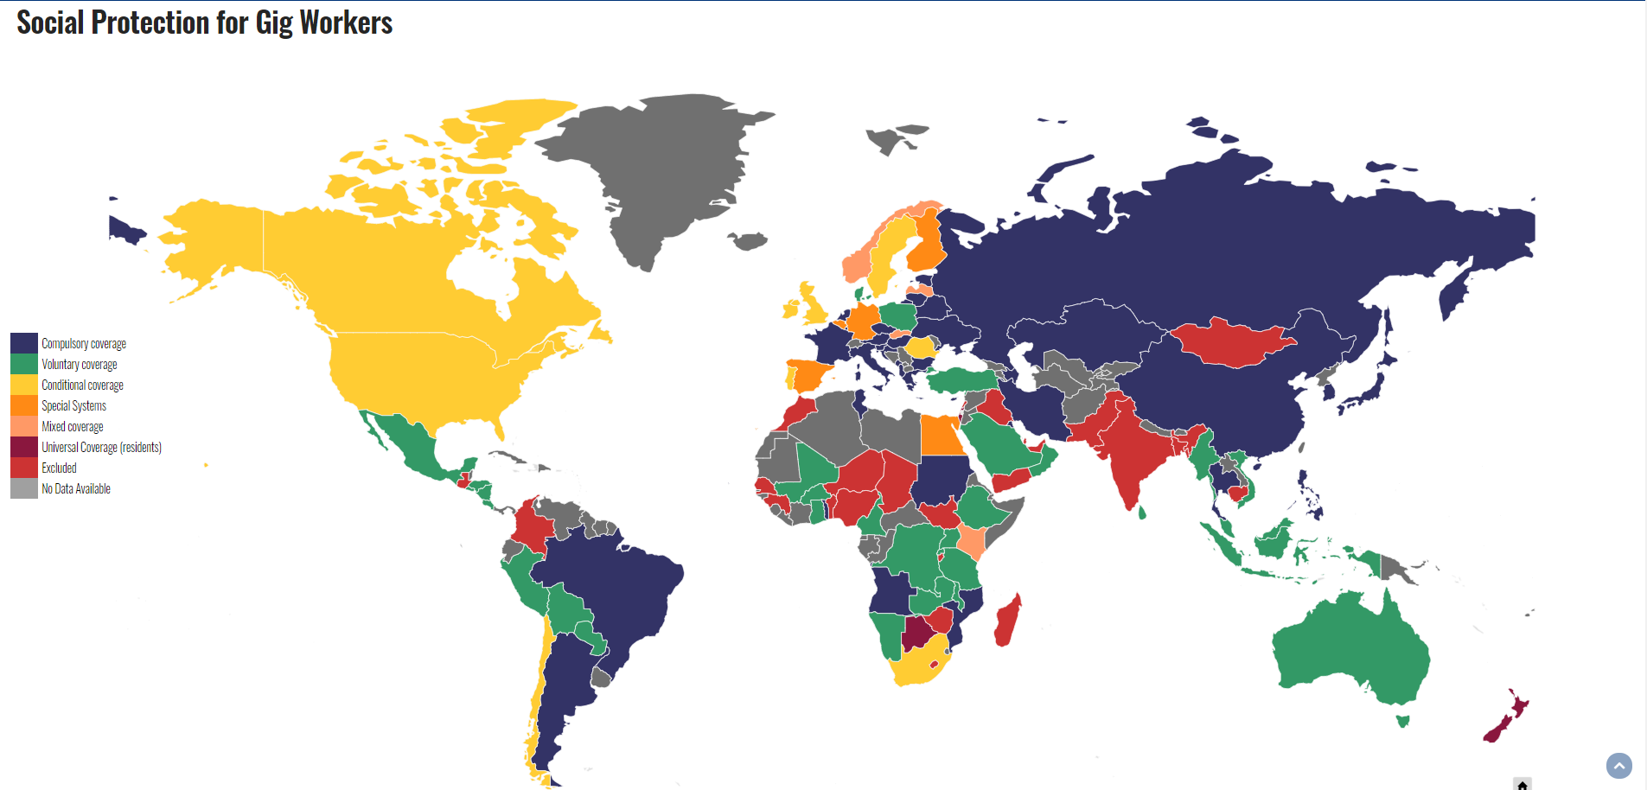

Slide 25
Thank You

