Slide 1
Do Minimum Wages & Living Wages affect Industrial Relations in Asian Countries?
www.wageindicator.org
Rupa Korde
Biju Varkkey
Martin Guzi
Khushi Mehta
Faculty, Economics
FLAME University,
Pune, India
Faculty, HRM Area
Indian Institute of Management Ahmedabad, India
Masaryk University, Czech Republic & IZA Bonn, Germany
Regional Manager, WageIndicator.org, The Netherlands

Slide 2
Introduction
Minimum Wage
Importance of Minimum of Wage
The minimum amount of remuneration that an employer is required to pay wage earners for the work performed during a given period, which cannot be reduced by collective agreement or an individual contract (ILO)
A effective tool to reduce wage inequality & poverty
To safeguard the income & provide decent standard of living to low skilled workers, and men & women
Minimum Wage Legislation
Notes:
ILO Minimum Wage Fixing Convention, 1970 (No. 131) states that minimum wage setting should involve social partners and independent experts and take into consideration: (i) the needs of workers and their families, taking into account the general level of wages in the country, the cost of living, social security benefits and the relative living standards of other social groups; and (ii) economic factors, including the requirements of economic development, levels of productivity and the desirability of attaining and maintaining a high level of employment. Minimum wages should also be regularly adjusted to take account for fluctuations in the cost of living and other economic conditions.

Slide 3
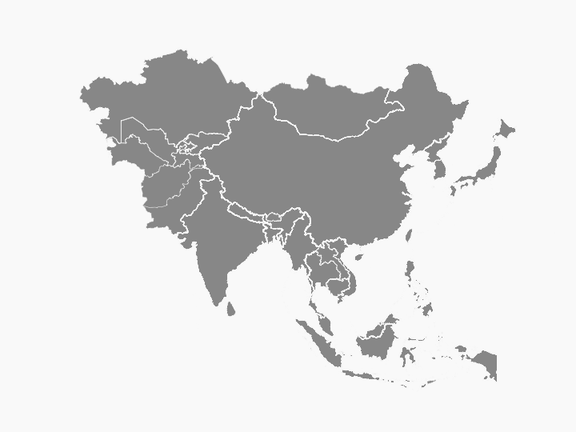

Legislation for Setting Minimum Wage
Pakistan
Minimum Wages
Ordinance 1961,
Minimum Wages
Rules 1962
Vietnam
Labour Code 1994
(amended 2002)
India
Minimum Wages Act 1949
Cambodia
Labour Code
1997
Sri Lanka
Wage Boards
Ordinance No. 27 of 1941,
amended to
Act No. 36 of 1982
Indonesia
Labour Law Act
No.13 2003
Bangladesh
Bangladesh Labour (Amendment)
Act 2013
Malaysia
National Wages
Consultative
Council Act 2011
(Act 732)
Myanmar
Myanmar Minimum
Wage Law 2013

Slide 4
Legislation for Setting Minimum Wage
Legislation
Ordinance
Labour Code
Pakistan
Minimum Wages
Ordinance 1961,
Minimum Wages
Rules 1962
Vietnam
Labour Code 1994
(amended 2002)
India
Minimum Wages Act 1949
Cambodia
Labour Code
1997
Sri Lanka
Wage Boards
Ordinance No. 27 of 1941,
amended to
Act No. 36 of 1982
Indonesia
Labour Law Act
No.13 2003
Bangladesh
Bangladesh Labour (Amendment)
Act 2013
Malaysia
National Wages
Consultative
Council Act 2011
(Act 732)
Myanmar
Myanmar Minimum
Wage Law 2013

Slide 5



Legislation for Adjusting Minimum Wage
Annual
2 years or more
Flexible
Pakistan
Vietnam
India
Cambodia
Sri Lanka
Indonesia
Bangladesh
Myanmar
Malaysia

Slide 6
Legislation for Adjusting Minimum Wage & Reality Check
Annual
2 years or more
Flexible
Pakistan
Annually or
Once in 2 years
Vietnam
Revised annually
India
Once in 3 years
Cambodia
Revised annually since 2015
Sri Lanka
Irregular
Indonesia
Revised annually except for a
few years
Bangladesh
Irregular
Myanmar
Revised after 3 years in 2018
Malaysia
Revised after 4 years in 2016 & 2017

Slide 7
Minimum Wage Revision Trends – Country Comparison in 2018 PPP USD
Notes:
In countries with multiple Minimum Wages, the lowest value is taken.

Slide 8
Why a Living Wage?

Slide 9
Reasons to pay Living Wage

Slide 10






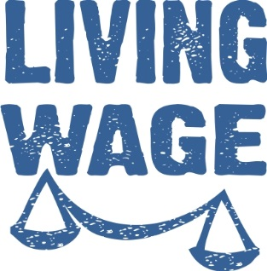






Slide 11
Living Wage
A wage that allows a family to meet its basic needs, and provides it with some ability to
deal with emergencies, without restoring to welfare or other public assistance
Notes:
TAXES + MANDATORY contributions are included.

Slide 12
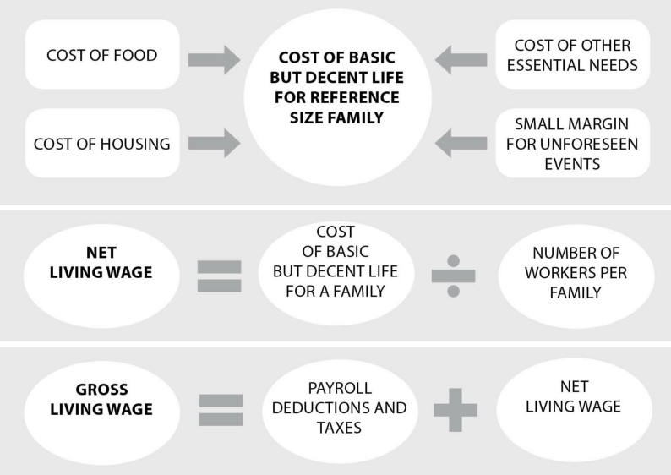
Living Wage Calculation

Slide 13
Methodology to Calculate Living Wage - WageIndicator

Slide 14

https://costofliving.wageindicator.org

Slide 15
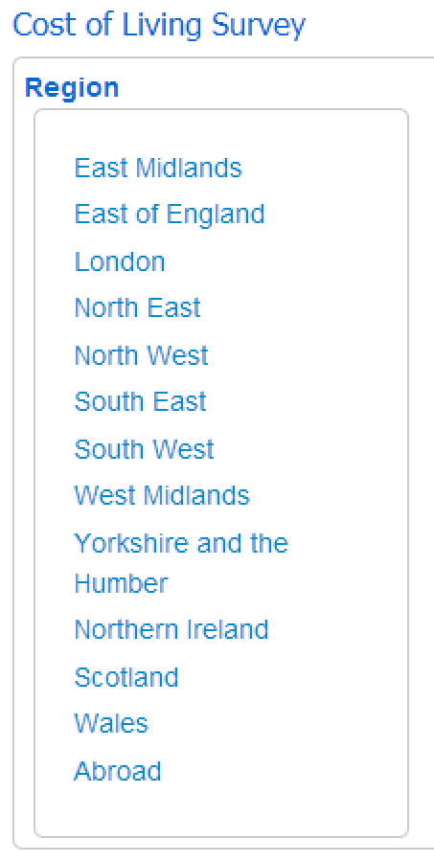
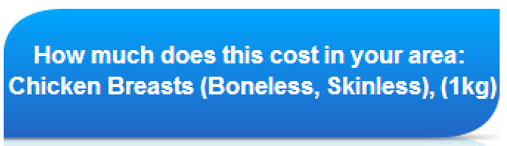
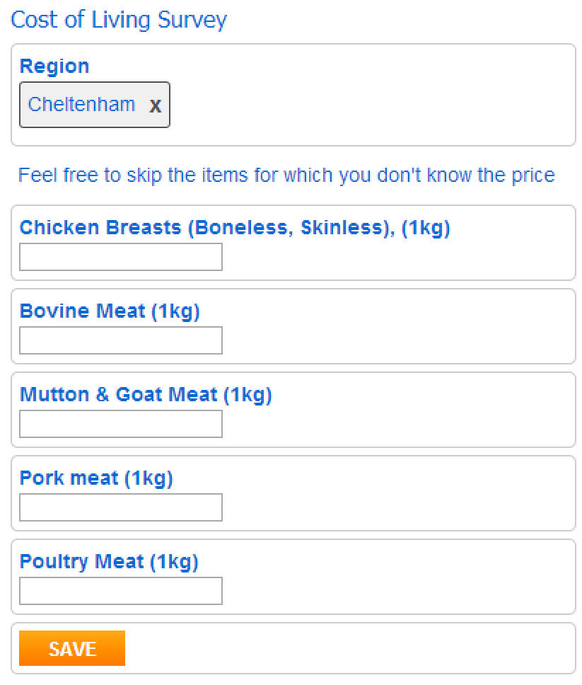
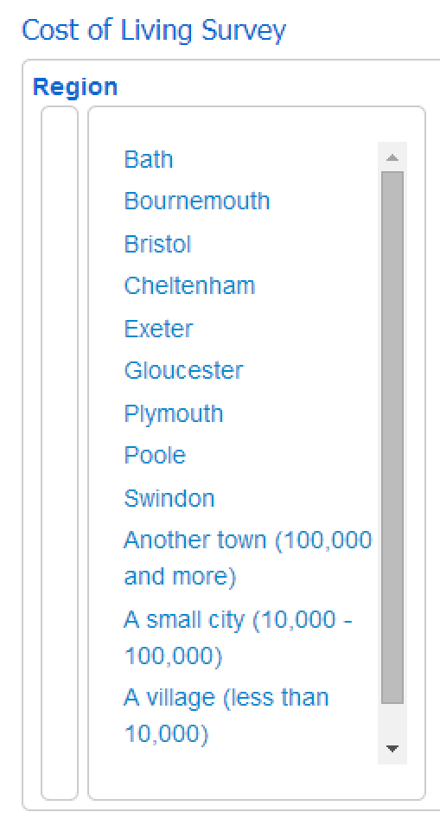


Slide 16

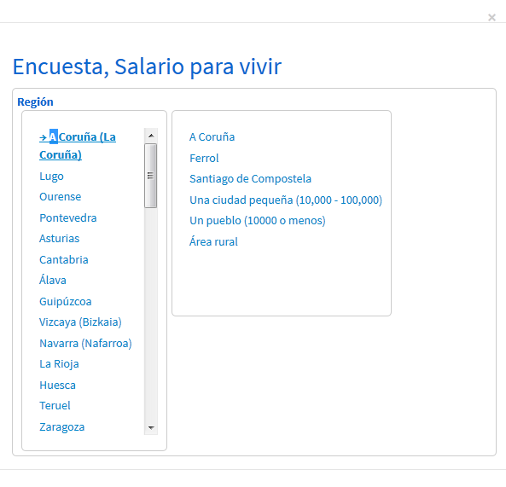
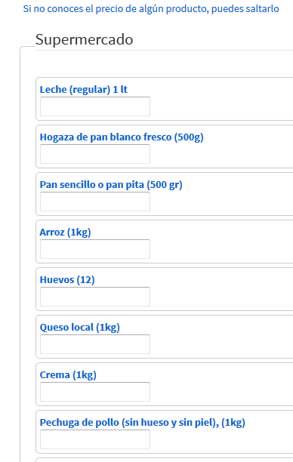
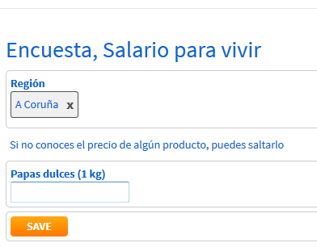

Slide 17
Living Wage in this Study:

Slide 18
Minimum Wage vs. Living Wage in Asian Countries

Slide 19








Minimum Wage vs. Living Wage for a Family: 2018
VIETNAM
Minimum Wage
US$ 312
56%
PAKISTAN
Living Wage
US$ 551
INDIA
Minimum Wage
US$ 486
Minimum Wage
US$ 208
68%
30%
Living Wage
US$ 692
Living Wage
US$ 696
CAMBODIA
Minimum Wage
US$ 414
84%
Living Wage
US$ 490
SRI LANKA
Minimum Wage
US$ 132
MALAYSIA
19%
Minimum Wage
US$ 723
Living Wage
US$ 681
97%
Living Wage
US$ 747
BANGLADESH
15%
Minimum Wage
US$ 47
Myanmar
INDONESIA
Minimum Wage
US$ 317
Living Wage
US$ 317
32%
Minimum Wage
US$ 292
Living Wage
US$ 976
75%
Living Wage
US$ 390

Slide 20
Wages in Context in 2018 – National Currency
Country | Living wage | Real wages of employee |  |  | Minimum wage
 | Family | High skill | Medium skill | Low skill
Bangladesh | 10200 | 5689 | 4254 | 3508 | 1500
Cambodia | 807200 | 1398825 | 883722 | 159444 | 680000
India | 13900 | 26733 | 13223 | 7801 | 4162
Indonesia | 1957000 | 3457564 | 2938830 | 2370988 | 1454154
Malaysia | 1240 |  |  |  | 1200
Myanmar | 169500 |  |  |  | 104000
Pakistan | 22100 | 33487 | 22120 | 23316 | 15000
Sri Lanka | 33500 | 38587 | 24492 | 17036 | 6500
Vietnam | 4842500 | 7641165 | 5472368 | 4893510 | 2760000
Findings:
High- and medium-skilled workers earn wages that are sufficient to cover the monthly expenses of their families.
Low-skilled workers depending on minimum wage are at risk of poverty and could not afford decency for their families.
Wages in Indonesia and Pakistan comply with Living wages
Wages in Bangladesh and Sri Lanka are low even for medium skilled workers.

Slide 21
Conclusions
We proposed the method to calculate the living wage for the large number of countries and at the regional level.
The calculation is sensitive to country characteristics (e.g. food consumption, price variations, family composition, labor market conditions)
Living wage could serve as an indicator of economic adequacy and a practical basis to set minimum wages.

Slide 22
Thank you
www.wageindicator.org
Rupa Korde
Biju Varkkey
Martin Guzi
Khushi Mehta
Faculty, Economics
FLAME University,
Pune, India
rupa.korde@flame.edu.in
Faculty, HRM Area
Indian Institute of Management Ahmedabad, India
bvarkkey@iima.ac.in
Masaryk University, Czech Republic & IZA Bonn, Germany
matoguzi@gmail.com
Regional Manager, WageIndicator.org,
The Netherlands
khushimehta@wageinidcator.org

