Slide 1

Labour market consequences of a transition to a Circular economy
Frithjof Laubinger
OECD Environment Directorate
WageIndicator Webinar: Circular Economy, Circular Work?
07 June 2024
Notes:
Provide an overview of our work on labour market consequences of a transition to a circular economy.
This work is done as part of the larger OECD RE-circle project, which focuses on different waste streams and policies to reduce environmental impacts from resource use.

Slide 2
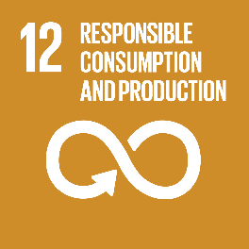
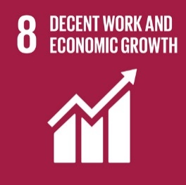
Circular economy transition & jobs
Many circular economy roadmaps emphasize job potential:
  EU CE Package: 170,000 direct jobs by 2035
  French ‘50 Measures for the CE’: 300,000 jobs
  Finland Roadmap to CE: 75,000 jobs
Notes:
Distributional aspects in transitions are key and employment implications of the circular economy transition are an important aspect to ensure that a transition to a CE is just.
Besides reducing materials consumption, many circular economy roadmaps emphasize on the Job potential of transitioning to a CE:
EU: Circular Economy package: 170,000 direct jobs created in the EU by 2035
France: ’50 measures for the circular economy’: 300,000 new jobs in France
Finland: Roadmap to CE 75,000 Job creation.
However, the RE-CE transition may also affect jobs negatively in certain sectors. (for instance in extractives and materials intensive sectors.)
It is thus important to look at the labour implications of the CE transition.
In this presentation, I will describe the underlying dynamics of labour market changes and provide an overview of the economic modelling literature on the topic.

Slide 3
How do policies induce changes on labour markets?
Notes:
Left to right:
A policy change can induce a number of effects on the macroeconomy:
Changes in production modes, demand patterns, aggregate income and international trade and competitiveness.
These can induce a number of effects on labour markets:
Job creations, job destructions, job substitutions and job redefinitions.

Slide 4
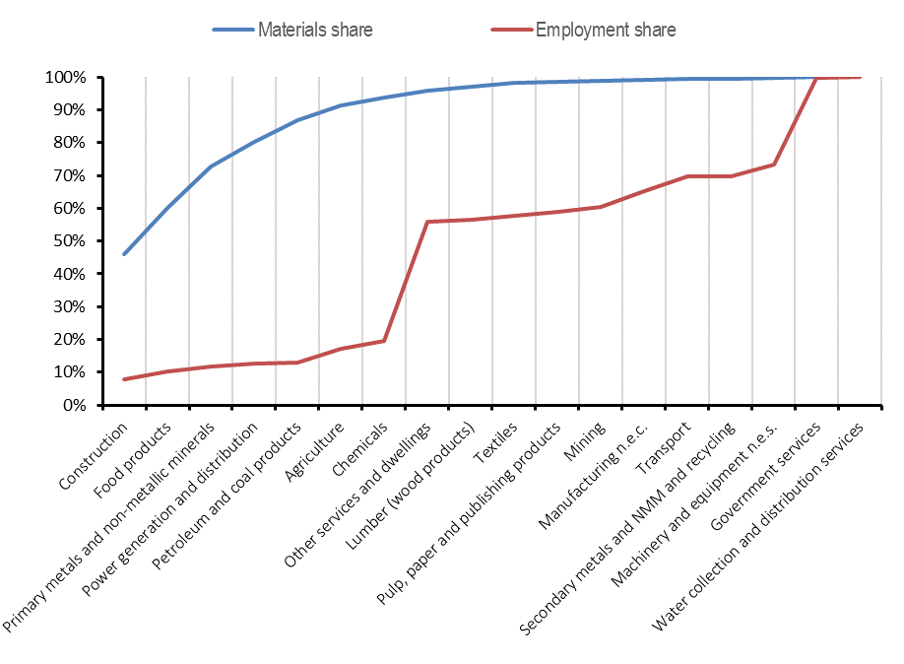
Expected sectoral changes
Cumulative shares of materials use and employment per sector in 2011
Sectors sorted by total materials use in 2011
Source: Laubinger, F., E. Lanzi and J. Chateau (2020), "Labour market consequences of a transition to a circular economy: A review paper", https://doi.org/10.1787/e57a300a-en.
Notes:
Looking at the current structure of the economy, can help identify where labour effects arise.
The sectoral composition of the economy is likely to change, as different sectors are likely to be affected differently, with implications for employment in these sectors.
On this graph you see the cumulative shares of materials use and employment per sector in 2011, sorted by materials use from left to right.
You can see that construction, which provides the largest bulk of materials use (46%) only provides 8% of employment.
On the other hand, most employment is provided by the services sectors.
A transition to a more circular economy is expected to shift economic activity from sectors with high materials footprint towards more sertivisation.
These sectoral changes can lead to an overall job creation as sertivisation is more labour intensive.
However job losses and distributional impacts are also important to consider and should not be neglected.

Slide 5
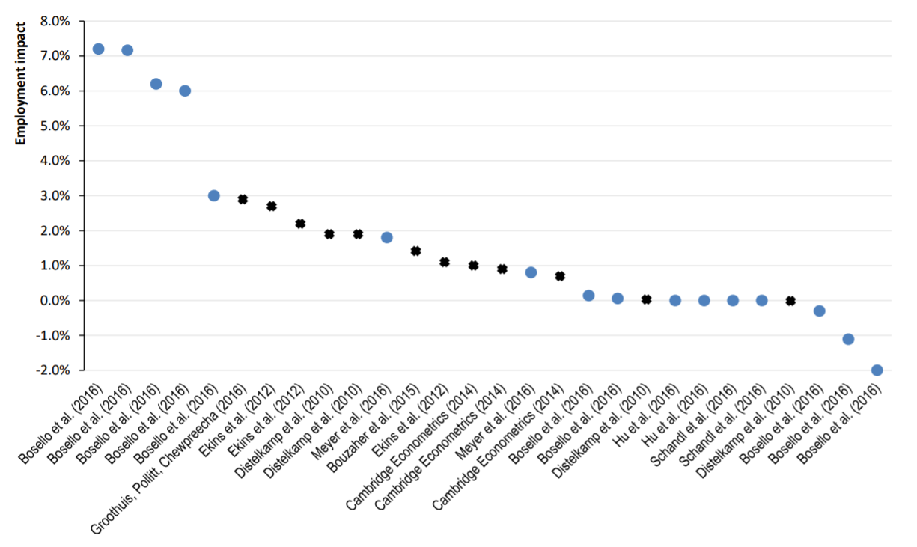


Employment effects of reviewed modelling studies
Scenarios until 2030 or shorter
Scenarios until 2050
Employment impact
(Difference to baseline)
Source: Laubinger, F., E. Lanzi and J. Chateau (2020), "Labour market consequences of a transition to a circular economy: A review paper", https://doi.org/10.1787/e57a300a-en.
Notes:
47 scenarios from 15 modelling studies

Slide 6
OECD modelling of employment effects
Material fiscal reform* scenario w.r.t baseline in 2040 as % of total employment.
 | Net employment growth | Job creations | Job destructions | Total job reallocation
OECD | 0.05% | 0.1% | 0.1% | 0.2%
BRIICS | 0.05% | 0.3% | 0.3% | 0.6%
Rest of the world | 0.01% | 0.2% | 0.2% | 0.4%
  *MFR Scenario:
  Materials tax coupled with subsidies to recycled and secondary metals sectors.
  Implemented gradually 2018 to 2040.
OECD modelling: positive employment can be seen in an “material fiscal reform” scenario
The overall net employment growth is very limited
But, some sectors can be heavily affected: job creations (e.g. secondary materials, recycling, services, utilities) and job destructions (e.g. primary materials, non-metallic materials, construction)
Differences across countries, depending on economic structure
Source: Chateau, J. and E. Mavroeidi (2020), "The jobs potential of a transition towards a resource efficient and circular economy", https://doi.org/10.1787/28e768df-en.
Notes:
Recently published report focuses on the implied structural changes following implementation of Resources Efficient and CE policies and the subsequent shift of labour across sectors.
Modelling tool: OECD’s ENV-Linkages general equilibrium model
25 regions
56 sectors, including recycling and 8 metal processing sectors
60 raw materials linked to economic activities
Material Fiscal Reform Scenario:
Materials tax coupled with subsidies to recycled and secondary metals
Implemented from 2018 to gradually reach their target in 2040

Slide 7
Other considerations
Consider not only number of jobs, but also what type of jobs are created?
  Aspects of job quality, gender
What is the future skill composition?
  What skills should education policies strengthen?
Where are the jobs created?
  Circles are not necessarily closed locally -> job creation can happen elsewhere
What is the job duration?
  Jobs created for a transition towards a CE, vs. jobs for the CE itself
Notes:
Reviewed modelling studies suggest RE-CE leads to a net (small) positive effect on employment

Slide 8





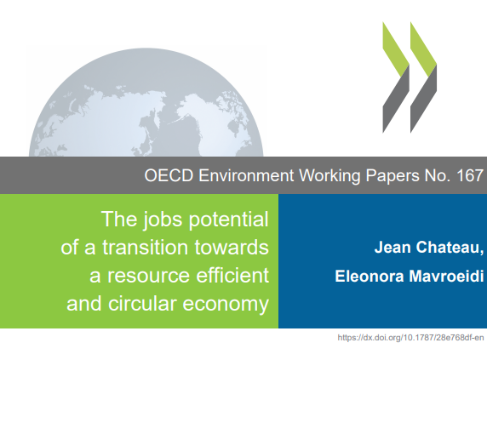

Thank you!
Frithjof.LAUBINGER@oecd.org

