Slide 1



Mywage.org/Ethiopia for living wages in the garment sector
PROJECT NAME: Sociale dialoog Ethiopie (SP)
PROJECT NR: NL0810101
Daniela Ceccon
Database manager at the WageIndicator Foundation
Amsterdam, 28th March2019

Slide 2
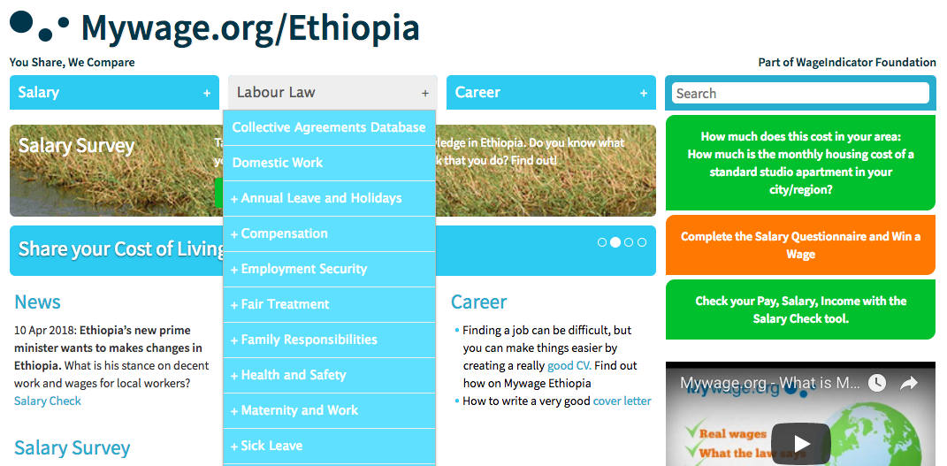

Slide 3
Mywage.org/Ethiopia - WageIndicator
Online Library – Mywage.org/Ethiopia collects, compares and shares labour market information through (online & offline) surveys and desk research. It serves as an online library for wage information, labour law and career advice
Global Organization – Mywage.org/Ethiopia is part of WageIndicator Foundation. WageIndicator Foundation is assisted by world-renowned universities, trade unions and employers’ organisations and currently operates in over 90 countries.
Transparent - Mywage.org/Ethiopia is dedicated to labour market transparency, focusing on dissemination of information on wages, labour law, by utilizing internet technology.
Free of charge - All information in Mywage.org/Ethiopia is accessible online by everyone free of charge

Slide 4
Mywage.org/Ethiopia for living wages in the garment sector – (2018-2020)
Textile and garment sector is growing: expected workforce of 100.000 on 2020
FOCUS = GARMENT SECTOR
ISSUES:
No statutory minimum wage in garment sector + pay levels below living wages
Compliance with labour law is not checked
GOAL = Improve wages and working conditions

Slide 5
OBJECTIVES OF THE PROJECT
Living wages being paid in the garment sector
Improvement of compliance with labour law
Use and improvement of collective agreements

Slide 6
HOW DO WE DO THAT?
Collecting and analysing factory cases of non-compliance with the labour law (using the Decent Work Check tool developed by WageIndicator)
Making an inventory of Collective Bargaining Agreements in garment sector, analysing the clauses and proposing (gender-specific) improvements
Mapping cost of living levels in 3 selected industrial hubs (using the Cost of Living app) → present updated living wages in the site
Bringing the results of these 3 investigations forward in sectoral debates involving as many and diverse stakeholders as possible

Slide 7
1) COLLECTING AND ANALYSING FACTORY CASES OF COMPLIANCE AND NON-COMPLIANCE WITH THE LABOUR LAW USING THE DECENT WORK CHECK APP
Create offline Decent Work Check app in Amharic
Collect data about compliance with the labour law. We collected so far 1061 face-to-face observations from garment workers in 52 factories of the 3 regions (Addis Abeba – 24, Oromia – 17, and Hawassa - 11).

Slide 8
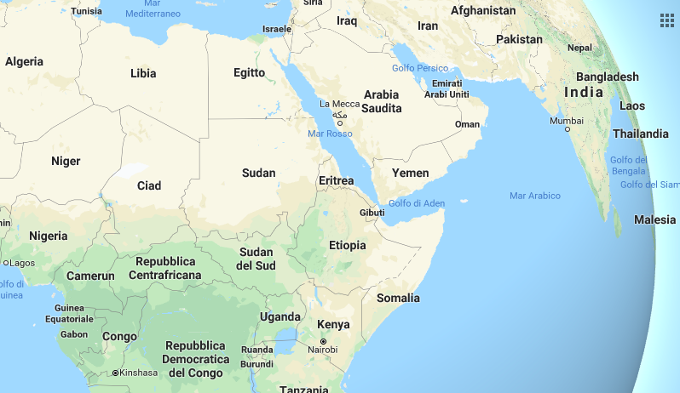
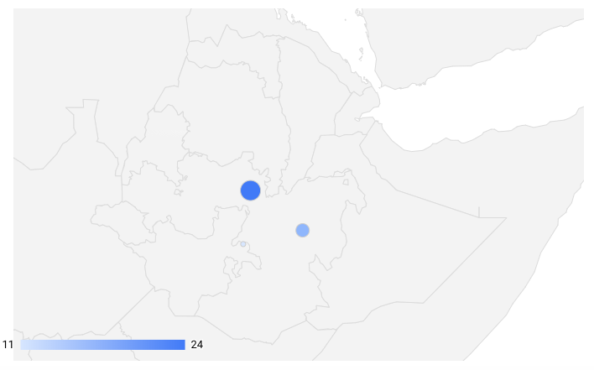
Addis Abeba
Oromia region
Hawassa

Slide 9
THE DECENT WORK CHECK SURVEY
Preparing support letters
Securing permission from factory authorities
Arranging time and place with factory authorities to do surveys
Interviewing respondents using offline application - tablets and smart phones

Slide 10
SAMPLING
Totally, 1061 employees from 52 factories were interviewed.
The number of interviewees ranges from 14 to 40
Random sampling technique was applied to select interviewees
We randomly sampled employees from different units/departments
The selection process was done in consultation with:
- Factory authorities
- Trade unions leaders (in few cases)
Exceptionally, in two factories, employers selected employees in advance

Slide 11
PROCEDURE
Briefing selected employees about the objectives of the interview – what decent work is about
Getting the consent of employees before interviewing
Structured interview using offline application - tablets and smartphones
- Demographic information
- Employment Security
- Working hours
- Salary
- Maternity and work
- Health and safety
- Social security
- Fair treatment
- Right to organize
The interviews were in Amharic
Time – 10 -20 minuets for a single interview
Place – in factories – offices and outside of factory buildings
5 interviewers were involved in the data collection

Slide 12
CHALLENGES
Despite support and cooperation by employers, the following challenges are worth mentioning:
Strong resistance from some employers (especially in industrial parks except Hawasa IP)
Lack of awareness by employers and employees about the relevant aspects of decent work in workplace
Pre-determined sampling by employers – few employers didn’t allow select employees randomly
Lack of trust by employees – they assumed data collectors work for employers and they were pessimistic about change the surveys bring to their life.

Slide 13
FIRST FACTORY PAGES ONLINE:
https://mywage.org/ethiopia/labour-law/garment-factories

Slide 14
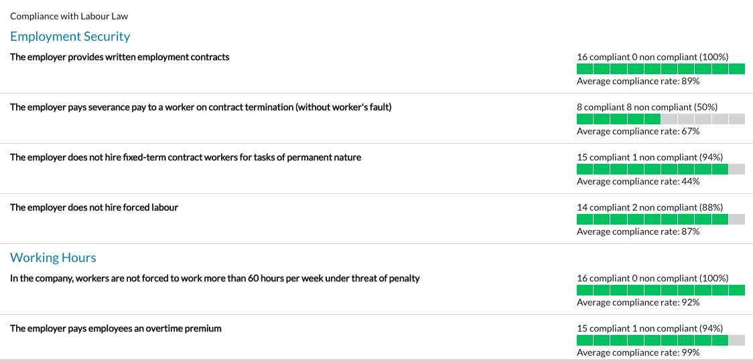

Slide 15
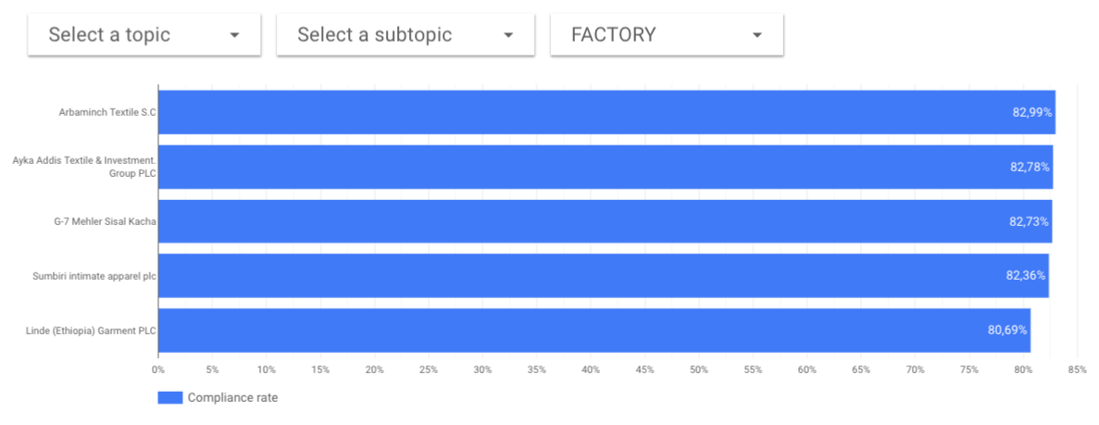
RESULTS / 1: WHICH ARE THE 5 FACTORIES WITH BEST RESULTS?
Arbaminch Textile S.C.
Ayka Addis Textile & Investment Group PLC
G7 Mehler
Sumbiri Intimate Apparel PLC
Linde (Ethiopia) Garment PLC

Slide 16
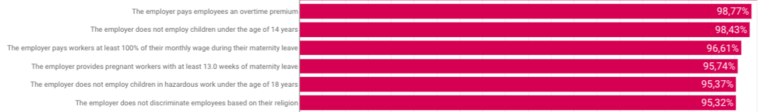
RESULTS / 2: WHICH ARE THE TOPICS WITH HIGHEST COMPLIANCE RATES (where more than 95% of the interviewed workers is compliant)?
In Indonesia, we see the highest compliance rates (more than 92%) for: no sexual harassment, no religion-based discrimination, children below 18 not employed in hazardous work, no child work, paid leave and weekly rest day, respect of overtime maximum hours.

Slide 17
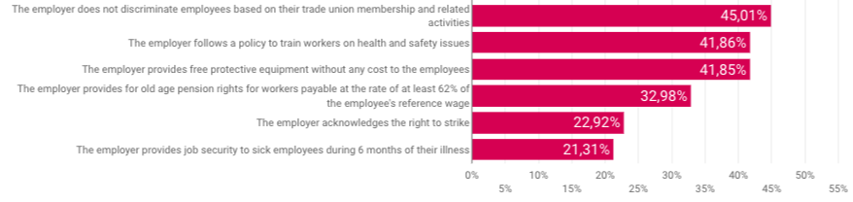
RESULTS / 3: WHICH ARE THE TOPICS WITH LOWEST COMPLIANCE RATES (where less than 50% of the interviewed workers is compliant)?
In Indonesia, we see lowest compliance rates for: right to strike (41%), not hiring contract workers to perform jobs where permanent workers are required (45%), nursing breaks for mothers (56%).

Slide 18
MAIN GENERAL ISSUES SPOTTED
Trade unions-related: discrimination based on trade union membership and activities + no right to strike
Health and safety: lack of training + no free protective equipment
Job security during up to 6 months of illness
After around one year, all factories will be re-surveyed to check improvements!

Slide 19
2) MAKING AN INVENTORY OF CBAS, ANALYISING THE CLAUSES AND PROPOSING IMPROVEMENTS
Collect at least 15 CBAs from garment sector: we collected 15, but decided to publish only 12 so far. One is in Oromipha, so more work is needed on that one. Other two are from other regions and miss many pages, we excluded them for now. More CBAs are needed!
Code the agreements, assess clauses
Propose a model agreement for garment sector
Collect and analyse 15 new (improved) or renewed CBAs
CBAs can be found here: mywage.org/ethiopia/labour-law/collective-agreements-database

Slide 20
3) MAPPING COST OF LIVING WITH THE COST OF LIVING APP
Create offline cost of living survey app in Amharic
Collect data about cost of living (we collected so far 80 full offline observations in the 3 regions (Addis – 37, Oromia – 23, and Hawassa - 20).
3. Do calculation of wages in context and publish them in the site.

Slide 21
THE COST OF LIVING SURVEY / 1
Securing permission from supermarket managers/owners
Interviewing respondents using offline application - tablets and smartphones
In three regions – Addis Ababa, Oromia (Dukem, Alemgena, Ambo, Jimma, Adama, Tafo, Sululta, Sebeta, Bishoftu, and Gelan) and Hawassa
80 observations (Addis – 37, Oromia – 23, and Hawassa - 20)
Data were collected from supermarkets, markets, and shops
Sellers and buyers (residents) were interviewed to cross-check the accuracy of data - triangulation
Areas around factories were selected purposefully.

Slide 22
THE COST OF LIVING SURVEY / 2
CoL survey included the cost of:
- Food items
- Transport items
- Housing items
- Family expenses
The surveys were done in Amharic
7 data collectors were involved in the data collection.

Slide 23
CHALLENGES
Suspicion by sellers – sellers were over concerned about the CoL surveys. This made them lower the price of some items.
Data collectors couldn’t get all items in one place

Slide 24
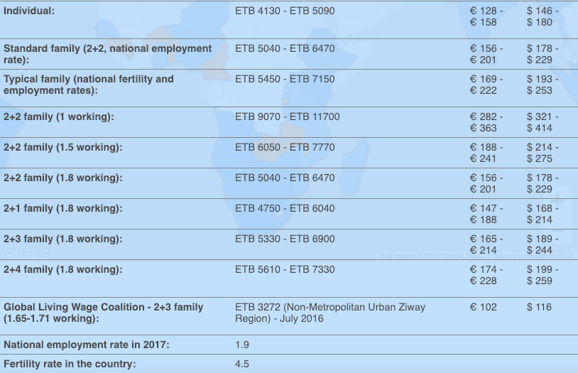
LIVING WAGES IN ETHIOPIA
= gross monthly wage needed to cover the necessary living costs of an individual or a family.
WageIndicator publishes it as a range.
Living Wage is based on the data from the WageIndicator Cost of Living survey.
The Living Wage calculated by WageIndicator is composed of five parts: food costs, housing costs, transport costs, tax/contribution costs and other costs (mostly medical expenses).

Slide 25
THE WAGES ISSUE IN THE GARMENT SECTOR
4130 Birr is the minimum an individual needs to live in Ethiopia
BUT
92.5 % of the workers we surveyed in the garment sector earn LESS than that
5450 Birr is the minimum one working parent needs to earn in a family where there are 4.5 kids and two parents working almost full time (one full time and one 90%) BUT 97% of the workers in the garment sector earn LESS.
DEBATE: How to improve?

Slide 26
4) BRINGING THE RESULTS OF THESE 3 INVESTIGATIONS FORWARD IN SECTORAL DEBATES
Organize debates (mini social dialogues) with employers and trade unions at factory level to discuss about
living wages;
compliance with law;
CBAs.
And, of course, CHECK IMPROVEMENTS.

Slide 27
DEDICATED PAGES ARE PUBLISHED IN:
Mywage.org/Ethiopia
THANK YOU!
Contact:
Daniela Ceccon - danielaceccon@wageindicator.org

