Slide 1
ILO RDW Conference Special Session on Minimum Wages
Towards a Classification of Minimum Wage Fixing Machinery
Dr. Janna Besamusca
University of Amsterdam

Slide 2
Minimum Wages as a policy instrument
Inclusive growth and decent wages
Poverty reduction
Impetus for collective bargaining and social dialogue
Create a level playing field for good employers
(Eyraud and Saget 2005; ILO 2014; Varkkey, Korde, and Singh 2016; Tijdens & van Klaveren)

Slide 3
Minimum Wage Conventions
 | Convention No. 26 | Convention No. 99 | Convention No. 131
Year of adoption | 1928 | 1951 | 1970
Entry into force | 14/Jun/30 | 23/Aug/53 | 29/Apr/72
Number of ratifications | 103 | 52 | 52
Status | Status quo (no longer fully up to date but relevant in certain respects) | Status quo (no longer fully up to date but relevant in certain respects) | Up to date
Principle obligation | Create or maintain machinery whereby minimum rates of wages can be fixed | Create or maintain adequate machinery whereby minimum rates of wages can be fixed | Establish a system of minimum wages
Scope of application | Trades or parts of trades in which no arrangements exist for the effective regulation of wages and wages are exceptionally low | Workers employed in agricultural undertakings and related occupations | All groups of wage earners whose terms of employment are such that coverage would be appropriate
Role of social partners | Consultation or participation in equal numbers and on equal terms | Consultation or participation on a basis of complete equality | Full consultation. Wherever appropriate, direct participation on a basis of equality
Criteria for fixing minimum wages | No | No | Yes
Periodical adjustment | No | No | Yes
Binding force | Yes – Possible derogation by collective agreement subject to the general or particular authorization of the competent authority | Yes – The competent authority may permit exceptions in individual cases to prevent curtailment of the opportunities of employment of workers with disabilities | Yes
Enforcement measures | Yes | Yes | Yes
Source: (ILO 2014)

Slide 4
The ICTWSS
Database on Institutional Characteristics of Trade Unions, Wage Setting, State Intervention and Social Pacts (ICTWSS).
The ICTWSS database (1960-2017) covers four key elements of 51 modern political economies: trade unionism, wage setting, state intervention and social pacts.
Growth of the database to include all OECD and EU member states – with Brazil, China, India, Indonesia, Russia, and South Africa has led to some methodological challenges.

Slide 5
ICTWSS (NMW)
One item measure the existence of a statutory minimum wage and its scope
NMW: National Minimum Wage
0 | No statutory minimum wage
1 | Statutory minimum wage in some sectors (occupations, regions/states) only
2 | Statutory national (cross-sectoral or inter-occupational) minimum wage exists.

Slide 6
Minimum wages 1960-2017
Statutory MW from 20% to 80%
No MW reduced from 50% to 15%

Slide 7
ICTWSS (Government intervention)
NMWS: Minimum Wage Setting
0 | No statutory minimum wage, no sectoral or national agreements
1 | Minimum wages are set by (sectoral) collective agreement or tripartite wage boards in (some) sectors;
2 | Minimum wages are set by national (cross-sectoral or inter-occupational) agreement (“autonomous agreement”) between unions and employers;
3 | National minimum wage is set by agreement (as in 1 or 2) but extended and made binding by law or Ministerial decree;
4 | National minimum wage is set through tripartite negotiations;
5 | National minimum wage is set by government after (non-binding) tripartite consultations;
6 | Minimum wage set by judges or expert committee, as in award-system;
7 | Minimum wage is set by government, bound by a fixed rule (index-based minimum wage);
8 | Minimum wage is set by government based on a fixed rule (index-based minimum wage) or target (growth, employment, poverty), but government can (and sometimes does) take a discretionary decision;
9 | Minimum wage is set by government, without a fixed rule.

Slide 8
Measurement issues
NMW
Lack of discriminatory ability in recent years
Unable to distinguish between single and multiple rates in a country or region
Unclear threshold for ‘some sectors/occupations/regions’
NMWS
Hard to classify typology due to inclusion of role of government, as well as social partners and updating procedures
Little guidance on practice versus law

Slide 9
Challenges
How do we measure the policy intent: minimum wages as a wage floor or wage politics?
Do we measure the legal (paper) reality or application in practice?
How to deal with the informal sector?
Look into the dimensions identified by previous research and in other surveys (ILO, Eurofound, WageIndicator)

Slide 10
A classification taking account of policy intent
Policy intention | Floor | Wage politics
MW | Yes | Yes
Scope | Include all workers or all workers in sectors w/o collective bargaining | Level playing field and labour peace in industrial sectors
Differentiation | None or Geographical (cost of living) Basic rate – no more than on in any territory/region - with collective bargaining on top. Potentially excepting youth etc. | Multiple rates, centrally or locally set. Sector or occupation or skill.
Updating Criteria | Decent income, inflation / cost of living | Productivity, level of employment, enterprise wages
Social partner involvement | Possible | Possible
Government intervention | Possible | Strong

Slide 11
Coverage of the minimum wage
MW: Is there a statutory minimum wage? (Yes / No)
Coverage: Does the statutory MW exclude (groups of) dependent workers (like agriculture, tipped professions) that are not covered by another rate?
No
Yes, but only informal sector workers and/or workers in private households are excluded
Yes
Differentiation: Does the statutory minimum wage consist of one or multiple wage rates (e.g. differentiated by age, geographical, sectoral). Can this be coded from the WI Minimum Wage Database?
Single rate for the entire country
Multiple, but no more than one rate per region
Multiple rates covering the same geographical territory

Slide 12
Updating of the Minimum Wage
Level: at which level is the MW set?
Only at the national/federal level (N.B. refers to who sets the MW, could be multiple wage rates as long as set centrally)
At the national/federal level with higher rates set by sub-national/local authorities
At the national/federal level with different rates (higher or lower) set by sub-national/local authorities
At the level of sub-national/local authorities
Indexation: How is the updating of the minimum wage regulated?
By law, specified period.
By law, indexation
At discretion of government of the body setting the MW, regular updates
At discretion of government of the body setting the MW, rarely

Slide 13
Mapping consultation
Actors | Variables | Variable follow up. Was this..
Government, tripartite council, trade unions, employer organisations, experts | Brought the final level into effect | standard practice, as an unusual practice or not at all
 | Decided the final level unilaterally
 | Decided the final level taking into account recommendations of other players or mechanisms (e.g. indexation)
 | Was not involved at all in this respective year
Source: EUROFOUND Eurowork database

Slide 14
Thank you for your attention Comments: J.Besamusca@uva.nl

Slide 15
Appendices

Slide 16
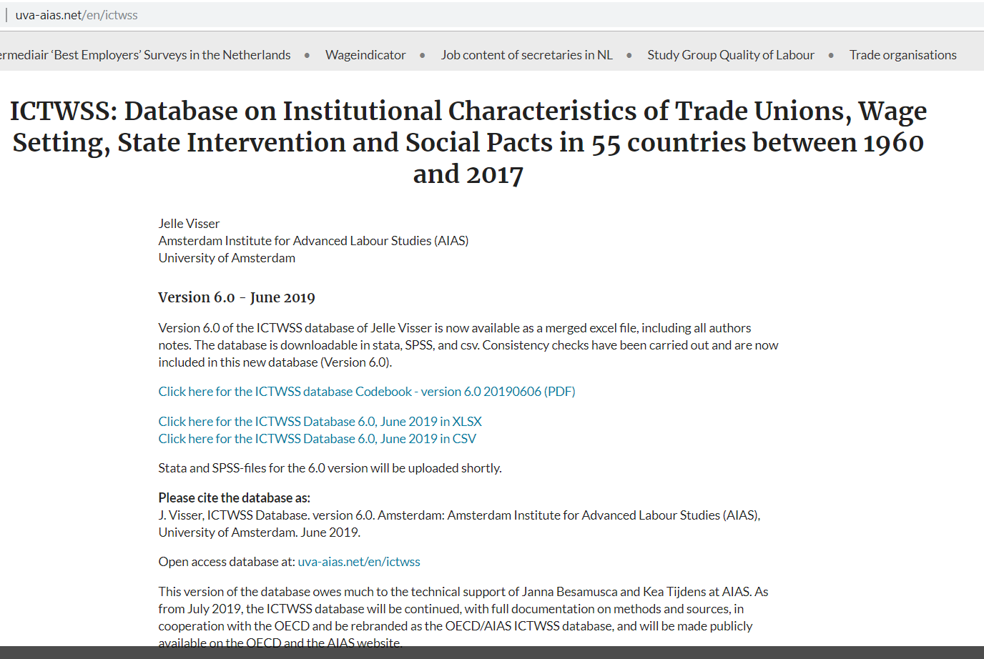
Available on AIAS website for download

Slide 17
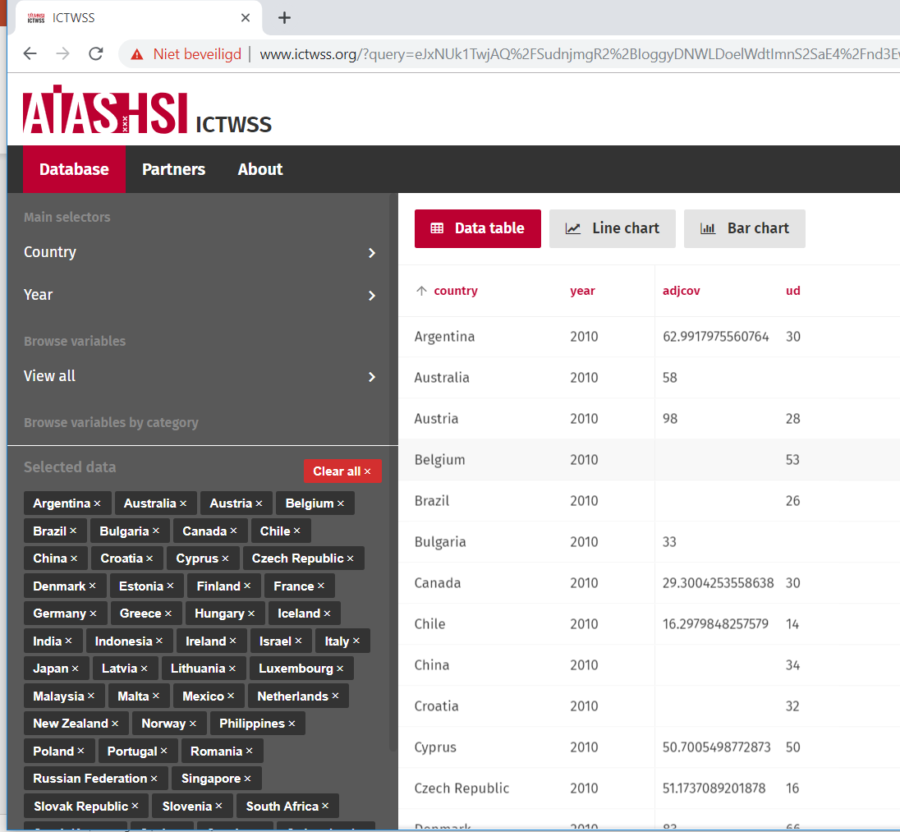
New website & interface (sneak preview)
Users download the data
Or make and download tables/figures/bar charts using a selection of variables, countries and years
Country experts can enter data on the website backside

Slide 18
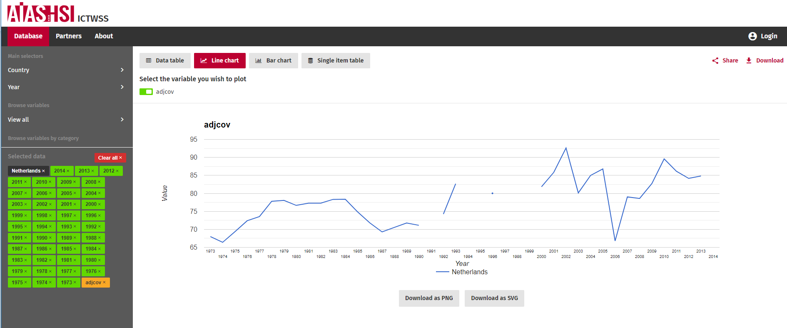
WWW.ICTWSS.ORG

Slide 20
Questions about MW Fixing Machinery
Is there minimum wage?
Do all workers have the right to (the same) minimum wage?
Who sets the minimum wage level?
How is the minimum wage updated?

