Slide 1


Navigating the Future of Bargaining in European Services:
Towards ‘smart bargaining’
Marta Kahancová
Central European Labour Studies Institute
Conference on collective bargaining in the services sectors
Brussels, 4. 12. 2025

Slide 2


Why services
https://celsi.sk/en/barservice/
Services as pillar of the European economy, range of subsectors, unique employment models, challenges, exposure to undeclared and underreported work
Little systematic knowledge on bargaining practices
New ways forward...technology, changing character of work, new vulnerabilities of workers and business

Slide 3









A RESEARCH AGENDA TO UNDERSTAND
BARGAINING AND BARGAINING COVERAGE
Bargaining actors
Extension mechanisms
Unions fragmented, employers unorganised - are there systematically capable bargaining partners?
Are there effective extension mechanisms, and do social partners want to use them?
Content of collective agreements
What do collective agreements actually regulate?
Role of the state
Legislation
How can the state support collective bargaining even more, beyond the transposition of legislation?
To what extent and how exactly is legislation supporting collective bargaining?

Slide 4

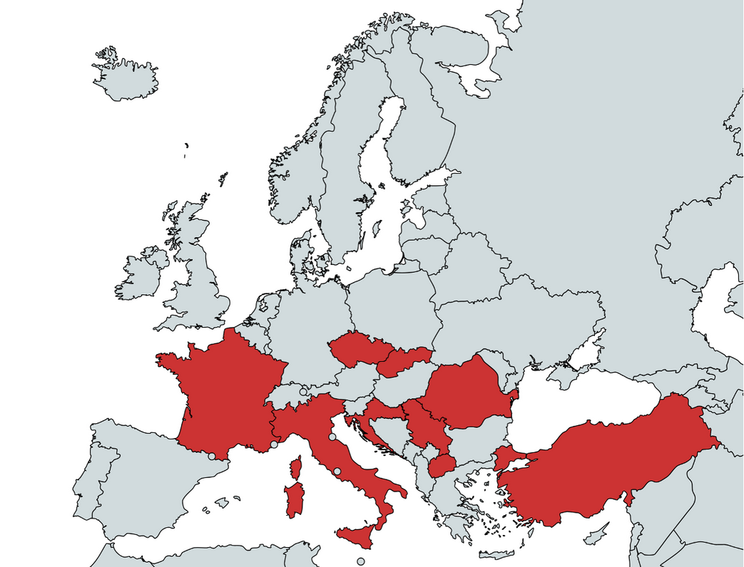
Case selection
Commerce
Publishing
Finance
Social care
9 countries, 8 partners, 80 interviews

Slide 5

How to approach collective bargaining?
Inductive, one size does not fit all
Smart bargaining: bargaining practices at the most feasible level leading to collective agreements beyond wages
Provisions for:
Career progression
Skills and training
Health and safety
Work-life balance
Decent pay and working time regulation
Digitalisation and innovation

Slide 6

The concept of smart bargaining varies significantly across countries, reflecting their distinct institutional structures, bargaining traditions, and sectoral challenges
Understanding working conditions and the needs of the services sectors

Slide 7
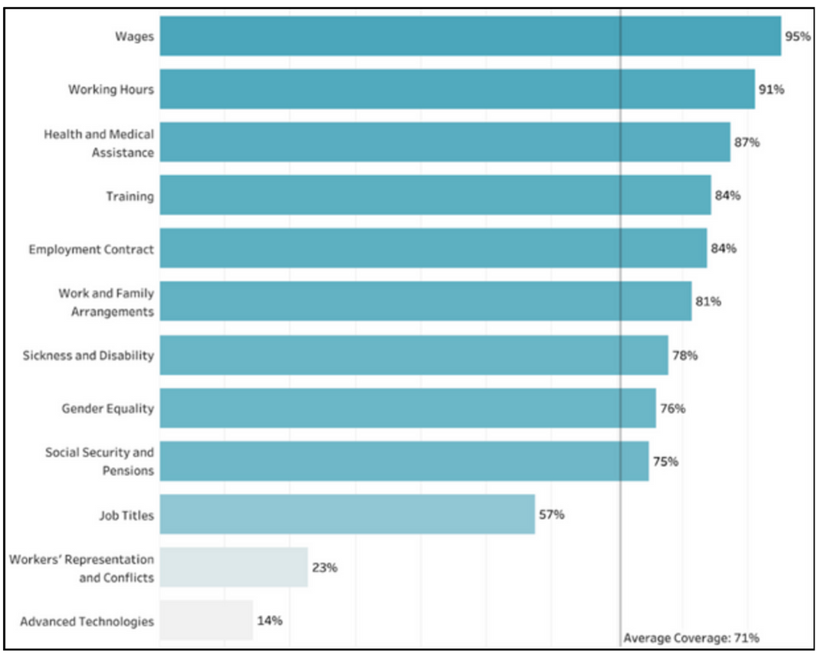
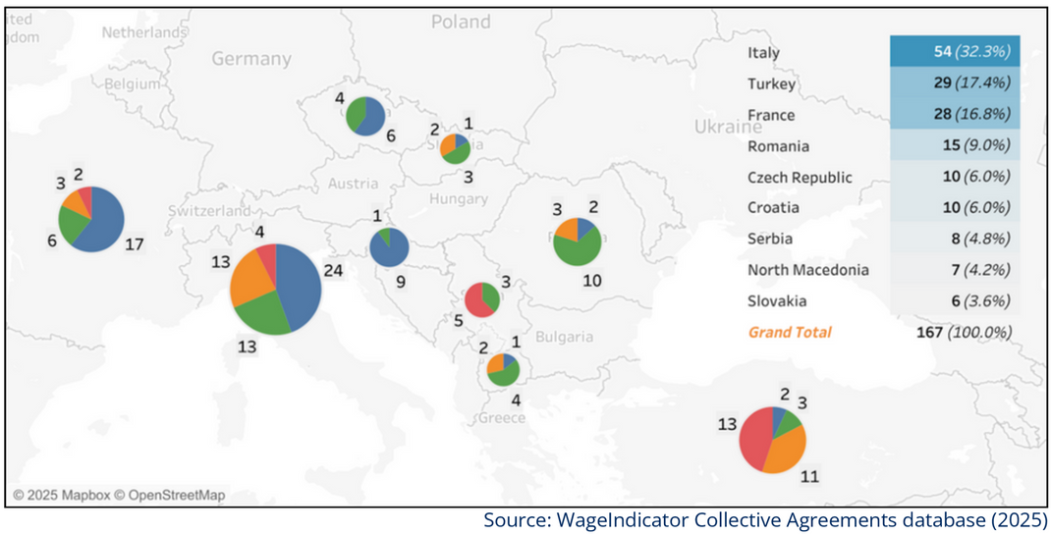
Content of collective agreements
Weak in incorporating stipulations on the use of technology, workers’ representation, lifelong learning, gender equality measures, flexible work arrangements, and protection from workplace violence

Slide 8



Towards smart bargaining in the services sectors
www.celsi.sk/en/barservice
https://wageindicator.org/about/projects/barservice
Sectoral reports: commerce, publishing, care, finance
Country-specific policy briefs and sectoral reports
Report analysing the content of collective agreements in services
Report on undeclared work in the services sector
Country videos
Other materials

Slide 9
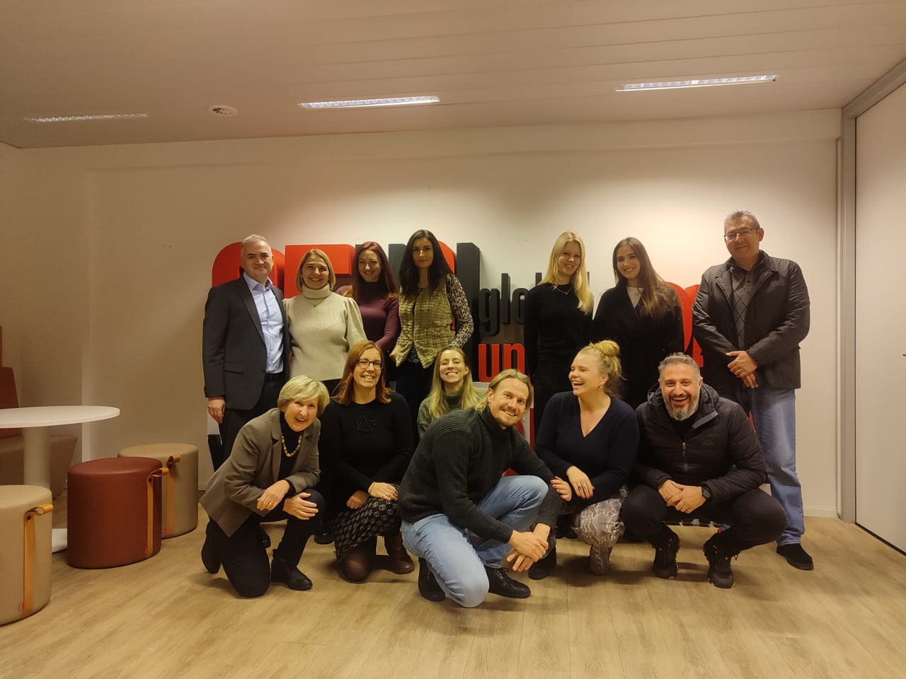
Bedankt!
Merci!
Thank you!
Teşekkür ederim!
Hvala!
Благодарам!
Mulțumesc!
Ďakujem!
Děkuji!
Хвала!
Grazie!
Köszönöm!

