Slide 1
The BARCOM project on innovative tools for bargaining support in the Commerce sector
Daniela Ceccon –
Database manager in WageIndicator Foundation / researcher at the University of Amsterdam
BRUSSELS, 6th June 2016

Slide 2
WHAT IS THE BARCOM PROJECT ABOUT?
BARCOM project is about COLLECTIVE BARGAINING in the Commerce sector in Europe and DATA.
Collective bargaining is important
BUT
there is hardly any shared and organized cross-country knowledge about what is actually agreed in collective agreements.
How can this be achieved?
Through DATA COLLECTION and ANALYSIS

Slide 3
WHO IS WORKING ON THE BARCOM PROJECT?
BARCOM project partners:
RESEARCH:
University of Amsterdam/AIAS (coordinator), Amsterdam
Central European Labour Studies Institute (CELSI), Bratislava
University of Economics in Bratislava (EUBA), Bratislava
SOCIAL PARTNERS
EuroCommerce – The Retail, Wholesale and International Trade Representation to the EU
UNI Europa – Uni Global Union – Europe
Associate partner (coding and database)
WageIndicator Foundation (WIF), Amsterdam

Slide 4
WHAT WILL THE RESULTS BE AFTER 2 YEARS?
4 REPORTS:
Comparison of the content of 140 collective agreements from 28 countries (around 5 per country). More than 500 variables will be analysed;
Sector-level bargaining settings (approximately 10 variables per country will be taken into account);
Relationship between agreements’ content and sector-level characteristics;
28 one-page-one-country reports about the content of collective agreements in the country
WHICH MEANS…

Slide 5
Storage of data about the provisions in collective agreements
More expertise for the social partners on collective bargaining in other countries (by cross-country comparison)
Insight into the patterns in collective bargaining provisions, to help future policy decisions
Conference with debates within the commerce sector (employers’ associations and trade unions) about the outcomes of the research.

Slide 6
HOW DO WE GET THERE?
STEP 1
CBA collection (all, but especially UNI Europa and EuroCommerce): 140 agreements, around 5 per country.

Slide 7
STEP 2
Annotation (CELSI/AIAS) using WageIndicator coding form and database.
WageIndicator is a foundation based in the Netherlands and running websites in 85 countries. Through our national websites, we collect, compare and share information about Wages, Labour Law and Career.
In 29 extra-European countries we already have a Collective Bargaining Agreements Database, where we annotate and publish collective agreements.

Slide 8

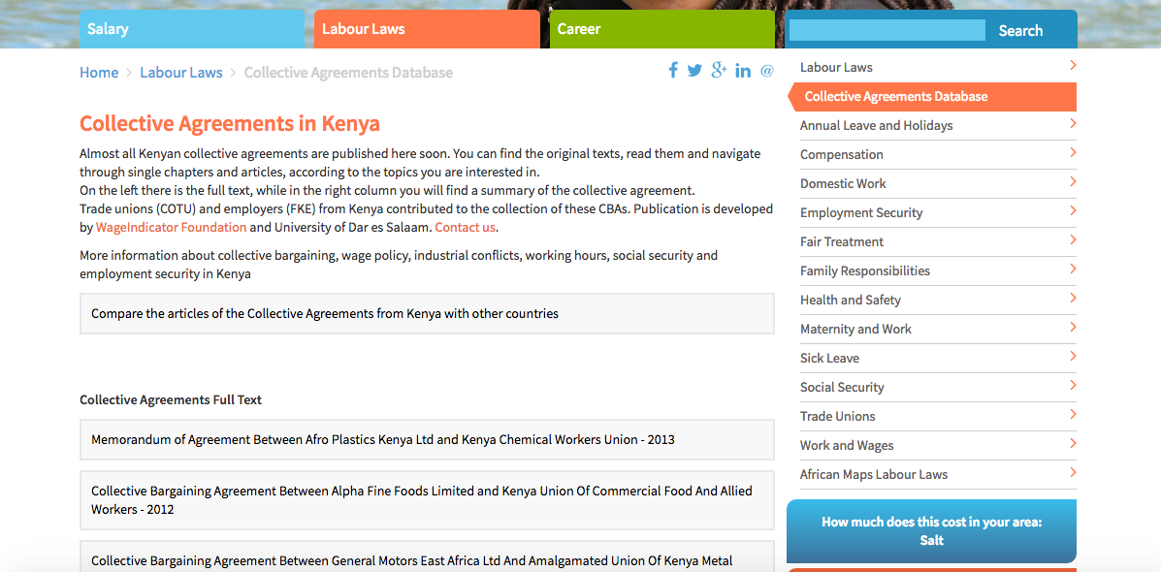
CBAs arrangement in the websites - Kenya
Cobra Team

Slide 9
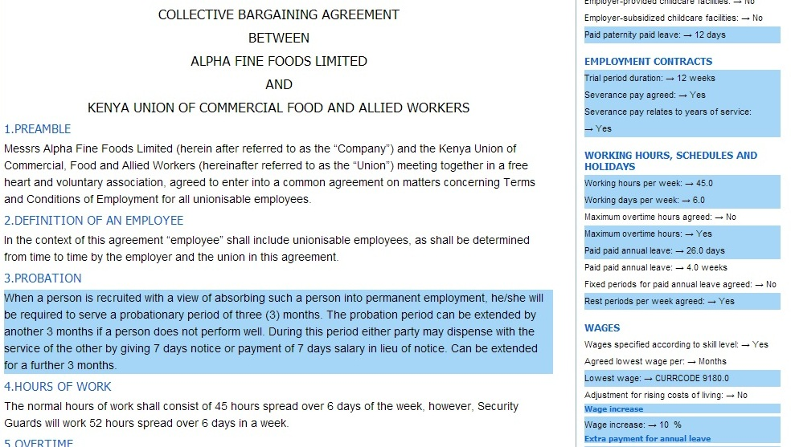
How a CBA looks like when online
Cobra Team

Slide 10
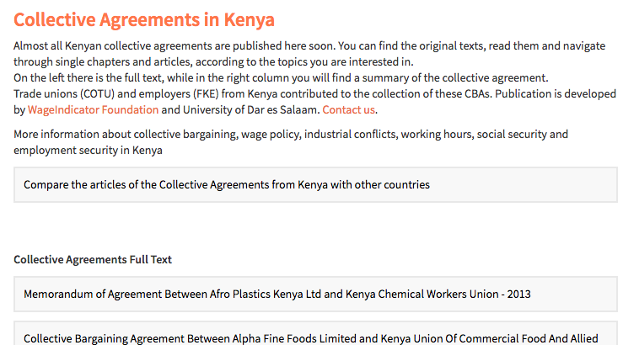
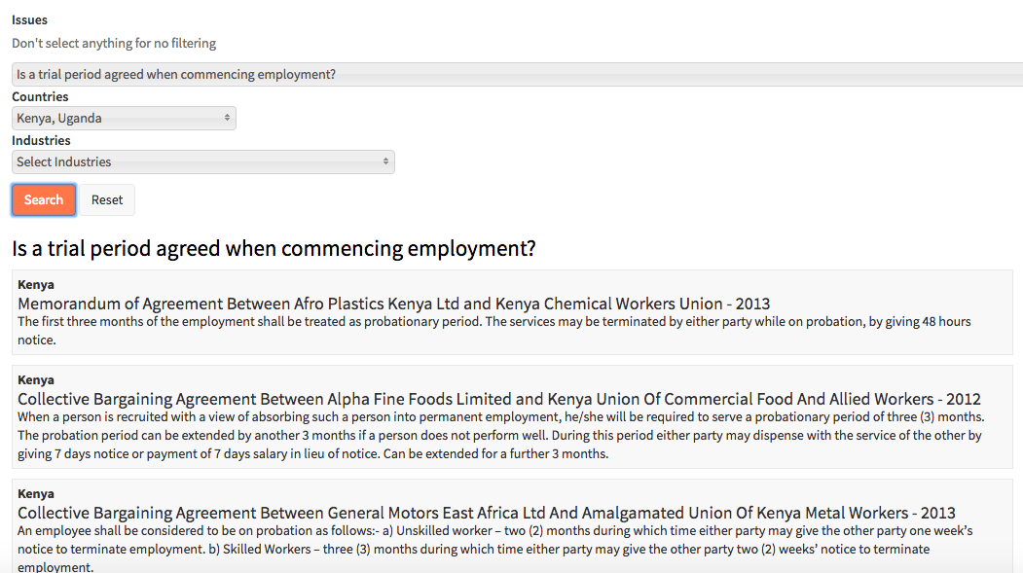
The Comparison Tool
Cobra Team

Slide 11
To annotate collective agreements we already have a coding system, i.e. a long online form with questions on the following topics:
General CBA data
Job titles
Social security and pensions
Training
Employment contracts
Sickness & disability
Health & medical assistance
Work/family balance arrangements
Gender equality issues
Wages
Working hours
Coverage.
For every question, the relevant clause is selected.

Slide 12
STEP 3
Data analysis and reporting.
After the uploading and annotation of the agreements, the WageIndicator CBA Database provides for a huge excel file with more than 500 variables, which can be compared, analysed and shown through graphs and tables.
Also, we have the actual clauses (pieces of text).

Slide 13
BACK TO CBA COLLECTION…
For this project, we need 140 agreements from commerce sector – around 5/country.
We would like them to be:
- Sectoral (when existent) or company agreements
In force
Complete
With high coverage

Slide 14
“Problematic” countries
Bulgaria
Croatia
Cyprus
Czech Republic
Estonia
Finland
Hungary
Ireland
Latvia
Lithuania
Luxembourg
Malta
Poland
Romania
Slovenia
Sweden
United Kingdom

Slide 15
Let’s collaborate!
To make this project start, we need to work together.
By Monday 13th June, let’s try to collect the agreements that are needed to start.
Please send them to: danielaceccon@wageindicator.org
And please provide your email address / phone number, so we can contact you.
THANK YOU!

