Slide 1
Gender Equality and Work/Family Balance Arrangements in European Collective Agreements
Daniela Ceccon –
Database manager of the WageIndicator Foundation / Researcher at the University of Amsterdam
AMSTERDAM, 30th March 2017

Slide 2
WHAT is WAGEINDICATOR?
WageIndicator is a foundation based in the Netherlands and running websites in 92 countries. Through our national websites, we collect, compare and share information about Wages, Labour Law and Career.

Slide 3
WHAT IS the WAGEINDICATOR CBA DATABASE?
Collective bargaining is important
BUT
there is hardly any shared and organized cross-country knowledge about what is actually agreed in collective agreements. Such knowledge is useful for workers, but also for trade unions and employers. HOW?
To improve CBAs (more transparent, with better provisions)
To make collective bargaining easier (comparison, sample CBAs – full or per topic)
How can this be achieved?
Through DATA COLLECTION, ANALYSIS and RESEARCH

Slide 4

From single CBAs to an organized database
The WageIndicator CBA Database
WAGEINDICATOR FOUNDATION
TRADE UNIONS - EMPLOYERS
CBAs
PDF –> Word format
Word format -> xhtml navigable text
ANNOTATION:
Answer questions on relevant topics
Select clauses on relevant topics
SITE
COMPARISON between CBAs, sectors and countries
NAVIGATION through the whole text
INFORMATION on relevant topics
CLAUSES on relevant topics

Slide 5
To annotate collective agreements we have a coding system, i.e. a long online form with questions on the following topics:
General CBA data
Job titles
Social security and pensions
Training
Employment contracts
Sickness & disability
Health & medical assistance
Work/family balance arrangements
Gender equality issues
Wages
Working hours
Coverage.
For every question, the relevant clause is selected.

Slide 6
Since January 2013, WageIndicator has been collecting CBAs from all over the world.
WE CURRENTLY HAVE IN THE DATABASE:
720 collective agreements, from
48 countries.
This analysis takes into account 77 agreements from 20 European countries (most of them are from or related to commerce sector, all of them cover the private sector).

Slide 7
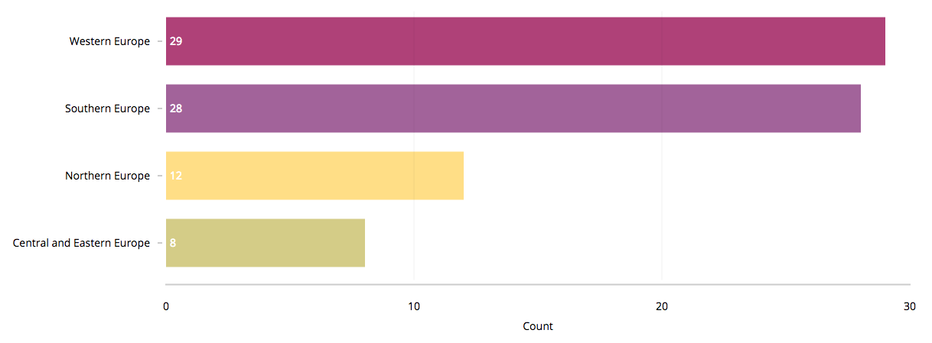
Regions, countries and sectors of analyzed European CBAs

Slide 8
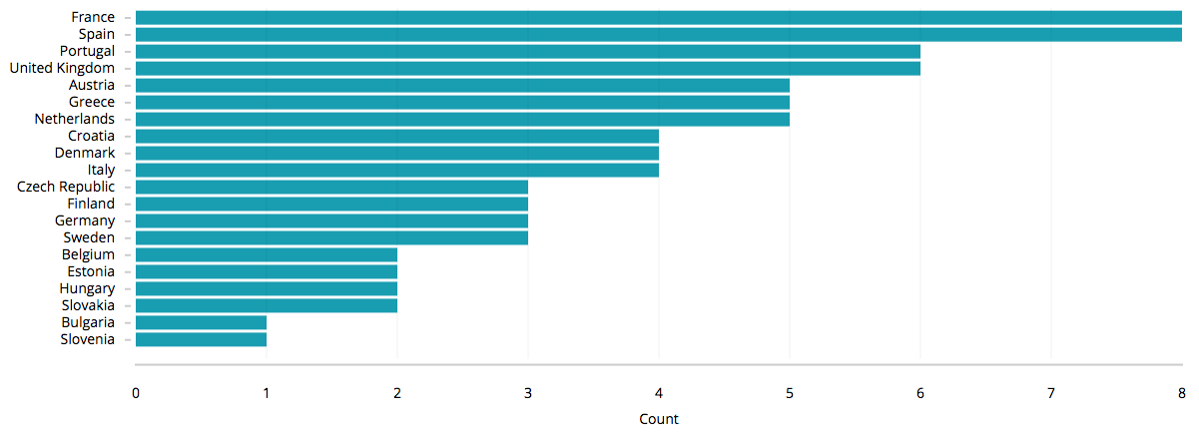

Slide 9
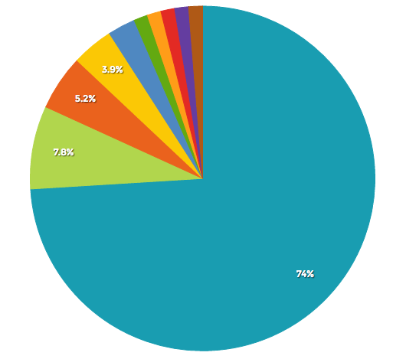
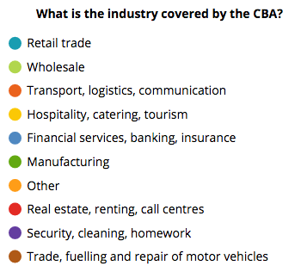

Slide 10
TOPICS
Work/family balance arrangements:
Maternity / paternity leave
Pregnancy and breastfeeding
Childcare
Equality issues:
Equal pay
Discrimination
Equal opportunities for women
Gender equality
Sexual harassment and violence at work

Slide 11
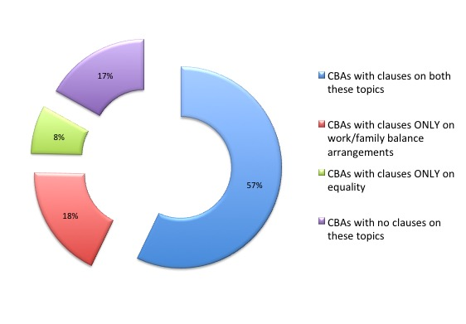
Distribution of clauses on work/family balance arrangements and equality

Slide 12
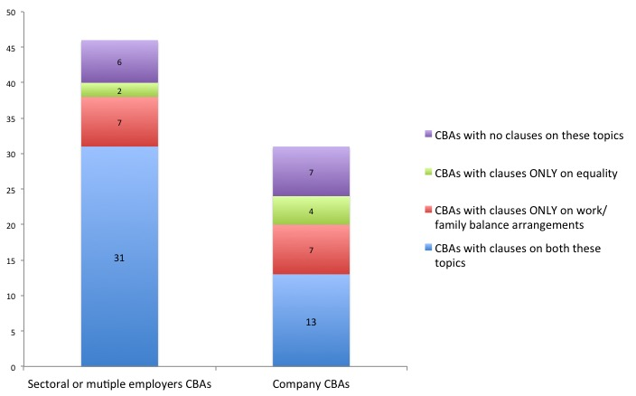

Slide 13
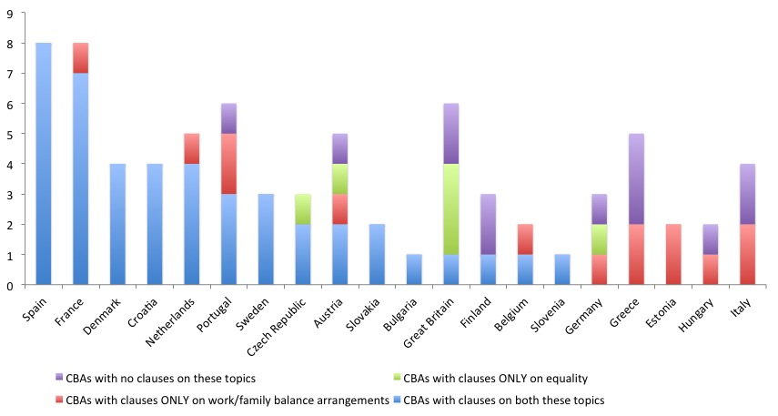

Slide 14
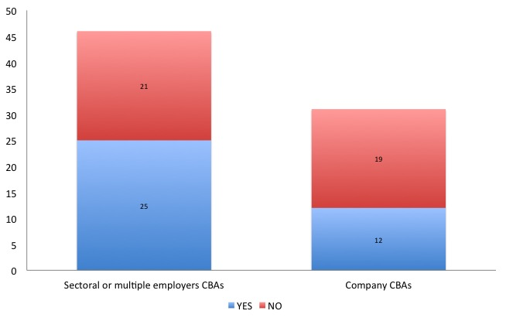
Does the agreement contain clauses on paid maternity leave?

Slide 15
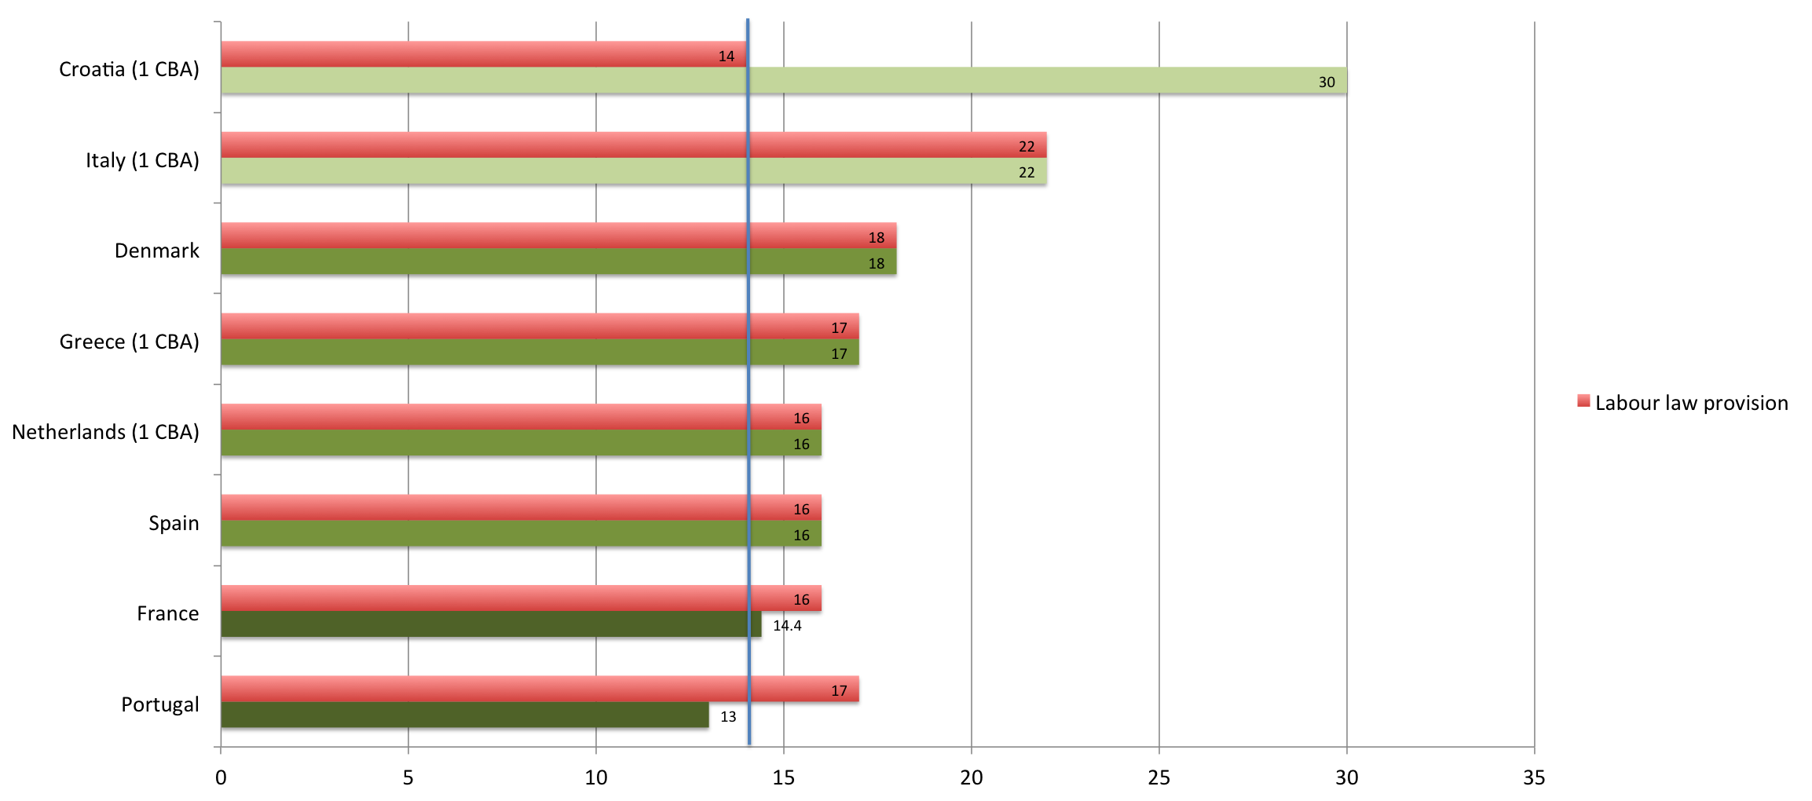
Average weeks of maternity leave per country (CBAs, labour law and ILO standard comparison) – data from 23 CBAs
14,0

Slide 16
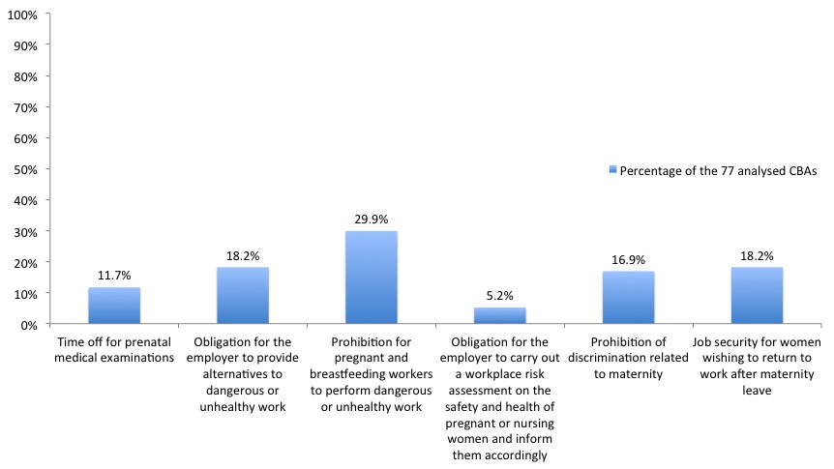
Other provisions related to pregnancy

Slide 17

Does the agreement contain clauses on paid paternity leave?

Slide 18

Nursing and childcare facilities
Employer-provided nursing facilities? no CBA
Employer-provided childcare facilities? no CBA
Employer-subsidized childcare facilities? 1 CBA from Greece (L’Oreal)

Slide 19
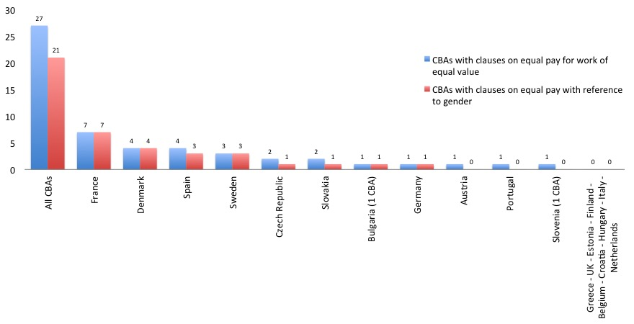
CBAs with clauses on equal pay

Slide 20
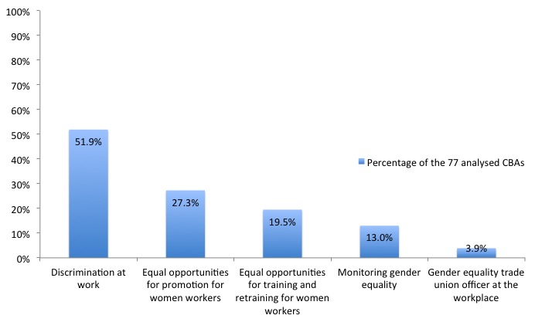
Collective agreements with provisions on discrimination and/or equal opportunities

Slide 21
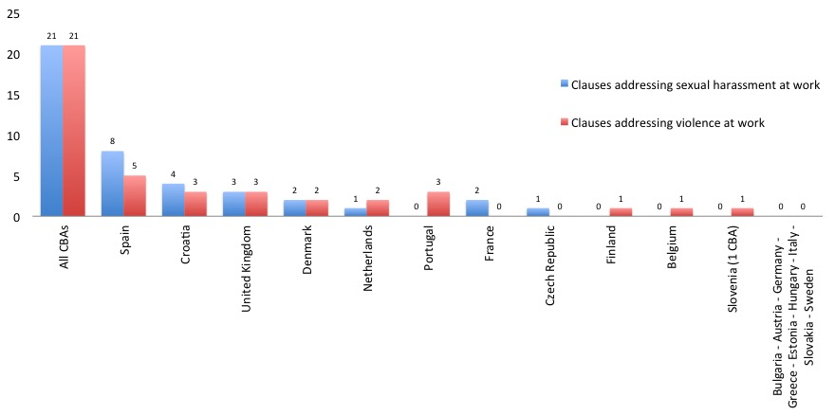
Collective agreements with provisions on sexual harassment and/or violence at work

Slide 22
WANT TO HAVE A LOOK AT OUR DATA?
Check this:
http://wageindicator-collective-agreements-database.silk.co/page/WageIndicator-CBA-Database
Some bibliography:
WageIndicator Labour Law database: http://www.wageindicator.org/labourlaw
Ceccon, D. (2015). Gender Equality and Work/Family Balance Arrangements in Collective Agreements in Africa, Latin America and South East Asia, on the basis of the WageIndicator CBA Database. Amsterdam: WageIndicator Foundation, December 2015 (available in the Publications section of the Wageindicator website)

