Slide 1


Do Collective Agreements increase Equality and promote Work-Life Balance ? Evidence from WageIndicator Database
Daniela Ceccon (presenter)
WageIndicator Foundation – University of Amsterdam
danielaceccon@wageindicator.org
Iftikhar Ahmad (corresponding author)
WageIndicator Foundation
iftikharahmad@wageindicator.org

Slide 2
Violence in the workplace: where is this prohibited in the highest percentage of collective agreements?
COSTA RICA
CROATIA
RWANDA
PORTUGAL
INDONESIA
BRAZIL

Slide 3

Violence in the workplace: where is this prohibited in the highest percentage of collective agreements?
COSTA RICA
CROATIA
RWANDA
PORTUGAL
INDONESIA
BRAZIL

Slide 4
Violence in the workplace: where is this prohibited in the highest percentage of collective agreements?
CLAUSES VS VIOLENCE: 86% (Europe 29%, South America 4%)
CLAUSES VS DISCRIMINATION: 70% (Europe 46%, Africa 10%). These countries do better: Spain, Czech Rep., France, Denmark.
CLAUSES VS SEXUAL HARASSMENT: 34% (Europe 27%, South America 3%). These countries do better: UK, Cambodia, Croatia, Costa Rica, Spain
COSTA RICA
CROATIA
KENYA
PORTUGAL
INDONESIA
BRAZIL

Slide 5
THE SAMPLE USED IN THIS ANALYSIS
886 collective agreements, from 45 countries
Around 70 variables about work and family balance arrangements and equality
36% of the CBAs are from manufacturing sector (mostly textile)
Other most represented sectors are retail trade (10%) and agriculture, forestry and fishing (9%)
82% are enterprise level CBAs, but there is a 17.5% of sectoral CBAs. There are also 5 inter-professional agreements from West Africa

Slide 6
THE WAGEINDICATOR DATABASES
COLLECTIVE AGREEMENTS DATABASE
LABOUR LAW DATABASE
Established in 2012
Currently contains almost 900 collective agreements from 52 countries
Agreements are coded, annotated (749 variables and nine main topics) and published in the national sites run by WageIndicator
Established in 2009 (updated every year)
Provides information on 48 themes relating to decent work agenda
Covers more than 100 countries
Decent Work Checks are available as country labour law profiles in English and local language
Labour law information is available on country websites

Slide 7
THE WAGEINDICATOR DATABASES
WageIndicator is a foundation based in the Netherlands and running websites in 92 countries. Through our national websites, we collect, compare and share information about Wages, Labour Law and Career.
COLLECTIVE AGREEMENTS DATABASE
LABOUR LAW DATABASE
Established in 2012
Currently contains almost 900 collective agreements from 52 countries
Agreements are coded, annotated (749 variables and nine main topics) and published in the national sites run by WageIndicator
Established in 2009 (updated every year)
Provides information on 48 themes relating to decent work agenda
Covers more than 100 countries
Decent Work Checks are available as country labour law profiles in English and local language
Labour law information is available on country websites

Slide 8
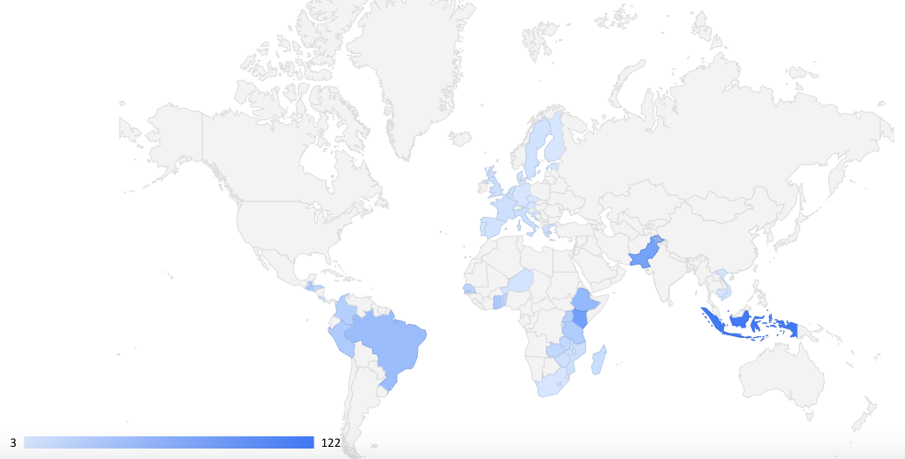
WHERE ARE THE CBAS FROM?

Slide 9
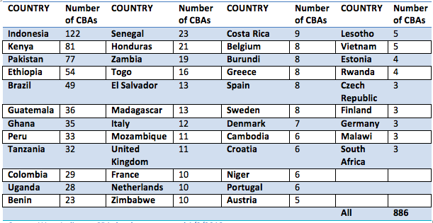
WHERE ARE THE CBAS FROM?

Slide 10
Maternity leave duration. Which country is providing more than others? Where does collective bargaining provide more than the law?
COSTA RICA
CROATIA
RWANDA
PORTUGAL
INDONESIA
BRAZIL

Slide 11
Maternity leave duration. Which country is providing more than others? Where does collective bargaining provide more than the law?
COSTA RICA
CROATIA
RWANDA
PORTUGAL
INDONESIA
BRAZIL

Slide 12
Maternity leave duration. Which country is providing more than others? Where does collective bargaining provide more than the law?
MATERNITY LEAVE DURATION BY LAW: 14 WEEKS
MATERNITY LEAVE DURATION IN CBAS: 30 WEEKS
COSTA RICA
CROATIA
KENYA
PORTUGAL
INDONESIA
BRAZIL

Slide 13
Considerations on maternity leave
ILO standard for maternity leave is of 14 weeks minimum
In Europe and South America the average number of weeks in CBAs is more than 14.
In Africa, Asia and Central America the average is around 13.
BUT
93% of CBAs comply with their national legislation.
15% of CBAs provide more than the law, but the majority of them don’t reach the 14 weeks of maternity leave. → In many countries (in Africa, Latin America and Asia) the law does not comply with ILO minimum AND among these only Burundi fills the gap.

Slide 14
Job security for women after maternity leave. Which country has a higher percentage of CBAs with this provision?
COSTA RICA
CROATIA
RWANDA
PORTUGAL
INDONESIA
BRAZIL

Slide 15
Job security for women after maternity leave. Which country has a higher percentage of CBAs with this provision?
COSTA RICA
CROATIA
RWANDA
PORTUGAL
INDONESIA
BRAZIL

Slide 16
Job security for women after maternity leave. Which country has a higher percentage of CBAs with this provision?
IN AFRICA: 38% OF CBAS PROVIDE FOR JOB SECURITY FOR WOMEN AFTER MATERNITY LEAVE. IN OTHER CONTINENTS IT’S 10-18%
IN RWANDA: 75% OF THE CBAS CONTAIN THIS PROVISION
COSTA RICA
CROATIA
RWANDA
PORTUGAL
INDONESIA
BRAZIL

Slide 17
Paternity leave duration. Which country is providing more than others? Where does collective bargaining provide more than the law?
COSTA RICA
CROATIA
RWANDA
PORTUGAL
INDONESIA
BRAZIL

Slide 18
Paternity leave duration. Which country is providing more than others? Where does collective bargaining provide more than the law?
COSTA RICA
CROATIA
RWANDA
PORTUGAL
INDONESIA
BRAZIL

Slide 19
Paternity leave duration. Which country is providing more than others? Where does collective bargaining provide more than the law?
COSTA RICA
CROATIA
PATERNITY LEAVE DURATION BY LAW: 25 DAYS
PATERNITY LEAVE DURATION IN CBAS: 16.7 DAYS
PATERNITY LEAVE DURATION BY LAW: NO PROVISION
PATERNITY LEAVE DURATION IN CBAS: 10.3 DAYS
PORTUGAL
KENYA
INDONESIA
BRAZIL

Slide 20
How can these data improve the lives and wages of workers?
CBA texts are published in the sites → increase awareness
Good practices → model (sample CBAs) → better / new provisions
Negotiators can compare clauses → improve CBAs → reduce the gender pay gap

Slide 21
THANK YOU!
All the collective agreements can be found at www.wageindicator.org/cbadatabase

