Slide 1

Collective Bargaining during the Covid-19 Pandemic Evidence from an International Negotiator Survey
Giedo Jansen (AIAS-HSI)
Funded by the European Commission. Directorate-General
for Employment. Social Affairs and Inclusion - VS/2021/0190 1

Slide 2
BARCOVID PROJECT
Influence of COVID-19 Pandemic on collective negotiations and collective agreements
The negotiation process
The wider industrial relations climate
Negotiation outcomes (changes in agreements)
Research Question 1:
How has the COVID-19 pandemic influenced the negotiation process for renewing collective labor agreements across various European countries?
Notes:
Background: The COVID-19 pandemic and subsequent lockdowns have significantly disrupted global economies. Europe, among other regions, experienced considerable challenges in renewing collective labor agreements due to these disturbances.

Slide 3
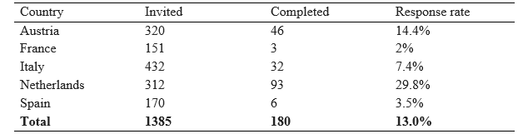
BARCOVID NEGOTIATOR SURVEY
About half of the respondents are from trade unions (53.9%), the other half from employer and employer associations (46,1%)
Majority of respondents (85%) from sector-level negotiations. The rest from company-level (11%) or national-level (4%)
Notes:
Negotiators or signatories involved collective negotiations during the pandemic in 5 countries (Austria, France, Italy, the Netherlands, and Spain)
We invited 1385 organizations/individuals
180 negotiators from 124 unique collective agreements

Slide 4
1. Overall Influence
Did the pandemic make it more or less difficult to reach an agreement?
Notes:
"In the Netherlands, over 50% of negotiators found the pandemic significantly hampered reaching collective agreements, with only 7% seeing any ease. Interestingly, 37% felt no change in negotiation difficulty. In Italy, the pattern shifted. Around 52% found negotiations harder, but 48%, reported no change. Unlike the Netherlands, no Italians saw any easing of negotiations due to the pandemic. Now let's look at Austria. Here, a substantial 68% majority reported no change in negotiation difficulties, with only 31% finding the process harder during the pandemic. This gives us a diverse picture of how COVID-19 has influenced collective bargaining across different European nations."

Slide 5
1. Overall Influence
How important was the covid19 pandemic compared to other factors that affected the negotiation process?

Slide 6
1. Overall Influence
Frequency of negotiations | Netherlands | Italy | Austria
Weekly | 18,9 | 8,3 | 10,3
Monthly | 45,6 | 66,7 | 10,3
Incidental | 35,6 | 25 | 79,5
Change in negotiation freqency
(vs. before the pandemic)
Decreased | 12,4 | 25 | 10
Stayed the same | 78,7 | 58,3 | 77,5
Increased | 9 | 16,7 | 12,5

Slide 7
1. Overall Influence
 | Netherlands | Italy | Austria
Online or offline negotiations
Fully offline | 26,7 | - | 25,6
Mostly offline, sometimes online | 27,8 | 8,7 | 25,6
Both offline/online (about equally) | 14,4 | 30,4 | 25,6
Mostly online, sometimes offline | 22,2 | 26,1 | 17,9
Fully online | 8,9 | 34,8 | 5,1
Changes due to quarantine¹
Never | 17,8 | 13 | 42,5
Seldom | 38,9 | 43,5 | 37,5
Sometimes | 32,2 | 39,1 | 20
Often | 11,1 | 4,3 | -

Slide 8
2. Most important topics

Slide 9
3. Perceptions of changes in CBAs
 |  | Netherlands | Italy | Austria
Wages | Decreased | 0.0 | 0.0 | 5,4
 | Stayed the same | 2.3 | 0.0 | 5,4
 | Increased | 94.3 | 73.3 | 89,2
 | DK/NA | 3.4 | 26.7 | 5,4
Coverage | Decreased | 10,3 | 6,7 | 2.7
 | Stayed the same | 62,1 | 60,0 | 83.8
 | Increased | 19,5 | 20,0 | 8.1
 | DK/NA | 8,0 | 6,7 | 5.4
# Signatories | Decreased | 5,7 | 0.0 | 0.0
 | Stayed the same | 88,5 | 93,3 | 94.6
 | Increased | 3,4 | 6,7 | 5.4
 | DK/NA | 2,3 | 0.0 | 0.0

Slide 10
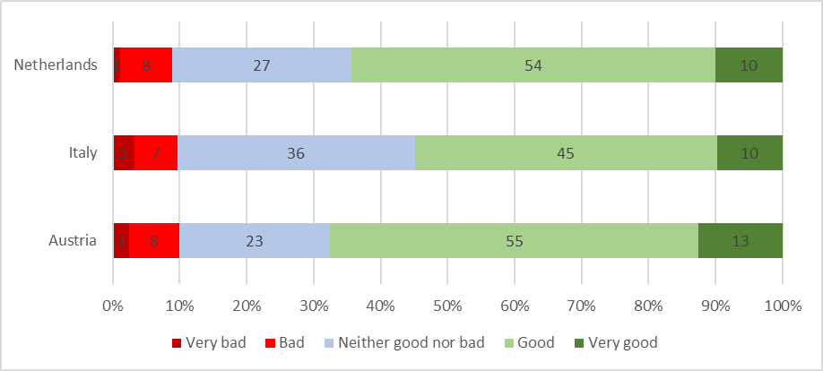
4. Quality of social partners relations

Slide 11
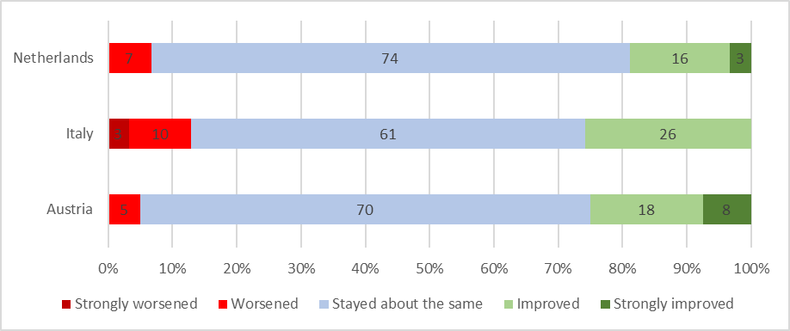
4. Quality of social partners relations (change since start pandemic)

Slide 12
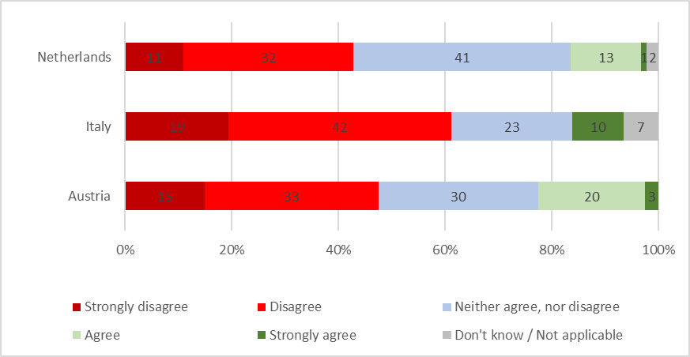
5. “Power of trade unions weakened?”

Slide 13
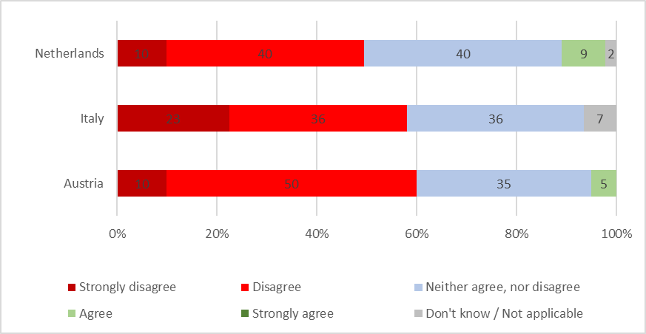
5. “Power of employers weakened?”

Slide 14
Conclusion
COVID-19 noted as a significant influence on negotiations.
Mixed views on increased difficulty in agreement processes.
Stability in negotiation frequency despite the shift to online platforms.
Minimal changes in coverage rates and signatory parties.
Increased focus on wages as a key negotiation topic.
Good quality of social relations during pandemic negotiations.
Unchanged bargaining power of trade unions and employers.
Notes:
Majority of negotiators acknowledged significant effects of the pandemic on negotiation processes.
While many reported increased difficulty in reaching agreements, a substantial group saw negligible changes due to COVID-19.
Despite the shift to online platforms, negotiation frequency largely remained stable.
Coverage rates and the number of signatory parties experienced minimal changes.
Wages emerged as the most important topic, with most negotiators reporting an increase.
Quality of social relations remained good and stable throughout the pandemic
Most respondents believe that the bargaining power of trade unions or employers has not weakened due to the pandemic.

Slide 15
Collective Bargaining during the Covid-19 Pandemic Evidence from an International Negotiator Survey
Giedo Jansen (AIAS-HSI)
Funded by the European Commission. Directorate-General
for Employment. Social Affairs and Inclusion - VS/2021/0190 1

