Slide 1


The Challenges Of Understanding the Content Of Collective Bargaining
8th ILO Regulating for Decent Work Conference Ensuring decent work in times of uncertainty

Slide 2

Funding acknowledgements
BARWAGE is a project within the Social Dialogue Program of the European Commission. (SOCPL-2021-IND-REL - Project ID 101052319)
BARMETAL is a project within the Social Dialogue Program of the European Commission. (SOCPL-2021-IND-REL – Project ID 101052331)
BARCOVID is a project within the Social Dialogue Program of the European Commission Directorate-General for Employment. Social Affairs and Inclusion (VS/2021/0190)
Laudes Foundation for funding improving working conditions in Indonesia, see https://wageindicator.org/about/projects/makin-terang-improving-work-and-worker-representation-in-indonesia.
The papers presented solely reflects the opinion of the authors and does not necessarily reflect the official opinion of the funder

Slide 3
The Challenges Of Understanding the Content of Collective Bargaining
Explaining the Global WageIndicator Collective Agreements Database Daniela Ceccon and Gabriele Medas, WageIndicator Foundation
The interplay of collective wage bargaining and statutory minimum wages in realizing adequate wage floors across European sectors Janna Besamusca, Utrecht University; Martin Guzi, Masaryk University; Kea Tijdens, WageIndicator Foundation
Female friendly clauses in collective bargaining agreements Rupa Korde and Mahika Gandhi, FLAME University / WageIndicator Foundation
Wage-setting in Collective Bargaining in Africa: Analyses using WageIndicator Database Ernest Ngeh Tingum, University of Namibia/WageIndicator Foundation
Understanding Collective Bargaining Agreements in Turkey Ceyhun Güler, Dokuz Eylul University / WageIndicator Foundation
Collective Bargaining After Labour Law Reform in Indonesia Nadia Pralitasari, WageIndicator Foundation / Gajimu.com

Slide 4
Explaining the Global WageIndicator Collective Agreements Database
Daniela Ceccon
Director Data at WageIndicator
danielaceccon@wageindicator.org
Gabriele Medas
Manager of the WageIndicator Collective Agreements Database
gabrielemedas@wageindicator.org

Slide 5
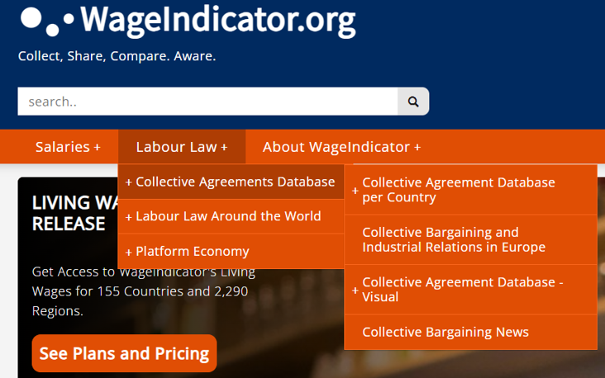
The WageIndicator Collective Agreements Database in numbers
Established in 2012
Currently hosting more than 2200 CBAs from 67 countries all over the world, in 27 languages
Agreements are collected, annotated (coding scheme with around 800 variables) and published in WageIndicator national websites, all in national languages
12 main macro-topics

Slide 6
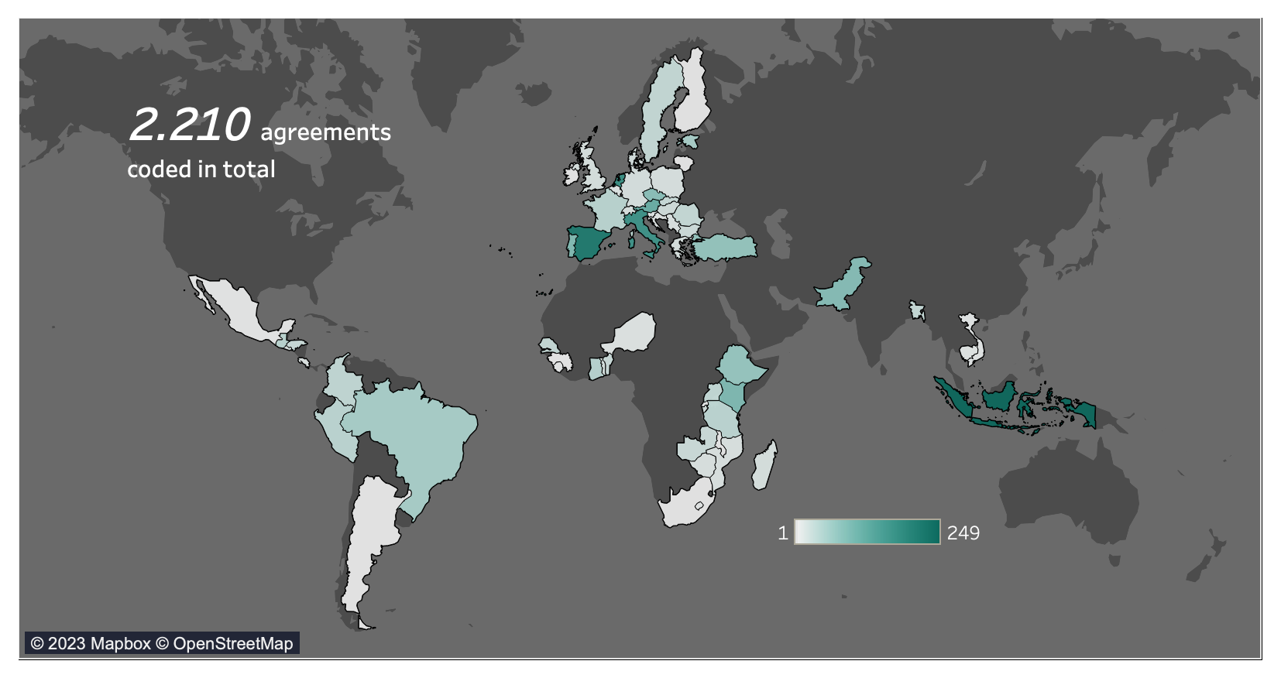
CBAs around the world

Slide 7
The CBAs Database team
A skilled multilingual team of professionals:
Around 20 people currently involved (annotators and researchers)
20 languages spoken at a mother tongue level
Coders who are able to manage multiple languages

Slide 8
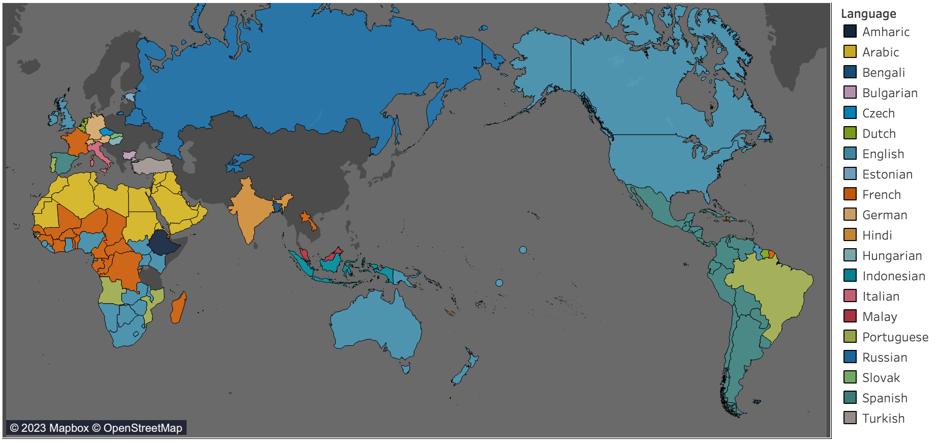
Languages spoken by the CBAs Database team

Slide 9
Collecting, annotating and coding agreements
THE PROCESS OF ANNOTATION
1.
JPEG / PDF / Scanned document
Html navigable text
Word document
OCR software
Html editor
2.
The text is uploaded in WageIndicator system, called COBRA.
3.
Questions are answered and clauses are selected about 12 macro topics.

Slide 10
Anonymization of CBAs
If explicitly requested, we can guarantee two options:
A: The CBA can be fully hidden to the public. This means that the text will not be published at all and it will only be coded and analyzed internally, for research purposes.
B: The CBA can be published but without showing any sensitive data regarding the signatories. All the referring data regarding the signatories are deleted by our team prior to publishing the text of the agreement on the WageIndicator website.

Slide 11
Collecting, annotating and coding agreements
THE TOPICS CODED IN COBRA
Social security and pensions
Individual employment contracts / job security
Work-life balance arrangements
Wages
Equality and/or violence in the workplace
New Technologies & Green clauses
Working hours, schedules, holidays and days of leave
Workers’ Representation & Conflicts
Training / apprenticeship
Health and medical assistance
Sickness and disability

Slide 12
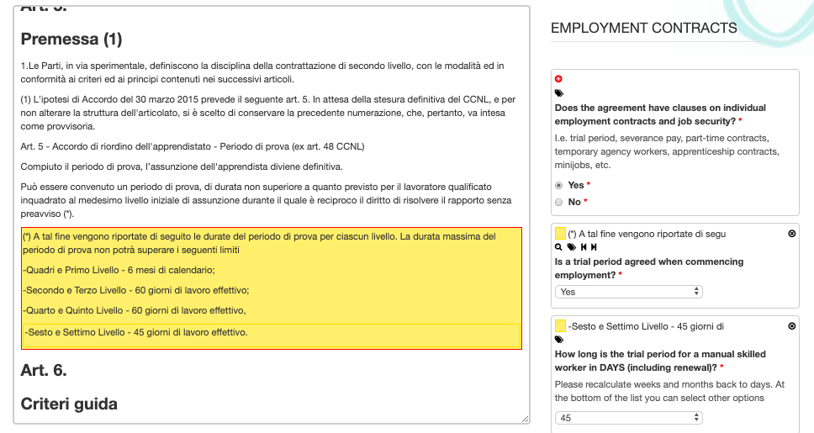
Collecting, annotating and coding agreements
‘COBRA’ ANNOTATION SYSTEM used by annotators :
https://cobra.wageindicator.org

Slide 13
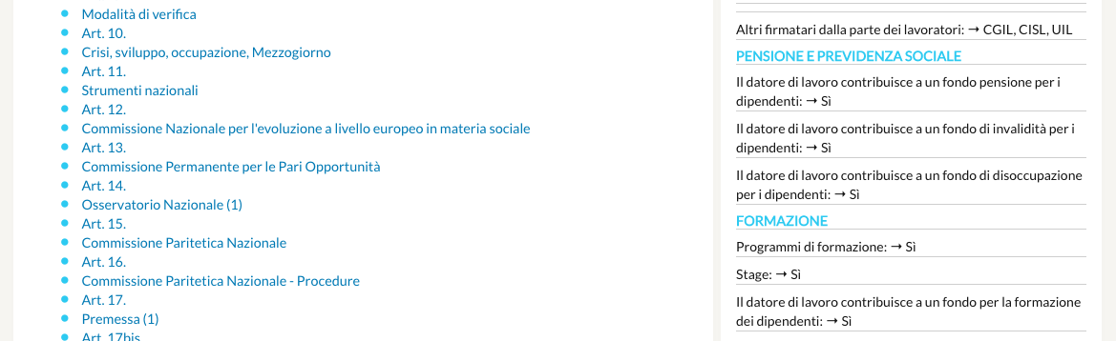
Collecting, annotating and coding agreements
WHAT CBAs LOOK LIKE ONLINE to users (i.e., citizens, trade unions, researchers) :
https://wageindicator.org/cbadatabase

Slide 14
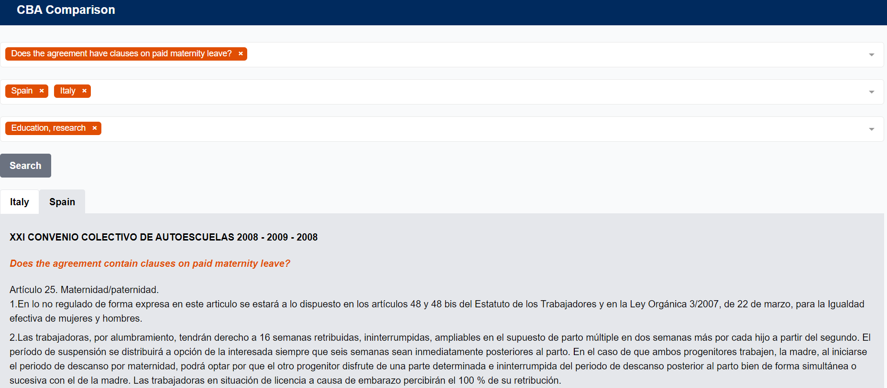
THE COMPARISON TOOL:
Compare the articles of the Collective Agreements across topics, sectors and countries

Slide 15
Comparative analysis of collective agreements
Which comparisons are possible through the CBAs comparison tool?
Cross-country comparison on some topics/provisions (e.g., Gender Equality and Work/Family Balance Arrangements in Collective Agreements in Africa, Latin America and South East Asia, on the basis of the WageIndicator CBA Database - Amsterdam: WageIndicator Foundation. Copyright © 2016 International Labour Organization · 1 dic 2016)
Changes over time in one country/sector/CBA (eg BARCOVID)
Variations between different CBA types (eg MEB-SEB in LevelUp)
Qualitative analysis on clauses.

Slide 16
A comprehensive coding scheme* in continuous evolution…
According to:
Findings coming from the CBAs analysis
Annotators and researchers’ inputs and insights
Industrial relations Projects (ongoing, in the pipeline as well as potential ones)
Highly relevant topics emerging in the public debate: remote work, Industry 4.0, green transition, wages, AI (artificial intelligence) in collective bargaining
*See the latest CBAs Database Codebook available here: Ceccon, D., Medas, G. (2022). Codebook WageIndicator Collective Agreements Database – Version 5 – February 2022. WageIndicator Foundation, Amsterdam.

Slide 17
Projects of the WIF CBAs Database
Analysis of CBAs are key for every social dialogue project which aims at understanding the collective bargaining
Past projects
Several Living Wage and Decent Wage projects (2012-2017): CBAs in Africa, Latin America and South-East Asia
BARCOM (Contents of CBAs in the commerce sector in the EU)
COLBAR (Contents of CBAs in all sectors in the EU)
Current projects
BARMETAL (Contents of CBAs in the metal sector & developing coding scheme for automatization, digitalization and decarbonization)
AI in Collective Bargaining
LEVEL-UP (Increase collective bargaining coverage by levelling-up bargaining to the sectoral/multi-employer level)
BARCOVID (Effects of COVID on bargaining & building a time series)
BARWAGE (Coding pay scales & sampling)
EUROFOUND CBA Database (Wage floors & sampling)
SSHOC (machine reading / NLP – Natural Language Processing techniques)
Decent work and living wages projects in garment sector in Indonesia and garment and flower sectors in Ethiopia
Projects in the pipeline
BARSERVICE: Support smart collective bargaining in the services sector in Europe: overview, challenges, opportunities
BARTIME: The monetary rewards of working time dimensions in collective bargaining in Europe

Slide 18
THANK YOU
Daniela Ceccon
Director Data at WageIndicator
danielaceccon@wageindicator.org
Gabriele Medas
Manager of the WageIndicator Collective Agreements Database
gabrielemedas@wageindicator.org

Slide 19

The interplay of collective wage bargaining and statutory minimum wages in realizing adequate wage floors across European sectors Janna Besamusca, Martin Guzi and Kea Tijdens
Prepared for “8th Conference of the Regulating for Decent Work Network” on Ensuring decent work in times of uncertainty 10-12 July 2023

Slide 20

Collective Bargaining vs Minimum wage floors
This paper focuses on the interplay of the wage setting arenas of statutory minimums and collective bargaining on pay
Statutory minimum wages and collective bargaining both theorized to support the decent wage agenda.
Considerable scientific debate about their interaction
Crowding out or reinforcing?

Slide 21
Structure of Earnings Survey (2018) and
The focus of our analysis is on workers who earn below the median wage in each country. The estimation sample comprises 2.57 million workers employed in 181,698 enterprises in 17 EU countries.
Sample includes workers between 20 and 59 years old who work at least 50% of full-time hours. Data on minimum wage rates are sourced from the WageIndicator Minimum Wage Database. Our main outcome variable is referred as low pay that indicates workers earning between 100 and 110 percent of minimum wage.

Slide 22
Characteristics of workers in our sample
14 percent of workers in our sample are identified with low pay.
The incidence of low pay is lower (10 percent) in the group of workers covered by CBA than in the group not covered (23 percent).
Workers covered by CBA attain lower education levels, are more likely to have part-time work; more likely to have permanent than temporary contracts; and more concentrated in the public sector.

Slide 23

Different impact of CBA between sectors Contribution of collective bargaining is weaker in sectors employing high-skilled workers
Note: Presented are estimates on CBA variable obtained from models estimated separately for each sector. All estimates are confirmed significant at 1% level.
The magnitude of coefficient is lowest in education and health sector and reaches the highest values in construction and manufacturing sectors.

Slide 24

Heterogenous impact of collective bargaining The impact of collective wage bargaining on wage levels is higher for workers with lowest education attainment, older workers, those employed in private firms, and workers with temporary contracts or with part-time work.
Note: Separate models are estimated by adding interaction terms between coverage and characteristics of workers (education, age, gender) and parameters of their job (firm ownership, type of contract) to baseline specification.

Slide 25
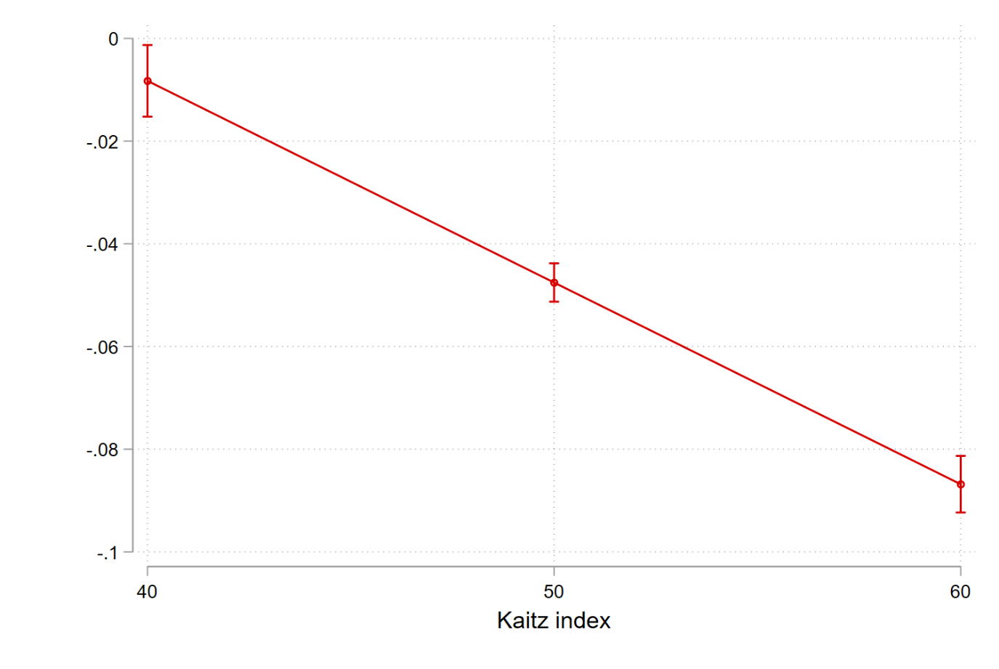
The impact of collective bargaining vary with the level of minimum wages to median wage (Kaitz index)
The marginal effect of collective bargaining on the incidence of low pay for different values of Kaitz index
The impact of being covered by a collective agreement is stronger in countries with high Kaitz index. This indicates that collective bargaining helps workers to sustain their wages above minimum wage levels even at more generous minimum wage levels.
Note: Predictions are based on the estimation of baseline model with added interaction term between coverage bargaining and Kaitz index. 95% confidence intervals are shown.

Slide 26
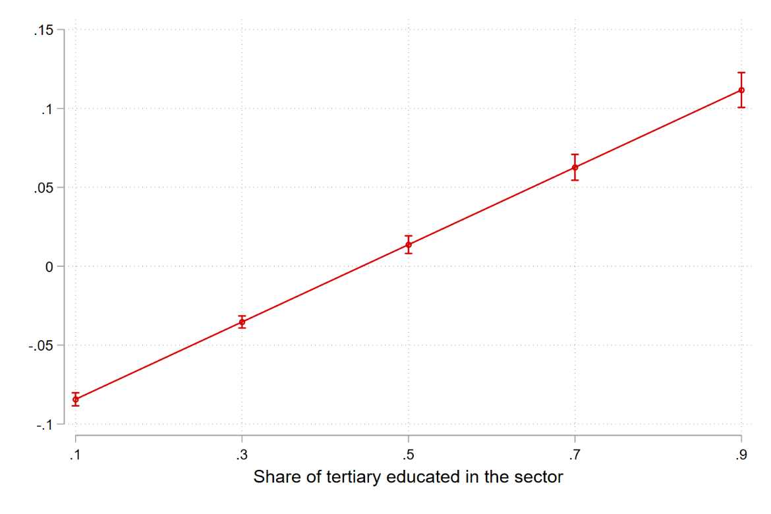
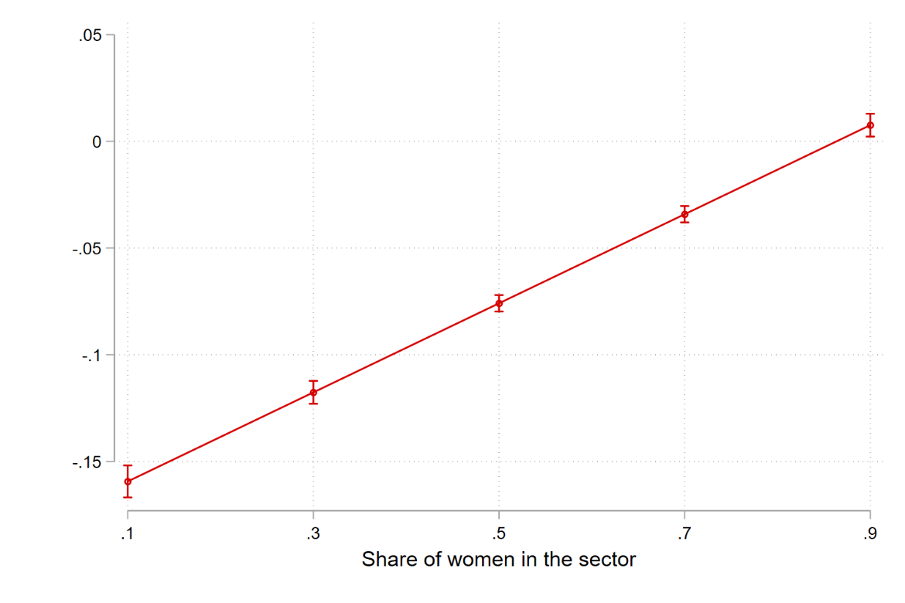
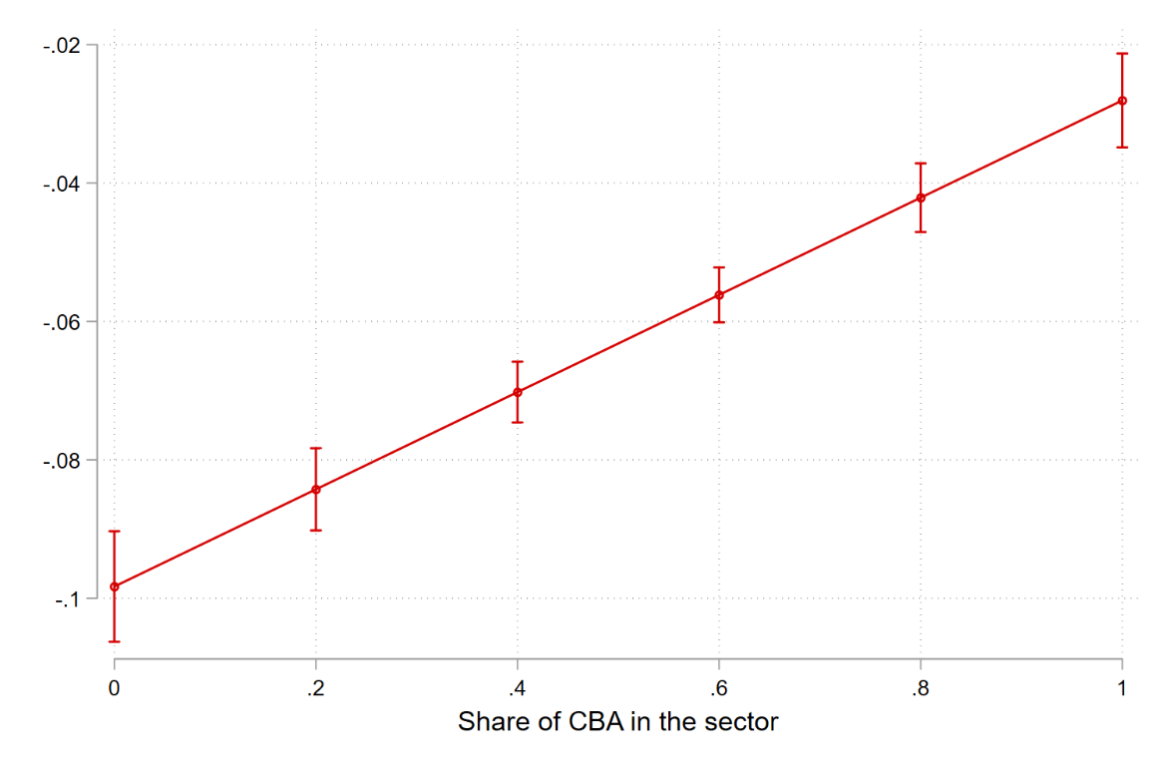
The interaction of collective bargaining with sectoral characteristics The impact of collective bargaining is higher in sectors with dominant low-skill workforce and male dominated sectors and in sectors with lower proportion of workers covered by CBA.
The marginal effect of collective bargaining on the incidence of low pay in interaction with sectoral differences in the characteristics of workforce

Slide 27

Conclusion
Collective bargaining as a policy instrument for achieving decent wages in Europe.
Evidence for added impact of collective bargaining towards decent wages
Sectoral differences are crucial. Larger effect of collective bargaining in sectors with more women, low educated and lower collective bargaining coverage
More important to more vulnerable workers (females, older workers)

Slide 28
Contact Us
Contact: j.w.besamusca@uu.nl

Slide 29


Female friendly clauses in collective bargaining agreements
Rupa Korde and Mahika Gandhi
Economics and Public Policy Department
FLAME University, India

Slide 30
Introduction
The potential women workforce is almost 50%, however the global FLFPR is only about 50%, whereas that of men is almost 80% (ILO, 2017)
One of the biggest barriers affecting women’s participation in the labour market is the work-life balance
Governments as well as researchers suggest that including women friendly and gender equality clauses in CBAs may encourage more women to participate in the labour market

Slide 31
Research Objectives
To assess and compare the inclusion of female-friendly clauses in the CBAs across countries using WageIndicator’s CBA database
To study the relationship between female labour force participation rate and the extent of female-friendly clauses in the CBAs

Slide 32
Data and Research Methodology
Focus on Gender equality issues and Work/family balance arrangement
 | WageIndicator CBA Database | Research Paper
Topics | 12 | 2
Variables | 749 | 35
WageIndicator’s CBA Database
Topics covered:
General CBA data
Job titles
Social security and pensions
Training
Employment contracts
Sickness and disability
Health and medical assistance
Work/family balance arrangements
Gender equality issues
Wages
Working hours
Coverage
Categorized into 6 themes
CBA Clause | Number of Clauses
Maternity Leave | 8
Health and Safety | 7
Breastfeeding | 7
Paternity Leave | 2
Gender Equality | 11

Slide 33
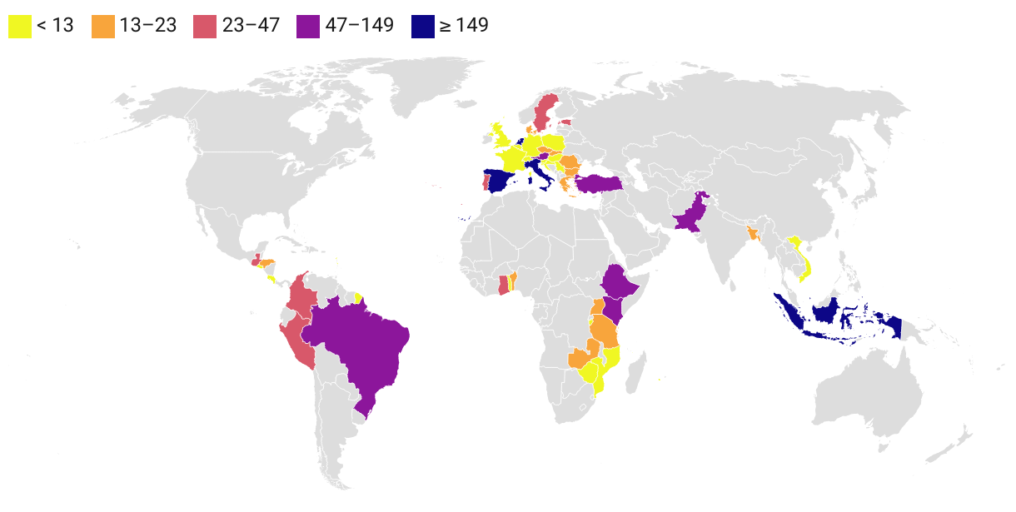
Number of CBAs across countries
Total CBAs 1668
Countries 47
2012 to 2022
Only those countries with more than five CBAs in the WageIndicator CBA database are considered for the analysis

Slide 34
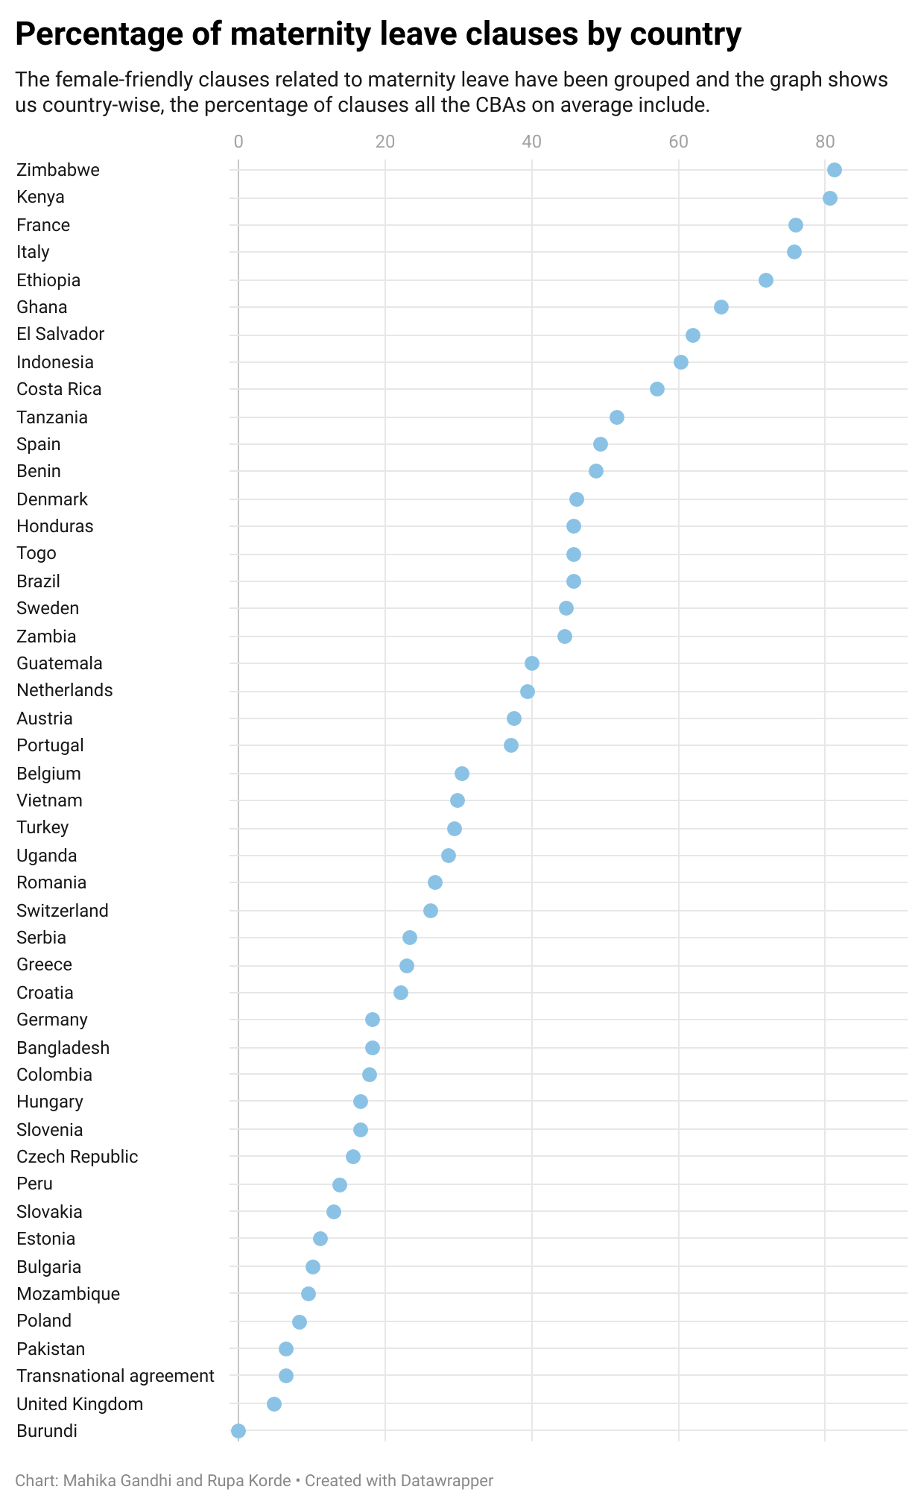
Maternity Leave Clauses
Percentage of maternity leave clauses in CBAs across countries
African countries are at the top the scale - Zimbabwe and Kenya stand out as leaders in this regard, with an astounding average of 80% of maternity leave clauses.
Burundi, on the other hand, trails substantially behind, with a remarkable absence of any kind of maternity leave clauses.
Ethiopia and Ghana are also amongst the top, with 65%+ of maternity leave clauses in their CBAs, on average.
Further, the European countries, France and Italy are amongst the top 5 at 75%.
No clear regional pattern

Slide 35
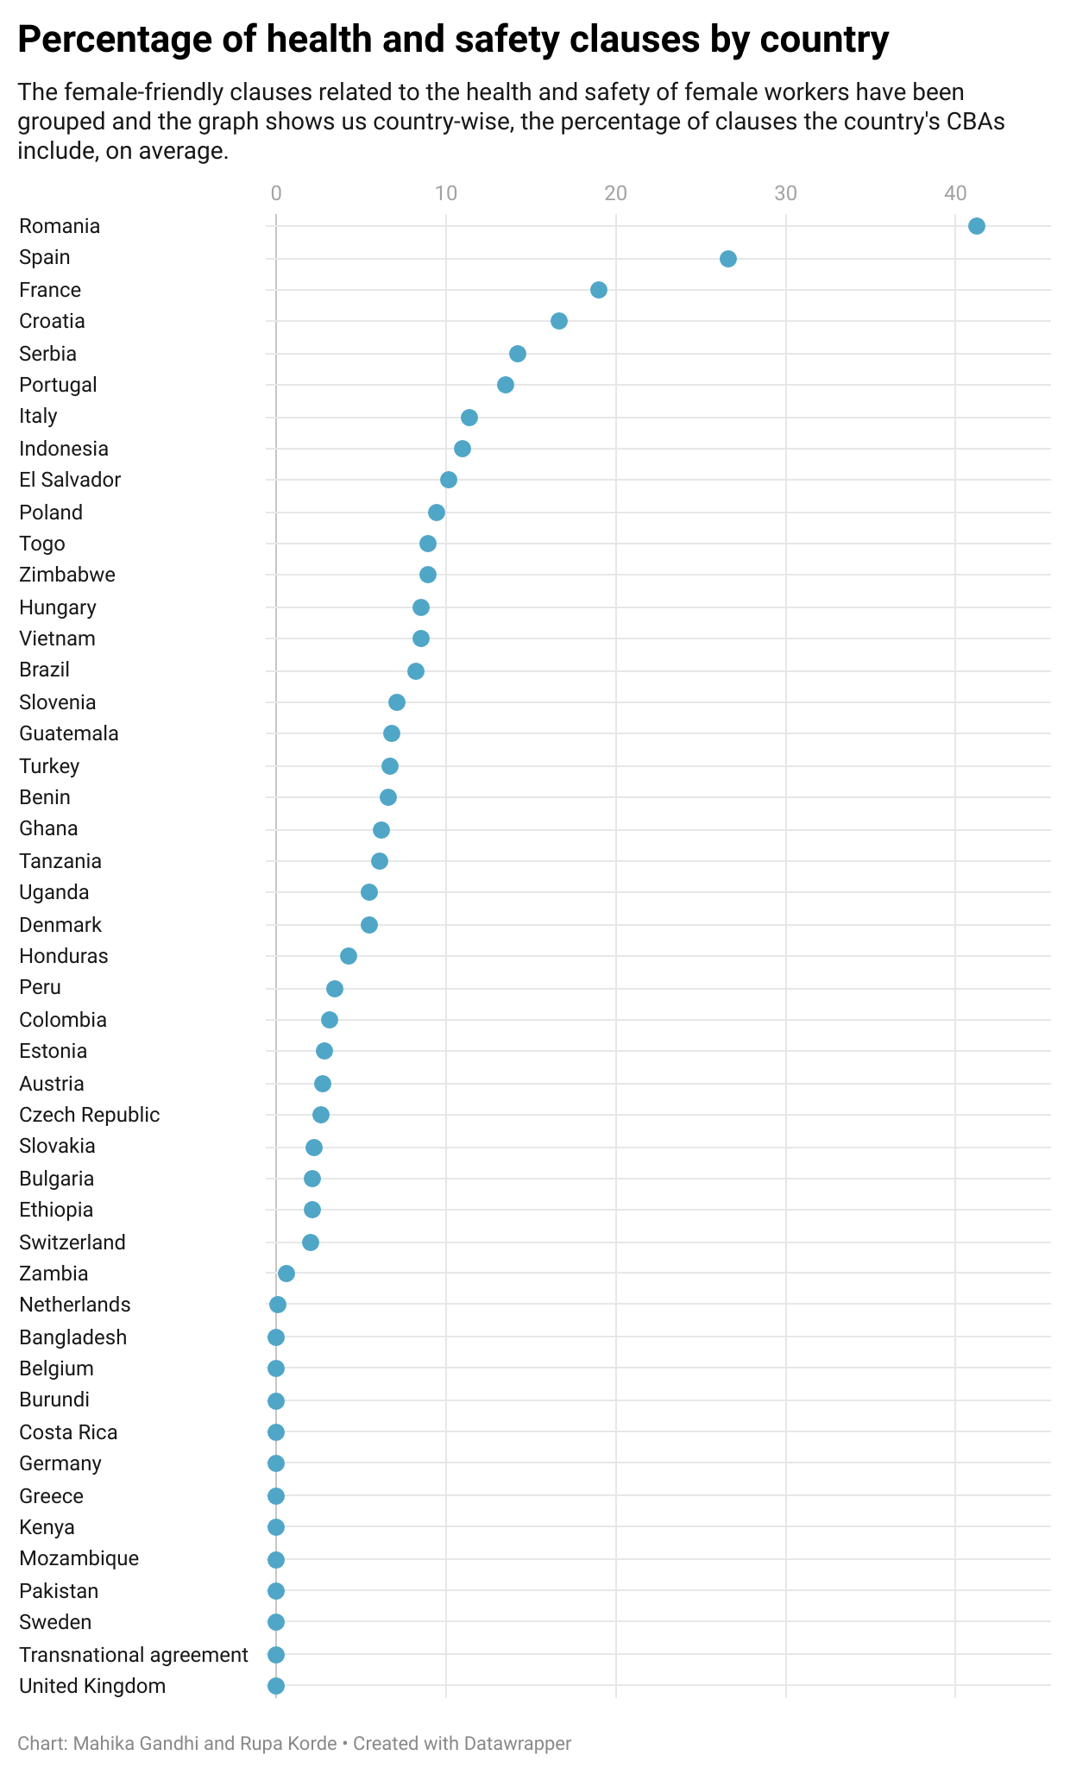
Health and Safety Clauses
The analysis of Collective Bargaining Agreements (CBAs) reveals a concerning trend regarding the inclusion of female-friendly health and safety clauses across most countries.
A majority lie between 0 to 10% of health and safety clauses in their CBAs.
Top 7 positions are held by European nations, with Romania at the top

Slide 36
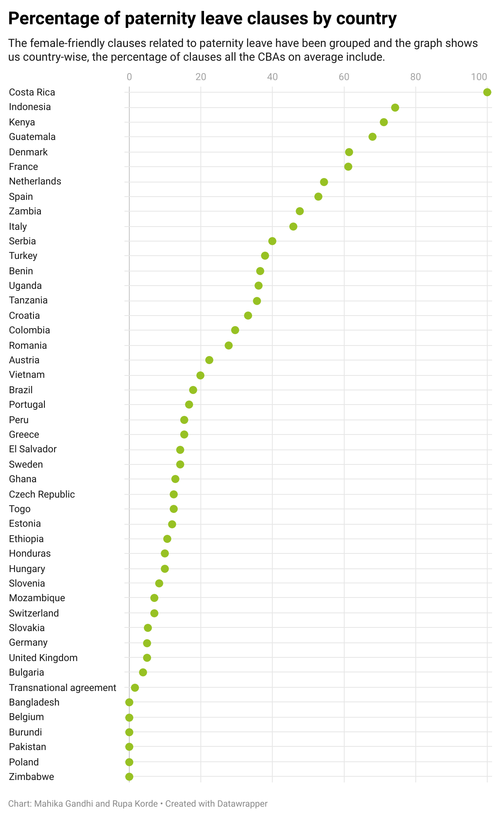
Paternity Leave Clauses
Paternity leave clauses in Collective Bargaining Agreements (CBAs) show no distinct regional trend.
Costa Rica takes the lead by including paternity leave clauses in all of its CBAs
Indonesia and Kenya also deserve recognition for their efforts, as they include over 70% of these clauses, on average, in their CBAs.
On the other end of the spectrum, countries such as Pakistan, Burundi, Bangladesh, Belgium, and Poland lag behind in terms of including paternity leave clauses in their CBAs.

Slide 37
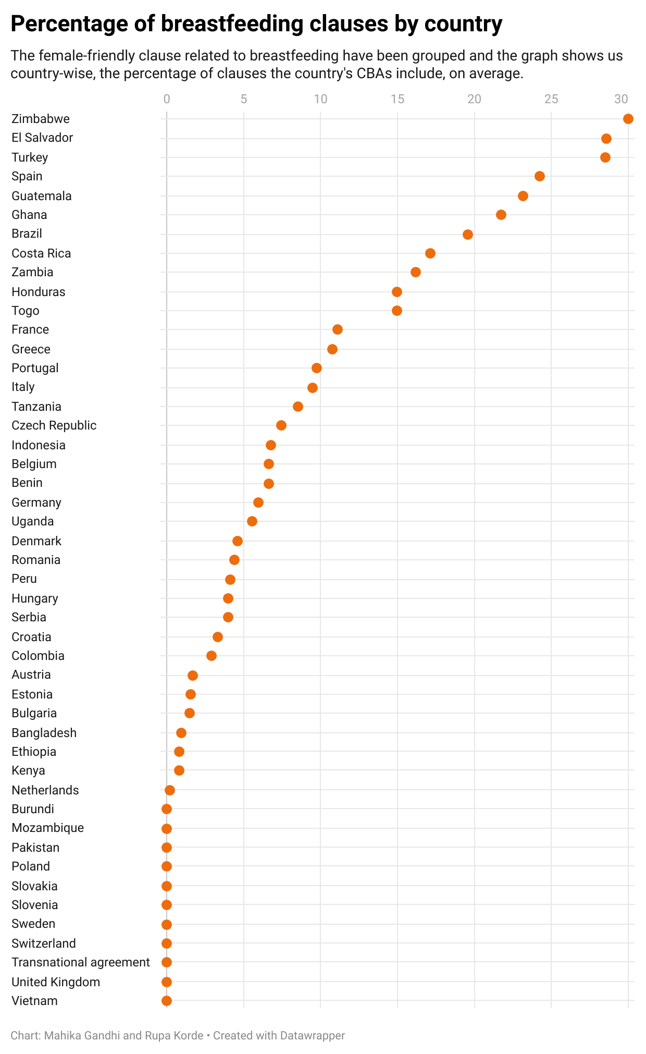
Breastfeeding Clauses
Zimbabwe emerges as a frontrunner with an average inclusion of 30% of such clauses
Notably, Central American countries showcase commendable progress in this area. El Salvador and Guatemala join the ranks of the top 5 countries with significant inclusion of breastfeeding clauses in their CBAs.
Furthermore, European countries also excel in prioritising breastfeeding clauses. Turkey and Spain secure their positions among the top 5.

Slide 38
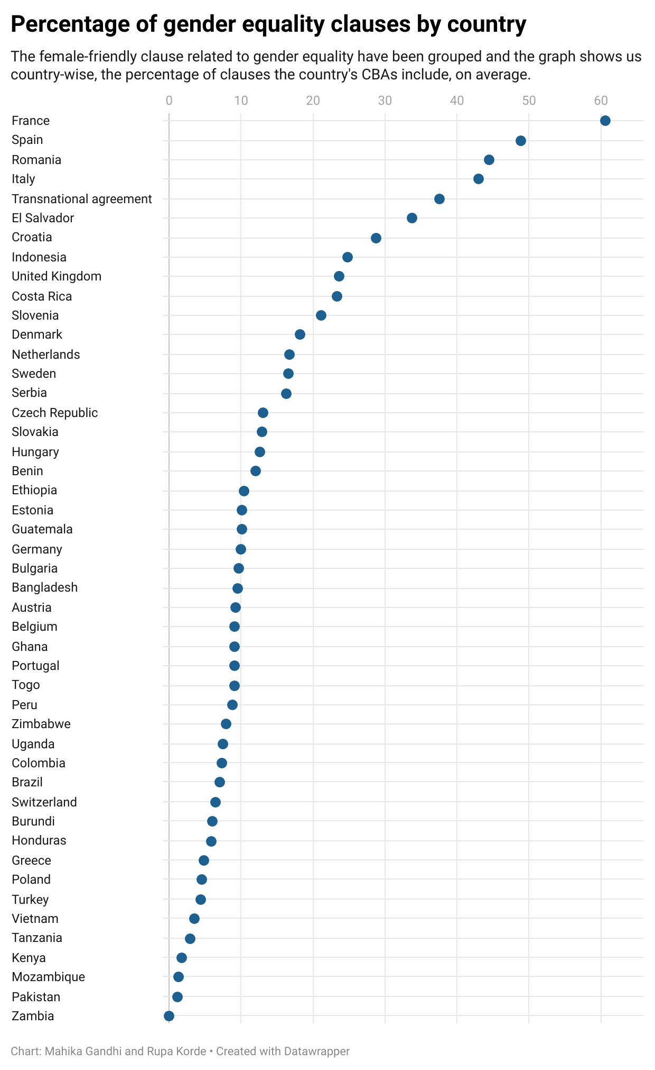
Gender Equality Clauses
Spain, Romania, and Italy stand out by including over 40% of these clauses, on average, in their CBAs.
France, in particular, incorporates 60% of these clauses in its CBAs.
However, there is room for improvement in several regions. African countries, including Tanzania, Kenya, Mozambique, and Zambia, along with Asian countries like Vietnam and Pakistan, have a significant opportunity to enhance the inclusion of gender equality clauses in their CBAs.

Slide 39
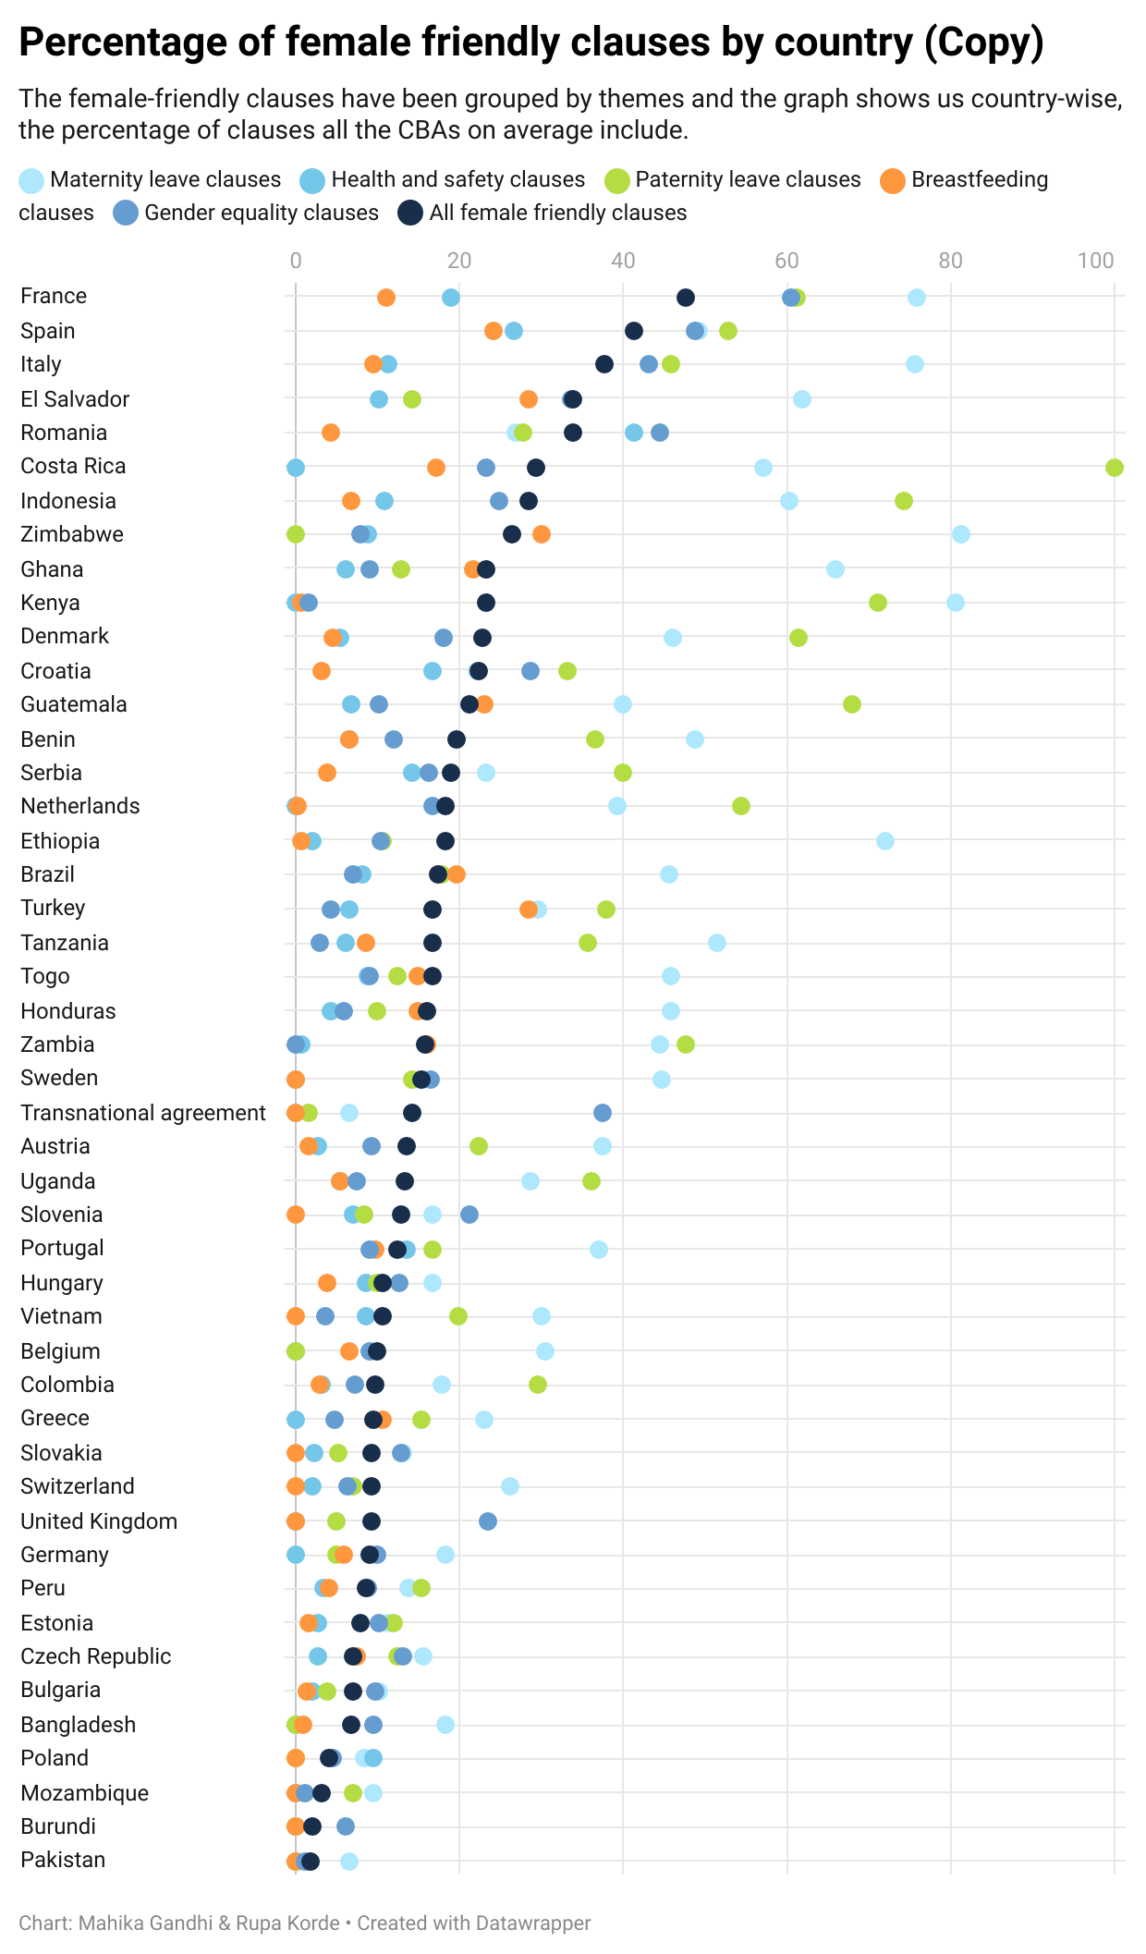
Female-friendly clauses by Country - Average
A majority of countries' CBAs exhibit a significant inclusion maternity and paternity leave clauses.
Remarkably, all of Costa Rica’s CBAs included all paternity leave clauses.
However, when examining the overall average, it becomes apparent that there are areas where CBAs are lacking.
Specifically, there is a notable scarcity of breastfeeding clauses, and gender equality clauses across most countries
The CBAs in France, on average have 47.57% of all the female-friendly clauses, the highest in the world while Pakistan has the lowest, at 1.8%.

Slide 40
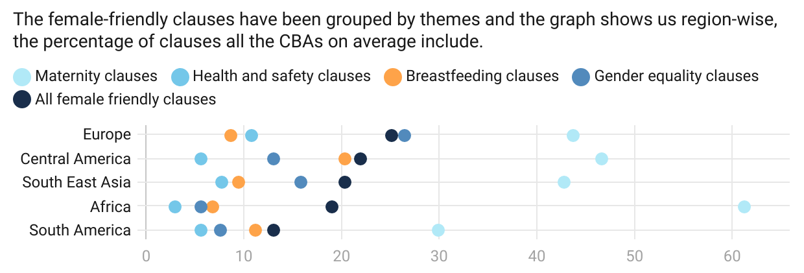
Percentage of Female-friendly Clauses by Region
The analysis of collective bargaining agreements (CBAs) across different regions reveals trends that align with the earlier observations. It is notable that, regardless of the region, CBAs universally exhibit a low proportion of breastfeeding and health and safety clauses.
The CBAs in all the regions have on average, 40-50% of the paternity leave clauses we are studying. South America’s CBAs, have a lower percentage of paternity leave clauses, with an average of only 20%. Furthermore, when considering the overall inclusion of female-friendly clauses, South America's CBAs exhibit the lowest percentage among all the regions.

Slide 41
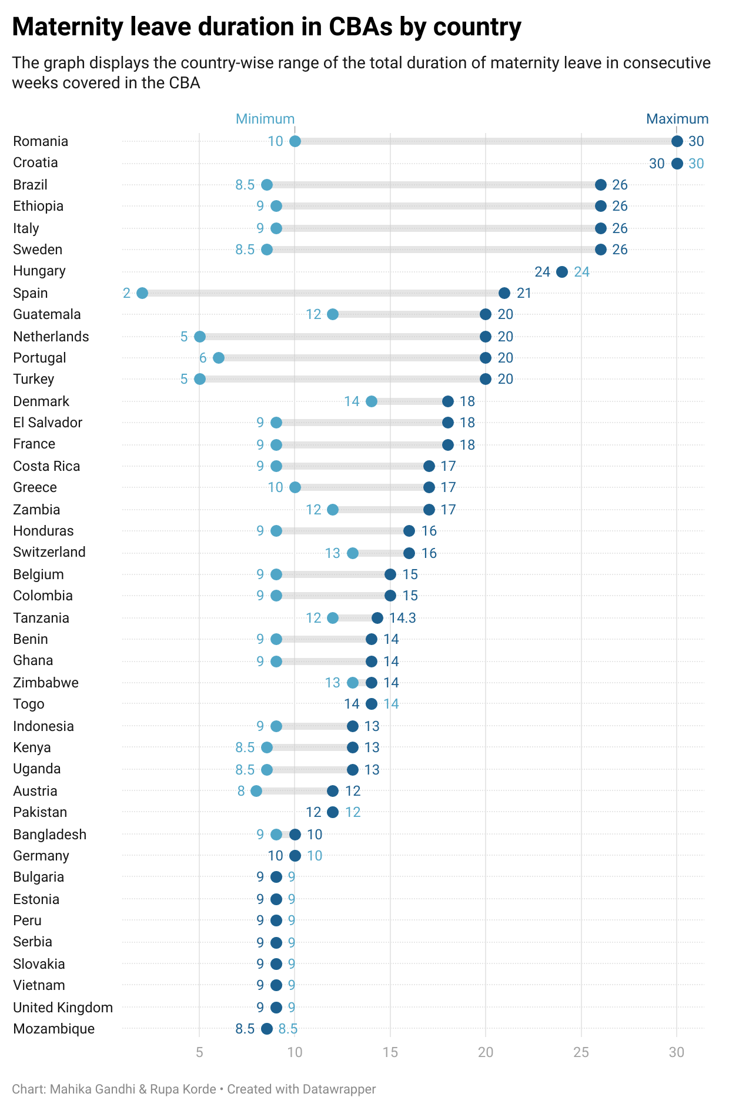
Maternity Leave in CBAs
There is a huge disparity across the countries when it comes to maternity leave.
All CBAs from Croatia have the 30 weeks of maternity, which is currently the highest amongst all the countries.
Romania also has a maximum of 30 weeks, however, there are also CBAs which mention only 10 weeks.
Mozambique has the lowest maternity leave at 8.5 weeks.
There is no clear regional trend that can be established, however many European countries lie at the bottom of the chart when it comes to maternity leave.

Slide 42
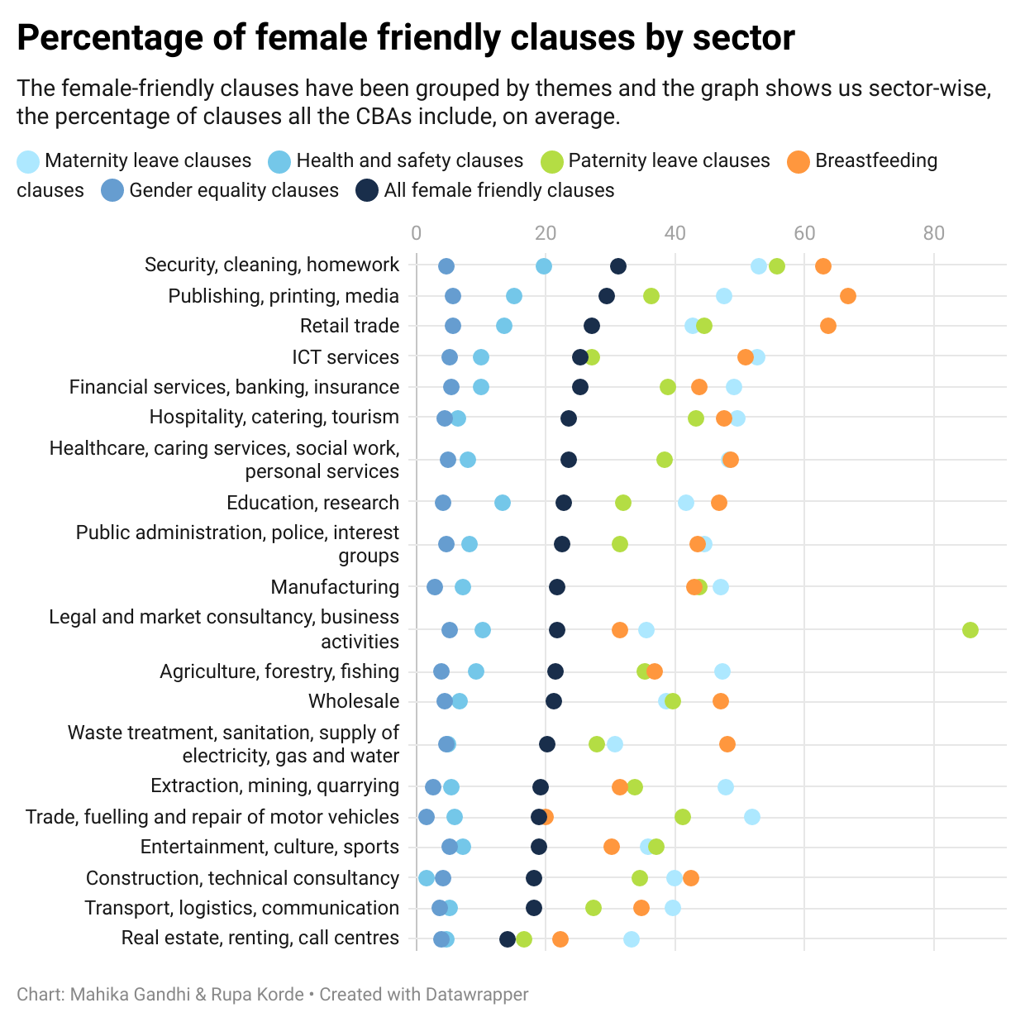
Percentage of female-clauses by sector
In the realm of security, cleaning, and homework sectors, collective bargaining agreements (CBAs) tend to include a substantial proportion of provisions that are conducive to fostering a female-friendly work environment.
The sector on average has 31% of these female-friendly clauses and most sectors are above the 20% mark.
However, certain areas lag behind in terms of incorporating female-friendly measures into their CBAs. Specifically, the real estate, renting, and call centre sectors exhibit the lowest percentage of such provisions, standing at a mere 14%.

Slide 43
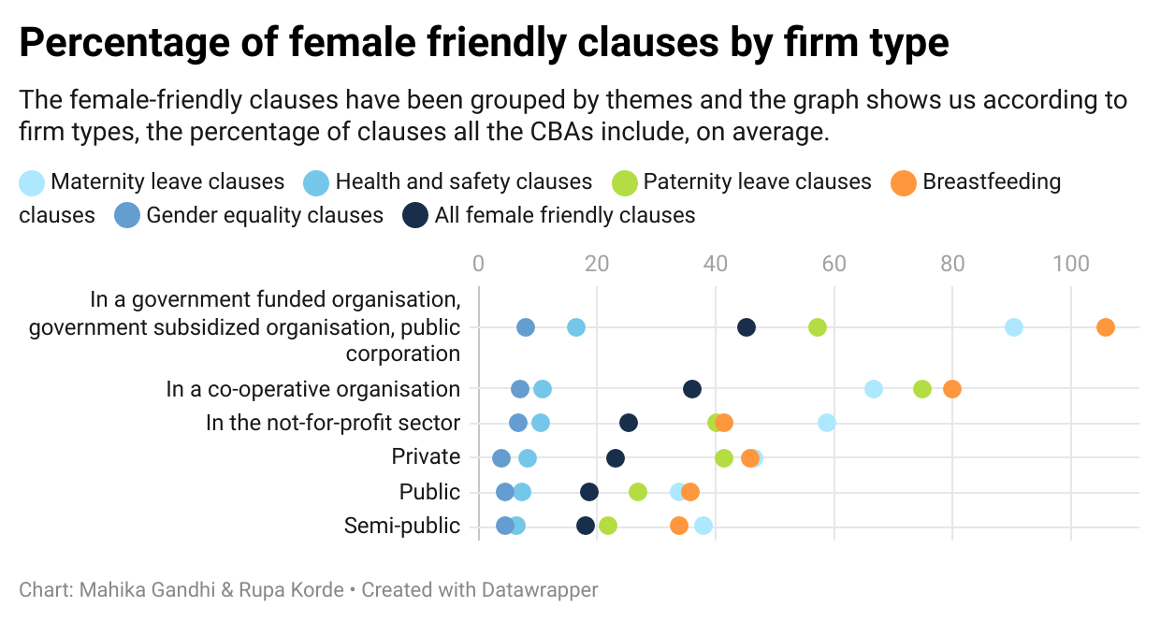
Percentage of female-clauses by Firm-type
Collective bargaining agreements (CBAs) in government-funded organizations stand out by having the highest percentage of female-friendly clauses, including more than 40% of female-friendly clauses.
However, all firms lack in terms of gender equality and health and safety clauses.

Slide 44
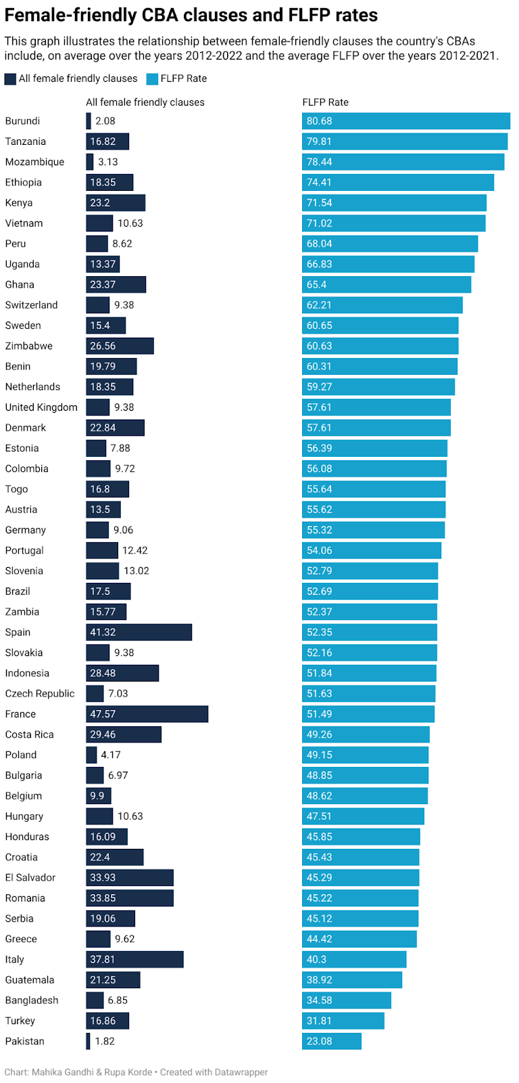
Female Labour Force Participation Rate and Female-friendly CBA Clauses
There is no significant correlation between average FLFPRs and the presence of female-friendly clauses within CBAs.
This suggests that there might be other influential factors at play such as societal norms, educational opportunities, and economic conditions when it comes to determining FLFPRs (Klasen, 2019). While CBAs play a crucial role in shaping workplace policies and conditions, they do not encompass all industries and job sectors.

Slide 45
Conclusion
The analysis of 35 female friendly clauses in CBAs using the WageIndicator CBA database provides insights into gender equality and work/family balance status of 47 countries.
Most countries include maternity clauses in their CBAs, however African countries perform better in this aspect.
Breastfeeding clauses can be a factor affecting higher FLFPRs
All countries in question perform poorly on gender equality clauses
Overall, European countries include more female friendly clauses as compared to the other regions
However, this does not translate into improved FLFPRs
Future direction:
Individual CBA clauses tested for association with FLFPRs to identify the crucial CBA clauses affecting FLFPRs
Country-level assessment of sectoral and firm-type and its relationship with FLFPRs

Slide 46
Wage-setting in Collective Bargaining in Africa: Analyses using WageIndicator Database Prepared for “8th Conference of the Regulating for Decent Work Network” on Ensuring decent work in times of uncertainty 10-12 July 2023 Ernest Ngeh Tingum University of Namibia/WageIndicator Foundation

Slide 47
Overview of Collective bargaining
What is collective bargaining?
process of negotiation between employers and employees (representatives)
to determine the terms and conditions of employment
Wage-settings are important components of the bargaining having significant impact on labour market outcomes
Bargaining Process
Bhuller et al., (2022)
Decentralized level
Individual firms and workers determine wages
Centralized level
Employers negotiate with trade unions

Slide 48
Wage-setting and Collective Bargaining in Africa
Based on WI data few countries have centralized wage settings
21.9% of agreement are multiple enterprise bargaining
Most systems are decentralized
Believe to allow for more negotiation at the local level
However, there is a lack of empirical research on the effectiveness of these systems in Africa
relates to lack of data on CBAs
Addressing issues of inequality and social justice at work place

Slide 49
Few empirical research in Africa
Besamusca and Tijdens (2015).
Two databases with collective agreement text Africa
AGREED of SA Labour Research Service (LRS,2022)
Wageindicator CBAs (WI, 2023)
Objective:
comprehensively understand the content of agreements with respect pay-settings and related financial benefits
“Very little is known about what exactly is agreed in these collective bargaining agreements”

Slide 50
Issues addressed and Methodology
Issues addressed
Methodology
Apart from wages, what other financial benefits are agreed within the agreements?
How important are the sectors of industry in wage settings?
How important are sectors of industry in wage level determination?
First, apply descriptive statistics to analyse additional financial benefits
Second, the logistic model applied to the trigger question “Does the agreement have clauses on wages [YES/NO]?”.
Third, the multinomial logit model is applicable to the question, “Where are the wages determined [INDIVIDUAL LEVEL/COMPANY LEVEL /SECTORIAL LEVEL/ ELSEWHERE]?”.

Slide 51
Collective Bargaining agreements per country
Country | Number | Number of agreements Ratified | Number of agreements signed in the Private Sector | Single Enterprise bargaining agreements | Language of the agreement
Burundi | 19 | 17 | 2 | 18 | French
Benin | 23 | 19 | 10 | 18 | French
Ethiopia | 66 | 53 | 66 | 66 | English
Ghana | 38 | 25 | 33 | 38 | English
Guinea | 1 | 1 | 1 | 0 | French
Kenya | 90 | 7 | 89 | 78 | English
Lesotho | 5 | 1 | 5 | 4 | English
Madagascar | 13 | 6 | 12 | 9 | French
Malawi | 3 | 1 | 3 | 2 | English
Mozambique | 11 | 7 | 10 | 11 | Portuguese
Niger | 7 | 4 | 3 | 4 | French
Rwanda | 4 | 3 | 3 | 4 | English
Senegal | 28 | 22 | 23 | 3 | French
Sierra Leone | 2 | 2 | 1 | 0 | English
South Africa | 3 | 1 | 3 | 2 | English
Zimbabwe | 10 | 4 | 10 | 0 | English
Togo | 16 | 5 | 13 | 1 | French
Uganda | 29 | 12 | 25 | 19 | English
Tanzania | 34 | 22 | 33 | 32 | English
Zambia | 22 | 18 | 10 | 22 | English
Total | 424 | 230 (54.2%) | 355 (83.7%) | 331 (78.1%)

Slide 52
Share of collective agreements that include additional financial benefits clauses per country (%)
Country | No | Maternity Pay | Disability pay | Severance Pay | Health Insurance pay | Yearly Bonus | Eveningg Premium | Standby or on-call Premium | Extra Leave premium | Overtime premium | Hardship premium | Sunday Premium | Transport Allowance | Seniority Allowance
Burundi | 19 | 15.79 | 80 | 15.79 | 25 | 35.71 | 14.29 | 0 | 7.14 | 35.71 | 0 | 0 | 21.43 | 28.57
Benin | 23 | 39.13 | 88.89 | 73.91 | 60.87 | 31.82 | 52.38 | 0 | 47.62 | 86.36 | 40.91 | 45.45 | 63.64 | 22.73
Ethiopia | 66 | 90.91 | 44.44 | 51.52 | 31.91 | 27.78 | 5.41 | 2.7 | 0 | 54.29 | 2.78 | 16.22 | 29.73 | 0
Ghana | 38 | 84.21 | 77.14 | 94.74 | 84.21 | 81.08 | 62.16 | 43.24 | 8.11 | 83.78 | 11.11 | 66.67 | 45.95 | 64.86
Guinea | 1 | 0 | 100 | 100 | 100 | 100 | 100 | 0 | 0 | 100 | 100 | 100 | 0 | 100
Kenya | 90 | 84.44 | 59.55 | 95.56 | 27.27 | 23.86 | 35.23 | 1.16 | 86.05 | 100 | 2.35 | 74.12 | 29.76 | 11.63
Lesotho | 5 | 0 | 0 | 0 | 0 | 0 | 0 | 0 | 0 | 0 | 0 | 0 | 0 | 0
Madagascar | 13 | 76.92 | 69.23 | 46.15 | 38.46 | 46.15 | 53.85 | 0 | 38.46 | 76.92 | 7.69 | 53.85 | 30.77 | 53.85
Malawi | 3 | 0 | 0 | 0 | 0 | 100 | 0 | 0 | 0 | 0 | 0 | 0 | 100 | 0
Mozambique | 11 | 0 | 80 | 100 | 36.36 | 70 | 50 | 0 | 30 | 63.64 | 9.09 | 10 | 63.64 | 18.18
Niger | 7 | 57.14 | 71.43 | 71.43 | 42.86 | 42.86 | 0 | 14.29 | 14.29 | 71.43 | 14.29 | 28.57 | 71.43 | 85.71
Rwanda | 4 | 75 | 100 | 25 | 33.33 | 50 | 0 | 0 | 50 | 50 | 0 | 0 | 25 | 0
Senegal | 28 | 21.43 | 80 | 96.43 | 12.5 | 17.86 | 64.29 | 3.57 | 50 | 82.14 | 14.81 | 48.15 | 21.43 | 77.78
Sierra Leone | 2 | 100 | 50 | 100 | 100 | 100 | 100 | 0 | 100 | 100 | 100 | 100 | 50 | 50
South Africa | 3 | 100 | 50 | 0 | 100 | 66.67 | 33.33 | 66.67 | 0 | 33.33 | 0 | 0 | 33.33 | 33.33
Zimbabwe | 10 | 100 | 80 | 80 | 77.78 | 75 | 40 | 0 | 10 | 90 | 0 | 40 | 60 | 20
Togo | 16 | 50 | 100 | 87.5 | 64.29 | 53.33 | 60 | 0 | 13.33 | 86.67 | 13.33 | 60 | 73.33 | 80
Uganda | 29 | 37.93 | 78.57 | 44.83 | 50 | 25.93 | 17.86 | 7.14 | 26.92 | 39.29 | 3.57 | 21.43 | 25.93 | 25
Tanzania | 34 | 44.12 | 66.67 | 67.65 | 57.58 | 38.71 | 35.48 | 9.68 | 70.97 | 70 | 3.23 | 41.94 | 58.06 | 51.61
Zambia | 22 | 63.64 | 42.86 | 54.55 | 43.75 | 50 | 20 | 5 | 55 | 75 | 20 | 70 | 40 | 40
Total | 424 | 62.74 | 66.57 | 67.92 | 44.35 | 39.51 | 36.76 | 7.59 | 43.29 | 76.36 | 9.29 | 47.81 | 39.78 | 34.42

Slide 53
Descriptive statistics of variables
 | Frequency | Mean | S.D. | Min | Max
Dependent Variables
Wage trigger
Yes | 374 | 0.882 | 0.323 | 0 | 1
No | 50 | 0.118 | 0.323 | 0 | 1
Level of wage determination
Individual level | 190 | 0.636 | 0.482 | 0 | 1
Company level | 31 | 0.104 | 0.305 | 0 | 1
Sectoral level | 32 | 0.107 | 0.309 | 0 | 1
Elsewhere ( state, regional…) | 78 | 0.154 | 0.361 | 0 | 1
Independent Variables
Ratified collective Bargaining | 230 | 0.542 | 0.499 | 0 | 1
Private sector Bargaining | 355 | 0.837 | 0.369 | 0 | 1
Single Employer Bargaining | 331 | 0.789 | 0.408 | 0 | 1
English collective Bargaining | 306 | 0.722 | 0.449 | 0 | 1
Manufacturing Sector | 134 | 0.321 | 0.467 | 0 | 1
Agriculture and forestry sector | 62 | 0.148 | 0.356 | 0 | 1
Construction sector | 26 | 0.062 | 0.242 | 0 | 1
Transportation and Storage | 38 | 0.091 | 0.288 | 0 | 1
Accommodation and food service | 29 | 0.069 | 0.254 | 0 | 1
Financial and Insurance | 37 | 0.089 | 0.284 | 0 | 1
Public Administration and defence | 20 | 0.046 | 0.209 | 0 | 1
Education sector | 22 | 0.053 | 0.223 | 0 | 1
Social work and other services | 27 | 0.065 | 0.246 | 0 | 1

Slide 54
Sectoral impact and wage setting in collective agreements: Probability of inclusion of wage clauses in agreements
Variables | (1) | (2) |  | (3) | (4) |  | (5) | (6)
 | Coefficients |  |  | Marginal effects |  |  | Marginal effects (at mean)
CBA Ratified | 0.997*** | 0.987*** |  | 0.0886*** | 0.0891*** |  | 0.0669*** | 0.0676***
 | (0.380) | (0.379) |  | (0.0336) | (0.034) |  | (0.0254) | (0.0256)
Single Employer | -1.182* | -1.115* |  | -0.1051* | -0.1006* |  | -0.0794* | -0.0763*
 | (0.643) | (0.649) |  | (0.0573) | (0.0586) |  | (0.041) | (0.0418)
English countries | 1.704*** | 1.880*** |  | 0.1516*** | 0.1696*** |  | 0.1145*** | 0.1286***
 | (0.599) | (0.591) |  | (0.0529) | (0.053) |  | (0.0371) | (0.0368)
Private sector | 1.291* |  |  | 0.1148* |  |  | 0.0867*
 | (0.746) |  |  | (0.0661) |  |  | (0.0501)
Manufacturing | 0.507*** | 0.583** |  | 0.0451*** | 0.0526** |  | 0.0341*** | 0.0399**
 | (1.086) | (1.086) |  | (0.0967) | (0.0981) |  | (0.0727) | (0.0741)
Agriculture | -1.426* | -1.489* |  | -0.1268* | -0.1344* |  | -0.0957* | -0.1019*
 | (1.091) | (1.089) |  | (0.097) | (0.0982) |  | (0.073) | (0.0742)
Construction | 2.259** | 2.201* |  | 0.2009** | 0.1986* |  | 0.1517** | 0.1506*
 | (1.145) | (1.141) |  | (0.1013) | (0.1024) |  | (0.0771) | (0.0781)
Transportation | -0.918 | -0.952 |  | -0.0817 | -0.0859 |  | -0.0617 | -0.0652
 | (1.173) | (1.172) |  | (0.1044) | (0.1058) |  | (0.0785) | (0.0799)
Accommodation | -0.56 | -0.636 |  | -0.0498 | -0.0574 |  | -0.0376 | -0.0436
 | (1.207) | (1.206) |  | (0.1075) | (0.1089) |  | (0.0808) | (0.0822)
Financial sector | 0.263*** | 0.025*** |  | 0.0234*** | 0.0022*** |  | 0.0176*** | 0.0017***
 | (1.282) | (1.273) |  | (0.114) | (0.1149) |  | (0.0861) | (0.0871)
Public Admin | -3.474** | -2.459* |  | -0.3090** | -0.2219* |  | -0.2333** | -0.1683**
 | (1.398) | (1.267) |  | (0.124) | (0.1142) |  | (0.0908) | (0.0842)
Education sector | -2.749** | -2.239* |  | -0.2445** | -0.2020* |  | -0.1846** | -0.1532*
 | (1.258) | (1.213) |  | (0.1112) | (0.1093) |  | (0.0836) | (0.0816)
Social works | -1.112 | -0.972 |  | -0.0989 | -0.0877 |  | -0.0747 | -0.0665
 | (1.29) | (1.285) |  | (0.1148) | (0.116) |  | (0.0865) | (0.0876)
Constant | 7.403*** | 6.289***
 | (1.474) | (1.311)
Observations | 418 | 418 |  | 418 | 418 |  | 418 | 418

Slide 55
Sectors of Industry and wage level determination (Multinomial levels)
Variables |  | Model 1 |  |  |  |  |  | Model 2
 | (1) | (2) |  | (3) | (4) |  |  | (5) | (6) |  | (7) | (8)
 | Individual |  | Company | Sectoral |  | Elsewhere |  | Individual |  | Company | Sectoral | Elsewhere
CBA Ratified | 0.066*** |  | -0.034 | -0.015 |  | -0.017 |  | 0.066*** | -0.032 |  | -0.013 | -0.015
 | (3.166) |  | (2.179) | (1.325) |  | (2.450) |  | (3.166) | (5.954) |  | (3.537) | (6.216)
Single Employer | -0.019 |  | 0.056*** | -0.045 |  | 0.009 |  | -0.019 | 0.050*** |  | -0.041 | 0.006
 | (5.361) |  | (3.555) | (4.002) |  | (1.199) |  | (5.361) | (9.214) |  | (11.190) | (2.551)
English countries | 0.172 |  | -0.134 | -0.058 |  | 0.020 |  | 0.172 | -0.124 |  | -0.051 | 0.019
 | (9.803) |  | (8.564) | (5.206) |  | (2.759) |  | (9.803) | (23.014) |  | (13.791) | (7.871)
Private sector | 0.055*** |  | 0.015*** | 0.008 |  | 0.031
 | (4.119) |  | (1.010) | (0.754) |  | (4.323)
Manufacturing | 0.031** |  | 0.005** | 0.020 |  | 0.016 |  | 0.031** | 0.004** |  | 0.018 | 0.013
 | (2.641) |  | (0.314) | (1.814) |  | (2.175) |  | (2.641) | (0.802) |  | (4.921) | (5.645)
Agriculture and forestry | -0.003 |  | -0.028 | 0.013 |  | 0.019 |  | -0.003 | -0.030 |  | 0.011 | 0.016
 | (3.322) |  | (1.819) | (1.140) |  | (2.688) |  | (3.322) | (5.529) |  | (2.848) | (6.803)
Construction and mining | 0.302* |  | 0.002* | -0.323 |  | 0.019 |  | 0.302* | 0.002* |  | -0.330 | 0.013
 | (10.337) |  | (0.463) | (10.444) |  | (2.692) |  | (10.337) | (0.681) |  | (16.304) | (5.383)
Transportation | 0.156 |  | 0.046 | 0.016 |  | -0.217 |  | 0.156 | 0.041 |  | 0.013 | -0.206
 | (1.633) |  | (2.998) | (1.459) |  | (1.235) |  | (1.633) | (7.893) |  | (3.710) | (4.546)
Accommodation | 0.028 |  | -0.037 | 0.013 |  | -0.004 |  | 0.028 | -0.034 |  | 0.012 | -0.003
 | (2.624) |  | (2.374) | (1.164) |  | (0.512) |  | (2.624) | (6.350) |  | (3.208) | (1.097)
Financial and insurance | 0.016*** |  | 0.006* | 0.028 |  | -0.006 |  | 0.016** | 0.011** |  | 0.024 | -0.008
 | (2.546) |  | (0.410) | (2.493) |  | (0.826) |  | (2.546) | (2.036) |  | (6.397) | (3.547)
Public Admin and defence | 0.823 |  | -0.663 | 0.016* |  | -0.176 |  | 0.823 | -0.714 |  | 0.008* | -0.184
 | (4.415) |  | (3.758) | (1.786) |  | (2.739) |  | (4.415) | (1.434) |  | (3.213) | (7.393)
Education | -0.019 |  | -0.048 | 0.039** |  | 0.028* |  | -0.019 | -0.054 |  | 0.031** | 0.010*
 | (5.829) |  | (3.047) | (3.500) |  | (3.864) |  | (5.829) | (10.079) |  | (8.349) | (4.121)
Social work and services | -0.031 |  | -0.007 | 0.017 |  | 0.022 |  | -0.031 | -0.013 |  | 0.013 | 0.014
 | (3.199) |  | (0.470) | (1.486) |  | (3.063) |  | (3.199) | (2.496) |  | (3.384) | (6.150)
Observations | 295 |  | 295 | 295 |  | 295 |  | 295 | 295 |  | 295 | 295

Slide 56
Discussion and Conclusion
agreements in the manufacturing, financial and insurance, mining and construction sectors are more likely to include provisions related to wages
Same as those from English countries and private sector
education, public administration and defence sectors are mostly set by the state
financial and manufacturing sectors, wages are set in individual contracts
most agreements included clauses on maternity pay and yearly bonus.
Agreements from Guinea and Sierra Leone guarantee a majority of these premiums and allowances
Ghana, Kenya, Senegal, Uganda, Tanzania and Zambia (mostly English-speaking countries) are the only countries where all the premiums and allowances are sometimes awarded
Recommendation for future research: analyse the agreements that have fixed both wage scales and low/minimum wages as well as show how wage in collective bargaining agreements are compared to decent wages

Slide 57
Thank You
Comments and Suggestions

Slide 58


Understanding Collective Bargaining Agreements In Turkey
Prepared for “8th Conference of the Regulating for Decent Work Network”
on Ensuring decent work in times of uncertainty
10-12 July 2023
Asst. Prof. Dr.Ceyhun GÜLER
Dokuz Eylul University
Department of Labour Economics & Industrial Relations

Slide 59



Two different collective bargaining regimes
For workers
Law No. 6356
For civil servants
Law No. 4688

Slide 60


For workers Law No. 6356 | For civil servants Law No. 4688
Workplace or enterprise level | Sectoral or national level
Group collective bargaining agreement | Service branches
Cover trade union member workers (Solidarity Fee) | Cover all civil servants
Scope and Level of Collective Bargaining Agreement

Slide 61
Duration of collective agreements
For workers
Law No. 6356
1-3 Years
For civil servants
Law No. 4688
2 years
The vast majority of CBAs, which annotated through the Cobra System, are for 2 years.

Slide 62


For workers
Law No. 6356
Industry threshold
Enterprise threshold
Workplace thresold
Collective agreement signing authority
For civil servants
Law No. 4688
Trade union confederation with the highest number of members
Trade union with the highest number of members

Slide 63

Turkish WageIndicator CBA Database
69 CBAs for which annotations were entered within the COBRA system (25 of the cover civil servants/ 44 of them cover workers)
CBAs concluded for civil servants are excluded from the scope in order to make a sound evaluation
There is no significant difference between the renewed CBA and the expired CBA in terms of the provisions

Slide 64



14 of these CBAs belong to private sector and 14 of them belong to public and semi-public.
11 of these CBAs were signed after 2020.
8 belong to the energy sector
5 to transportation, 9 to Commerce Bureau Education, 3 to general industry
1 to metal, 1 to food industry and 1 to communication sector
Total of 28 CBAs for which explanations were entered into the COBRA system.

Slide 65



JOB DESCRIPTION OR JOB CLASSIFICATION SYSTEM
11 OF 28 CBAS INCLUDE
JOB DESCRIPTION WAS INCLUDED IN ONLY ONE CBA
JOB CLASSIFICATION WAS INCLUDED IN 10 CBAS
TRAINING AND APPRENTICESHIP
TRIAL PERIOD
27 OF 28 CBAS INCLUDE A TRIAL PERIOD
2-4 MONTHS
3 OF THESE CBAS HAD A TRIAL PERIOD OF 120 DAYS, 9 OF THEM 30 DAYS, 5 OF THEM 60 DAYS AND 10 OF THEM 90 DAYS OF TRIAL PERIOD.
16 OF 28 CBAS INCLUDE
TRAINING IN ALL OF THE 16 CBAS
ONLY 7 OF THEM MENTIONED APPRENTICESHIP

Slide 66

5 of 28
Social security and pension
24 of 28
Sickness and disability
1 of 28
Employer's contribution regarding health insurance
Note: Considering the legal framework regarding working life and the right to social security in Turkey, it should be underlined that all insured workers are covered by health insurance.

Slide 67




Working hours
8 hours a day is common in general
Weekly working hours are accepted as 45 hours in the majority
27 CBAs include compensation for overtime work
In case of working on Sundays, premium is given in 13 CBAs

Slide 68


Four half-months for a two-year CBA
WAGES
Increases by seniority
Consumer price indexes and inflation

Slide 69
Occupational health and safety
Seri 1
Seri 2
Occupational health and safety trainings
Health and safety clauses related to pregnancy
0
10
20
30

Slide 70

REGULATIONS ON SOCIAL RIGHTS
PAID ALLOWANCES
AIDS AND ASSISTANCES
GENDER
Education
Military
Marriage
Maternity
Paternity
Death of Relatives
Fuel
Funeral
Travel
Disability
Clothing
Breast Feeding Rooms
Nursery
Discrimination at work

Slide 71

Thanks for your Attention

Slide 72
Collective Bargaining After Labour Law Reform in Indonesia A National-Level Analysis on the WageIndicator Collective Bargaining Agreement Database Prepared for “8th Conference of the Regulating for Decent Work Network” on Ensuring decent work in times of uncertainty 10-12 July 2023 Nadia Pralitasari WageIndicator Foundation

Slide 73
Collective Bargaining in Indonesia
“No Negotiations if No Legal Basis?”
Based on data published by the Ministry of Manpower, only 1.25% of the company had a registered Collective Bargaining Agreement (CBA) out of 1,247,660 companies that were listed in the Mandatory Labor Report application as of 31 December 2022
Low level of unionization (11%) limits trade union bargaining power
The existence of company's trade union does not guarantee a smooth CBA implementation process.
The normative legal framework serve as an upper limit in Indonesian CBA negotiations – become apparent after the passing of Omnibus Law
The Omnibus Law has led to significant increase in the duration of negotiation processes for CBAs - Employers seek to align their latest company CBA with the Omnibus Law while trade union safeguard the agreed upon CBA
What is the impact of Omnibus Law on the content of Collective Bargaining Agreement in Indonesia?

Slide 74

Labor Law Reform Changes in Indonesian Labor Law
The Indonesian Parliament passed the Job Creation Law (Law No. 11/2020) on November 2, 2020, known as Omnibus Law
On March 21, 2023, the House of Representatives passed an Act with the same title, Law No. 6/2023 on Job Creation
Labor Law No.13/2003 was amended by the Omnibus Law. While certain labor protection have improved, others have declined
Improvement | Regression
a. Compensation for contract workers upon termination
b. The legal consequences of the terms of a contract
Revision: Worker’s years of service is calculated from the date of fixed-term employment contract begin
c. Prohibition of probation period for contract workers
Revision: not only granted with permanent status, the probation period is counted as working period for the worker.
d. Employment termination notice
e. Unemployment benefit scheme
a. Fixed-term employment contracts period extended from 3 to 5 years
b. Removal the limitations to outsourcing certain types of work
c. Removal the legal consequences of outsourcing implementation violations that regulate worker employment relations with the outsourced company changed to the company providing the job.
d. Longer overtime hours
e. Removal the Sabbatical leave
f. Reduction termination compensation for permanent worker
g. Abolished the cost of the living survey on the minimum wage formula
h. Exemption of MSMEs workers receive a number of rights
i. Simplifies the recruitment of Foreign Workers which has the effect of competing with local employees

Slide 75
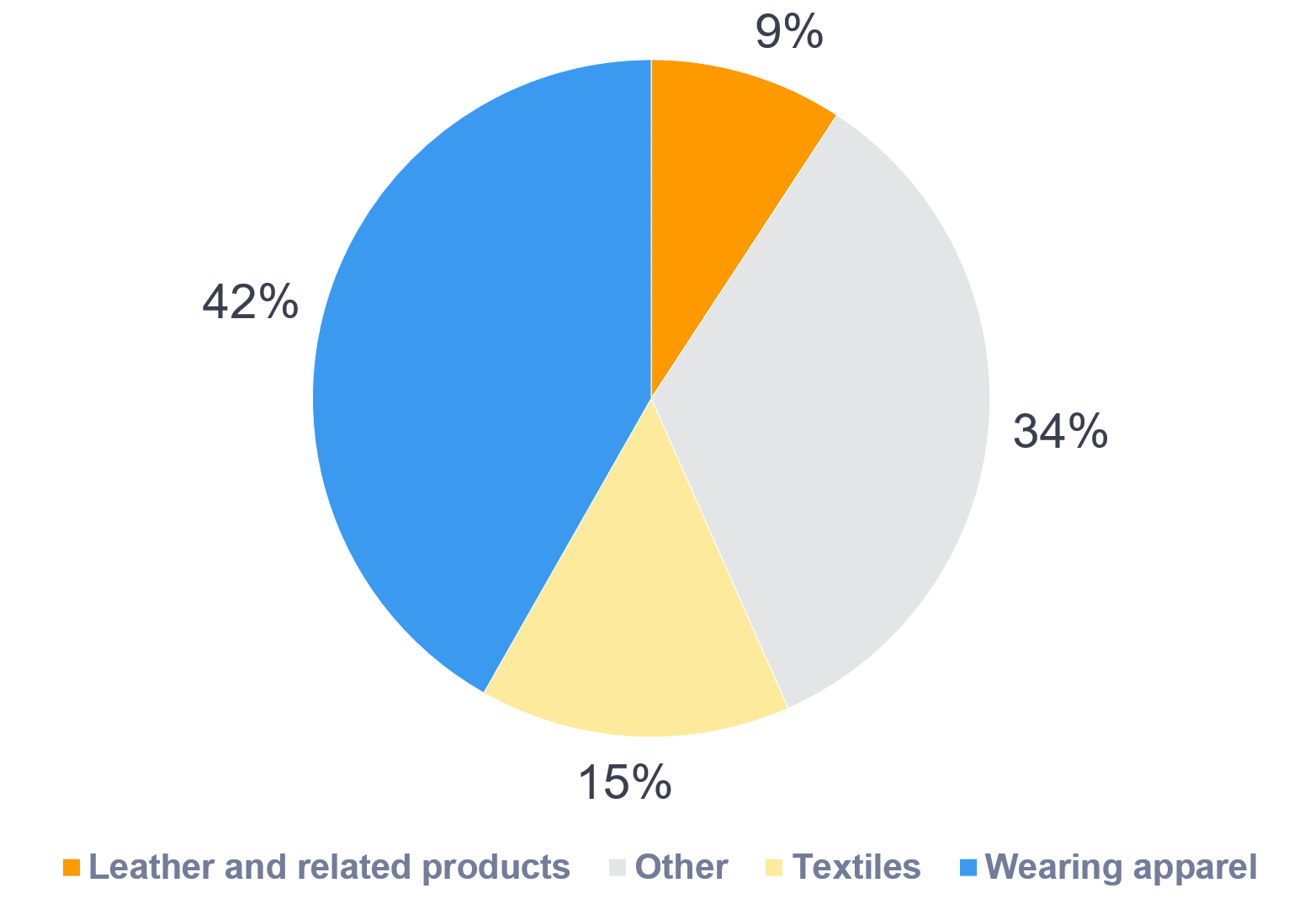
WageIndicator Collective Bargaining Agreement Database
The WageIndicator CBA Database lists 10 main topics that CBA contents cover:
Job titles,
Training,
Social Security & Pensions,
Employment Contracts,
Sickness and Disability,
Health and Medical Assistance,
Work-Family Balance Arrangements,
Gender Equality Issues,
Working Hours,
Wages
Sub-questions are used to analyze each main topic. This specific study analyzes 110 subtopics related to 10 main topics
In Indonesia, WageIndicator collects CBAs from trade union partners and request registered CBA at the local manpower department
A total of 249 CBAs are annotated and available in WageIndicator’s CBA Database.
Out of 249 CBAs in WageIndicator’s system, 164 CBAs are from wearing apparels (104 CBAs), textile (37 CBAs), leather and related products (23 CBAs)

Slide 76
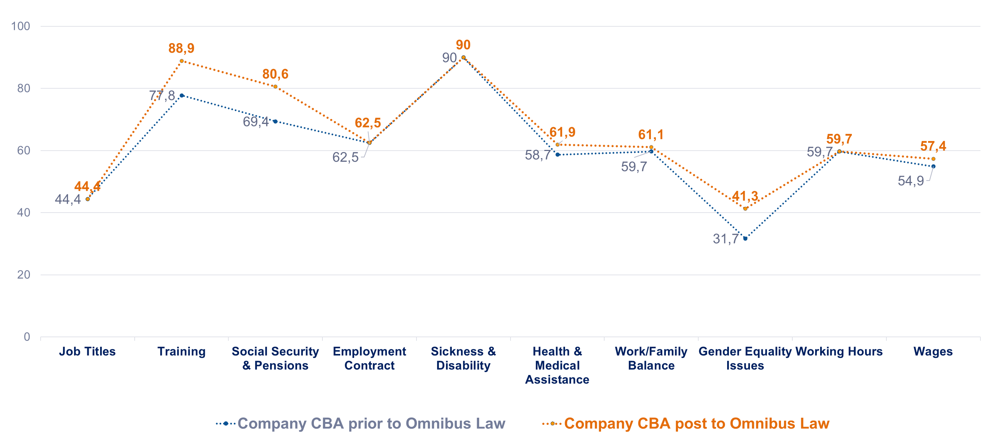
CBA Comparison Pre- and Post Omnibus Law Comparison on average % of each WageIndicator coded main topics in 9 renewed company Collective Bargaining Agreement content
Data compared 18 garment, textile, and footwear CBAs from 9 companies signed pre- and post the Omnibus Law - which become the focus of the paper
Improvement is measured by two main variables. First, new CBA clauses in unregulated areas. Second, the extent of provision enhancement, such as increasing annual leave days from 12 to 16
Training at 11.1%, gender equality at 9.6%, and social security & pensions at 11.2% show the greatest improvement
Topics that are improving most are either unaffected by the Omnibus Law or made possible by it

Slide 77
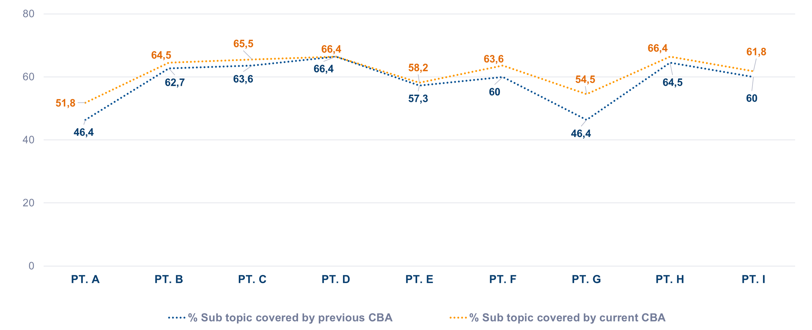
CBA Comparison Pre- and Post Omnibus Law Comparison on average % of all WageIndicator coded sub-topics of the 9 renewed company CBAs post and prior Omnibus Law, categorized by company
Before the Omnibus Law, all 9 companies CBAs covered 58% of the 110 WageIndicator subtopics, the figure improve to 61% after Omnibus Law
8 of the 9 company's CBAs have improve their CBA clauses and provisions. One CBA remain unchanged
Companies with lower starting positions in their CBAs have more potential to improve their CBA than those in top positions

Slide 78
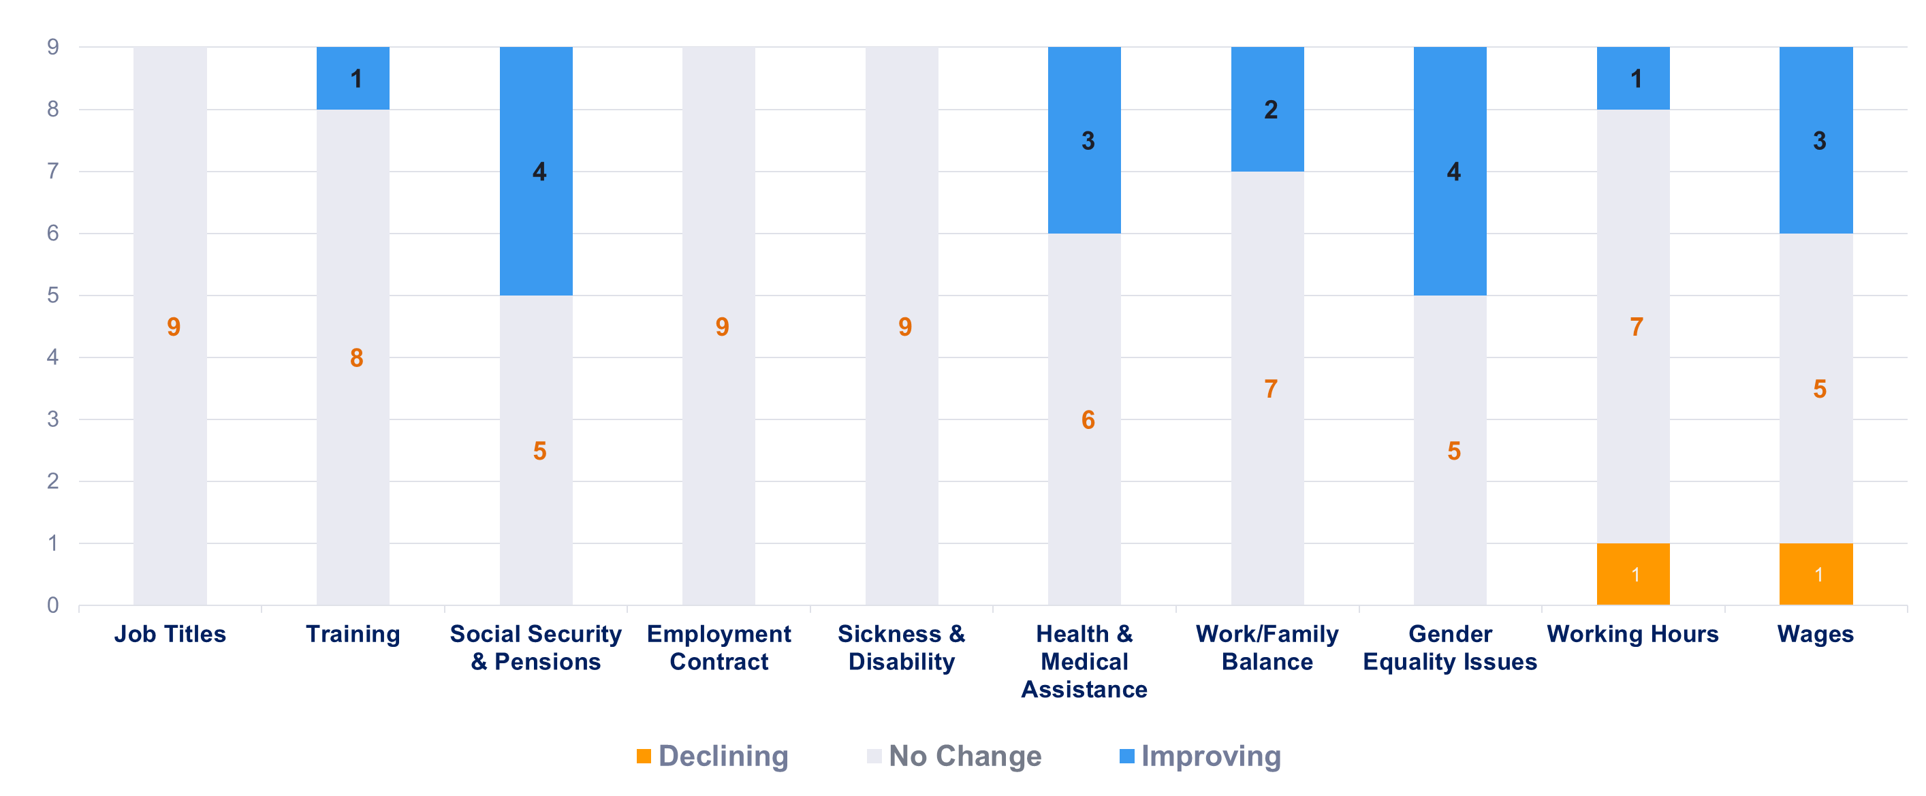
CBA Post Omnibus Law Number of companies that change the clauses and/or provision in their Collective Bargaining Agreement post Omnibus Law, categorized by coded main topics
1 company's CBA clauses/provisions decreased in the working hours and wages topics. However, 1 company improved working hours and 3 improved wages. 4 company enhanced gender equality, social security, and pension CBA clauses
Gender equality – adding clauses on discrimination, sexual harassment, and workplace violence, into their collective bargaining agreements
Health & medical assistance – adding clauses on COVID-19 pandemic, improve provision in protective clothing/gear and health insurance
Trade unions are negotiating for improvements to other clauses unaffected by the Omnibus Law in order to compensate the loss of other clauses

Slide 79
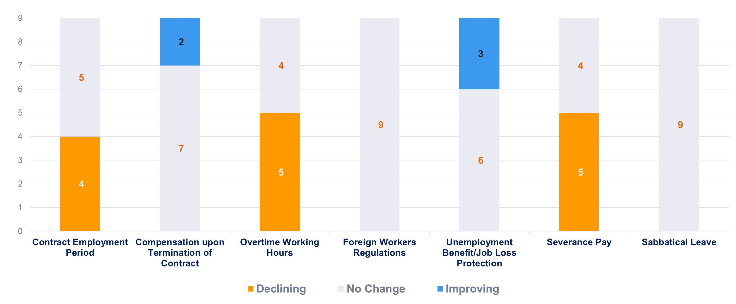
Impact of the amendment’s articles in the Omnibus Law on the content of CBA
Improving Articles in Omnibus Law
Only 2 of 9 companies CBA included contract worker termination compensation clauses in their CBAs
3 companies have included new clauses on unemployment benefits/job loss protection into their CBAs
Declining Articles in Omnibus Law
4 companies revised their CBA to comply with the Omnibus Law, which extends fixed-term contracts to five years
5 companies changed their CBAs to enable 4 hours of overtime per day and 18 hours per week instead of 14 hours per week
5 companies have decreased their CBA severance pay provision to comply with Omnibus Law

Slide 80
Conclusion
What is the impact of Omnibus Law on the content of
Collective Bargaining Agreement in Indonesia?
Omnibus Law has reduced CBA protections in companies, resulting longer overtime hours, less severance pay, and longer employment contract period
Companies with lower starting positions in their pre-Omnibus Law CBA had a substantial increase in their latest CBA clauses/provision compared to those in top positions
Trade unions are using gender equality, work-family, and other agreements to prevent Omnibus Law revisions from lowering their CBA clauses/provision
Shift in the interpretation of the CBA essence, national labor law serves as the normative legal basis as an upper provision
As a result of the Omnibus Law, CBA negotiations become difficult and take longer period due to trade unions' reliance on national labor law

Slide 81

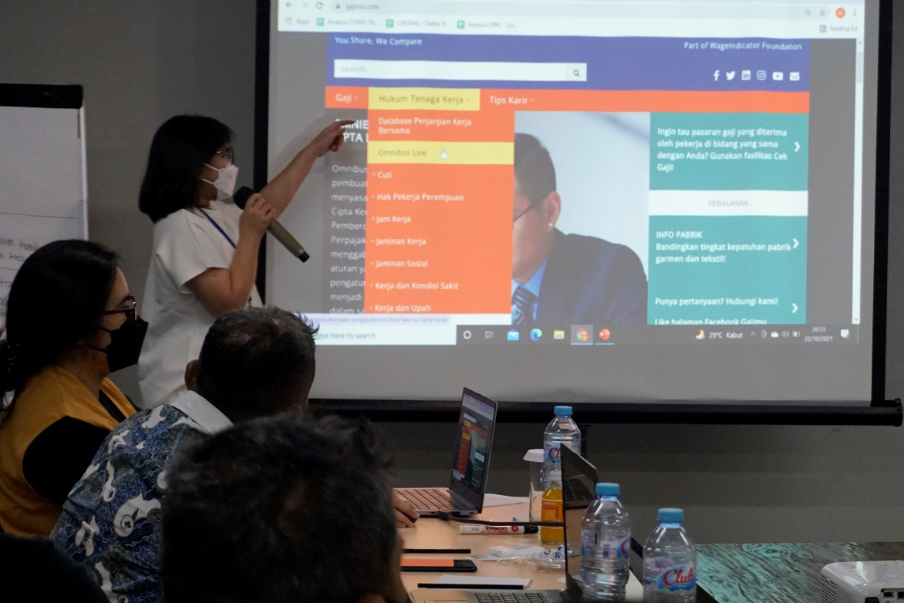
Contact Us
To learn more
www.gajimu.com/garment
Contact: gajimu@wageindicator.org

Slide 82

Thank you for your attention! Want to know more? Contact us at office@wageindicator.org
A WageIndicator side session at 8th Regulating for Decent Work ILO Conference 11 July 2023, Geneva

