Slide 1
KVSystem
The Austrian Collective Agreement Database

Slide 2
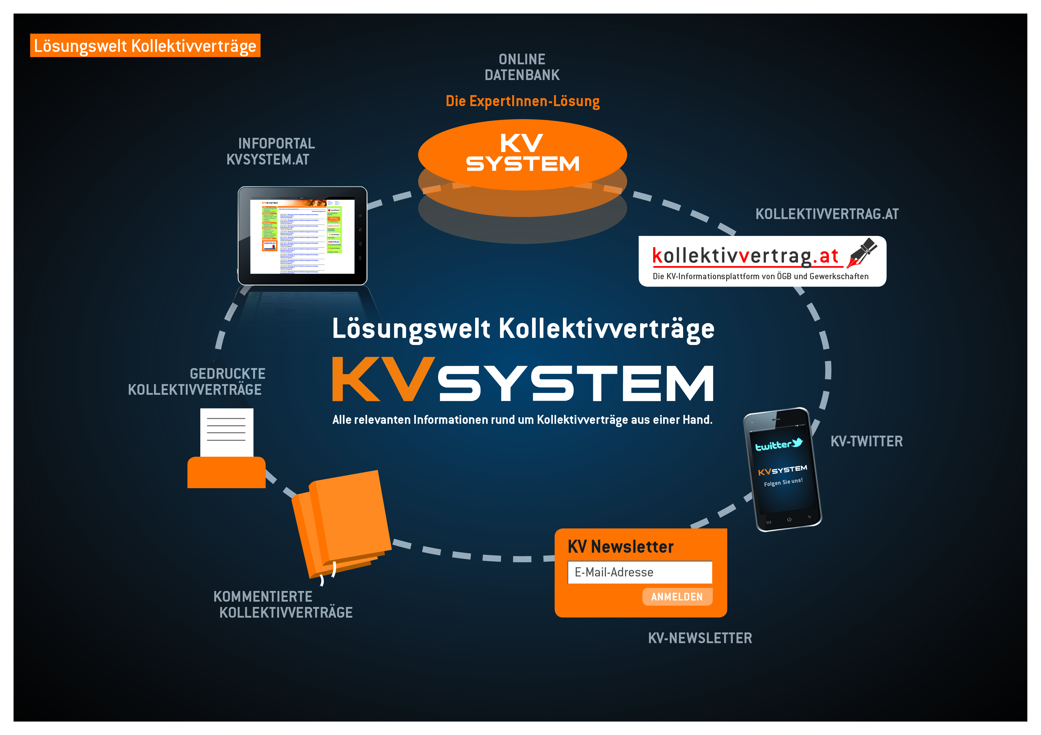

Slide 3
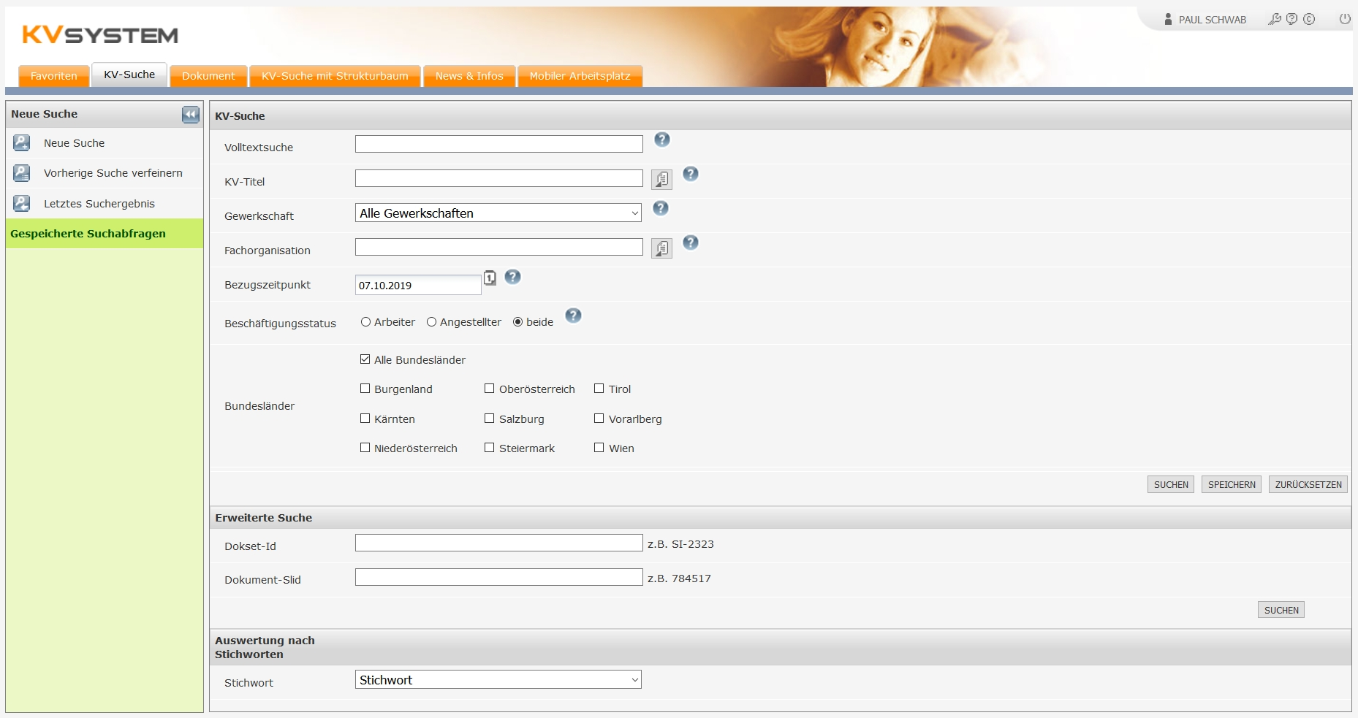
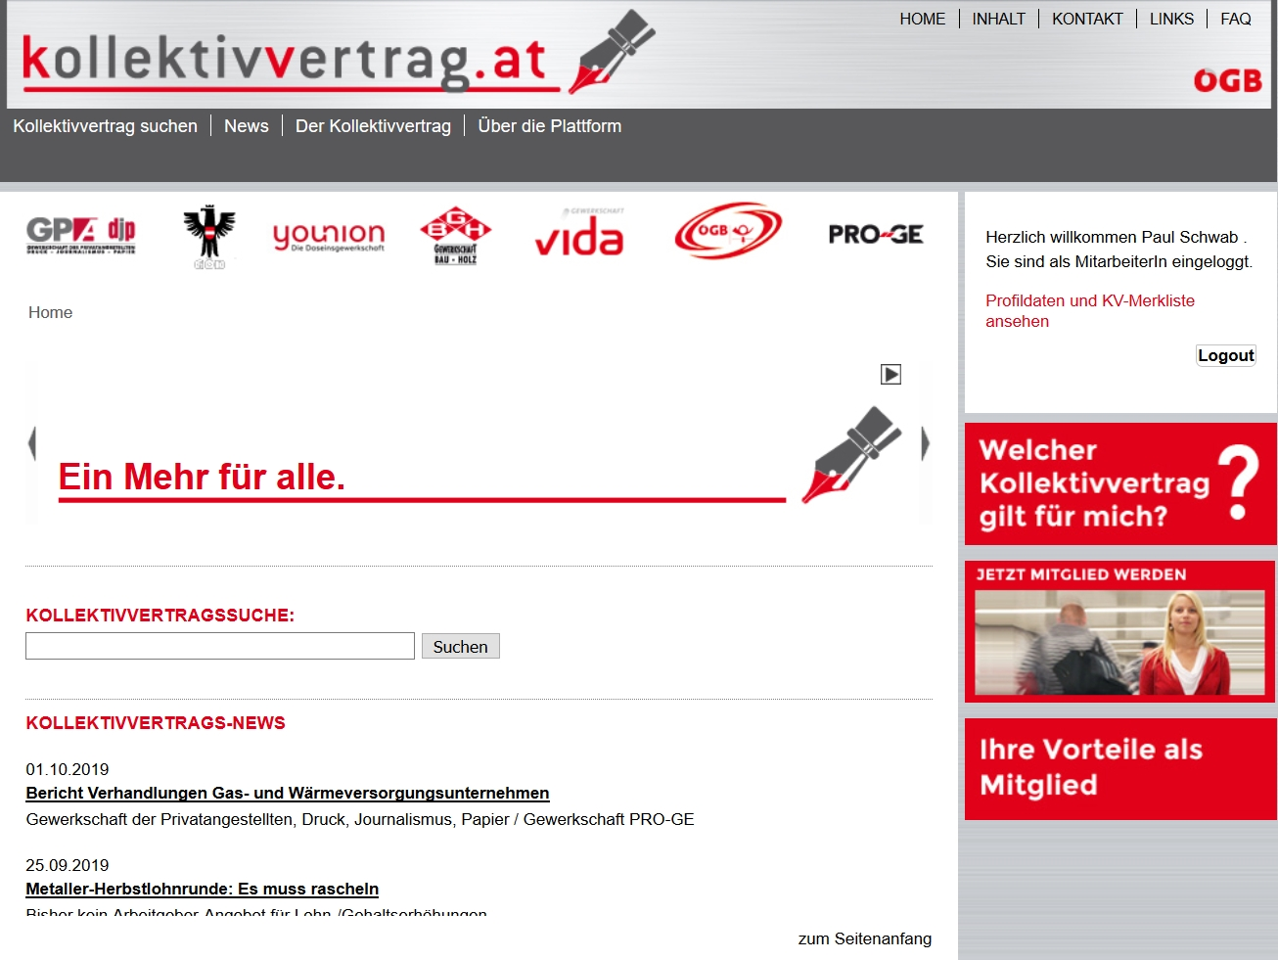

Slide 4


Target group: experts
Paid service
CLA of the past 25 years
Quicksearch, filters, metadata, notes
Target group: employee
Free
Current CLA
Quicksearch, notes (only for union members)

Slide 5
Historical outline
KVSystem - 1995
Driven by trade unions
  Availability in a central place
  Facilitate the legal advice
  Competition between representatives of employees and employers
kollektivvertrag.at – 2015
Driven by google
  Visibility in search engines
  Main source for collective agreements

Slide 6
Content (1)
Main content are Austrian collective agreements, that are negotiated on industry level.
Additional content:
  minimum wage rates
  homework contracts
  apprenticeships
  general collective agreements
  brief overview

Slide 7
Content (2)
As of November 2019 we have about 25,000 documents in our database
We cover in our database around 800 collective agreements
Per year around 800 new documents are added to the database
  Framework
  Supplements
  wages

Slide 8
Coded CBAs
XML
  content-reuse
Metadata
  Logic of database (connection of documents)
  Keywords/topics
  General Information (validation, regional affiliation, …)
Annotation
  wage data – can be read out automatically

Slide 9
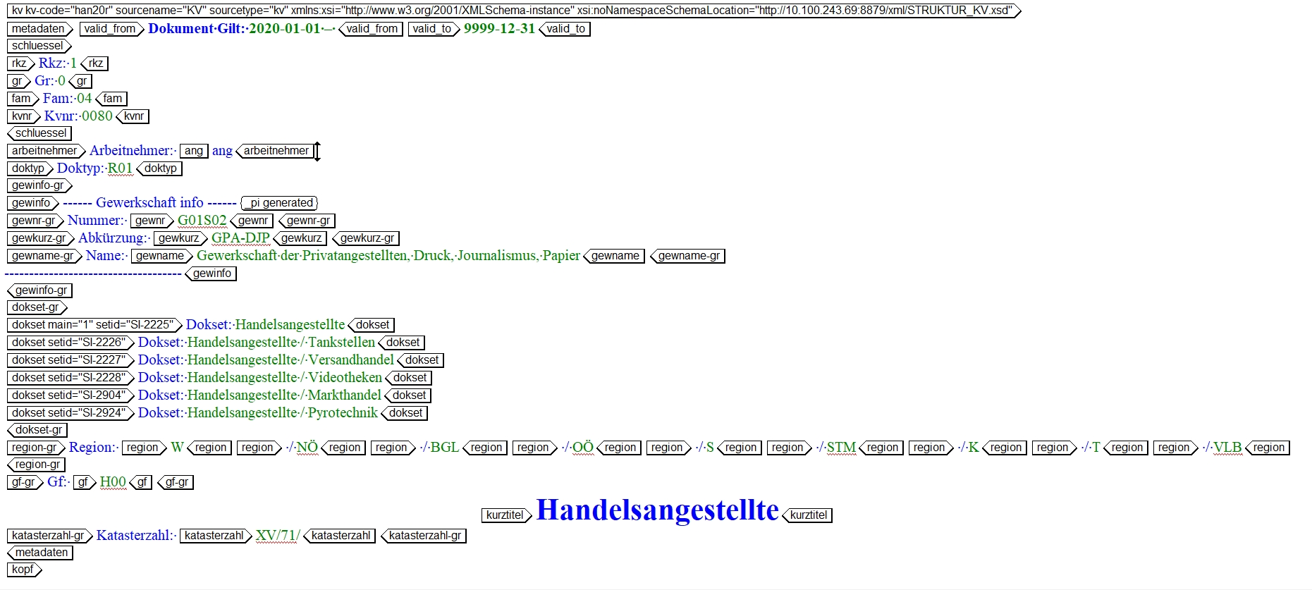
XML content (1)

Slide 10
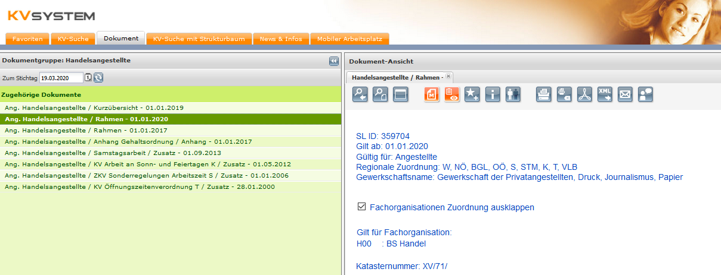
Metadata

Slide 11
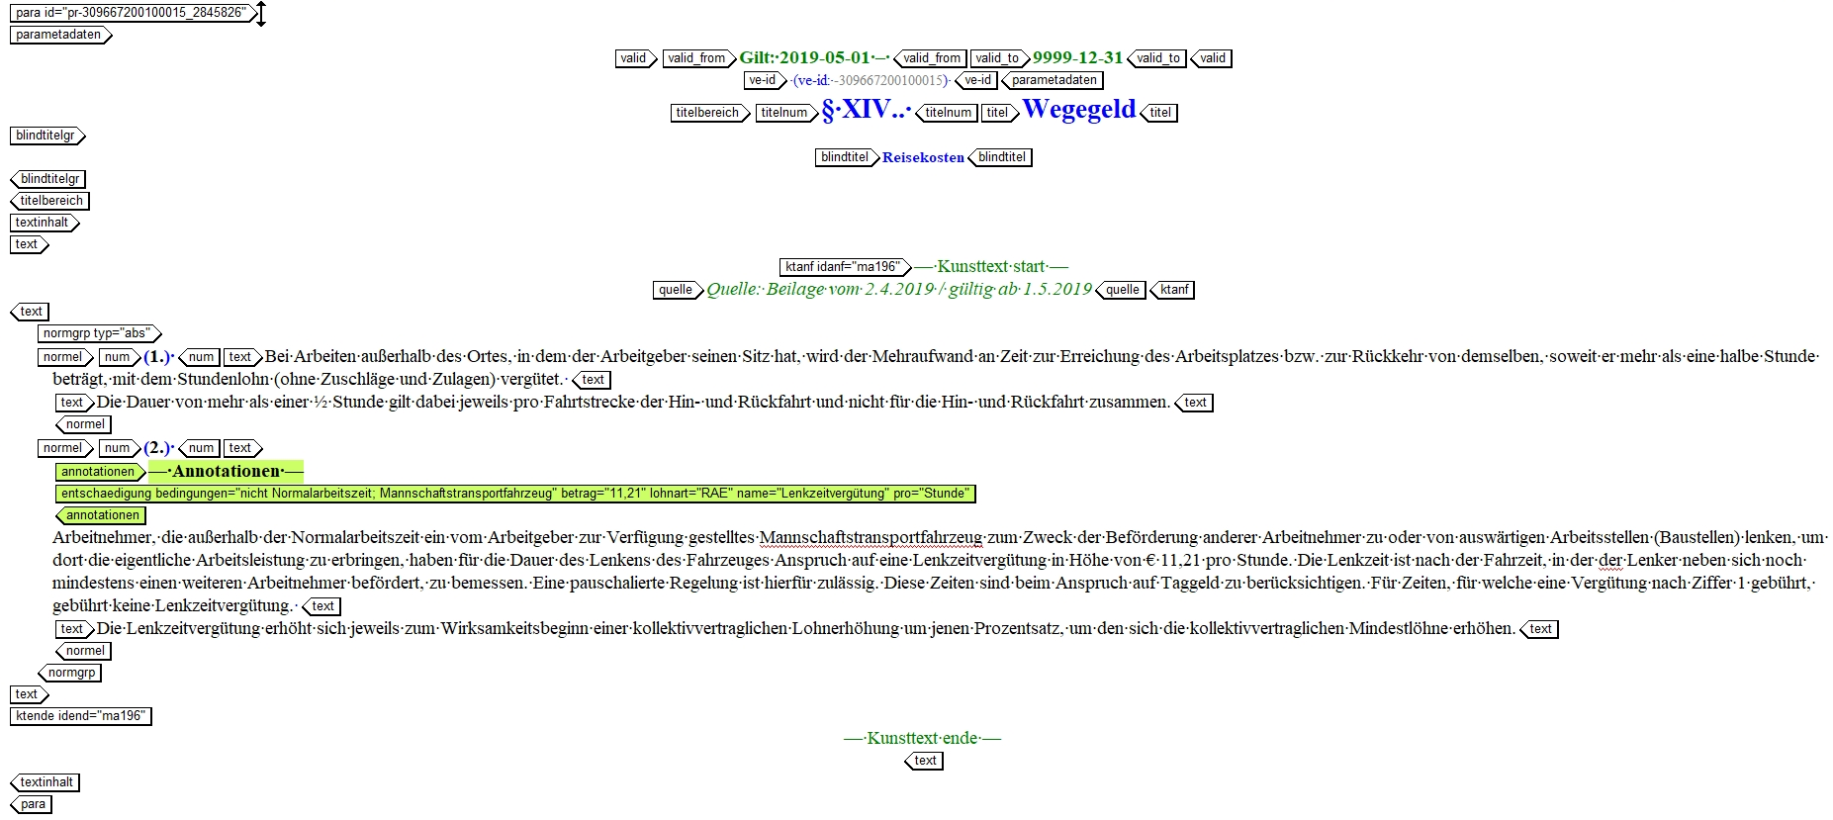
XML content (2)

Slide 12
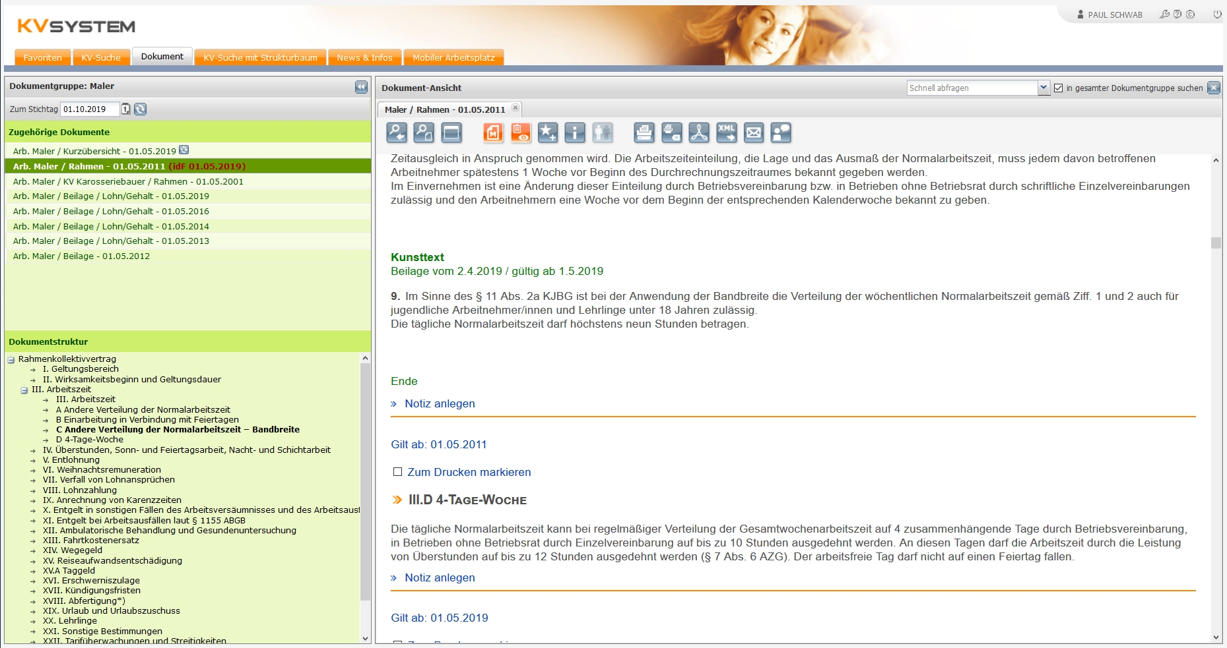
Consolidation

Slide 13
Keywords/topics
21 topics the user can choose from
  Main topics are:
    working hours, wages, allowances, extra pay, termination
Database searches through all valid documents of a collective agreement and creates a new document, where all the information are collected
Special case: historical wage tables
  In this case all the information regarding wage tables are collected from all documents over time. The result is a document with all available wage tables for this collective agreement

Slide 14
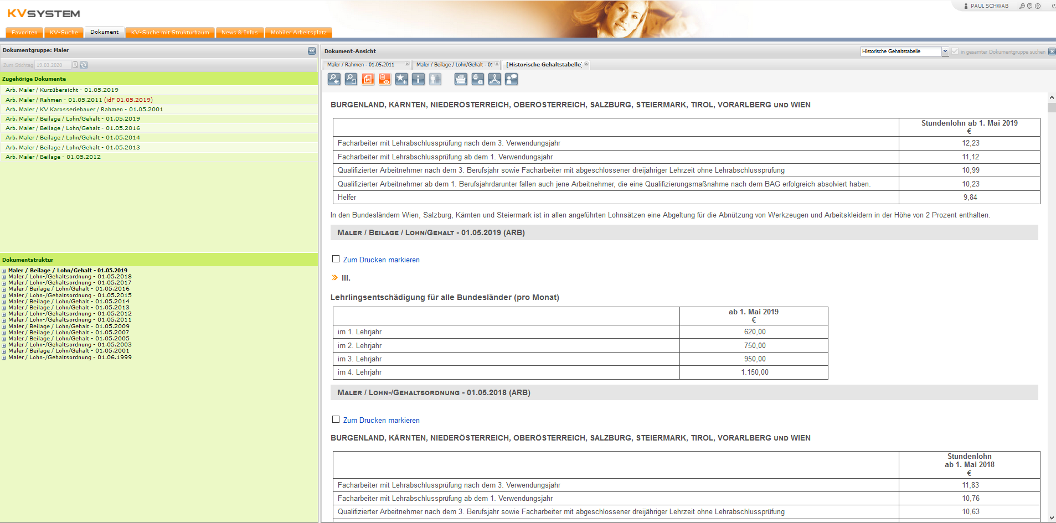
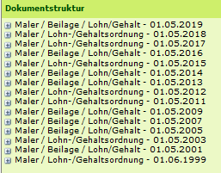
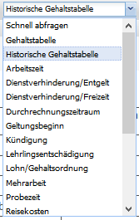
Quicksearch

Slide 15
CBAs of the last 25 years
goes back 25 years
  also some older collective agreements can be found
No possibility to compare the documents
  Exception: historical wage tables
  Ongoing Project
    We started to manually (editor) add the information if the content changed

Slide 16
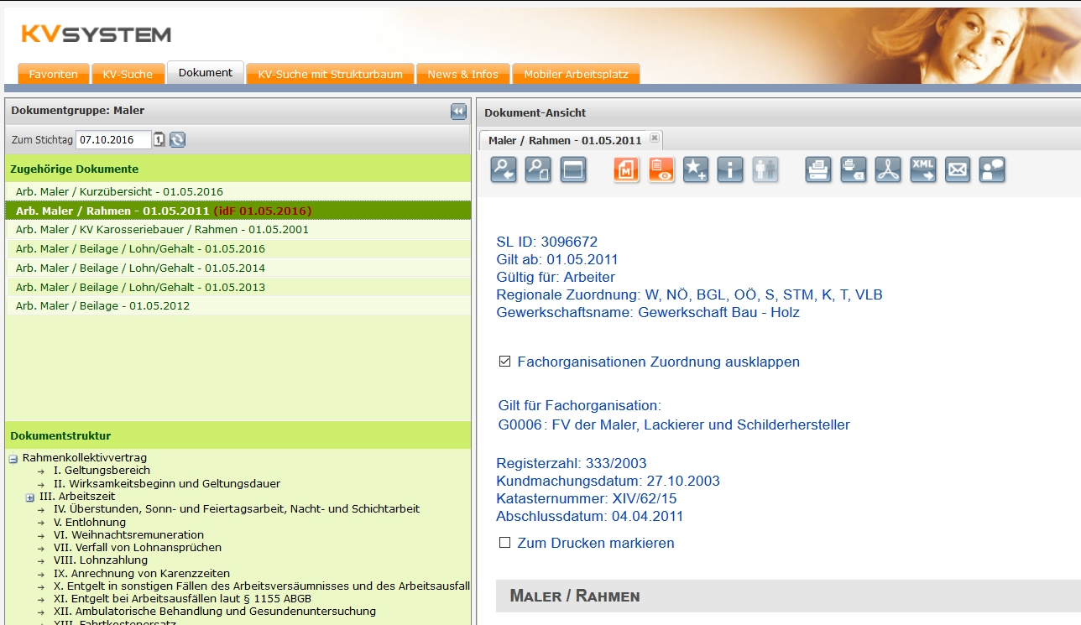
Historical data

Slide 17

project with the ministry of labor
plattform with information for posting workers in Austria
website is available in 7 languages
briew overview of 60 collective agreements
  czech
  slovak
  polish
  slovenian
  hungarian
  english

Slide 18
Thank you for your attention!

