Slide 1

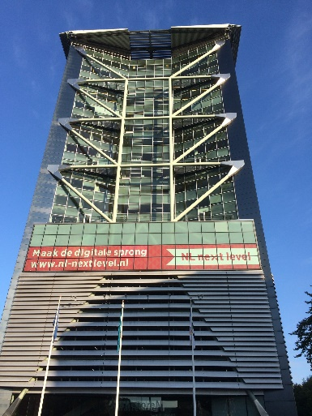
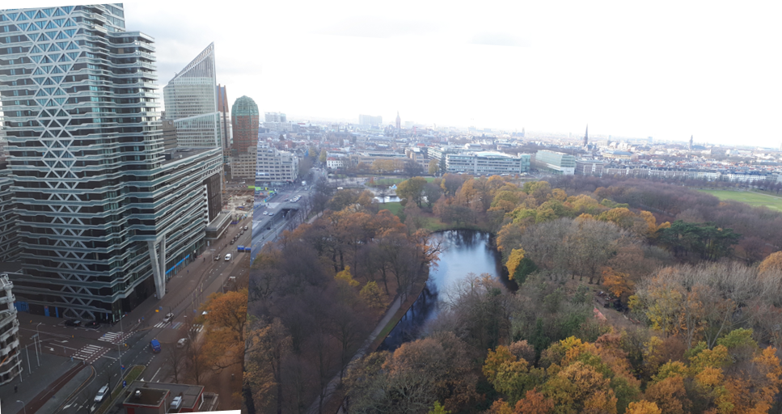
Who?
AWVN
Laurens Harteveld
L.Harteveld@awvn.nl
A000-1747378867-15890

Slide 2
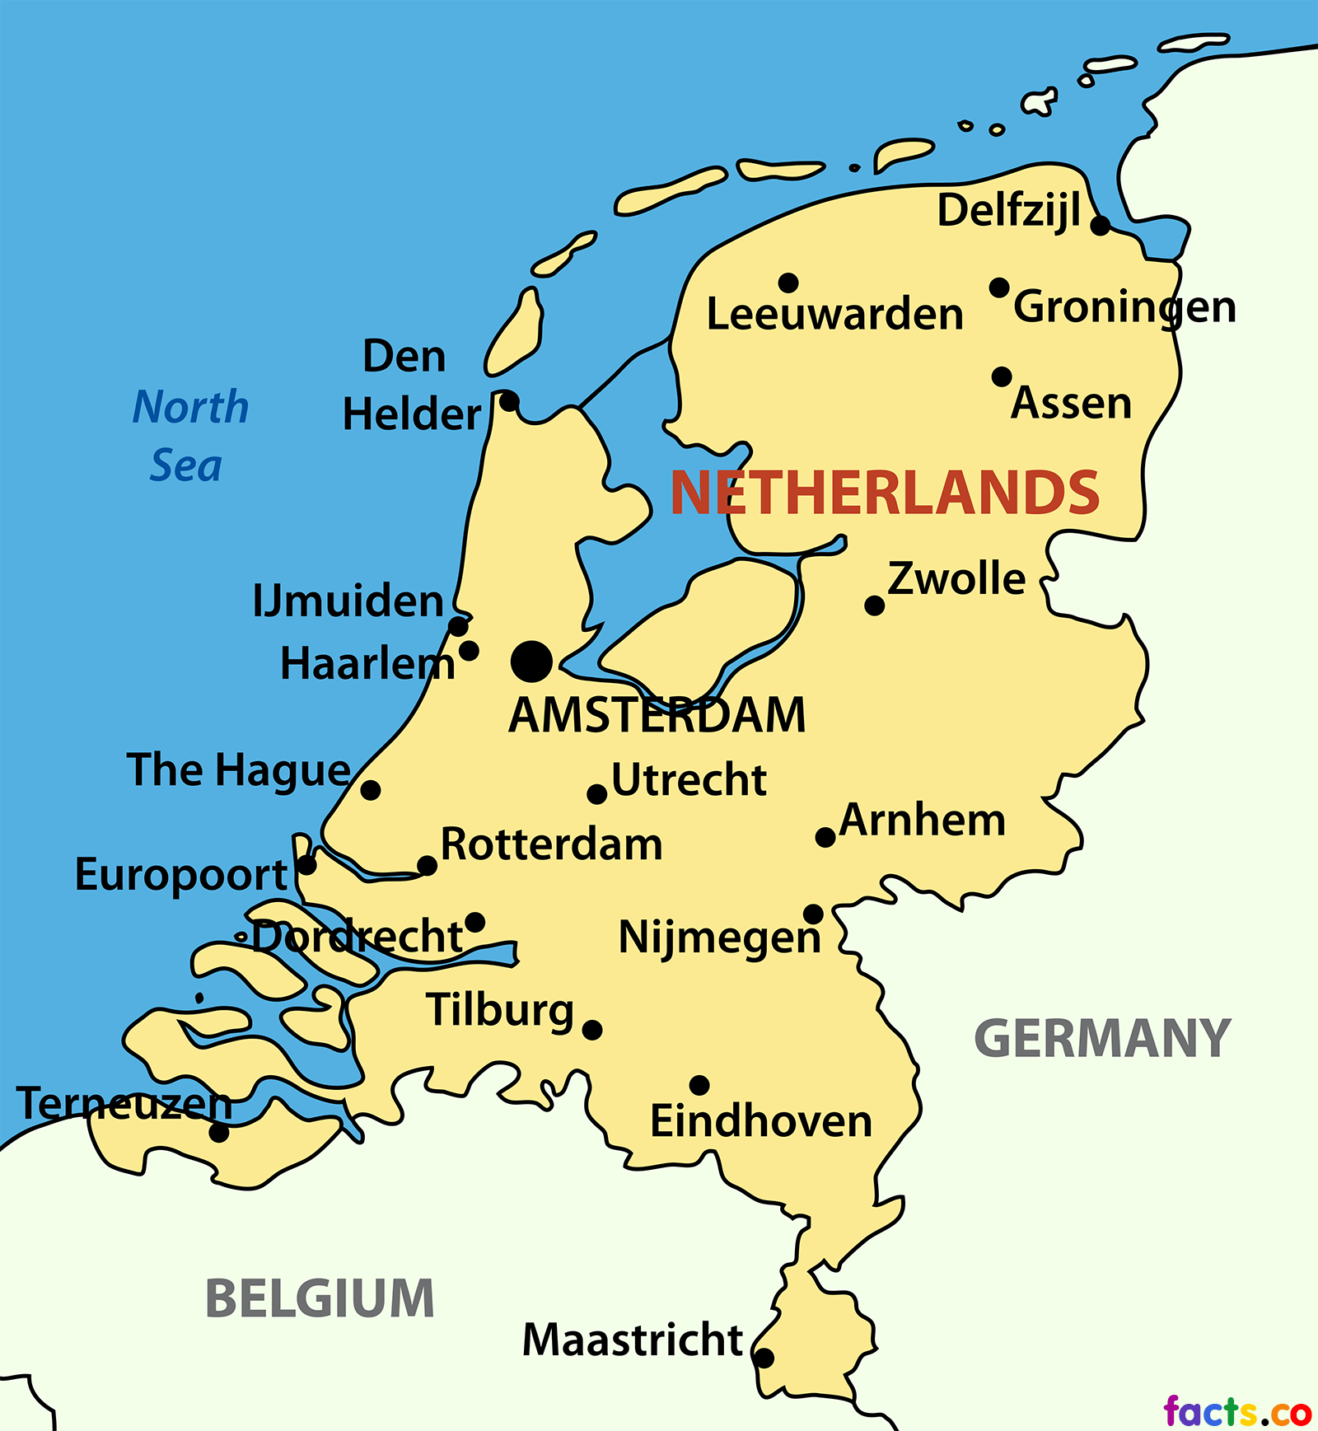

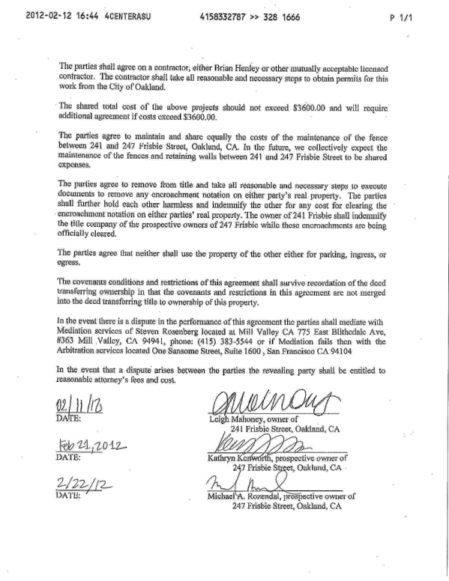

Who?
6,7 million employees
659 CLA’s for 5,5 million employees
CLA coverage: almost 80%
AWVN coverage: 2 out 3 CLA’s
CLA
Notes:
30-9-2019: https://opendata.cbs.nl/statline/#/CBS/nl/dataset/81463ned/table?dl=309C0
6,7 mln. reguliere banen

Slide 3





What?
All CLA’s in The Netherlands
External Internal Data
Information information input

Slide 4


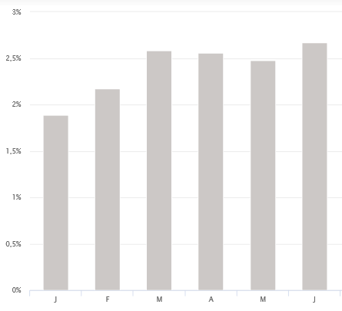

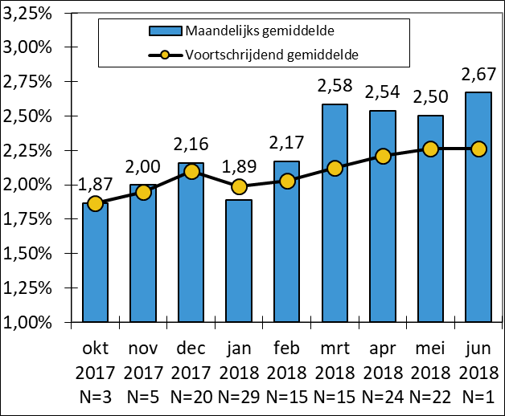




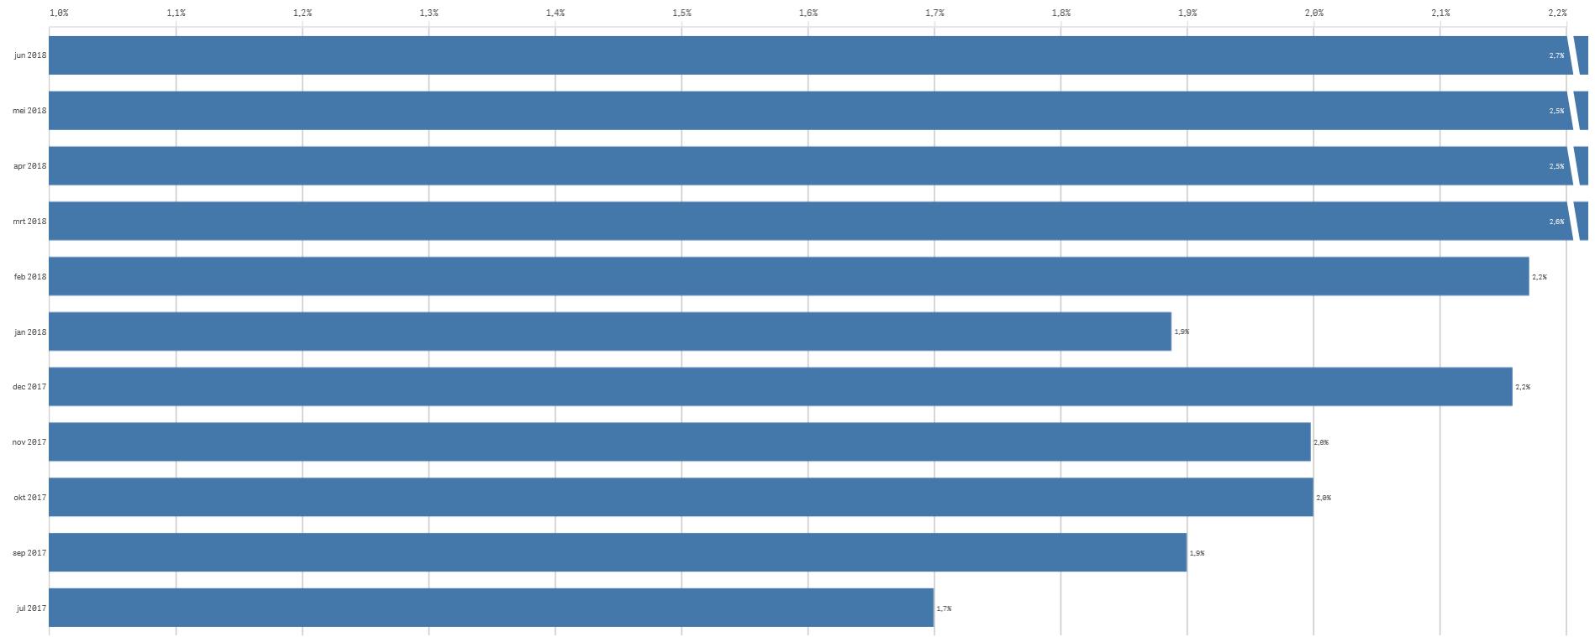

Collective labour agreements
Users:
all visitors of AWVN website
Users:
AWVN members
Cao-kijker (CLA watcher)
Data: averages
User:
AWVN employees
Data: averages
& number
of cases
By:
AWVN employees
Medium: internet
(daily)
Medium: .pdf (once in 2 weeks)
By: AWVN XLS
Medium: .doc (week-ly)
Data: individual
cases
Medium:
QlikSense
(daily)

Slide 5
Why?
All recent CLA’s in The Netherlands
Reputation Value for Core
& media contribution business
impact

Slide 6


Format?
Figures = wages & duration; text = agreement
Figures Figures Figures
Full text & text Text Text

Slide 7

Topics?
Main themes annual guide line document
Notes:
N=4
N=14
N=6

Slide 8
Start & numbers?
Text: 2020+2019; wages (by industry/region/type):
Start: 2016 Start: 2016 Start: 2008
N=all N=all
Start: 2010 (2000)
N=450

Slide 9
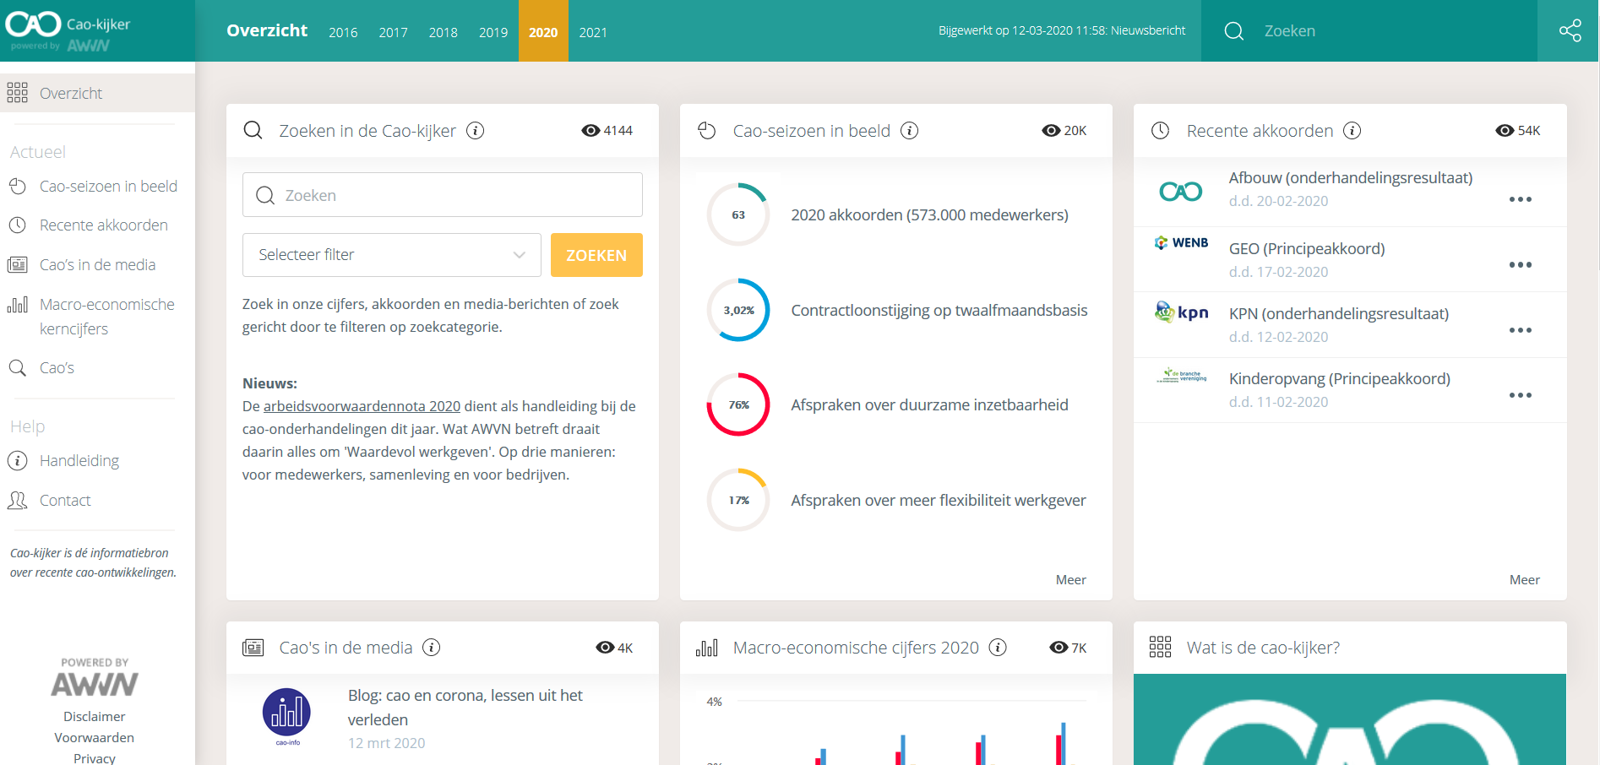
https://cao-kijker.awvn.nl/

