Slide 1

DIEESE and collective agreement databases in Brazil

Slide 2

DIEESE’s Collective Contracts Monitoring System
In 1993 DIEESE created SACC (Collective Contracts Monitoring System) in order to know what was being negotiated in collective agreements. A group of specialists in collective agreement choose 94 important negotiations from different economic sectors. Every year all 94 documents were read and every clause was classified according to a typology created by DIEESE.
In 2003, we expanded the number of negotiations to 220 and, in 2010, we expanded it again to 225.
DIEESE created SACC in order to support the trade union movement and to produce information and studies.

Slide 3
Mediador - Brazilian government homologation system
In 2007 the federal government created an online system called Mediador where trade unions can insert collective agreements in order to homologate them. The government system is based on DIEESE’s system SACC, but there are some differences.
In Brazil, approximately 45,000 collective agreement are inserted every year in the system. The data is publicly available, and it can be used as a database.
The homologation of the collective agreement in the government system has been mandatory since 2009.

Slide 4
Number of collective agreement in Mediador (government system)
 | 2007 | 2008 | 2009 | 2010 | 2011 | 2012 | 2013 | 2014 | 2015 | 2016 | 2017 | 2018 | 2019
Collectiv Agreements | 5.229 | 18.267 | 39.657 | 42.800 | 46.418 | 49.449 | 49.781 | 49.361 | 47.434 | 48.183 | 47.367 | 41.138 | 31.436

Slide 5
Data in Mediador
Each collective agreement is hosted in a single web page. Although each collective agreement contains only text, they are standardized. This allows DIEESE to collect the data and to tabulate it into a spreadsheet

Slide 6
Data in Mediador
The government system shows the following information about the collective agreement:
Type of collective agreement (collective agreement covers an entire industry or just one or more companies)
Parties (trade unions, employers’ associations, companies etc.)
Economic activity
Period covered
Workers covered
Type of clause
Text of the clauses
Cities, states and region covered

Slide 7
How DIEESE uses Mediador
In the past years, DIEESE has been learning to explore the government system in order to have a wider view of the negotiation process in Brazil.
Although the clauses are categorized, there are some problems. The classification is made by the own trade unions and companies that signed the collective agreements and sometimes the classification is not accurate. And also, when compared to our typology, the categorization is less specific than what is done in DIEESE’s system.
Over the last years DIEESE has been replacing its own database and has been using the government database Mediador.

Slide 8
How DIEESE uses Mediador
DIEESE’s main objective is to find good clauses and propagate them among trade unions. In this case, we search for specific topics in the collective agreement clauses, but we don’t have statistical concern.
Mediador also allows us to monitor the tendencies of collective negotiation within industry sectors, states and regions.
We have done studies on specific topics in which we search for words in the collective agreements and we analyze all clauses reading each one them. We have not used machine learning.

Slide 9
Studies about collective agreement
DIEESE has done a few studies using either its own database SACC or the government database Mediador.
In the following slides we selected important studies made by DIEESE over the years.

Slide 10
Negotiation of Collective Agreement Clauses Related to Gender and Race Equality
Funded by the International Labor Organization
Five studies were made over the years covering different periods: 1993-1995; 1996-2000; 2001-2006; 2007-2009; 2010-2012
The study used DIEESE’s database SACC

Slide 11
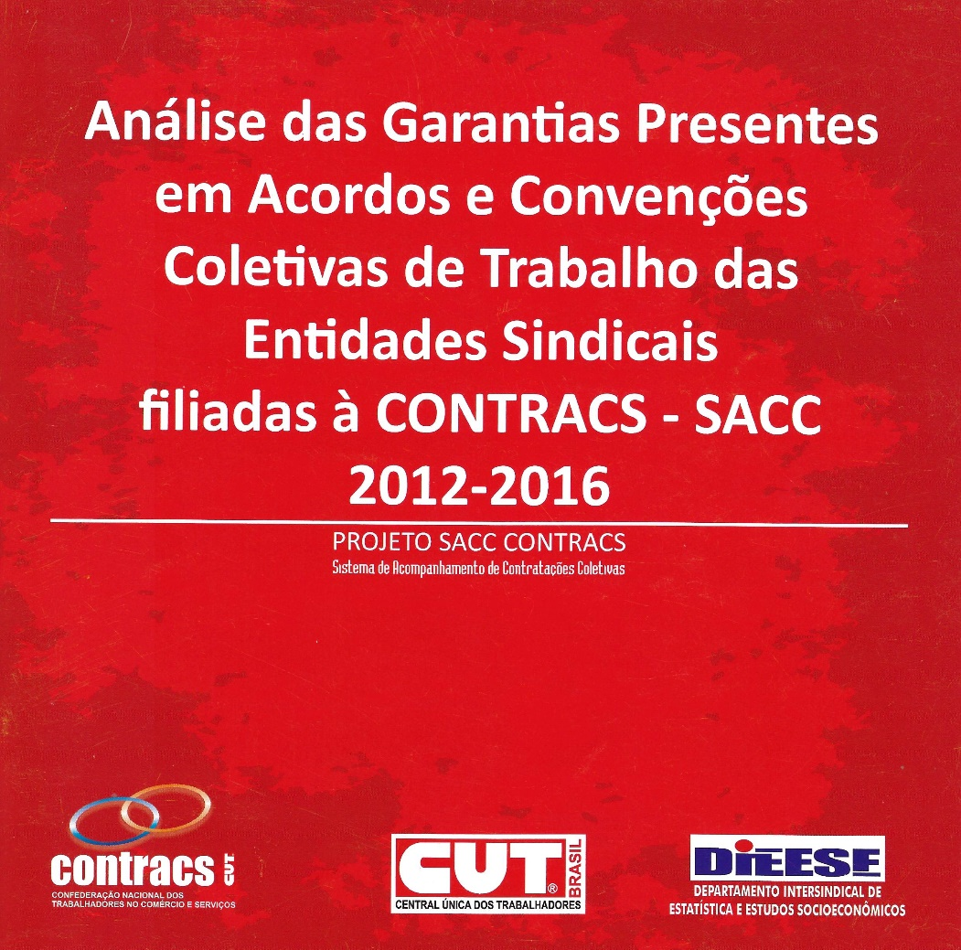
Analysis of Clauses in Collective Agreement of the Trade Unions Affiliated to CONTRACS
Funded by CONTRACS (Commerce and Services Workers Confederation)
Covers the period from 2012 and 2016
The study used DIEESE’s database SACC

Slide 12
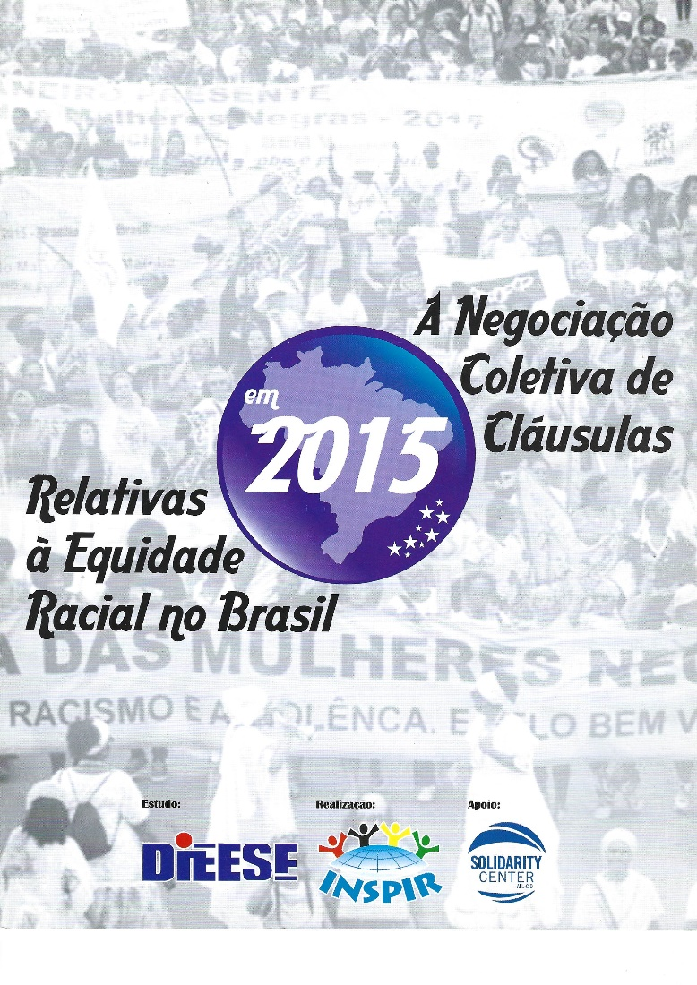
Collective Agreement Clasuses Related to Racial Equality in Brazil
Funded by Inspir (Trade Union InterAmerican Institute for Racial Equality) and Solidarity Center
The study used the government database Mediador

