Slide 1




The WageIndicator Collective Agreements Database
Daniela Ceccon
WageIndicator Foundation and University of Amsterdam
Supported by the European Commission, DG Employment, Social Affairs and Inclusion, VP/2018/004/0008

Slide 2

Recall: three project phases
Total duration: April 2019 – March 2021
Preparatory phase: April 2019 – January 2021
Kick-off meetings in Amsterdam, Rome, Bratislava (April – September 2019)
Collecting, annotating and coding agreements (April 2019 – January 2021)
Software development for extracting keywords (Dutch, Italian, Spanish) (Sept-Dec 2019)
Mid-term meeting in Amsterdam (March 2020, approx. 20 attending)
Research of coded agreements (January - December 2020)
Preparing reports for main event (September - December 2020)
Implementation phase: January – March 2021
Main event in Amsterdam to present the findings
Follow-up phase: March 2012
Finalising reports
Reporting to EU: reports + financial reporting (until 6 weeks after project ends)

Slide 3
Collecting, annotating and coding agreements / 1
WHAT WE NEED TO COLLECT (shared task among ALL partners)
613 national CBAs (EU28 + Albania, Macedonia, Montenegro, Serbia, Turkey).
= We expect 10 per country with some exceptions:
Belgium, France, Greece, Portugal and UK: 20
Albania, Macedonia, Montenegro and Serbia: 2
Turkey: 5
Italy, Netherlands and Spain: 100
25 transnational company agreements (TCA)
WHAT HAS ALREADY BEEN CODED FOR BARCOM: 120 CBAs

Slide 4
Collecting, annotating and coding agreements / 2
THE PROCESS OF ANNOTATION
1.
JPEG / PDF / Scanned document
Html navigable text
Word document
OCR software
Html editor
2.
The text is uploaded in WageIndicator system, called Cobra.
3.
Questions are answered and clauses are selected about the following topics.

Slide 5
Collecting, annotating and coding agreements / 3
THE TOPICS CODED IN COBRA
Wages
Social security and pensions
Sickness and disability
Work-life balance arrangements
Individual employment contracts / job security
Working hours, schedules, holidays and days of leave
Health and medical assistance
Equality and/or violence in the workplace
Training / apprenticeship

Slide 6
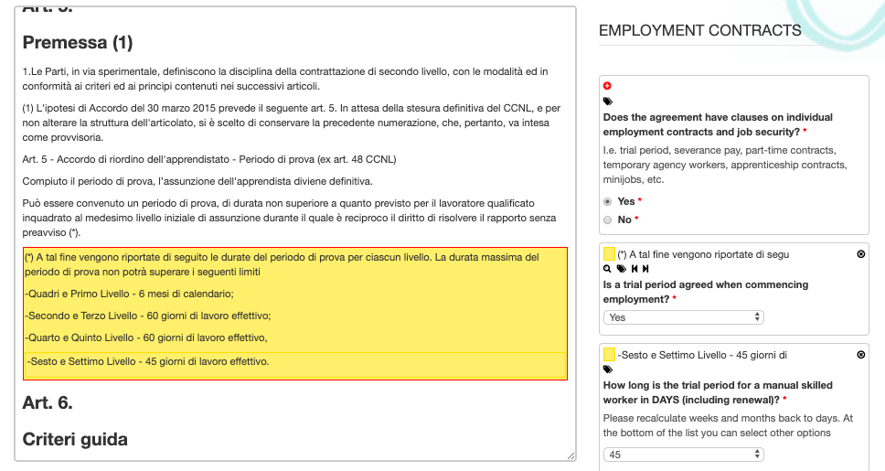
Collecting, annotating and coding agreements / 4
COBRA ANNOTATION SYSTEM:
https://cobra.wageindicator.org

Slide 7
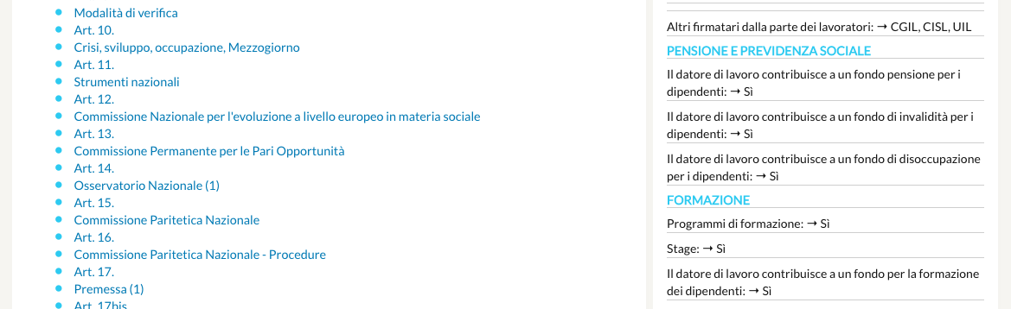
Collecting, annotating and coding agreements / 5
HOW CBAS LOOK WHEN ONLINE:
https://wageindicator.org/cbadatabase

Slide 8
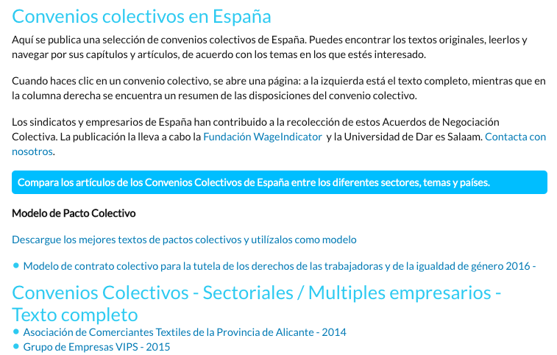
Collecting, annotating and coding agreements / 6
THE COMPARISON TOOL:

Slide 9
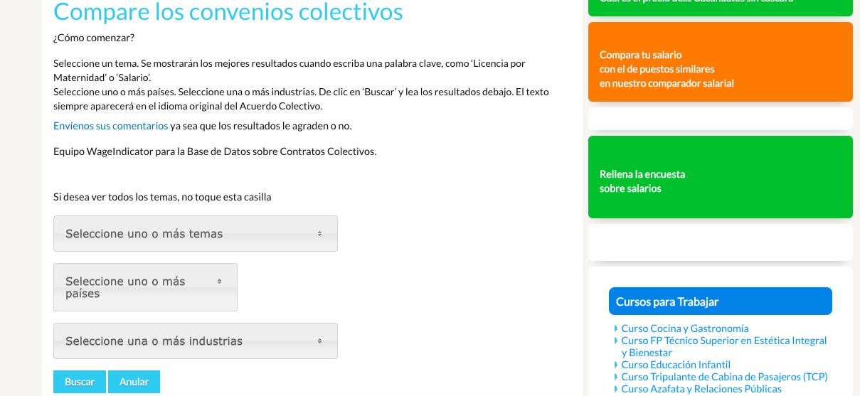
Collecting, annotating and coding agreements / 7
THE COMPARISON TOOL:
https://tusalario.es/leys-laborales/base-de-datos-de-convenios-colectivos/compare-clauses

Slide 10
Collecting, annotating and coding agreements / 8
PAYSCALES:
Within Cobra, we have a system to upload wages and payscales per CBA.
DOUBTS/QUESTIONS:
Annotation will be done by different teams in different places. I will keep a Google sheet where we can share doubts/questions.
Software development to extract keywords :
We are developing a script to extract keywords, which will help in spotting if and where one topic is addressed in a CBA. We will need a minimum of 30 agreements per language to start using this tool.

Slide 11
Who will annotate?
CNEL:
88 Italian CBAs (we have 12). Collection and annotation
CELSI:
33 CBAs from Visegrad countries. Some collection and annotation. We propose to add also some from Austria and Germany – the total doesn’t change.
UvA:
90 Dutch CBAs (we have 10). Collection and annotation
92 Spanish CBAs (we have 8). Collection and annotation
190 other agreements. Collection and annotation
25 TCA. Collection and annotation

Slide 12
Let’s start
As UvA, we have started already with annotation and collection.
We suggest to start the CBA work as soon as possible, as we need to finish annotation earlier than January 2021 – better have more time for data analysis and report.
Send your agreements to us! Better when they are: in force, with high coverage and – of course – complete. Better when we have a variety of sectoral / company.

Slide 13
THANK YOU!
danielaceccon@wageindicator.org

