Slide 1

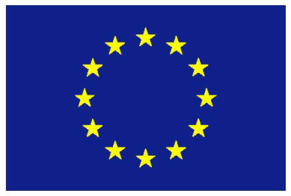
BARCOM
VS/2016/0106
Analysis of the collective bargaining landscape in the commerce sector
Marta Kahancová
Central European Labour Studies Institute
BARCOM Conference, February 28, 2018 Brussels

Slide 2
Commerce sector in the EU
BARCOM Conference, February 28, 2018 Brussels
30,7 millions of workers in commerce (2016)
14% of EU employment (Eurostat)
Collective bargaining - important mechanism of regulating working conditions of commerce workers
Collective bargaining landscape:
rich diversity in actors, bargaining levels, coverage, extensions
many new member states in Central and Eastern Europe (CEE) - few actors involved, decentralized bargaining and low bargaining coverage

Slide 3

Commerce: bargaining landscape
BARCOM Conference, February 28, 2018 Brussels
Comparing sectoral attributes of collective bargaining in commerce across EU-28
Who is involved in bargaining
Bargaining level
Bargaining coverage
Extension mechanisms
Articulation of enterprise bargaining
Constructiveness of industrial relations in commerce
Source: EPSU

Slide 4
Databases
BARCOM Conference, February 28, 2018 Brussels
BARCOM database on sectoral bargaining properties:
Actors, bargaining levels, coverage, extensions, articulation, bargaining preferences of workers
BARCOM CBA database:
116 collective agreements in commerce
Signatory parties, validity of agreements, bargaining level
WIBAR3 database:
Bargaining characteristics commerce
van Klaveren and Gregory (2018)
EurWORK database:
Eurofound representativeness study (2018)
largest companies, bargaining structure
Eurostat:
Employment structure in commerce
ICTWSS database:
National institutional characteristics
WageIndicator database:
Survey data (2017)
Bargaining preferences of individuals

Slide 5
CIR Index
BARCOM Conference, February 28, 2018 Brussels
How to compare sectoral bargaining attributes in commerce across the EU member states?
The logic:
Four institutional variables:
Trade union density
Bargaining coverage
Bargaining level
Extension of coverage
Higher value = more constructive bargaining (grounded in scientific literature)
Index of constructive industrial relations (CIR-Index)
exclusively sector-specific data (commerce sector)
average standardized composite scores

Slide 6
Trade union density
BARCOM Conference, February 28, 2018 Brussels
Country | Retail (%) | Wholesale (%) | All commerce (estimate) %* | Country | Retail (%) | Wholesale (%) | All commerce (estimate) %*
AT | 9 | 9 | 9 | HU | 5 | 5 | 5
BE | 25 | 25 | 25 | IE | 16 | 16 | 16
BG | 1 | 1 | 1 | IT | 25 | 25 | 25
CY | n/a | n/a | 3.9* | LT | n/a | n/a | 3
CZ | 2 | 2 | 2 | LU | n/a | n/a | n/a
DE | 10 | 6 | 8 | LV | n/a | n/a | 2
DK | 40 | 34 | 38 | MT | n/a | n/a | n/a
EE | 3 | 3 | 3 | NL | 11 | 11 | 11
ES | 11 | 11 | n/a | PL | 5 | 3 | 4*
FI | 38 | 38 | 38 | PT | 2 | 2 | 4.6*
FR | n/a | n/a | 6 | RO | 1 | 2 | 1
UK | 13 | 13 | 13 | SE | 28 | 28 | 28
GR | n/a | n/a | 5.7* | SI | 20 | 20 | 16
HR | n/a | n/a | 6.2* | SK | 6 | 6 | 6
Source: van Klaveren and Gregory (2018), Eurofound (2017) *Calculation of estimates for the entire commerce sector where data on retail and wholesale not available are based on estimations of a Dutch expert Maarten van Klaveren, consultations of national experts and data from Eurofound (2017). All data are in per cent and refer to the most recent year available, in most cases to 2017

Slide 7
Social partners and bargaining levels
BARCOM Conference, February 28, 2018 Brussels
Trade unions in commerce | Bargaining predominantly at local or company level | Intermediate or alternating between sector and company bargaining | Bargaining predominantly at sector level
0 – 2 | CZ, EE, HU, IE, LV, LT, MT, RO | BG, GR, HR, SK | DE, FI
3 – 5 | PL, UK | CY, LU | AT, BE, DK, ES, IT, NL, PT, SE, SI
6 and more |  |  | FR
Employers’ associations in commerce | Bargaining predominantly takes place at the local or company level | Intermediate or alternating between sector and company bargaining | Bargaining predominantly takes place at the sector or industry level
0 – 2 | CZ, EE, UK, LT, LV, MT, RO | BG, HR, SK | FI
3 – 5 | HU, IE, PL | CY, GR, LU | BE, DE, SE, SI
6 and more |  |  | AT, DK, ES, FR, IT, NL, PT
Source: van Klaveren and Gregory (2018), Eurofound (2017), ICTWSS Database Version 5.1 (2016), estimations of expert Maarten van Klaveren, consultations with national experts from various member states. Data on the number of unions are in per cent and refer to the most recent year available, in most cases to 2017. Data on predominant bargaining level (Eurofound 2017, ICTWSS 2016) refer to the most recent year available (2015 to 2017).
Notes:
Actors’ concentration does not straightforwardly lead to higher bargaining coverage, data to be interpreted in relation to each other
3 to 5 unions and employers’ associations are found in most countries with sector-level bargaining
extent of union plurality is not clearly related to bargaining decentralization: in 8 countries (Czechia, Estonia, Hungary, Ireland, Latvia, Lithuania, Malta and Romania), bargaining predominantly takes place at the local or company level despite the fact that a maximum of two trade unions operate in the sector
incidence of bargaining predominantly at the local or company level is high in countries where number of employers’ associations is limited (Czechia, Estonia, the UK, Latvia, Lithuania, Malta and Romania).
higher number of employers’ associations (3 and more) in countries with bargaining occurring predominantly at the sector level (11 countries, including Germany, Denmark, France, Sweden, Slovenia, Austria, Belgium, Spain, Portugal, Italy and the Netherlands)

Slide 8
BARCOM Conference, February 28, 2018 Brussels
Source: van Klaveren and Gregory (2018), Eurofound (2017), estimations of expert Maarten van Klaveren, consultations with national experts from various member states. All data are in per cent and refer to the most recent year available, in most cases to 2017 .
Notes:
France: low union density, high union plurality, but high bargaining coverage.
Austria, Belgium and Italy, coverage reaches 100%.
In total, in 9 countries coverage over 50%
Due to extension mechanisms (FR, IT, but not needed in AT where high coverage anyway due to coordinated bargaining).

Slide 9
Validity of CBAs by bargaining level
BARCOM Conference, February 28, 2018 Brussels
 |  | Bargaining predominantly takes place at the local or company level | Intermediate or alternating between sector and company bargaining | Bargaining predominantly takes place at the sector or industry level
Average length of validity in years for current CBAs | 1 year |  |  | SI
 | 2 years | EE, UK, LV | BG, SK | BE, DE, IT, NL, PT
 | 3 years | HU |  | DK, ES
 | 4 years |  | CY | SE
 | 5 years
 | 6 years |  |  | FR
Source: BARCOM CBA database (2017), Eurofound (2017), ICTWSS 5.1 (2016). All data refer to 2016-2017.
Bargaining level has no impact on the validity of agreements; in most countries (10) commerce CBAs valid for 2 years regardless of bargaining level
Notes:
bargaining level does not have an impact on the validity of agreements. In majority of countries (10 countries, including Estonia, the UK, Latvia, Bulgaria, Slovakia, Belgium, Germany, Italy, the Netherlands and Portugal) agreements are valid for two years regardless of the predominant bargaining level

Slide 10
Employees’ bargaining preferences
BARCOM Conference, February 28, 2018 Brussels
Country | Covered by collective agreement | Number of observations | Important to be covered | Number of observations | Correlation, *sig at 5%
BE | 67% | 347 | 59% | 400 | 0.2282*
DE | 36% | 1428 | 60% | 876 | 0.2692*
HU | 79% | 278 | 89% | 449 | 0.5401*
IT | 78% | 106 | 84% | 129 | 0.2006
NL | 67% | 1782 | 73% | 2154 | 0.3025*
PT | 53% | 205 | 75% | 223 | -0.0143
ES | 56% | 151 | 75% | 211 | -0.0185
Source: Wageindicator data (January 2015 - October 2017).
Employees’ bargaining coverage and preference for coverage: weakly positive, significant at the 5% level in BE, DE, HU and NL
Hungary: moderately positive relationship at 5% significance level: 79% of employees covered by a collective agreement, 89% survey participants find it important to be covered
Union members have 3.6 times the odds of thinking coverage is important than non-union members. Most robust relationship in Hungary.

Slide 11
Extension of CBA coverage
BARCOM Conference, February 28, 2018 Brussels
 | National-level regulation and practice of extensions | 0: Neither legal provisions for mandatory extension, nor a functional equivalent | 1: Extension exceptional, in some industries only, very high thresholds | 2: Extension in many industries, but with thresholds | 3: Extension is virtually automatic and more or less general
Sectoral extensions used in commerce | 2: Yes, pervasive | IT | LU | ES, FI, NL, PT | AT, BE, FR, SI
 | 1: Yes, but rather limited |  | DE
 | 0: No | CY, DK, GR, MT, PL, RO, SE, UK | CZ, HU, IE, LV, LT | BG, EE, HR, SK
Source: ICTWSS (2016) for national-level regulation and practice of extensions, Eurofound (2017), national social partners and BARCOM final conference participants’ feedback for the actual practice of extensions. All data for 2017 or the latest available year.
8 CEE states + IE do not use extensions in commerce despite the legal possibility to extend (high thresholds, veto rights, or social partners’ preference not to extend CBA coverage)
Sweden: extensions based on social partners’ consensus; Austria: bargaining coverage 100%, no need for extensions because of a functional equivalent

Slide 12
Articulation of enterprise bargaining
BARCOM Conference, February 28, 2018 Brussels
3 | Articulated bargaining: additional company bargaining on wages is recognized and under control of unions | BE, BG, CY, DE, DK, FI, FR, IT, NL*, SE, SI, SK
2 | Disarticulated bargaining; additional enterprise bargaining on wages is also conducted by non-union bodies | GR, PT
1 | Disarticulated bargaining: additional enterprise bargaining on wages is informal and restricted by law | AT, ES, LU
0 | Does not apply, data not available | CZ, EE, UK, HU, IE, LT, LV, MT, PL, RO
Source: ICTWSS 5.1 (2016), van Klaveren and Gregory (2018)
Articulated bargaining in two types of countries:
Predominant company-level bargaining (low bargaining coverage, lack of extensions or preference for company bargaining), e.g., in Bulgaria and Cyprus;
Both company and sector/multi-employer bargaining, company-level negotiations well informed by sectoral CBA provisions), e.g., in Belgium, Denmark, Finland, Sweden and Slovenia

Slide 13
Constructive industrial relations (CIR Index)
BARCOM Conference, February 28, 2018 Brussels
Finland, Belgium, Italy and Slovenia - countries with the most constructive industrial relations in commerce
‘Old’ EU members rank better than the ‘new’ EU member states in CEE and Southern Europe, with the exception of Slovenia
Romania, Lithuania, Estonia, Czechia, Poland and Latvia - least constructive industrial relations in commerce
Country | Z-score (standardized composite score)
FI | 1.58
BE | 1.27
IT | 1.27
SI | 1.06
AT | 0.89
DK | 0.81
FR | 0.80
NL | 0.79
ES | 0.78
PT | 0.75
SE | 0.67
LU | 0.32
DE | 0.13
IE | -0.46
SK | -0.51
GR | -0.55
HR | -0.57
UK | -0.62
CY | -0.63
BG | -0.71
HU | -0.75
MT | -0.80
LV | -0.87
PL | -0.91
CZ | -0.91
EE | -0.92
LT | -0.94
RO | -0.99
Source: own calculation based on Eurofound (2017) and BARCOM Report 2

Slide 14
Effects of constructive industrial relations (CIR Index)
BARCOM Conference, February 28, 2018 Brussels
Are more constructive industrial relations associated with specific patterns of collective bargaining?
specific bargaining processes (company vs. multi-employer bargaining)
specific bargaining outcomes (homogeneity in CBA contents)

Slide 15
Effects of constructive industrial relations (CIR Index)
BARCOM Conference, February 28, 2018 Brussels
Process: higher CIR index higher likelihood of sectoral/multi-employer CBAs
Outcomes: CBAs from countries with higher CIR Index
more likely to contain structural wage increases compared to no wage increases;
less likely to contain once-only pay increases
compared to no wage increases
more CBAs with wage increases as a combination of a % pay hike and a lump sum bonus compared to a simple % hike; fewer agreements with lump sum increase only
agreed working hours are about 1.5 hours shorter than in CBAs in countries with a lower CIR score

Slide 16
Conclusions
BARCOM Conference, February 28, 2018 Brussels
Collective bargaining is an important mechanism for setting working conditions
Lack of systematic analyses on sectoral bargaining landscapes and bargaining outcomes
BARCOM project to improve expertise in industrial relations on the above issues
Diversity in bargaining landscapes in commerce across the EU, particular bargaining attributes and institutional conditions facilitate particular CBA outcomes
3 BARCOM reports, www.wageindicator.org

Slide 17
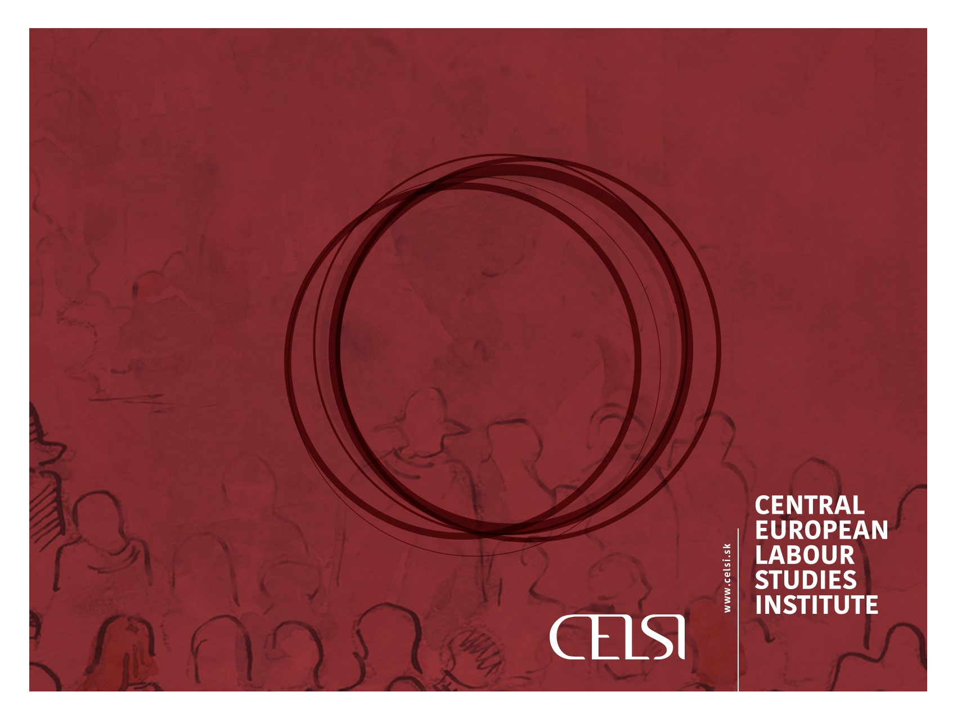
THANK YOU FOR YOUR ATTENTION!
Questions: marta.kahancova@celsi.sk

Slide 18
Employers’ organizations
BARCOM Conference, February 28, 2018 Brussels
Lack of data on employers’ organizations’ (EO) density, but data on EO structure in commerce
Plurality of EOs highest:
Italy and the Netherlands
plurality of unions
exceptionally high bargaining coverage
Plurality of EOs lowest:
Portugal, Malta and Croatia (1 EO),
modest trade union plurality in PT and MT
high bargaining coverage in PT
Croatia: 1 EO, 1 TU, low bargaining coverage
Lesson: Actors’ concentration does not straightforwardly lead to higher bargaining coverage, data to be interpreted in relation to each other

