Slide 1
NCBAs in Italy. Lack of Transparency?
Michele Faioli

Slide 2
Smooth Chaos
Section 2

Slide 3
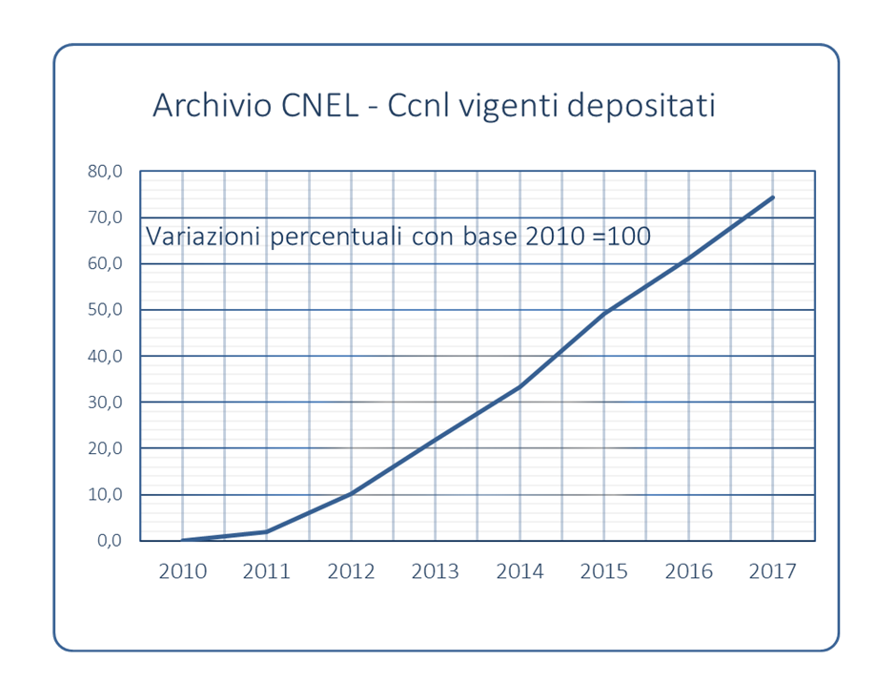
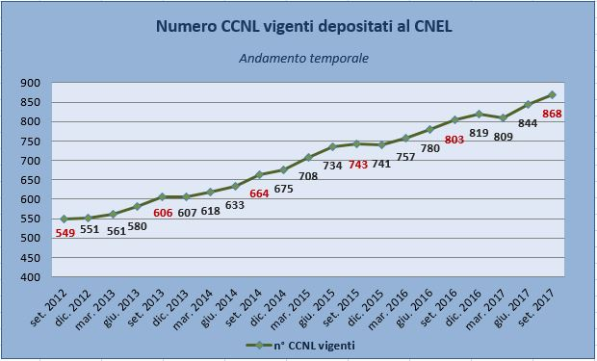

Slide 4
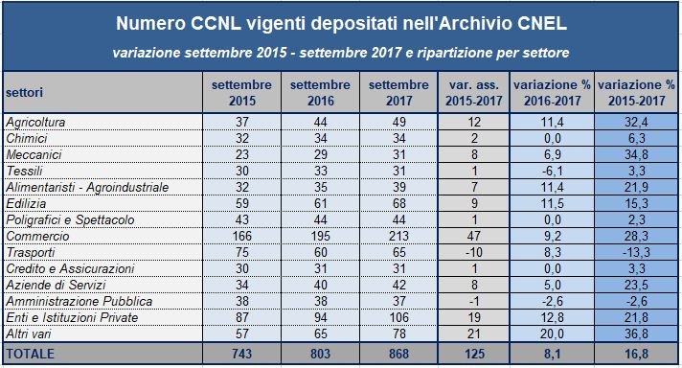

Slide 5
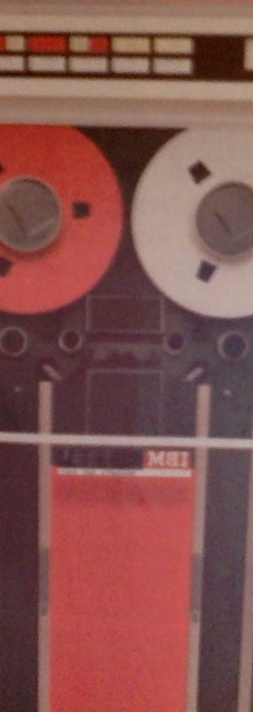
Why?
Crisis of the Centralized Bargaining Structure
Employers Organizations Stepping Out (Federdistribuzione vs Confcommercio)
Employers Stepping Out
Lack of Statutory Union Recognition
The Saga of the 2011/2014 Framework Agreement – why and what
More than 100 Frame Agreements

Slide 6
Commerce Sector(s) in Italy?
Section 2

Slide 7
NCBAs Commerce Sector(s)
Normal Life
Confesercenti – the 2016 NCBA
The New Normal?
Scenarios
Confcommercio – the 2015 NCBA
Federdistribuzione – Under Bargaining – the 2011 NCBA
Distribuzione Cooperativa– The 2011 NCBA
The Bogus Life
XXX NCBAs – Increasing Data

Slide 8
The Main Problem
Labor Costs
Differences
Renewal Schemes
Bargaining Process
Labor Inspectorate
Paritarian Instititions
Private Health Care Funds
Contributions
Benefits - Level

Slide 9
Recent Strategies
Boosting the NCBAs power broker functions
Labor Inspectorate – INL 3/2018 Document
CNEL&INPS Unified Digital Archive

Slide 10
Thank you
Michele Faioli
University of Rome Tor Vergata Law School & CNEL
Email to - michele.faioli@uniroma2.it

