Slide 1

The interplay of collective wage bargaining and statutory minimum wages in realizing adequate wage floors across European sectors Janna Besamusca, Martin Guzi and Kea Tijdens
Prepared for “8th Conference of the Regulating for Decent Work Network” on Ensuring decent work in times of uncertainty 10-12 July 2023
BARWAGE is a project within the Social Dialogue Program of the European Commission. (SOCPL-2021-IND-REL - Project ID 101052319)

Slide 2

Collective Bargaining vs Minimum wage floors
This paper focuses on the interplay of the wage setting arenas of statutory minimums and collective bargaining on pay
Statutory minimum wages and collective bargaining both theorized to support the decent wage agenda.
Considerable scientific debate about their interaction
Crowding out or reinforcing?

Slide 3
Structure of Earnings Survey (2018) and
The focus of our analysis is on workers who earn below the median wage in each country. The estimation sample comprises 2.57 million workers employed in 181,698 enterprises in 17 EU countries.
Sample includes workers between 20 and 59 years old who work at least 50% of full-time hours. Data on minimum wage rates are sourced from the WageIndicator Minimum Wage Database. Our main outcome variable is referred as low pay that indicates workers earning between 100 and 110 percent of minimum wage.

Slide 4
Characteristics of workers in our sample
14 percent of workers in our sample are identified with low pay.
The incidence of low pay is lower (10 percent) in the group of workers covered by CBA than in the group not covered (23 percent).
Workers covered by CBA attain lower education levels, are more likely to have part-time work; more likely to have permanent than temporary contracts; and more concentrated in the public sector.

Slide 5

Different impact of CBA between sectors Contribution of collective bargaining is weaker in sectors employing high-skilled workers
Note: Presented are estimates on CBA variable obtained from models estimated separately for each sector. All estimates are confirmed significant at 1% level.
The magnitude of coefficient is lowest in education and health sector and reaches the highest values in construction and manufacturing sectors.

Slide 6

Heterogenous impact of collective bargaining The impact of collective wage bargaining on wage levels is higher for workers with lowest education attainment, older workers, those employed in private firms, and workers with temporary contracts or with part-time work.
Note: Separate models are estimated by adding interaction terms between coverage and characteristics of workers (education, age, gender) and parameters of their job (firm ownership, type of contract) to baseline specification.

Slide 7
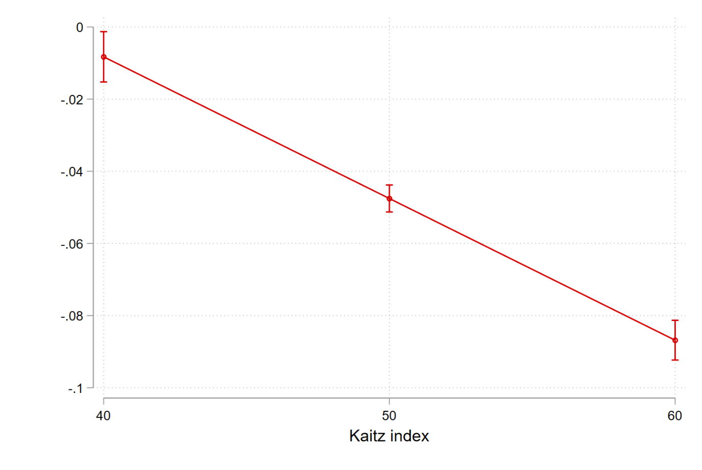
The impact of collective bargaining vary with the level of minimum wages to median wage (Kaitz index)
The marginal effect of collective bargaining on the incidence of low pay for different values of Kaitz index
The impact of being covered by a collective agreement is stronger in countries with high Kaitz index. This indicates that collective bargaining helps workers to sustain their wages above minimum wage levels even at more generous minimum wage levels.
Note: Predictions are based on the estimation of baseline model with added interaction term between coverage bargaining and Kaitz index. 95% confidence intervals are shown.

Slide 8
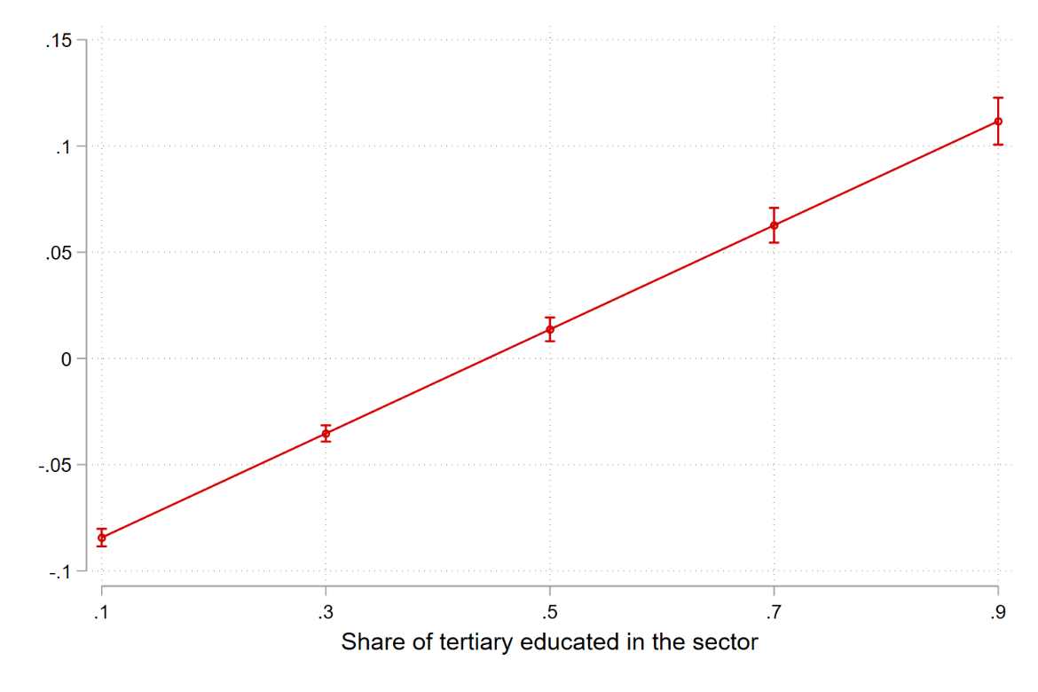
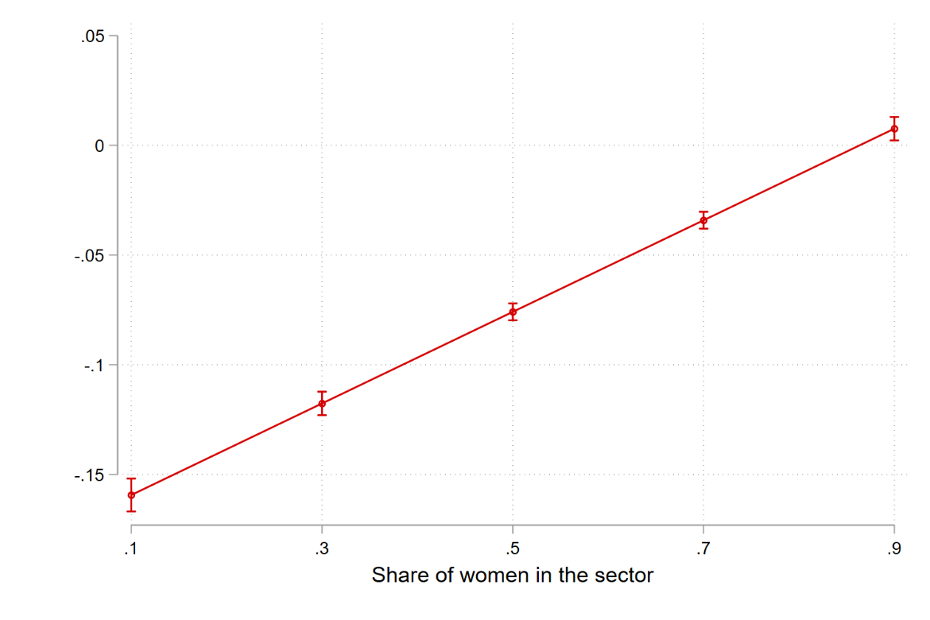
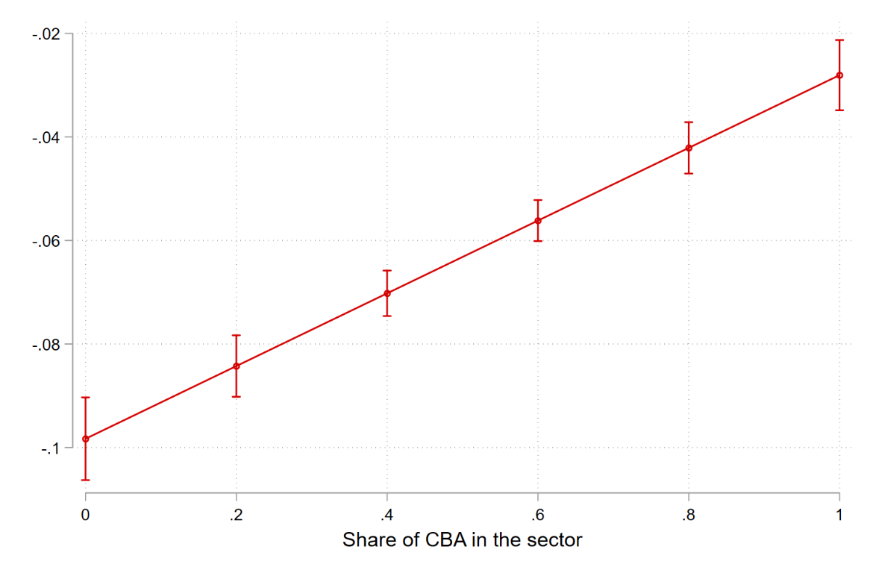
The interaction of collective bargaining with sectoral characteristics The impact of collective bargaining is higher in sectors with dominant low-skill workforce and male dominated sectors and in sectors with lower proportion of workers covered by CBA.
The marginal effect of collective bargaining on the incidence of low pay in interaction with sectoral differences in the characteristics of workforce

Slide 9

Conclusion
Collective bargaining as a policy instrument for achieving decent wages in Europe.
Evidence for added impact of collective bargaining towards decent wages
Sectoral differences are crucial. Larger effect of collective bargaining in sectors with more women, low educated and lower collective bargaining coverage
More important to more vulnerable workers (females, older workers)

Slide 10
Contact Us
Contact: j.w.besamusca@uu.nl

