Slide 1


Slide 2
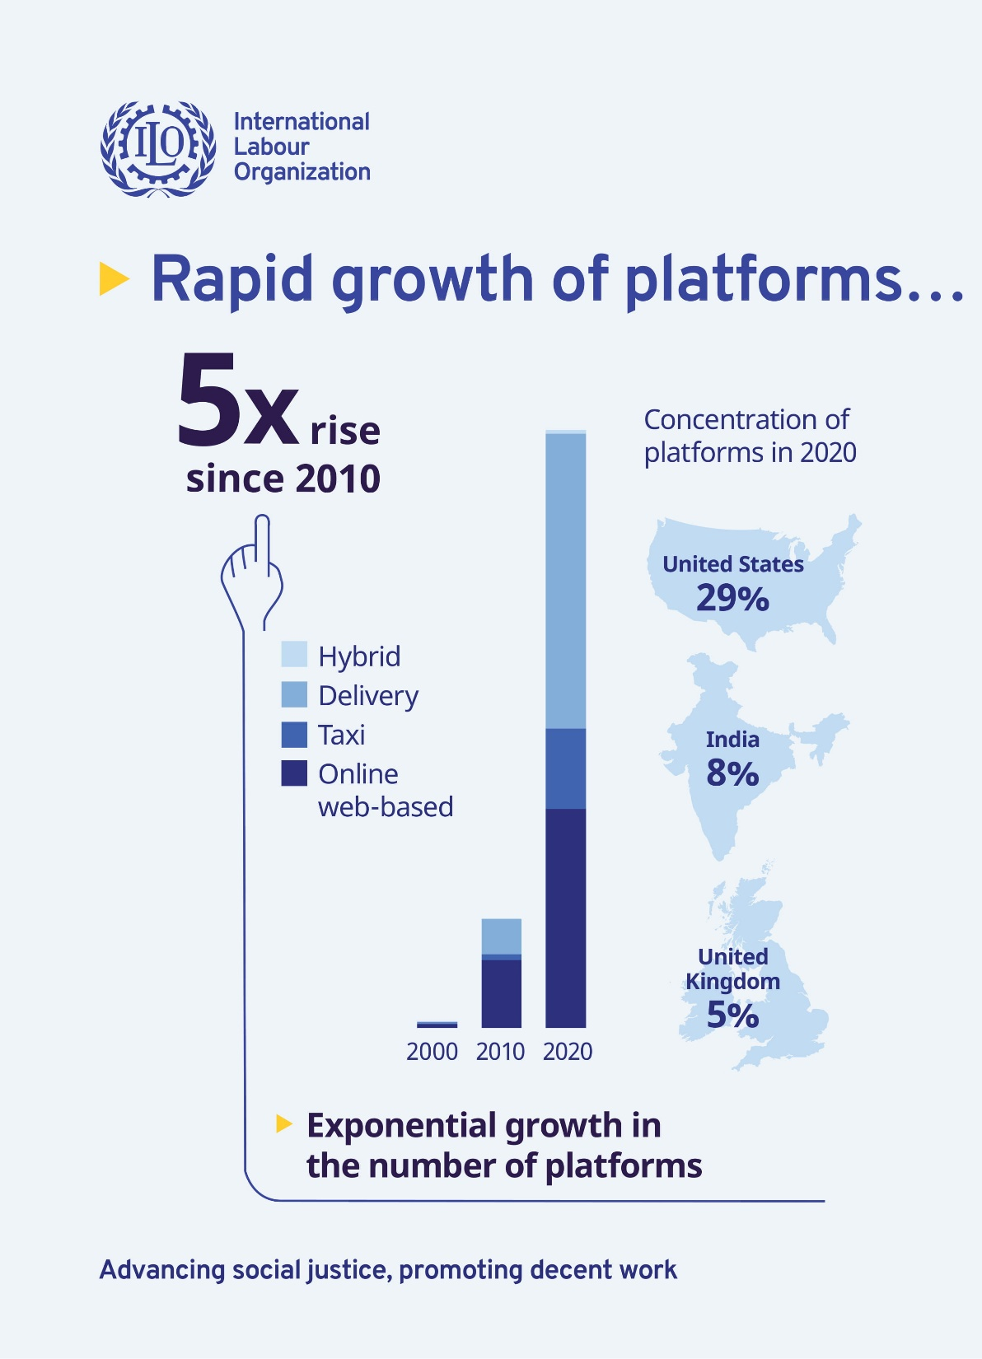


Rise of the digital labour platforms
Cloud computing and infrastructure
Use of big data and algorithms
Availability of venture capital funds
Innovative ways of working, and flexibility for both workers and businesses
Increasing relevance with COVID-19 pandemic

Slide 3
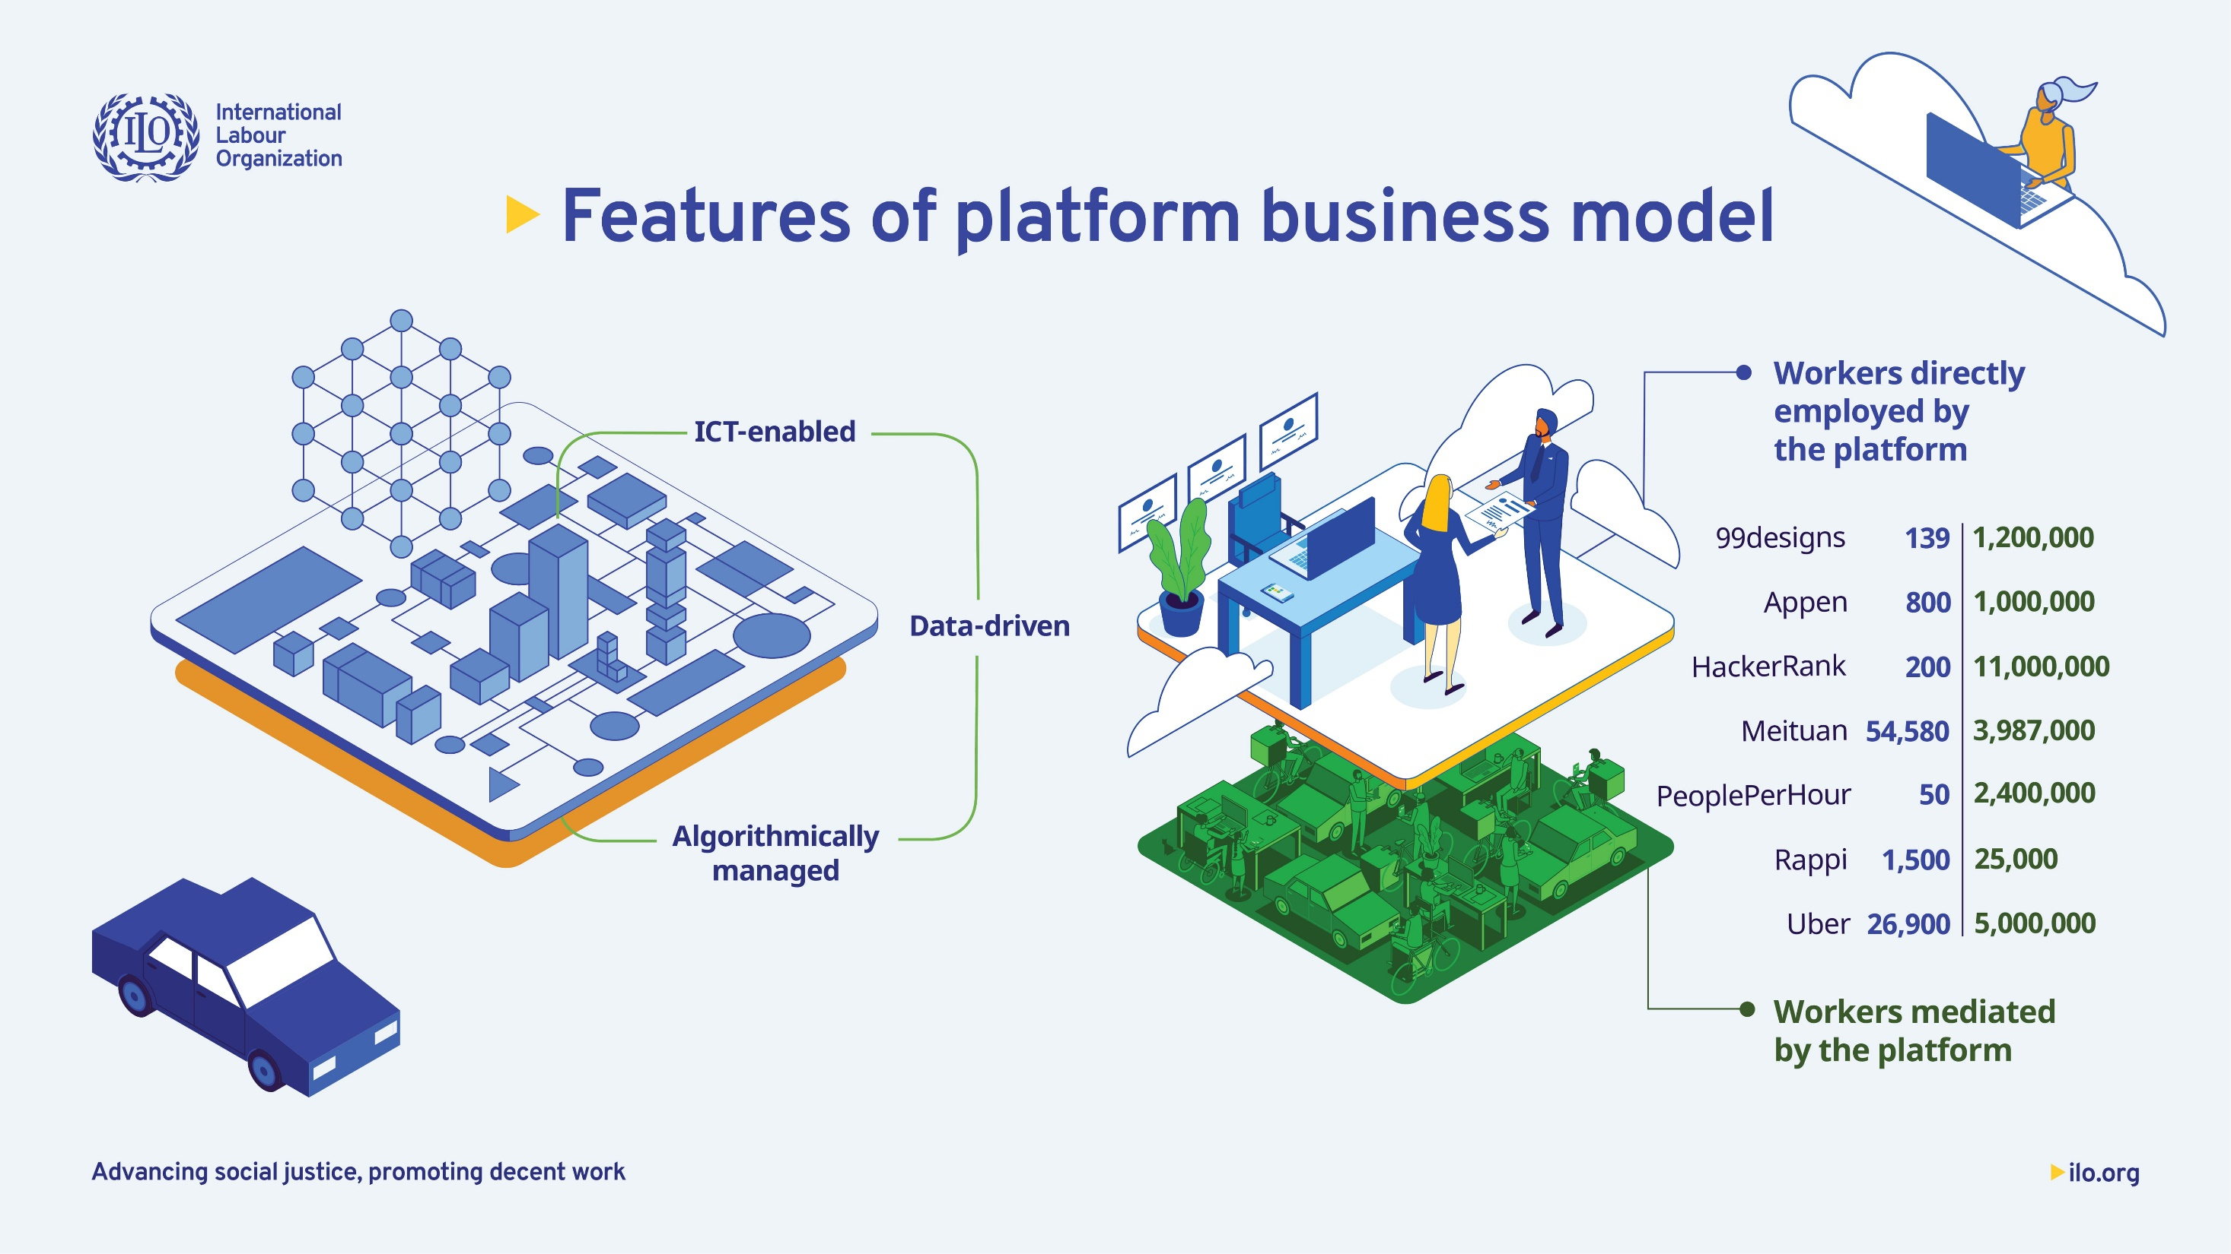

Slide 4
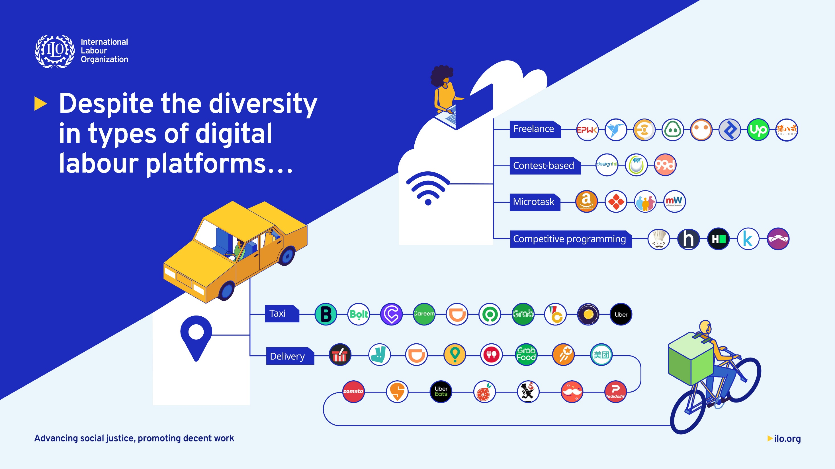

Slide 5
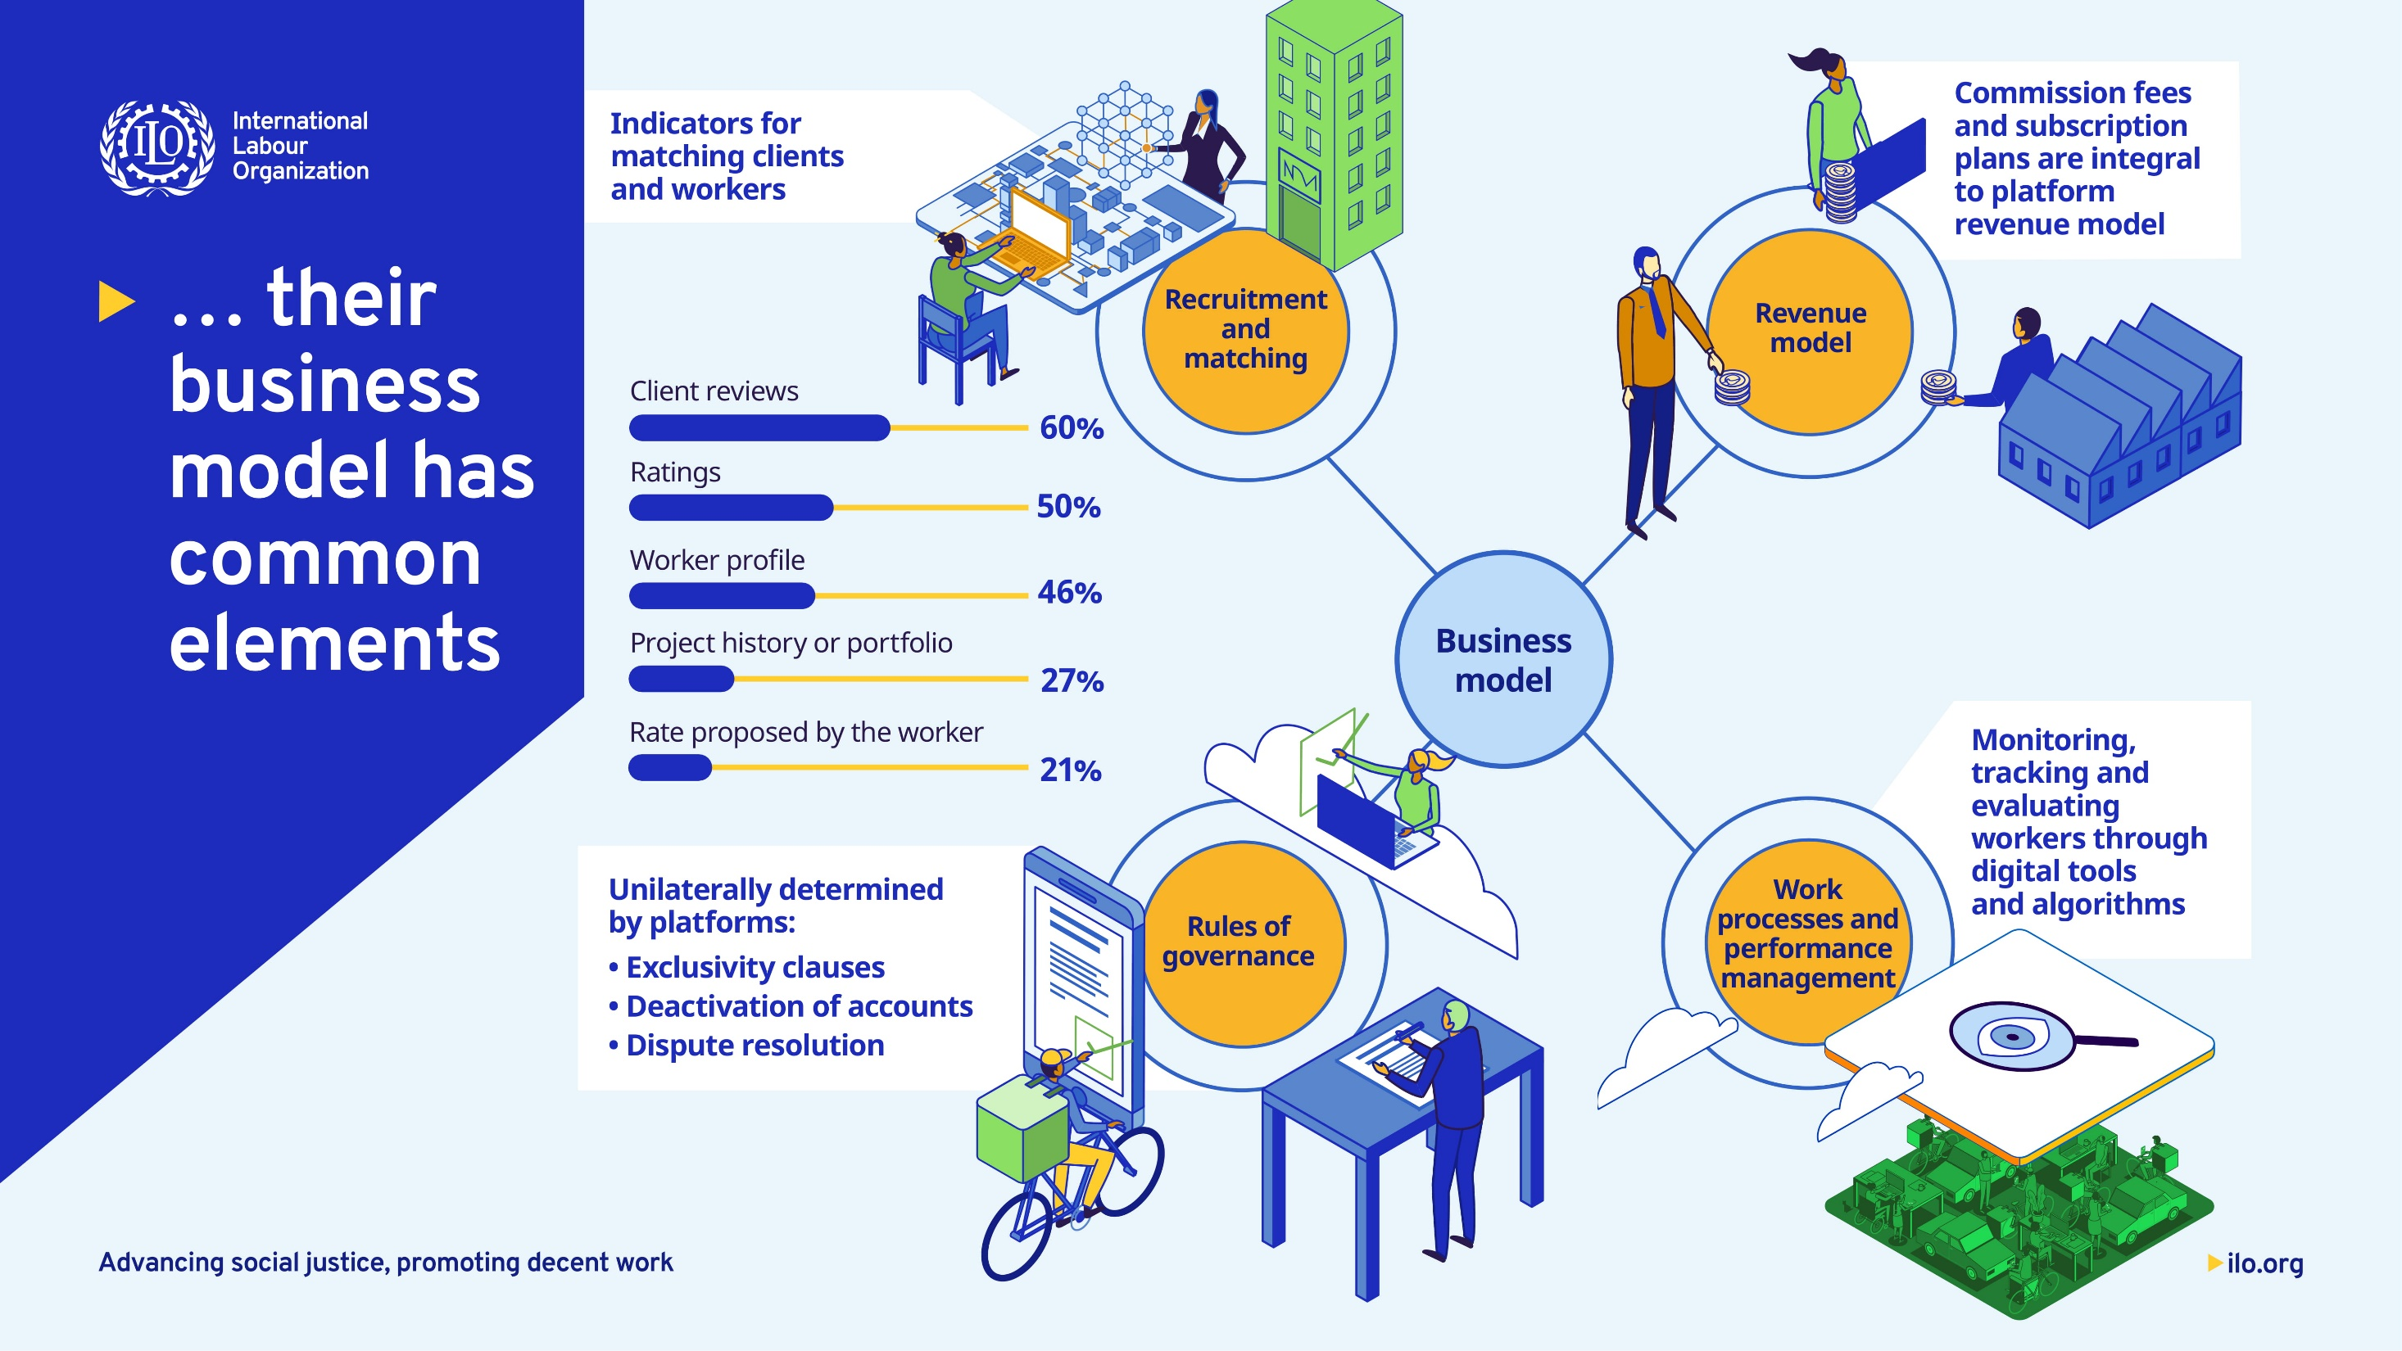

Allocation of work
Determining pay rates
Ratings
Refusing work

Slide 6
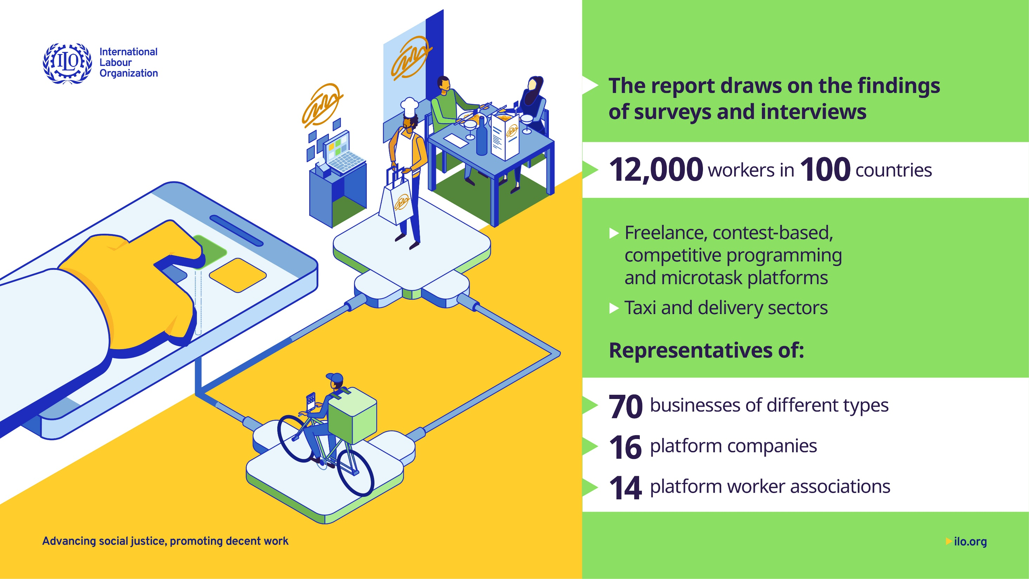

Slide 7
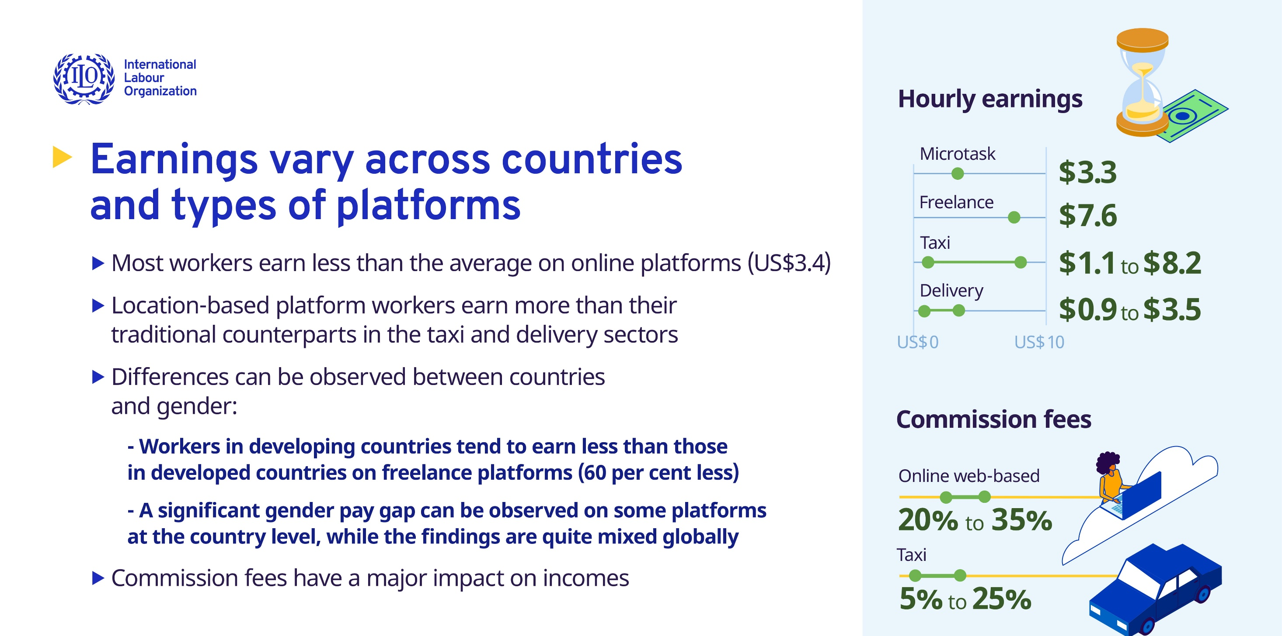
Working hours are quite high in location-based platforms
  65 hours in taxi sector; 59 hours in delivery sector per week
On online web-based platforms workers spend 8 hours in a typical week performing unpaid work

Slide 8
