Slide 1





Content of Collective Agreements in Visegrad Countries – Preliminary findings from BARCOM/COLBAR project
Gábor Szüdi
CELSI
Supported by the European Commission, DG Employment, Social Affairs and Inclusion, VP/2018/004/0008

Slide 2

The CBA Database
The CBA database contains many collective bargaining agreements that are made available online in the original language and coded in a comprehensive and uniform way using the custom-made COBRA system (Ceccon et al 2016)
Since January 2013, CBAs are collected from all over the world: 1081 CBAs from 61 countries
116 Collective Bargaining Agreements from the European commerce sector within BARCOM project (analysed) – growing number of CBAs in COLBAR project (361 collected)

Slide 3
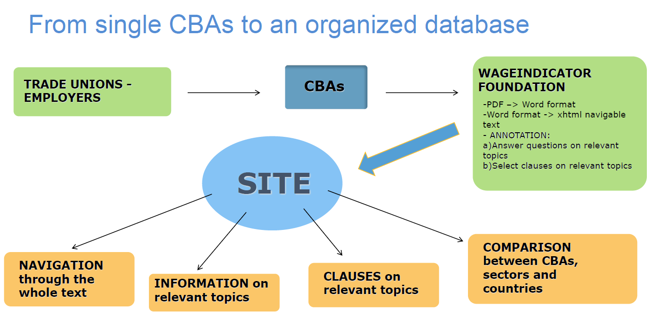

Slide 4
The CBA Database Topics
general CBA data
job titles
social security and pensions
training
employment contracts
sickness & disability
health & medical assistance
work & family balance arrangements
gender equality issues
wages
working hours
coverage

Slide 5
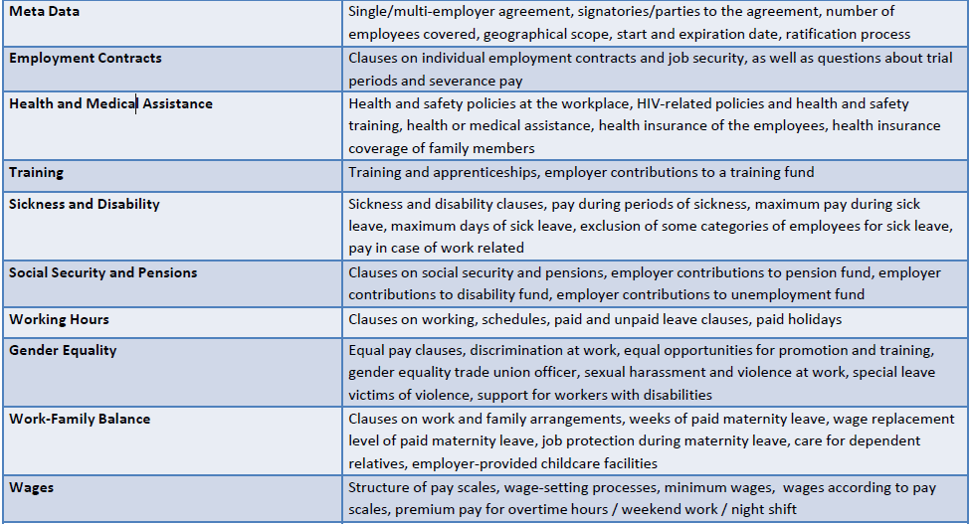

Slide 6
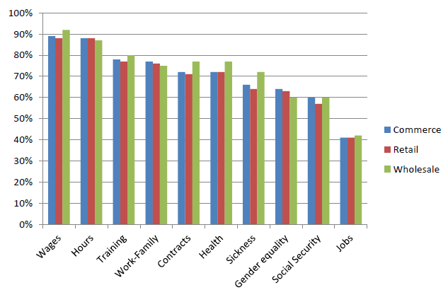
What is included in European CBAs?
Wages and working hours are almost always included in commerce CBAs in Europe
Training, work-family arrangements, employment contracts and health are often included
Sick leave, social security and gender equality are less common
Job descriptions/occupations are among the least included topics

Slide 7
Visegrad countries in the CBA database
Country | Agreement | Level | Sector
Czech Republic | Svaz obchodu a cestovni­ho ruchu CR | SECTORAL AGREEMENT | Commerce
Czech Republic | BILLA, spol. s r.o. | SECTORAL AGREEMENT | Commerce
Czech Republic | Penny Market, spol. s r.o. | SECTORAL AGREEMENT | Commerce
Hungary | Paks és vidéke ÁFESZ | COMPANY AGREEMENT | Commerce
Hungary | Országos Takarékszövetkezeti Szövetség | SECTORAL AGREEMENT | Commerce
Hungary | Az Egri Tankerületi Központ Köznevelési Intézményei | SECTORAL AGREEMENT | Public
Hungary | Magyar Posta | COMPANY AGREEMENT | Public
Hungary | GE Hungary | COMPANY AGREEMENT | Public
Hungary | Dunaferr | COMPANY AGREEMENT | Manufacturing
Hungary | Villamosenergia-ipari ágazati kollektív szerződés | SECTORAL AGREEMENT | Commerce
Poland | Arcelor Mittal | COMPANY AGREEMENT | Manufacturing
Poland | Leonardo | COMPANY AGREEMENT | Manufacturing
Poland | Zywiec | COMPANY AGREEMENT | Manufacturing
Slovakia | ZOCR_OZPOCR | SECTORAL AGREEMENT | Commerce
Slovakia | COOP | COMPANY AGREEMENT | Commerce

Slide 8
Wages
Most European commerce agreements in BARCOM database (89%) include clauses on wages: V4 countries all contain some clauses on wages
Wages are determined at the individual (37%), company (28%), sector (23%), regional (3%), or national (7%) level
However in V4 countries the picture is unclear: 9 (60%) of them does not contain clear provisions on level of wage determination, while individual (3) and higher level (3) wage determination is equal
36% of agreements determine wages based on pay scales, which is similar to V4 countries (40%)

Slide 9
Working hours
 | Weekly working hours | Allowed over hours | Annual Leave (days)
Austria | 41 (4) | 14 (1) | 25 (3)
Belgium | 32 (4)
Bulgaria |  |  | 20 (1)
Croatia | 42 (6) | 12 (5) | 21 (6)
Czech Republic | 40 (3) | 8 (2) | 20 (1)
Denmark | 37 (7) | 8 (4) | 26 (4)
Estonia | 40 (2) |  | 20 (2)
Finland | 37 (2) |  | 21 (2)
France | 38 (5) | 7 (3) | 27 (6)
Germany | 42 (3) |  | 36 (2)
Greece | 36.5 (4) |  | 22 (3)
Hungary | 40 (3) | 5.76 (3) | 20 (1)
Italy | 39 (4) | 5 (1) | 18 (2)
Lithuania | 48 (1) | 3 (1)
Netherlands | 39 (10) | 8 (3) | 24 (10)
Portugal | 40 (6) | 7 (6) | 22 (5)
Poland | 40 (3) | 4.8 (1) | 20 (1)
Slovakia | 40 (2) | 4.8 (1)
Slovenia | 40 (1) | 16 (1) | 20 (1)
Spain | 40 (5) |  | 28 (7)
Sweden | 39 (8) | 5 (1) | 25 (2)
86% of CBAs in database foresee 5 day working weeks and 90% set working hours 36-40 hours per week
V4 countries all 40, but 4 out of 7 HU no indication
Allowed overtime varies from 2 to 20 hours per week
HU: 300 hrs per year (3), PL-SK: 250 hours, CZ: 8 hrs per week
Paid annual leave varies from 10 to 36 days: V4 rarely mentioned, but uniform 20

Slide 10
Social security
 | Pension | Disability | Unemployment
Austria | 0 (2) | 0 (2) | 0 (2)
Belgium | 4 (5) | 3 (5) | 4 (5)
Bulgaria | 0 (1) | 0 (1) | 0 (1)
Croatia | 2 (3) | 4 (5) | 0 (5)
Czech Republic | 3 (3) | 0 (3) | 0 (3)
Denmark | 6 (6) | 4 (6) | 4 (6)
France | 10 (10) | 6 (10) | 7 (10)
Germany | 1 (1) | 1 (2) | 1 (2)
Greece | 1 (1) | 0 (1) | 0 (1)
Hungary | 1 (7) | 0 (7) | 0 (7)
Italy | 1 (1) | 1 (2) | 1 (2)
Netherlands | 8 (8) | 3 (9) | 0 (9)
Portugal | 2 (4) | 4 (4) | 1 (3)
Poland | 3 (3) | 1 (3) | 0 (3)
Slovakia | 2 (2) | 1 (2) | 1 (2)
Slovenia | 1 (1) | 1 (1) | 0 (1)
Spain | 2 (3) | 5 (7) | 0 (7)
Sweden | 1 (1) | 0 (3) | 0 (3)
United Kingdom | 1 (1) | 0 (1) | 0 (1)
60% of CBAs contain clauses on social security and/or pensions
40% contain employer contributions to employees’ pensions, 28% to disability funds and 16% to an unemployment fund.
Pension fund: all V4 countries include in CBAs, except for HU
Disability fund: not common (1 SK – 1 PL)
Unemployment fund: rare (1 SK)

Slide 11
Sickness and disability
75% CBAs have clauses on disability and sick leave. Wage replacement during the first six months for a worker with at least five years of service is at full wages in 56% of the cases and is at least half the regular wage in 90% of the agreements
Very sporadic data for V4: 1 CBA per country

Slide 12
Gender and Equality Bargaining
63% of CBAs contain at least one clause regarding gender equality or violence in the workplace; V4: around 50% (7)
28% specifically mention equal pay for work of equal value; V4: both SK CBAs, 2 out of 3 PL and CZ CBAs mention equality, but no HU
Half of CBAs contain at least one clause on paid maternity leave: period of paid maternity leave lasts between 9-30 weeks
In 90% of CBAs wage replacement is at 100% of the basic wage
V4: very sporadic data

Slide 13
Job Classification Systems
Of the 116 commerce CBAs in BARCOM database, 48 (41%) refer to a job classification system or include job descriptions; 29 (25%) include actual job descriptions, including a lot of sales functions, unskilled workers, shop assistants, cashiers, lorry drivers, clerks and forklift drivers
6 CBAs from Visegrad countries mention a job classification system: 3 (3) PL and 3 (7) HU, but job description is only provided in 1 HU CBA

Slide 14
Request for Collaboration
A collective agreement database makes sense only if it contains a good amount of comparable data across countries and sectors
So we need your support in collecting CBAs from sectors, as well as ideas on what to focus in subsequent research
Let’s have a lively discussion and let’s stay connected!
THANK YOU!
gabor.szudi@celsi.sk

