Slide 1





Project introduction
Paulien Osse
Supported by the European Commission, DG Employment, Social Affairs and Inclusion, VP/2018/004/0008

Slide 2

Aims of COLBAR-EUROPE
Collective bargaining is key for wage setting and working conditions, but very little is known about what exactly is agreed
COLBAR-EUROPE aims to improve knowledge about the content of Collective Labour Agreements in EU28 plus 5 candidate countries and about the content of Transnational Company Agreements (TCAs)
COLBAR-EUROPE main activities
collect, annotate and code these agreements
do so for 500+ Labour Agreements and 25 TCAs
merge with the already coded 120 agreements from the BARCOM project
compare and analyse the coded content of these agreements
organise a Main Event to present and discuss the findings

Slide 3
Consortium
PARTNERS
UvA - University of Amsterdam
CELSI - Central European Labour Studies Institute, Bratislava
CNEL - National Council for Economics and Labour (Consiglio nazionale dell'economia e del lavoro), Rome
ASSOCIATE PARTNERS
WageIndicator Foundation, Amsterdam
ETUI - European Trade Union Institute, Brussels
UNI Europa, Brussels
Solidarność Katowice, Poland
Solidarność Gdansk , Poland
CCOO Servicios, Madrid

Slide 4
Roles in consortium - Partners
UvA/AIAS-HSI
overall and scientific project management, maintaining project website and contact database, distributing newsletters
organising one kick-off meeting, one mid-term meeting and one final conference in Amsterdam,
collecting and coding the agreements (apart from Visegrad countries and Italy)
uploading the texts in the CBA Database
developing and applying the key word system
analysing the dataset for delivery of 8 out of 10 reports
CELSI
organising one kick-off meeting in Bratislava and contributing to the midterm meeting and final conference
collecting and coding agreements from Visegrad countries
delivering quarterly dataset updates of the CBA Database
analysing the dataset for delivery of 1 of the 10 reports: agreements in Visegrad countries
CNEL
organising one kick-off meeting in Rome and contributing to the midterm meeting and final conference
collecting and coding agreements from Italy
jointly with UvA/AIAS-HSI developing and applying the key word system
analysing the dataset for delivery of 1 of the 10 reports: agreements in Italy

Slide 5
Roles in consortium - Associate partners
Associate partners
WageIndicator
ETUI
UNI Europa
Solidarność Katowice
Solidarność Gdansk
CCOO Servicios
Tasks
Attend the meetings, comment on the aims and results of COLBAR-EUROPE
Contribute to collecting Agreements in your country
Promote the project and the CBA database with social partners in your country

Slide 6
Five research objectives
Which topics are agreed upon in the agreements and can patterns in bargaining topics be identified within and across countries and private and public sectors?
Do agreements include wage clauses, pay scales and indexation clauses, and how do pay scales compare within and across countries and sectors?
To what extent is a wider bargaining agenda agreed upon and are clauses traded off against each other?
Do agreements converge across countries when concluded by daughters of multinational companies and do they align with Transnational Company Agreements?
Is a continuous Europe-wide data collection of collective agreements feasible?

Slide 7
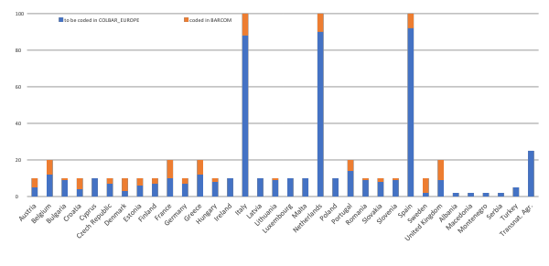
Analyses based on 613 Labour Agreements and 25 Transnational Agreements

Slide 8
Analyses of Agreements (COLBAR+BARCOM=TOTAL)
CELSI: one report about Visegrad countries
Czech Republic 7 + 3 = 10
Hungary 8 + 2 = 10
Poland 10 + 0 = 10
Slovakia 8 + 2 = 10
CNEL:
one report about Italy ( 88 + 12 = 100)
UvA:
one report about Netherlands (90 + 10 = 100)
one report about Spain (92 + 8 = 100)
four reports about entire dataset (518 + 120 = 638)
comparing agreements in 4 sectors
wage clauses in agreements
wider bargaining agenda
convergence across subsidiaries of MNEs and TCAs
one report about perspectives for CBA data collection

Slide 9
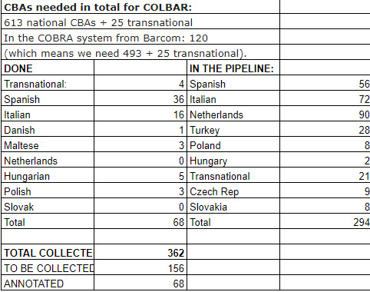
Collective Agreements - done or in the pipeline

Slide 10
Previous analyses with the dataset
BARCOM Reports:
Report 1 - Contents of Collective Bargaining Agreements in the Commerce Sector
Report 2 - Bargaining Systems in the commerce sector in Europe
Report 3 - Bargaining Systems and Collective Bargaining Agreements in the Commerce Sector
Other reports and journal articles
Ceccon, D., & Ahmad, I. (2018). Are Collective Agreements in Cambodia, Indonesia, Pakistan and Vietnam Guaranteeing Decent Working Conditions? WageIndicator Foundation, Amsterdam
Ceccon, D., & Ahmad, I. (2018). Do Collective Agreements increase Equality and promote Work-Life Balance? Evidence from WageIndicator Database. WageIndicator Foundation, Amsterdam
Borbély, S. (2016). GPG clauses in collective agreements, including summaries of the discussions in the trade unions. WageIndicator Foundation, Amsterdam.
Ceccon, D., Tijdens, K.G., Osse, P., Pralitasari, N., Ndoricimpa, A. and Ngeh Tingum, E. (2016). Manual and codebook of the WageIndicator Collective Agreements Database – Version 2 - May 2016. WageIndicator Foundation, Amsterdam.
Besamusca J., Tijdens K. (2015). Comparing collective bargaining agreements for developing countries. International Journal of Manpower, 36(1), 86 – 102.
Ceccon, D. (2015). Gender Equality and Work/Family Balance Arrangements in Collective Agreements in Africa, LatinAmerica and South East Asia. Amsterdam: WageIndicator Foundation
Downloadable
https://wageindicator.org/Wageindicatorfoundation/publications

Slide 11
Dissemination
Main Event in Amsterdam (January-March 2021)
Presentation and discussion of project results
Approx. 75 attendants: social partners, negotiators, policy makers, researchers
8 newsletters
distributed among social partners, negotiators, policy makers, researchers
COLBAR-EUROPE will maintain an email database
subscriptions: https://wageindicator.org/Wageindicatorfoundation/projects/colbar
WageIndicator websites with CBA pages
Project webpage
https://wageindicator.org/Wageindicatorfoundation/projects/colbar
all reports will be published here (free downloadable)
One-page-one-country reports
for Main Event: text and graphs about agreements in country

Slide 12
Added value of COLBAR-EUROPE
No EU-wide comparison of bargaining outcomes
Due to the absence of coded CBA data covering multiple countries, cross-country comparative analyses of the content of collective agreements were not possible until now
Exception: our previous BARCOM project coded 120 Agreements in commerce sector from 23 EU countries
COLBAR-EUROPE targets agreements for all sectors, including the public sector, and for candidate countries
Developing a keyword system
if a sufficient number of collective agreements in one language is coded, the coding processes can be speeded up by developing software for highlighting the keywords
thereby opening perspectives for long-term monitoring of the bargaining results in European countries
Standardisation of data collection procedures for the CBA databases
allowing for efficient continuation of the data collections beyond the action
thereby enlarging the time series for collective agreements in the CBA database
Cooperation of partners
aiming for long-term cooperation between applicant, co-applicants and associated partners
inviting new partners
thereby opening perspectives for continuation of the CBA database

