Slide 1
Decent Work Check In Ethiopia
Daniela Ceccon, Gashaw Tesfa, Eyoel Mekonnen WageIndicator Conference 2022 Part 1
29 April 2022

Slide 2
Introduction
Ethiopia is 2nd most populated
Transform economy: Agriculture Industry.
Until 1991 -only 19 factories
2018 - 252 Textile & Garment factories.
Priority to the textile industry.
In addition to the private industries, Gov’t built 13 Industry parks & created > 83000 jobs.

Slide 3
The Project Flow / Steps – Decent Work
1. Factory identification
2. Data collection - 1st wave
3. Data-driven Social Dialogue
4. Data collection - 2nd wave
Trade Union and WageIndicator team.
Surveys run by the WageIndicator team with HR managers / workers. Cost of Living survey with people living in the region
Organized by the Trade Union with the HR/CEO of the factory and the team from the Federation, led with data-assistance of the WageIndicator team
Surveys run by the WageIndicator team to check improvements

Slide 4
Decent Work Check: All Accessed Industries

Slide 5
Total Number Of Participants: DWC

Slide 6
Social Dialogue Participants

Slide 7
DWC: Improvement Areas After Social Dialogue

Slide 8
Challenges: DWC
Fear of surveys & social dialogues & their Consequences.
Unorganized employees (Absence of TU)
Lack of awareness of labor law, conventions, policies & CBA
Expulsion from AGOA
International & National Crisis
Skyrocketing living cost challenged smaller wages.
Reduced FDI
Foreign currency Shortage
Traditional leadership Practices

Slide 9
Future
WI-Ethiopia Team would like to: -
Expand the DWC to other untapped areas.
Conduct a monitoring and evaluation assessments
Expand the DWC and SD to other factories such as PP factories.
Impact the government to set minimum wages,
Make researches on why national Labor laws and international conventions are not obeyed.
See better working environments where rights and privileges (CBA) of employees are respected.

Slide 10
Opportunities

Slide 11
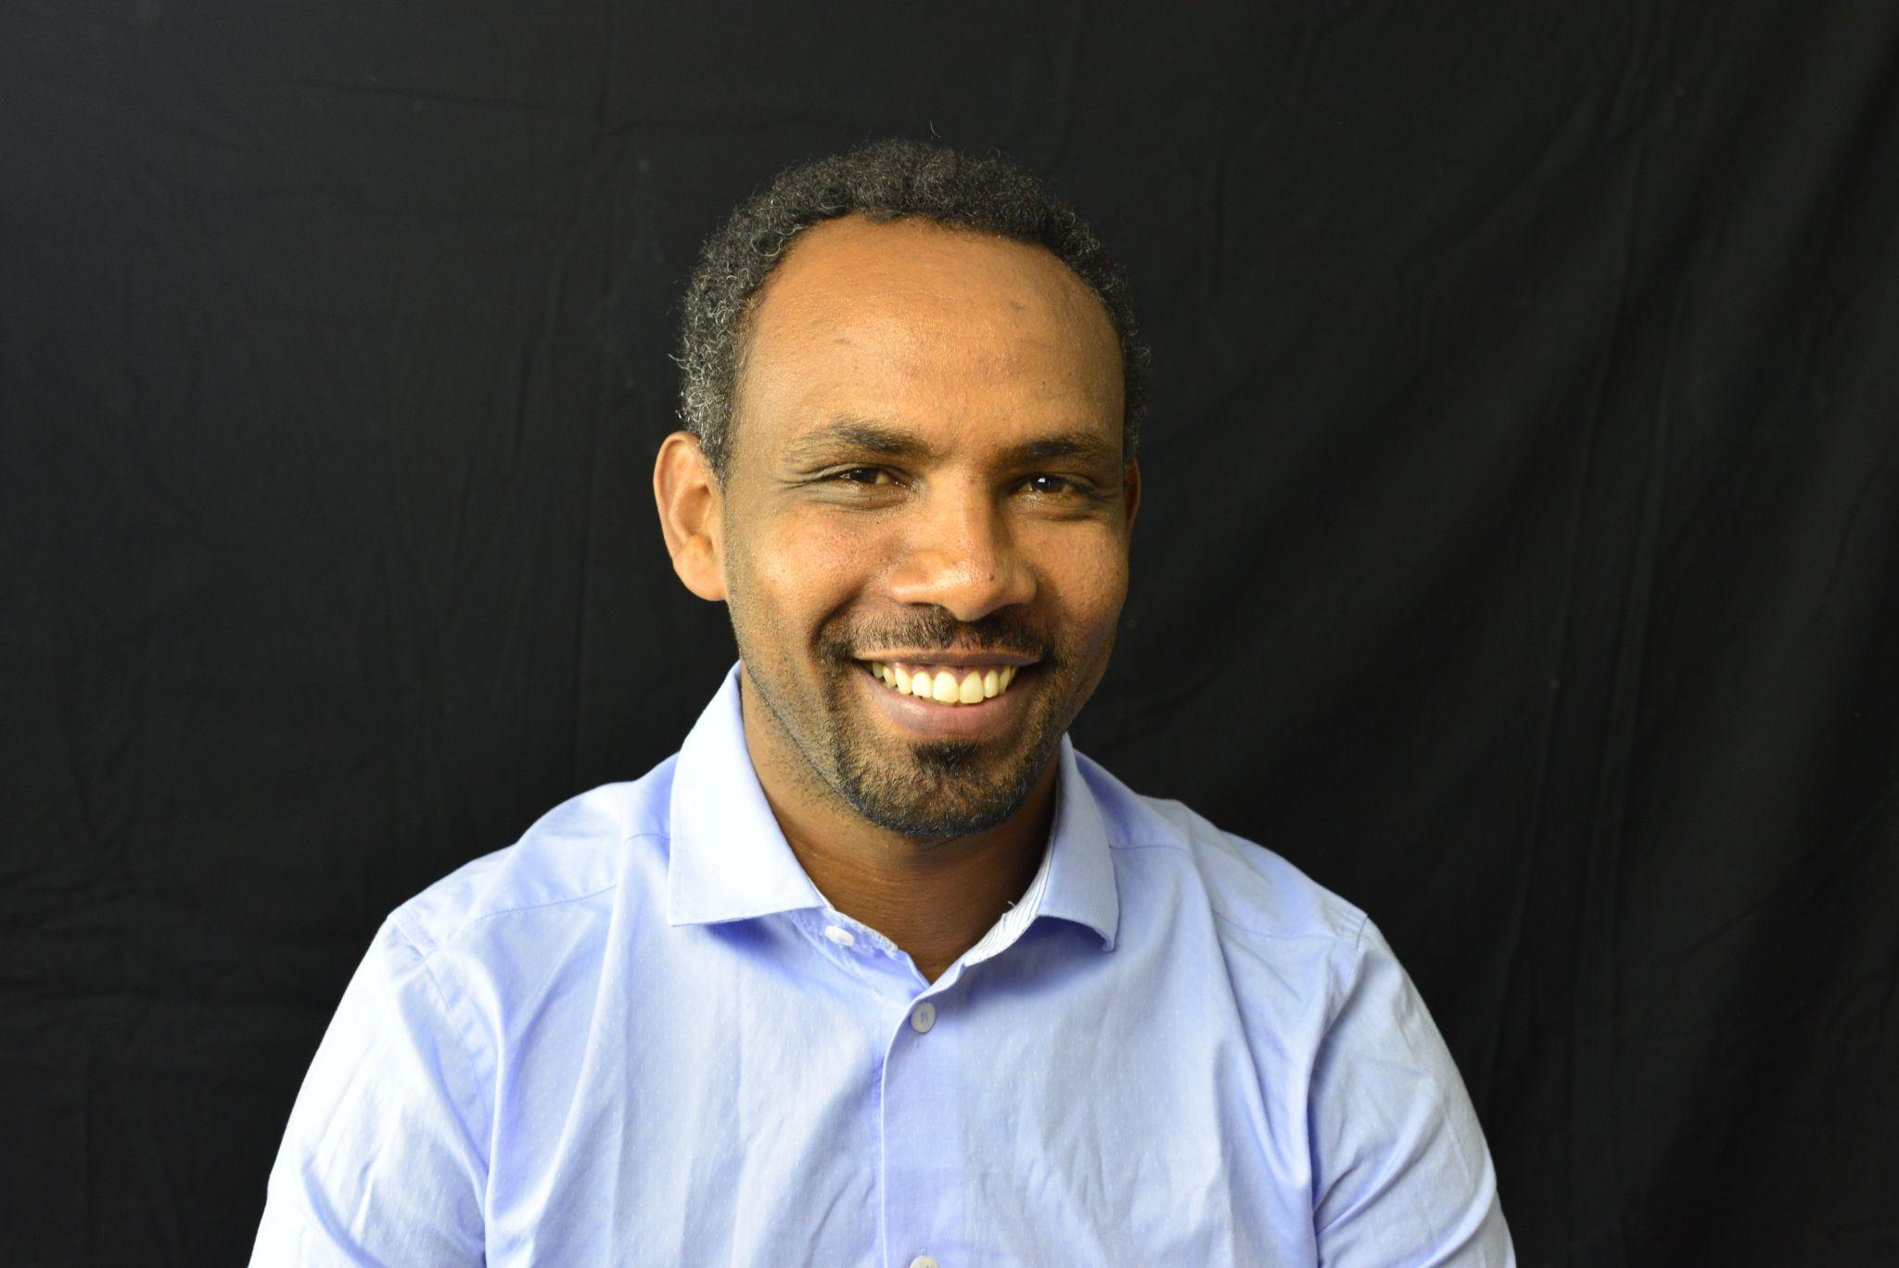
Special thought
A special thought goes to the project manager, Birhanu Mekonnen. Without him and his precious work, this would not have been possible.

Slide 12
Good to know:
THANK YOU FOR LISTENING!
Factory Pages
https://mywage.org/ethiopia/labour-law/garment-factories
Survey results in visuals
https://mywage.org/ethiopia/labour-law/garment-factories/data-visuals-changes-in-factories
Project page (phase 2)
https://wageindicator.org/Wageindicatorfoundation/projects/how-decent-is-my-factory-phase-2
Contacts:
Daniela Ceccon
danielaceccon@wageindicator.org
Eyoel Mekonnen
mekonneneyoel666@gmail.com
Gashaw Tesfa
gashawta07@gmail.com

