Slide 1


How To Calculate a Living Wage Globally
Martin Kahanec
Central European University, CELSI, GLO and WageIndicator

Slide 2
What is a ‘Living Wage’?
The Living Wage is based on the concept that work should provide an adequate income to cover the necessary living costs of a family.
Calculated for a family, not a single worker
Based on actual expenses in a given community,
and taxes and gov’t benefits
The motto of many living wage campaigns is to
‘make the minimum wage a living wage’
Living wage is voluntary, not legislated.

Slide 3
In-work poverty
Growing discrepancies between wages and labor productivity growth in a large number of countries.
Working poor = workers with a job but at risk of poverty.
(also in EU 9.5 % of the working population at risk of poverty)
Properly designed minimum wages, are an effective policy tool which can provide a decent wage floor.
Alternative policy includes targeted social security benefits to low-income households (public budgets are limited).
A living wage should make sure people earn enough to make ends meet.

Slide 4
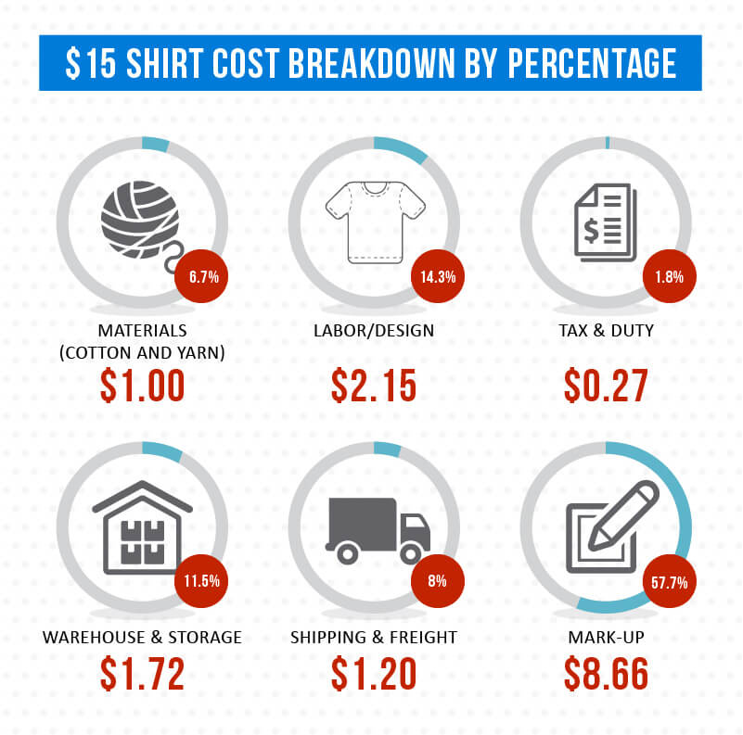
Ongoing living wage campaigns rise awareness to low wages across the world.
Source: https://graincreative.com/shirt-cost-breakdown/

Slide 5














Notes:
http://www.industriall-union.org/issues/social-justice-and-globalization/living-wage
http://www.ontariolivingwage.ca/
https://www.glasgowlivingwage.co.uk/index.aspx?articleid=1760

Slide 6
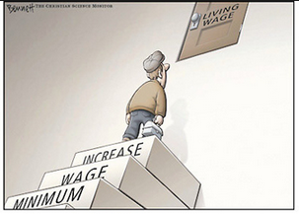
www.btlonline.org

Slide 7
Living Wage vs Minimum Wage in rich countries, 2019
 | Minimum Wage | Living Wage | Gap in | Gap in
 | per hour | per hour | 2019 | 2017
Ireland | 9.8 | 11.9 | 21% | 26%
New Zealand | 17.7 | 20.55 | 16% | 28%
United Kingdom | 8.21 | 9 | 10% | 13%
London | 8.21 | 10.55 | 29% | 30%
Vancouver, CA | 12.65 | 20.91 | 65% | 82%
USA | 7.25 | 15 | 106%
Note: Rates are stated in national currency.
Notes:
http://www.durhamlivingwage.org/
http://www.minimum-wage.co.uk/
https://www.rusu.co.uk/campaigns/winningprioritycampaigns/uorlivingwage/

Slide 8
Reference budgets
Reference budgets are baskets of goods and services that are considered necessary to reach an acceptable standard of living for an individual household within a given country, region or city.
This method requires information about social needs and prices of many goods and services.
Fully developed and used only in the UK and Ireland.
EU platform on reference budgets is a project funded by the European Commision that aims to develop comparable reference budgets in all EU Member States

Slide 9

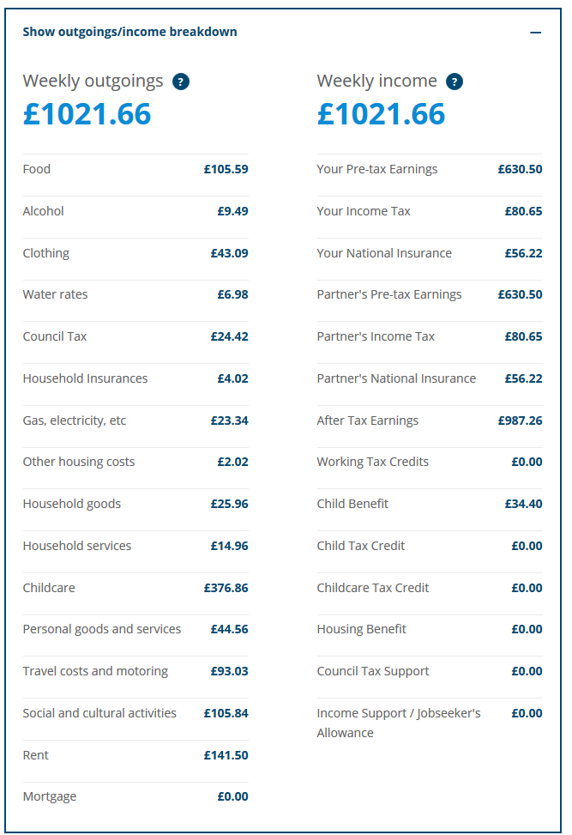
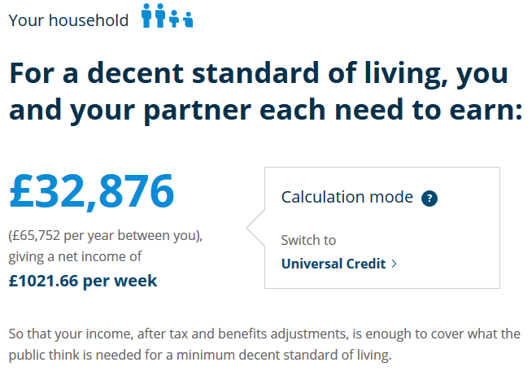
http://www.minimumincome.org.uk/london

Slide 10

WageIndicator Living Wage
Calculated Living Wage for more than 70 countries globally
Composed of seven parts: food, housing, transport, health, education, tax and other costs.
Calculated for different household types and under different assumptions about working hours
Methodology based on transparent principles
Easy to update regularly (prices are collected continuously)
Estimates published online at

Slide 11
Data used in the calculation
WageIndicator Cost-of-Living survey started in January 2014.
  Prices on 60 food items, housing rental prices, education and health expenditure, public transport
  Prices are reported by web visitors, via Cost-of-Living app, via offline surveys.
  Today we have sufficient data to calculate living wage
  for 70 countries (more than 2 million prices)
  Employ external price databases (e.g. Numbeo)
FAO food balance sheets are used to construct a food basket in every country.
World Bank data on fertility and employment rates.

Slide 12
Example of food basket in Brazil
Food group | Grams | Food kcal | Price per kilo
 | per day | per day | from-to
Wheat, barley and cereals products | 101 | 265 | 5-8
Rice | 58 | 214 | 2.8-3.5
Meat (beef, pork, poultry) | 180 | 300 | 10-15
Oils (soyabean, olive, palm) | 31 | 279 | 3-4
Sugar (Raw Equivalent) | 105 | 278 | 3.7-5.3
Maize and products | 50 | 158 | 3.2-4
Milk - Excluding Butter | 269 | 166 | 2.4-3
Vegetables, Other | 48 | 12 | 2-3
Potatoes and products | 32 | 21 | 3-4
Butter, Ghee | 6 | 45 | 4-8
Groundnuts (Shelled Eq) | 24 | 34 | 6-8.4
Pulses, Other and products | 0 | 1 | 3-5
Cassava and products | 65 | 56 | 3-3
Egg (price per 10 eggs) | 16 | 22 | 41-55
Sunflowerseed Oil | 1 | 6 | 4-5
Fish products | 20 | 11 | 15-25
Beer (0.5 liter/pint) | 121 | 43 | 7-10
Sweeteners, Other | 1 | 4 | 1.9-3
Beans | 29 | 97 | 4-4.7
Sweet potatoes | 2 | 1 | 3-4
Bananas | 52 | 33 | 3-4
Soyabeans | 7 | 12 | 5-8
Yams | 1 | 1 | 4-5.2
Apples and products | 9 | 5 | 4-5.3
Tomatoes and products | 33 | 7 | 4-5
Onions | 12 | 5 | 2.8-3.5
Oranges, Mandarines | 30 | 9 | 2.5-3
Peas | 0 | 1 | 4-7
Roots, Other | 0 | 0 | 3.1-5
Seeds and kernels | 0 | 1 | 5.5-8.6
Wine (bottle) | 3 | 2 | 17-27
Pineapples and products | 18 | 7 | -
Cream | 0 | 0 | 8-18
Olives (including preserved) | 1 | 1 | 9-9
Honey | 0 | 1 | 10-15
Citrus, Other | 0 | 0 | 3-4
Lemons, Limes and products | 8 | 1 | 2-3
Tea (including mate) | 4 | 1 | 5-8
Grapefruit and products | 1 | 0 | 3-4.1
Coffee and products | 6 | 3 | 5.9-8
Total |  | 2100
Food basket is scaled to 2,100 cal/person/day
Adults and children have same consumption

Slide 13
Expenditure and Living Wage calculation, in Brazil (BRL)
Standard family Living Wage is estimated for a family composed of two adults and two children. One parent is employed full-time and the second parent works 4 days a week it means family employment rate is 1.8.
Gross income Parent 1 (100%) = 1620, Gross income Parent 2 (80%) = 1300
Gross household monthly income: 2920 = 1620 + 1300
Net household monthly income: BRL 2530

Slide 14
Living Wages in context, Brazil 2019
For a comparison: Global Living Wage Coalition estimates the Living wage of BRL 1,596 for 2+2 family with family employment rate 1.7 in rural Brazil in 2018.

Slide 15
Living wage vs minimum wage
Note: The figure compares the calculated Living Wage based on living standards with the legislated minimum wage. All rates are expressed in PPP USD dollars.

Slide 16
Living wage summary
Using online prices Living Wage can be estimated for the large number of countries.
All estimates are published at www.wageindicator.org.
The calculation is sensitive to country characteristics
(e.g. food consumption, price variations, family composition, labor market conditions)
Living Wage could serve as an indicator of economic adequacy and a practical basis to set minimum wages.
When information on prices is sufficient Living Wage can be estimated at the regional level.

Slide 17







Comments are welcome:
KahanecM@spp.ceu.edu

Slide 18
DEFINITIONS
A FAIR PRICE is one that has been negotiated through dialogue and transparent price setting, which includes: an analysis of production and trade costs, a fair wage and provides a fair profit.
A FAIR WAGE represents an equitable, negotiated share of the value chain of the product and presumes the payment of a least a living wage.
A LIVING WAGE is the remuneration received for standard working hours (without overtime), which is sufficient to meet the basic needs of an individual and his/her dependents, and allow for some savings and/or discretionary expenditure.
Elements of a decent standard of living include food, water, housing, education, health care, transport, clothing and other essential needs, including provision for discretionary expenditure.
Fair Price
Fair Wage
Living Wage
Notes:
Important to note the concepts ‘nest’ into each other: Living Wage becomes a component of Fair Wages and Fair Wages becomes a component of Fair Price.

