Slide 1

Explaining the Global WageIndicator Collective Agreements Database
Daniela Ceccon
Director Data at WageIndicator
  danielaceccon@wageindicator.org
Gabriele Medas
Manager of the WageIndicator Collective Agreements Database
  gabrielemedas@wageindicator.org

Slide 2

Funding acknowledgements
BARWAGE is a project within the Social Dialogue Program of the European Commission. (SOCPL-2021-IND-REL - Project ID 101052319)
BARMETAL is a project within the Social Dialogue Program of the European Commission. (SOCPL-2021-IND-REL – Project ID 101052331)
BARCOVID is a project within the Social Dialogue Program of the European Commission Directorate-General for Employment. Social Affairs and Inclusion (VS/2021/0190)
Laudes Foundation for funding improving working conditions in Indonesia, see https://wageindicator.org/about/projects/makin-terang-improving-work-and-worker-representation-in-indonesia.

Slide 3
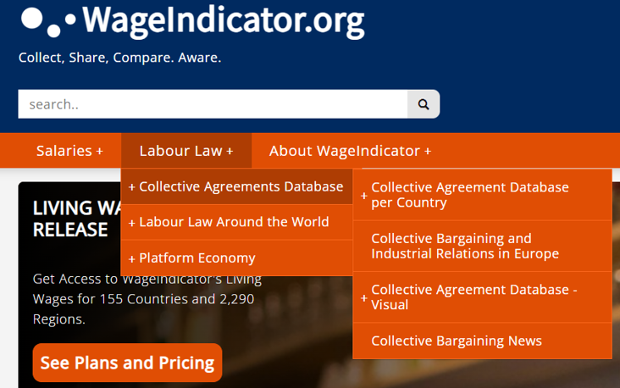
The WageIndicator Collective Agreements Database in numbers
Established in 2012
Currently hosting more than 2200 CBAs from 67 countries all over the world, in 27 languages
Agreements are collected, annotated (coding scheme with around 800 variables) and published in WageIndicator national websites, all in national languages
12 main macro-topics

Slide 4
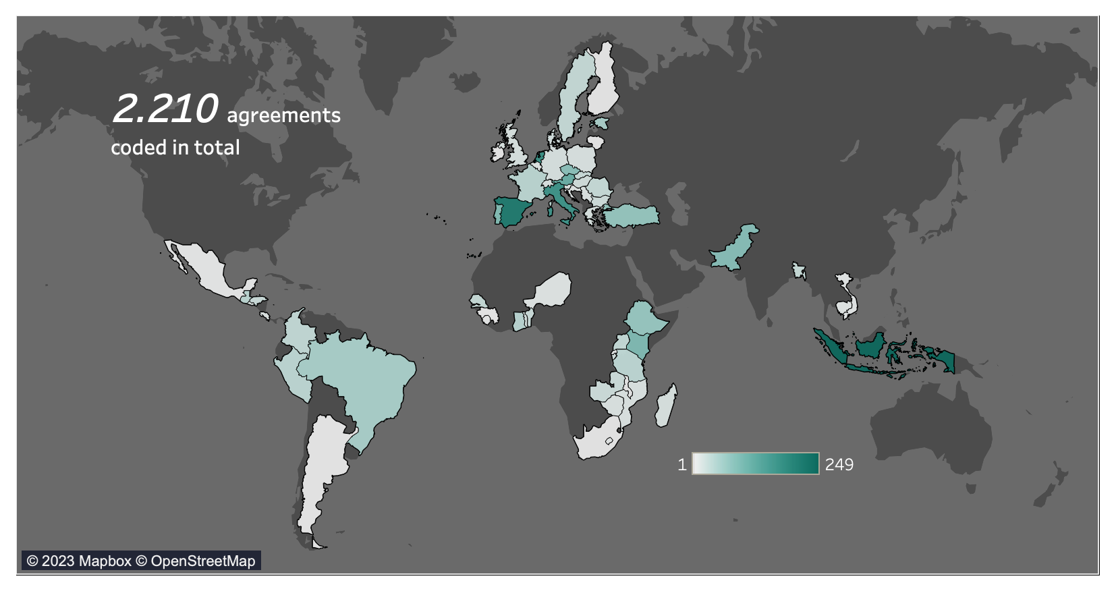
CBAs around the world

Slide 5
The CBAs Database team
A skilled multilingual team of professionals:
Around 20 people currently involved (annotators and researchers)
20 languages spoken at a mother tongue level
Coders who are able to manage multiple languages

Slide 6
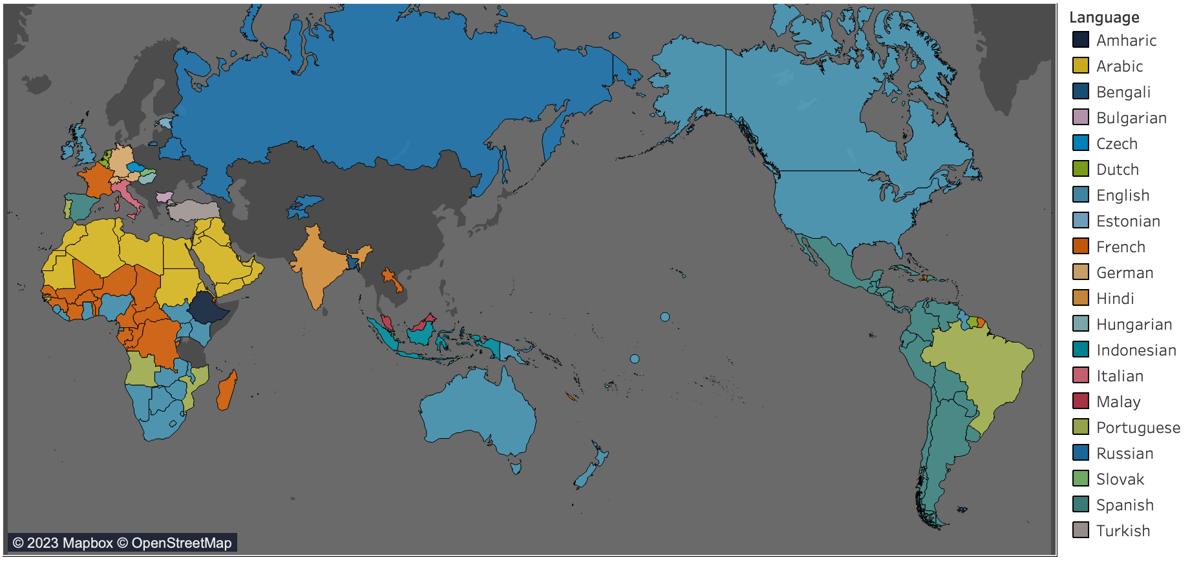
Languages spoken by the CBAs Database team

Slide 7
Collecting, annotating and coding agreements
THE PROCESS OF ANNOTATION
1.
JPEG / PDF / Scanned document
Html navigable text
Word document
OCR software
Html editor
2.
The text is uploaded in WageIndicator system, called COBRA.
3.
Questions are answered and clauses are selected about 12 macro topics.

Slide 8
Anonymization of CBAs
If explicitly requested, we can guarantee two options:
A: The CBA can be fully hidden to the public. This means that the text will not be published at all and it will only be coded and analyzed internally, for research purposes.
B: The CBA can be published but without showing any sensitive data regarding the signatories. All the referring data regarding the signatories are deleted by our team prior to publishing the text of the agreement on the WageIndicator website.

Slide 9
Collecting, annotating and coding agreements
THE TOPICS CODED IN COBRA
Social security and pensions
Individual employment contracts / job security
Work-life balance arrangements
Wages
Equality and/or violence in the workplace
New Technologies & Green clauses
Working hours, schedules, holidays and days of leave
Workers’ Representation & Conflicts
Training / apprenticeship
Health and medical assistance
Sickness and disability

Slide 10
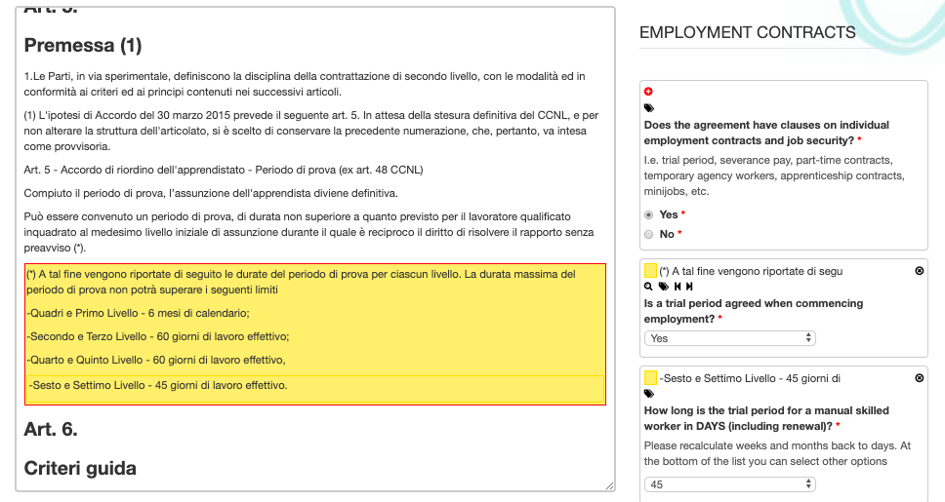
Collecting, annotating and coding agreements
‘COBRA’ ANNOTATION SYSTEM used by annotators :
https://cobra.wageindicator.org

Slide 11
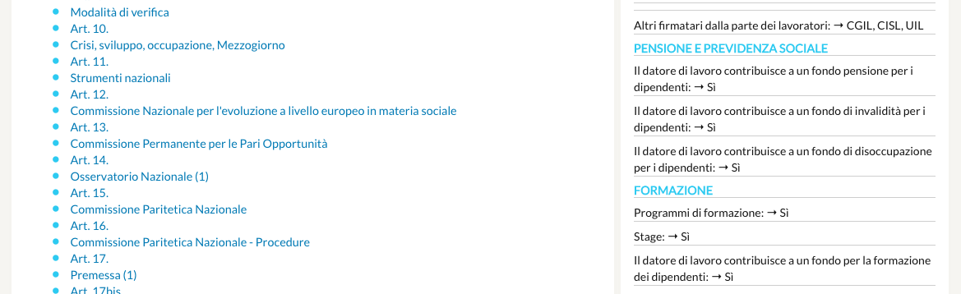
Collecting, annotating and coding agreements
WHAT CBAs LOOK LIKE ONLINE to users (i.e., citizens, trade unions, researchers) :
https://wageindicator.org/cbadatabase

Slide 12
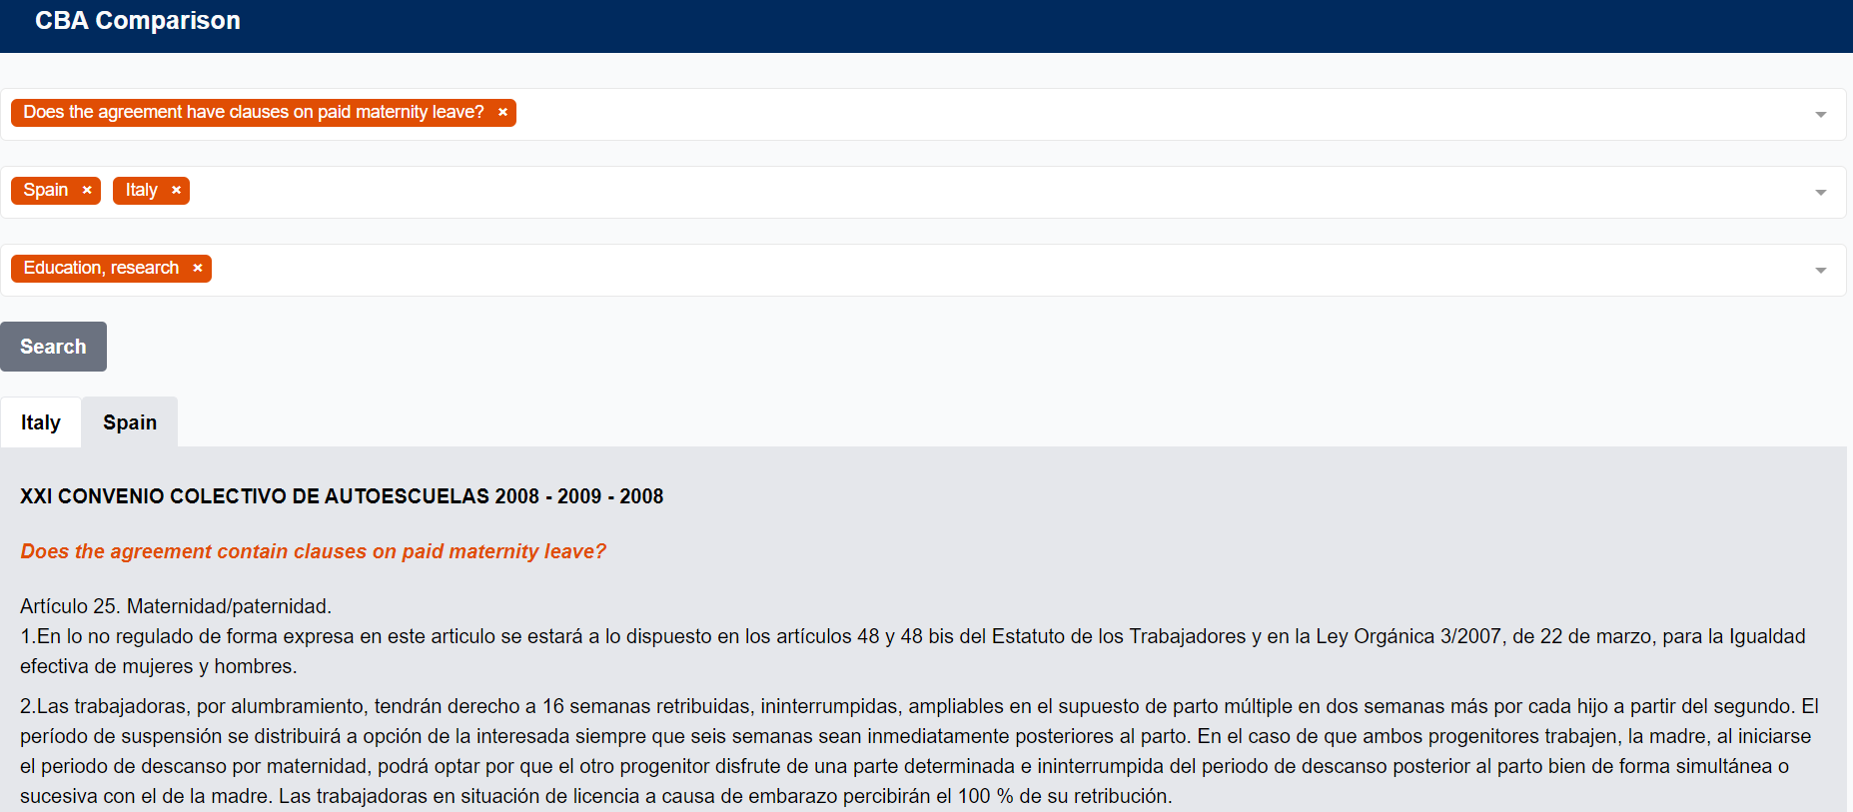
THE COMPARISON TOOL:
Compare the articles of the Collective Agreements across topics, sectors and countries

Slide 13
Comparative analysis of collective agreements
Which comparisons are possible through the CBAs comparison tool?
Cross-country comparison on some topics/provisions (e.g., Gender Equality and Work/Family Balance Arrangements in Collective Agreements in Africa, Latin America and South East Asia, on the basis of the WageIndicator CBA Database - Amsterdam: WageIndicator Foundation. Copyright © 2016 International Labour Organization · 1 dic 2016)
Changes over time in one country/sector/CBA (eg BARCOVID)
Variations between different CBA types (eg MEB-SEB in LevelUp)
Qualitative analysis on clauses.

Slide 14
A comprehensive coding scheme* in continuous evolution…
According to:
Findings coming from the CBAs analysis
Annotators and researchers’ inputs and insights
Industrial relations Projects (ongoing, in the pipeline as well as potential ones)
Highly relevant topics emerging in the public debate: remote work, Industry 4.0, green transition, wages, AI (artificial intelligence) in collective bargaining
*See the latest CBAs Database Codebook available here: Ceccon, D., Medas, G. (2022). Codebook WageIndicator Collective Agreements Database – Version 5 – February 2022. WageIndicator Foundation, Amsterdam.

Slide 15
Projects of the WIF CBAs Database
Analysis of CBAs are key for every social dialogue project which aims at understanding the collective bargaining
Past projects
  Several Living Wage and Decent Wage projects (2012-2017): CBAs in Africa, Latin America and South-East Asia
  BARCOM (Contents of CBAs in the commerce sector in the EU)
  COLBAR (Contents of CBAs in all sectors in the EU)
Current projects
  BARMETAL (Contents of CBAs in the metal sector & developing coding scheme for automatization, digitalization and decarbonization)
  AI in Collective Bargaining
  LEVEL-UP (Increase collective bargaining coverage by levelling-up bargaining to the sectoral/multi-employer level)
  BARCOVID (Effects of COVID on bargaining & building a time series)
  BARWAGE (Coding pay scales & sampling)
  EUROFOUND CBA Database (Wage floors & sampling)
  SSHOC (machine reading / NLP – Natural Language Processing techniques)
  Decent work and living wages projects in garment sector in Indonesia and garment and flower sectors in Ethiopia
Projects in the pipeline
  BARSERVICE: Support smart collective bargaining in the services sector in Europe: overview, challenges, opportunities
  BARTIME: The monetary rewards of working time dimensions in collective bargaining in Europe

Slide 16
THANK YOU
Daniela Ceccon
Director Data at WageIndicator
  danielaceccon@wageindicator.org
Gabriele Medas
Manager of the WageIndicator Collective Agreements Database
  gabrielemedas@wageindicator.org

