Slide 1


Female friendly clauses in collective bargaining agreements
Rupa Korde and Mahika Gandhi
Economics and Public Policy Department
FLAME University, India

Slide 2

Funding acknowledgements
BARWAGE is a project within the Social Dialogue Program of the European Commission. (SOCPL-2021-IND-REL - Project ID 101052319)
BARMETAL is a project within the Social Dialogue Program of the European Commission. (SOCPL-2021-IND-REL – Project ID 101052331)
BARCOVID is a project within the Social Dialogue Program of the European Commission Directorate-General for Employment. Social Affairs and Inclusion (VS/2021/0190)
Laudes Foundation for funding improving working conditions in Indonesia, see https://wageindicator.org/about/projects/makin-terang-improving-work-and-worker-representation-in-indonesia.
The papers presented solely reflects the opinion of the authors and does not necessarily reflect the official opinion of the funder

Slide 3
Introduction
The potential women workforce is almost 50%, however the global FLFPR is only about 50%, whereas that of men is almost 80% (ILO, 2017)
One of the biggest barriers affecting women’s participation in the labour market is the work-life balance
Governments as well as researchers suggest that including women friendly and gender equality clauses in CBAs may encourage more women to participate in the labour market

Slide 4
Research Objectives
To assess and compare the inclusion of female-friendly clauses in the CBAs across countries using WageIndicator’s CBA database
To study the relationship between female labour force participation rate and the extent of female-friendly clauses in the CBAs

Slide 5
Data and Research Methodology
Focus on Gender equality issues and Work/family balance arrangement
 | WageIndicator CBA Database | Research Paper
Topics | 12 | 2
Variables | 749 | 35
WageIndicator’s CBA Database
Topics covered:
General CBA data
Job titles
Social security and pensions
Training
Employment contracts
Sickness and disability
Health and medical assistance
Work/family balance arrangements
Gender equality issues
Wages
Working hours
Coverage
Categorized into 6 themes
CBA Clause | Number of Clauses
Maternity Leave | 8
Health and Safety | 7
Breastfeeding | 7
Paternity Leave | 2
Gender Equality | 11

Slide 6
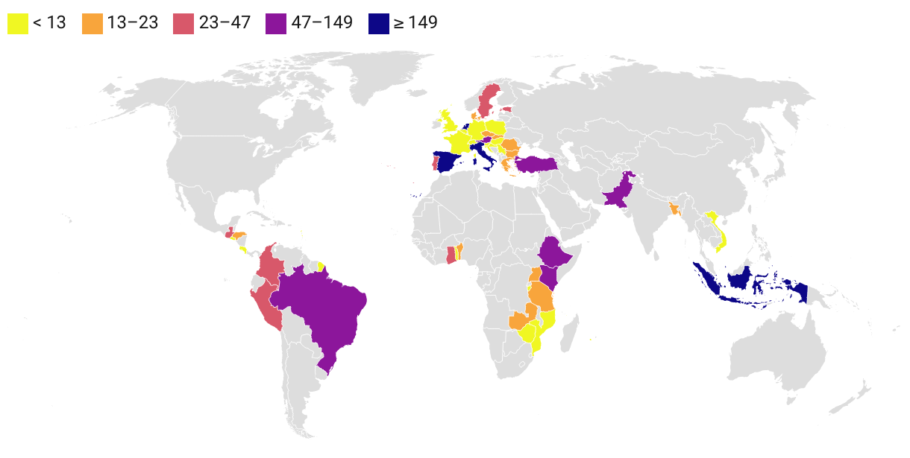
Number of CBAs across countries
Total CBAs 1668
Countries 47
2012 to 2022
Only those countries with more than five CBAs in the WageIndicator CBA database are considered for the analysis

Slide 7
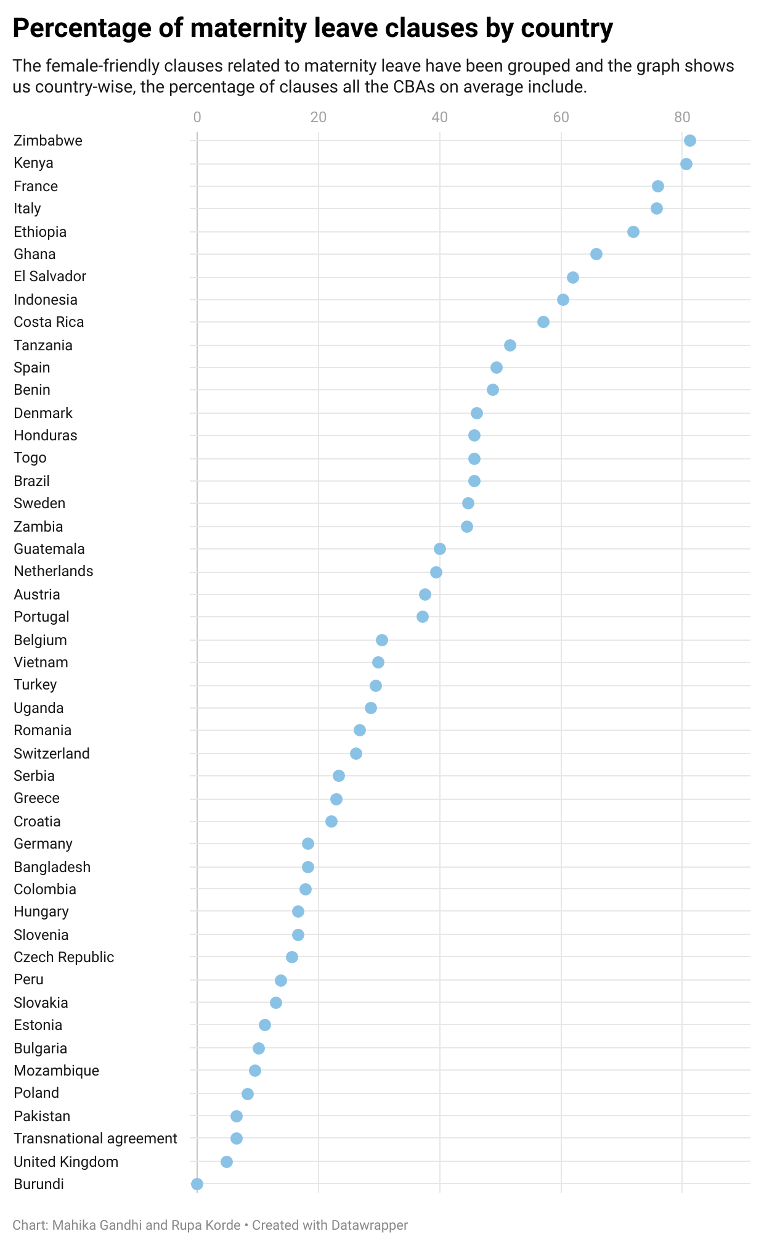
Maternity Leave Clauses
Percentage of maternity leave clauses in CBAs across countries
African countries are at the top the scale - Zimbabwe and Kenya stand out as leaders in this regard, with an astounding average of 80% of maternity leave clauses.
Burundi, on the other hand, trails substantially behind, with a remarkable absence of any kind of maternity leave clauses.
Ethiopia and Ghana are also amongst the top, with 65%+ of maternity leave clauses in their CBAs, on average.
Further, the European countries, France and Italy are amongst the top 5 at 75%.
No clear regional pattern

Slide 8
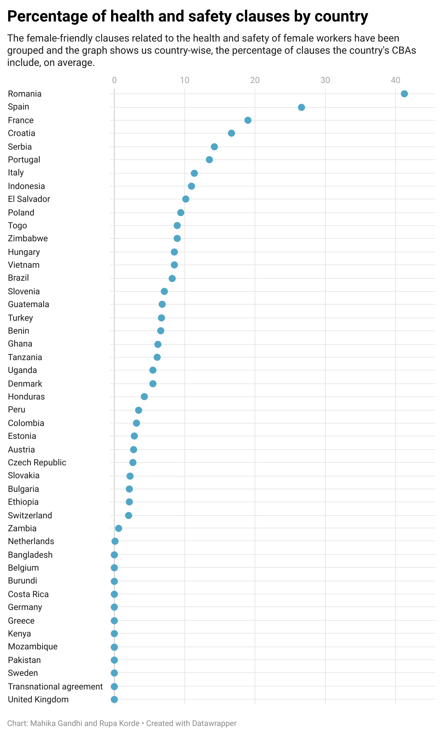
Health and Safety Clauses
The analysis of Collective Bargaining Agreements (CBAs) reveals a concerning trend regarding the inclusion of female-friendly health and safety clauses across most countries.
A majority lie between 0 to 10% of health and safety clauses in their CBAs.
Top 7 positions are held by European nations, with Romania at the top

Slide 9
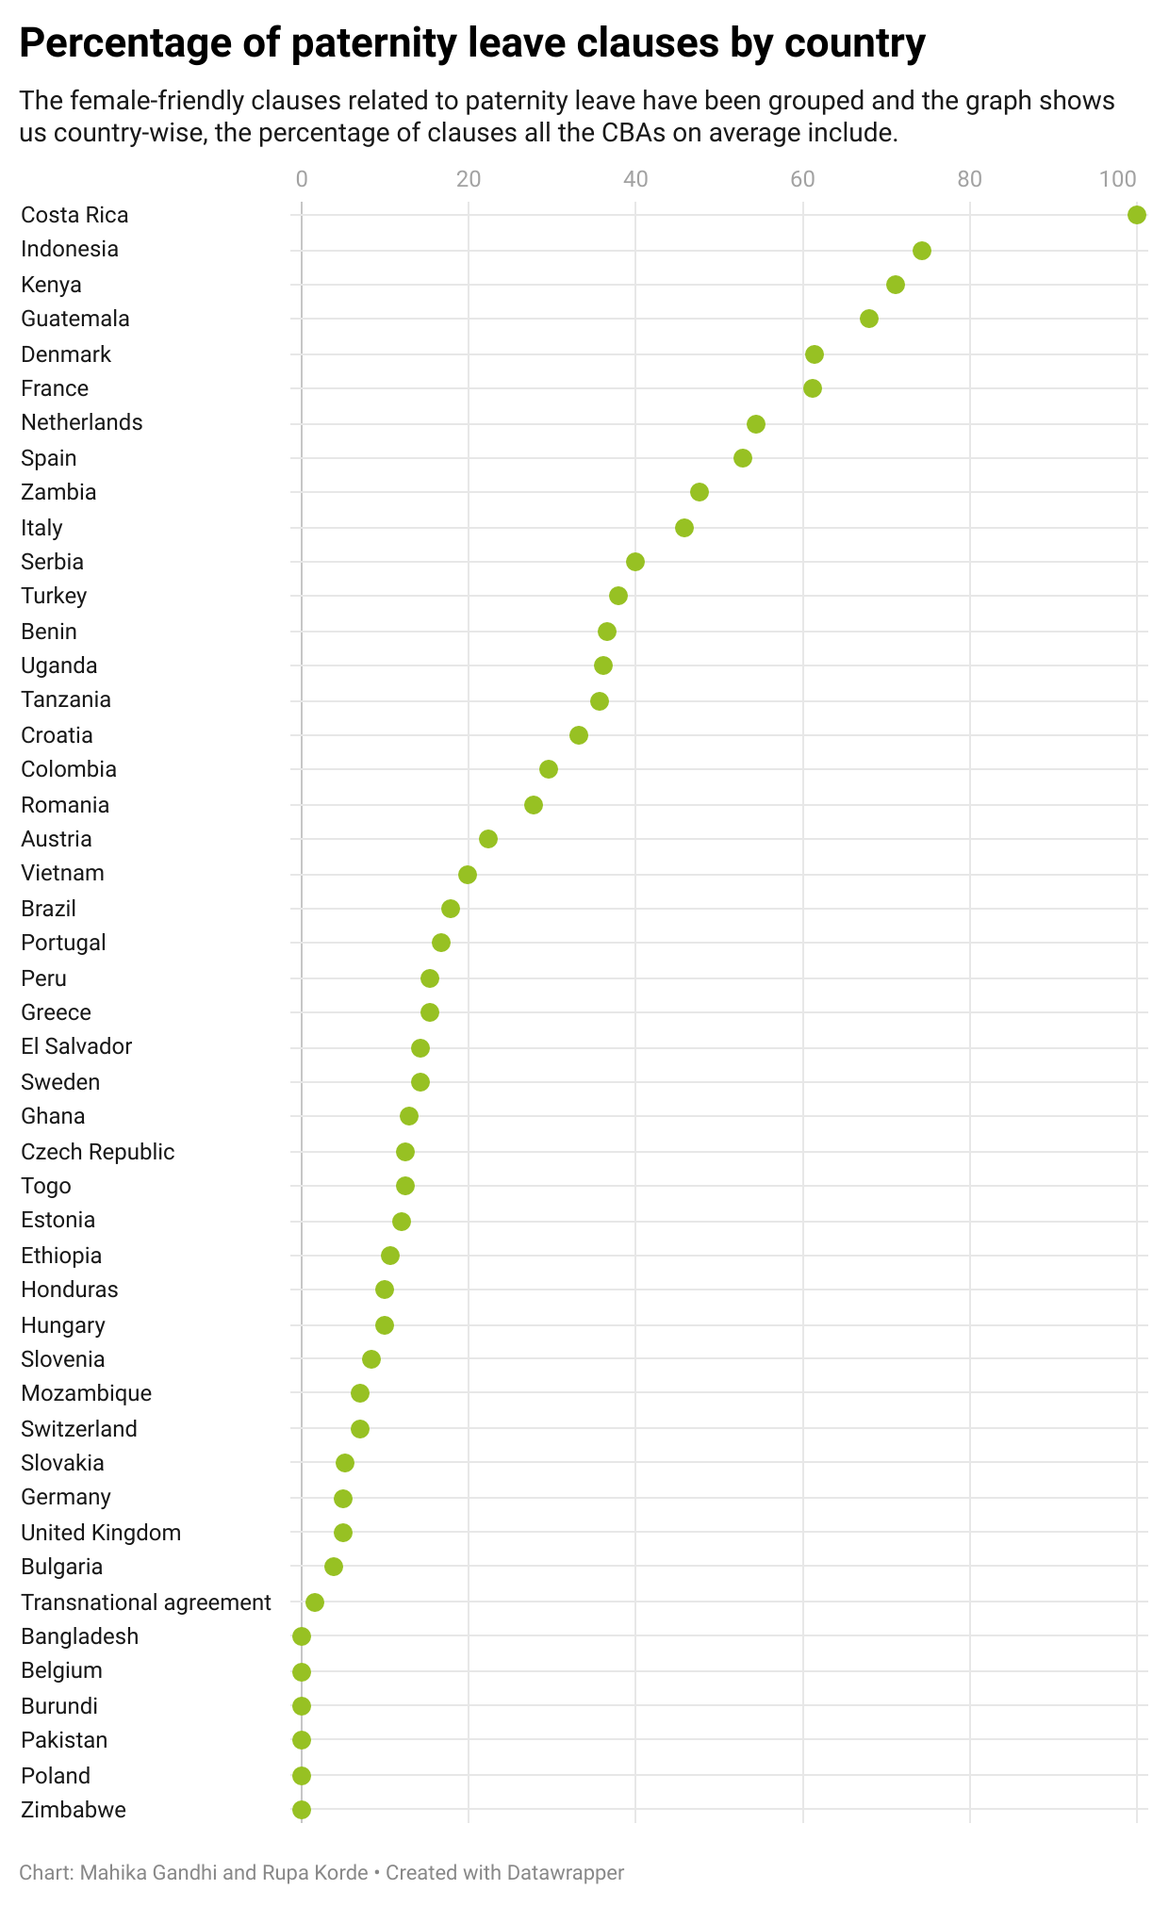
Paternity Leave Clauses
Paternity leave clauses in Collective Bargaining Agreements (CBAs) show no distinct regional trend.
Costa Rica takes the lead by including paternity leave clauses in all of its CBAs
Indonesia and Kenya also deserve recognition for their efforts, as they include over 70% of these clauses, on average, in their CBAs.
On the other end of the spectrum, countries such as Pakistan, Burundi, Bangladesh, Belgium, and Poland lag behind in terms of including paternity leave clauses in their CBAs.

Slide 10
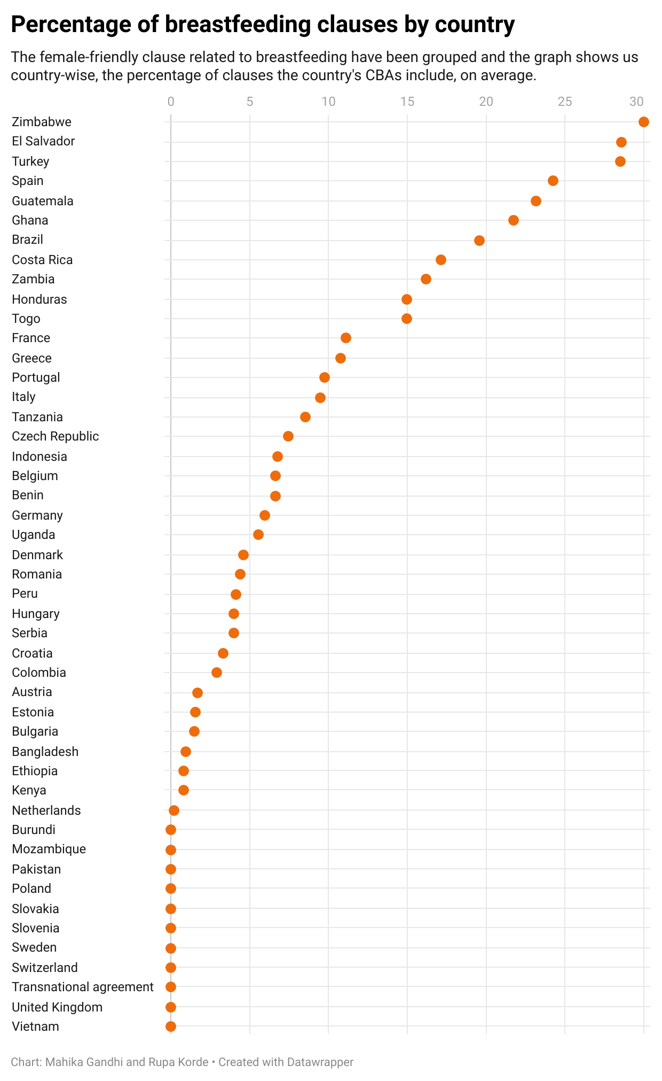
Breastfeeding Clauses
Zimbabwe emerges as a frontrunner with an average inclusion of 30% of such clauses
Notably, Central American countries showcase commendable progress in this area. El Salvador and Guatemala join the ranks of the top 5 countries with significant inclusion of breastfeeding clauses in their CBAs.
Furthermore, European countries also excel in prioritising breastfeeding clauses. Turkey and Spain secure their positions among the top 5.

Slide 11
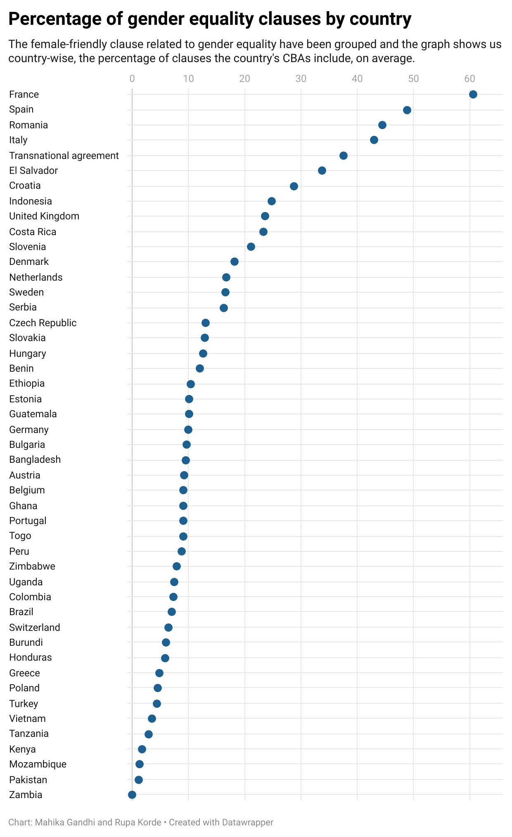
Gender Equality Clauses
Spain, Romania, and Italy stand out by including over 40% of these clauses, on average, in their CBAs.
France, in particular, incorporates 60% of these clauses in its CBAs.
However, there is room for improvement in several regions. African countries, including Tanzania, Kenya, Mozambique, and Zambia, along with Asian countries like Vietnam and Pakistan, have a significant opportunity to enhance the inclusion of gender equality clauses in their CBAs.

Slide 12
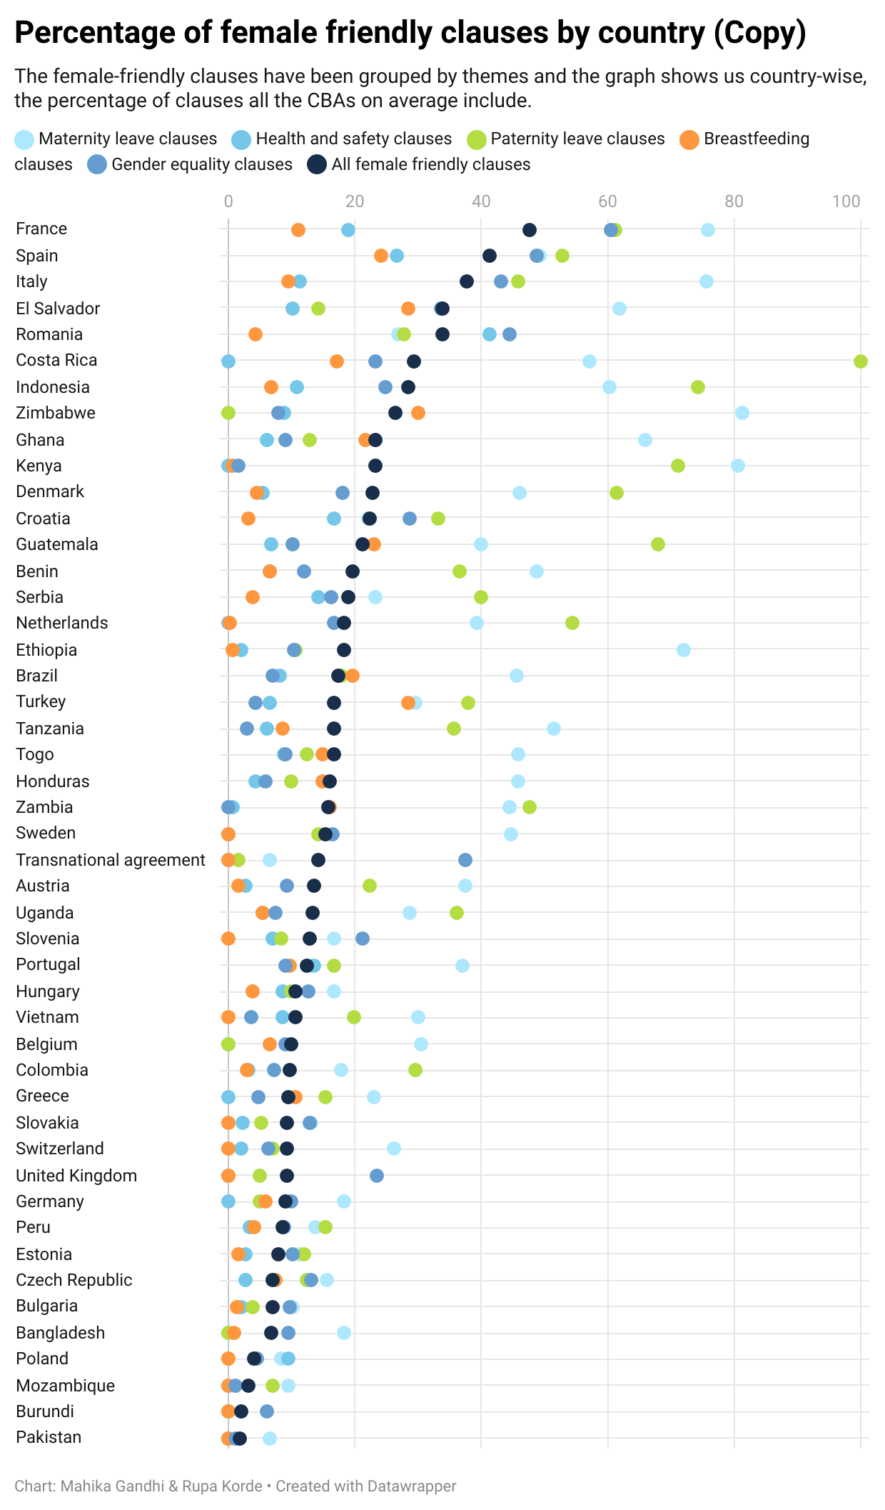
Female-friendly clauses by
Country - Average
A majority of countries' CBAs exhibit a significant inclusion maternity and paternity leave clauses.
Remarkably, all of Costa Rica’s CBAs included all paternity leave clauses.
However, when examining the overall average, it becomes apparent that there are areas where CBAs are lacking.
Specifically, there is a notable scarcity of breastfeeding clauses, and gender equality clauses across most countries
The CBAs in France, on average have 47.57% of all the female-friendly clauses, the highest in the world while Pakistan has the lowest, at 1.8%.

Slide 13
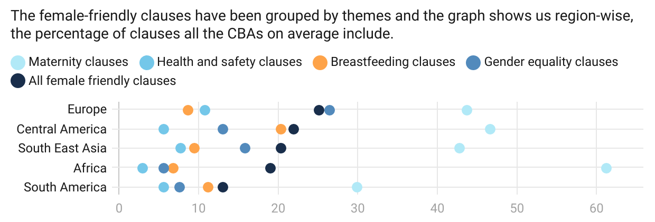
Percentage of Female-friendly Clauses by Region
The analysis of collective bargaining agreements (CBAs) across different regions reveals trends that align with the earlier observations. It is notable that, regardless of the region, CBAs universally exhibit a low proportion of breastfeeding and health and safety clauses.
The CBAs in all the regions have on average, 40-50% of the paternity leave clauses we are studying. South America’s CBAs, have a lower percentage of paternity leave clauses, with an average of only 20%. Furthermore, when considering the overall inclusion of female-friendly clauses, South America's CBAs exhibit the lowest percentage among all the regions.

Slide 14
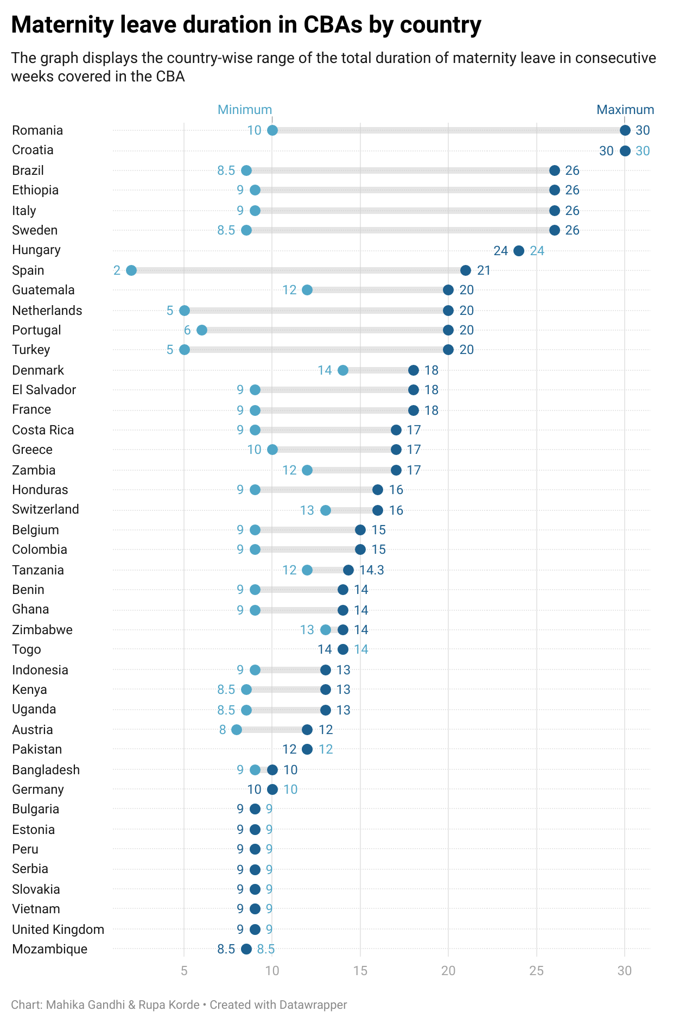
Maternity Leave in CBAs
There is a huge disparity across the countries when it comes to maternity leave.
All CBAs from Croatia have the 30 weeks of maternity, which is currently the highest amongst all the countries.
Romania also has a maximum of 30 weeks, however, there are also CBAs which mention only 10 weeks.
Mozambique has the lowest maternity leave at 8.5 weeks.
There is no clear regional trend that can be established, however many European countries lie at the bottom of the chart when it comes to maternity leave.

Slide 15
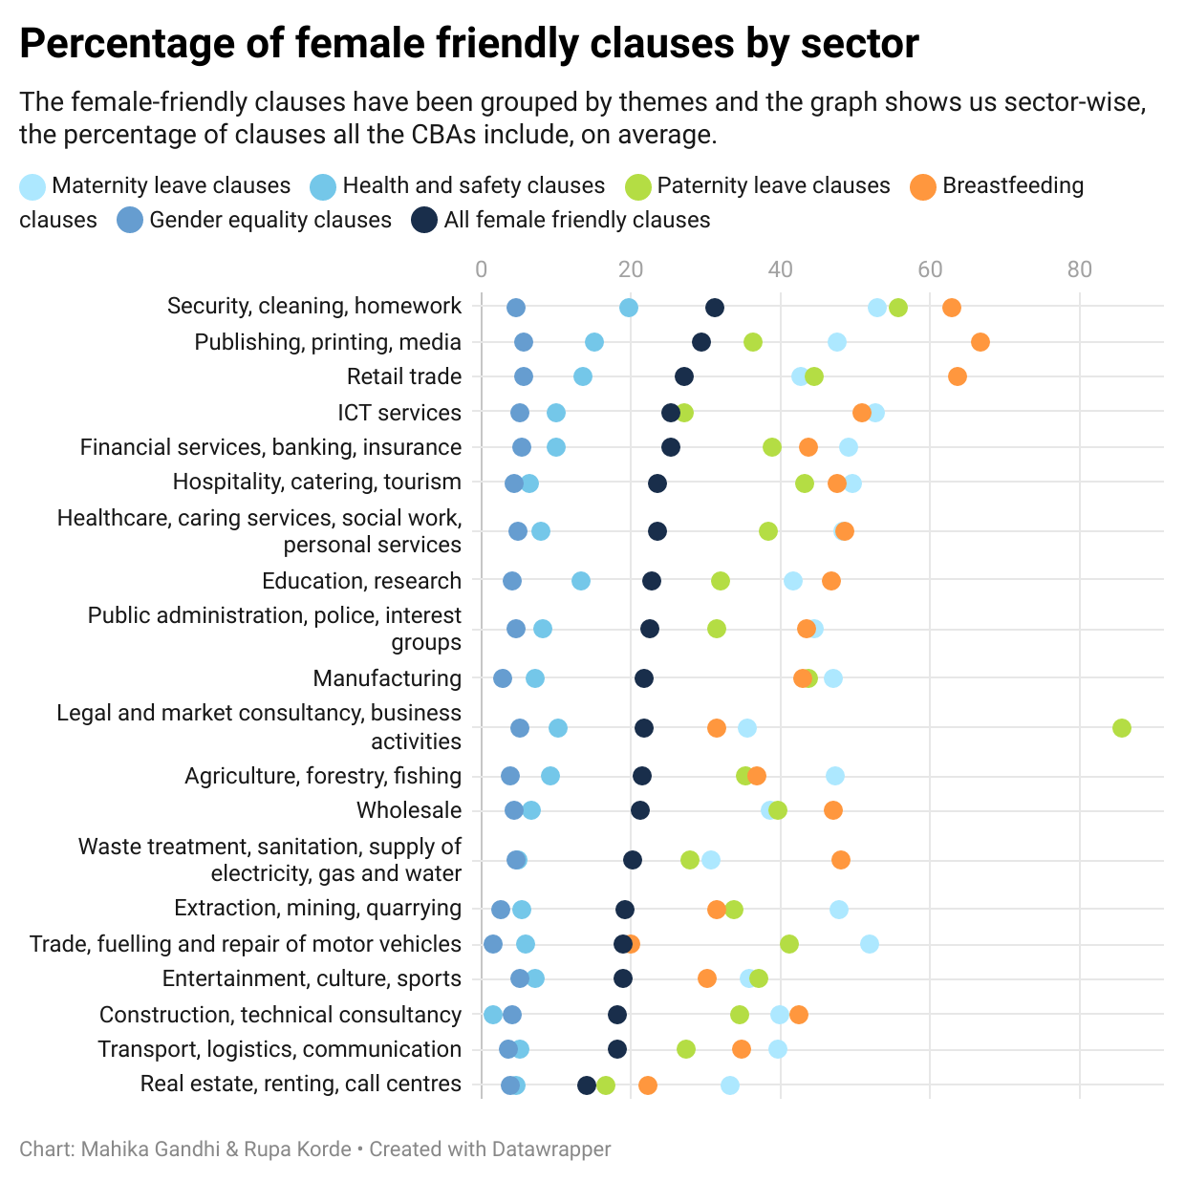
Percentage of female-clauses by sector
In the realm of security, cleaning, and homework sectors, collective bargaining agreements (CBAs) tend to include a substantial proportion of provisions that are conducive to fostering a female-friendly work environment.
The sector on average has 31% of these female-friendly clauses and most sectors are above the 20% mark.
However, certain areas lag behind in terms of incorporating female-friendly measures into their CBAs. Specifically, the real estate, renting, and call centre sectors exhibit the lowest percentage of such provisions, standing at a mere 14%.

Slide 16
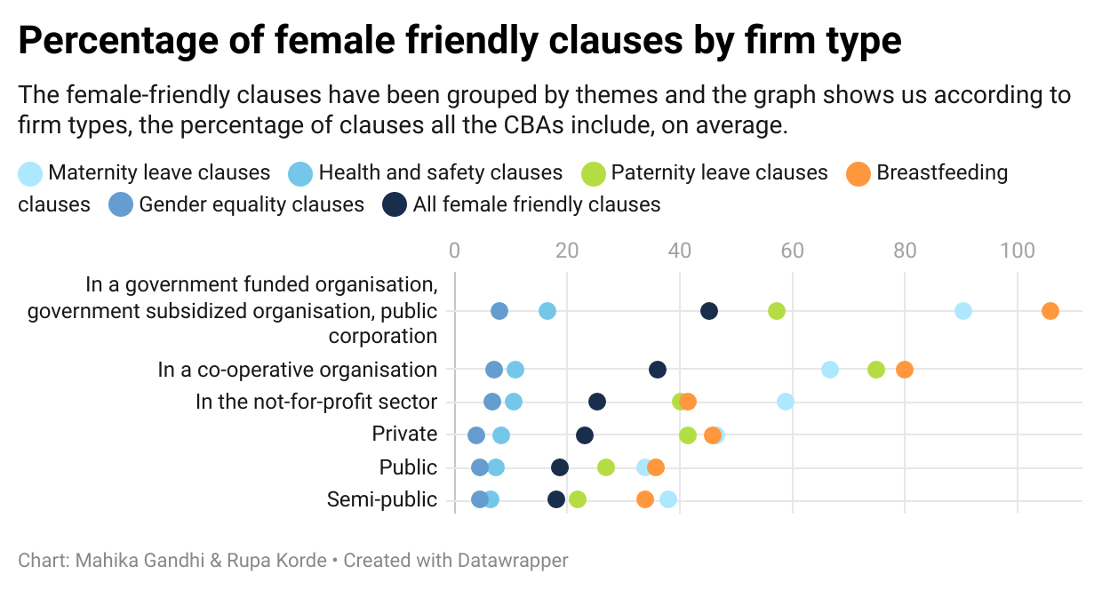
Percentage of female-clauses by Firm-type
Collective bargaining agreements (CBAs) in government-funded organizations stand out by having the highest percentage of female-friendly clauses, including more than 40% of female-friendly clauses.
However, all firms lack in terms of gender equality and health and safety clauses.

Slide 17
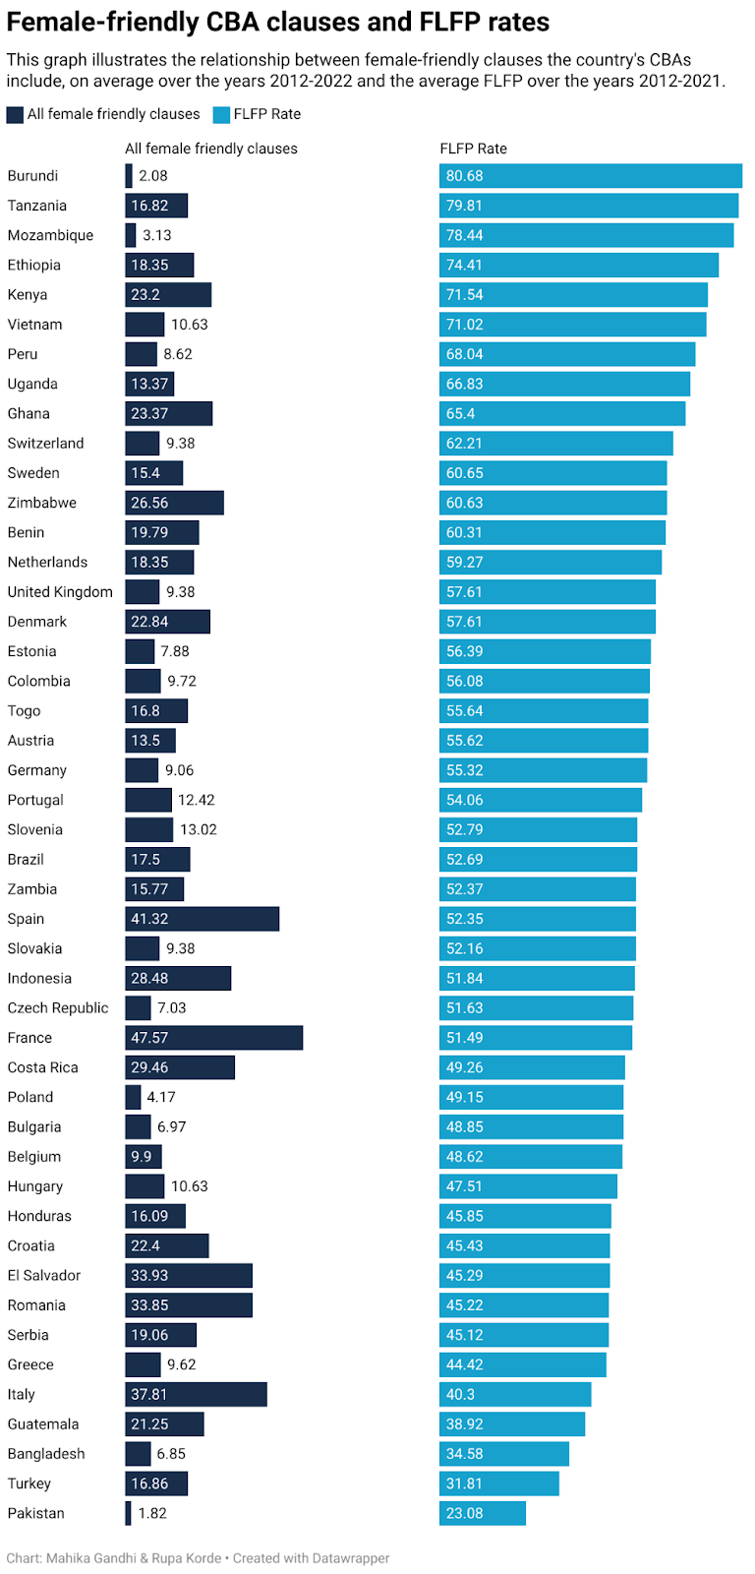
Female Labour Force Participation Rate and Female-friendly CBA Clauses
There is no significant correlation between average FLFPRs and the presence of female-friendly clauses within CBAs.
This suggests that there might be other influential factors at play such as societal norms, educational opportunities, and economic conditions when it comes to determining FLFPRs (Klasen, 2019). While CBAs play a crucial role in shaping workplace policies and conditions, they do not encompass all industries and job sectors.

Slide 18
Conclusion
The analysis of 35 female friendly clauses in CBAs using the WageIndicator CBA database provides insights into gender equality and work/family balance status of 47 countries.
Most countries include maternity clauses in their CBAs, however African countries perform better in this aspect.
Breastfeeding clauses can be a factor affecting higher FLFPRs
All countries in question perform poorly on gender equality clauses
Overall, European countries include more female friendly clauses as compared to the other regions
However, this does not translate into improved FLFPRs
Future direction:
  Individual CBA clauses tested for association with FLFPRs to identify the crucial CBA clauses affecting FLFPRs
  Country-level assessment of sectoral and firm-type and its relationship with FLFPRs

