Slide 1
Collective Bargaining After Labor Law Reform in Indonesia A National-Level Analysis on the WageIndicator Collective Bargaining Agreement Database Prepared for “8th Conference of the Regulating for Decent Work Network” on Ensuring decent work in times of uncertainty 10-12 July 2023 Nadia Pralitasari WageIndicator Foundation The authors acknowledge gratefully the Laudes Foundation for funding improving working conditions in Indonesia, see https://wageindicator.org/about/projects/makin-terang-improving-work-and-worker-representation-in-indonesia.

Slide 2
Collective Bargaining in Indonesia
“No Negotiations if No Legal Basis?”
Based on data published by the Ministry of Manpower, only 1.25% of the company had a registered Collective Bargaining Agreement (CBA) out of 1,247,660 companies that were listed in the Mandatory Labor Report application as of 31 December 2022
Low level of unionization (11%) limits trade union bargaining power
The existence of company's trade union does not guarantee a smooth CBA implementation process.
The normative legal framework serve as an upper limit in Indonesian CBA negotiations – become apparent after the passing of Omnibus Law
The Omnibus Law has led to significant increase in the duration of negotiation processes for CBAs - Employers seek to align their latest company CBA with the Omnibus Law while trade union safeguard the agreed upon CBA
What is the impact of Omnibus Law on the content of Collective Bargaining Agreement in Indonesia?

Slide 3
Labor Law Reform Changes in Indonesian Labor Law
The Indonesian Parliament passed the Job Creation Law (Law No. 11/2020) on November 2, 2020, known as Omnibus Law
On March 21, 2023, the House of Representatives passed an Act with the same title, Law No. 6/2023 on Job Creation
Labor Law No.13/2003 was amended by the Omnibus Law. While certain labor protection have improved, others have declined
Improvement | Regression
a. Compensation for contract workers upon termination
b. The legal consequences of the terms of a contract
Revision: Worker’s years of service is calculated from the date of fixed-term employment contract begin
c. Prohibition of probation period for contract workers
Revision: not only granted with permanent status, the probation period is counted as working period for the worker.
d. Employment termination notice
e. Unemployment benefit scheme
a. Fixed-term employment contracts period extended from 3 to 5 years
b. Removal the limitations to outsourcing certain types of work
c. Removal the legal consequences of outsourcing implementation violations that regulate worker employment relations with the outsourced company changed to the company providing the job.
d. Longer overtime hours
e. Removal the Sabbatical leave
f. Reduction termination compensation for permanent worker
g. Abolished the cost of the living survey on the minimum wage formula
h. Exemption of MSMEs workers receive a number of rights
i. Simplifies the recruitment of Foreign Workers which has the effect of competing with local employees

Slide 4
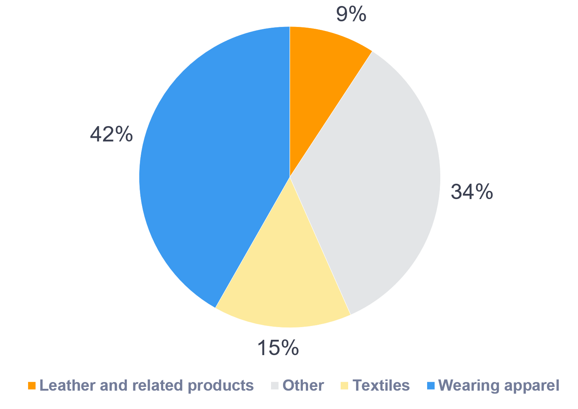
WageIndicator Collective Bargaining Agreement Database
The WageIndicator CBA Database lists 10 main topics that CBA contents cover:
Job titles,
Training,
Social Security & Pensions,
Employment Contracts,
Sickness and Disability,
Health and Medical Assistance,
Work-Family Balance Arrangements,
Gender Equality Issues,
Working Hours,
Wages
Sub-questions are used to analyze each main topic. This specific study analyzes 110 subtopics related to 10 main topics
In Indonesia, WageIndicator collects CBAs from trade union partners and request registered CBA at the local manpower department
A total of 249 CBAs are annotated and available in WageIndicator’s CBA Database.
Out of 249 CBAs in WageIndicator’s system, 164 CBAs are from wearing apparels (104 CBAs), textile (37 CBAs), leather and related products (23 CBAs)

Slide 5
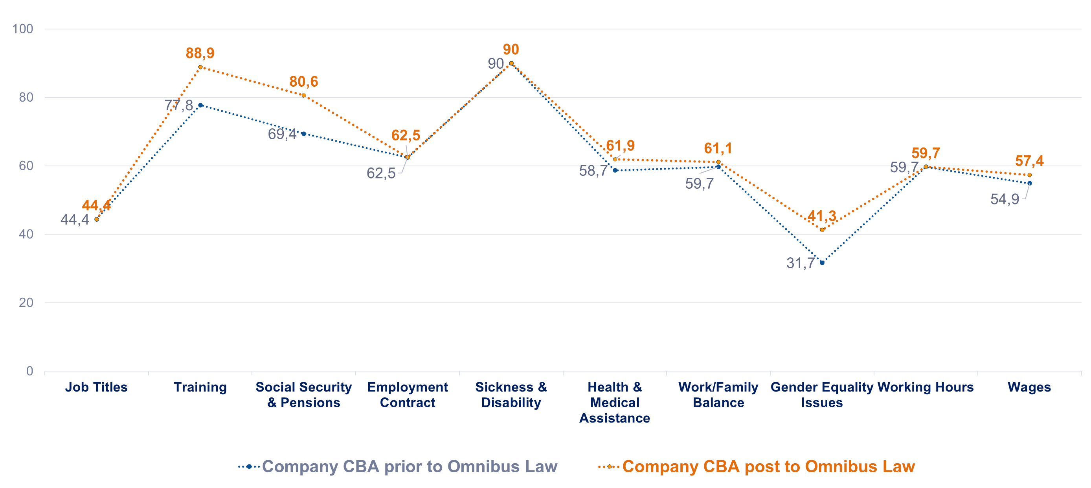
CBA Comparison Pre- and Post Omnibus Law Comparison on average % of each WageIndicator coded main topics in 9 renewed company Collective Bargaining Agreement content
Data compared 18 garment, textile, and footwear CBAs from 9 companies signed pre- and post the Omnibus Law - which become the focus of the paper
Improvement is measured by two main variables. First, new CBA clauses in unregulated areas. Second, the extent of provision enhancement, such as increasing annual leave days from 12 to 16
Training at 11.1%, gender equality at 9.6%, and social security & pensions at 11.2% show the greatest improvement
Topics that are improving most are either unaffected by the Omnibus Law or made possible by it

Slide 6
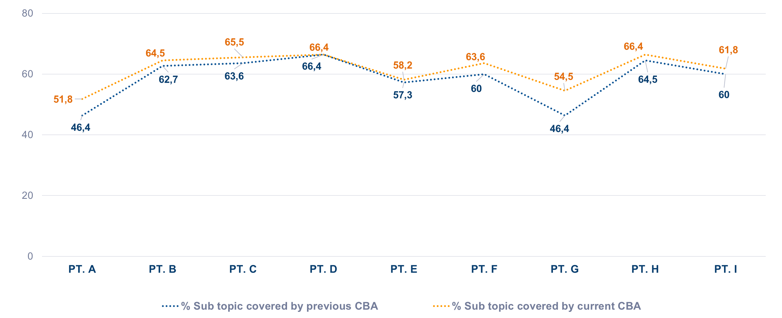
CBA Comparison Pre- and Post Omnibus Law Comparison on average % of all WageIndicator coded sub-topics of the 9 renewed company CBAs post and prior Omnibus Law, categorized by company
Before the Omnibus Law, all 9 companies CBAs covered 58% of the 110 WageIndicator subtopics, the figure improve to 61% after Omnibus Law
8 of the 9 company's CBAs have improve their CBA clauses and provisions. One CBA remain unchanged
Companies with lower starting positions in their CBAs have more potential to improve their CBA than those in top positions

Slide 7
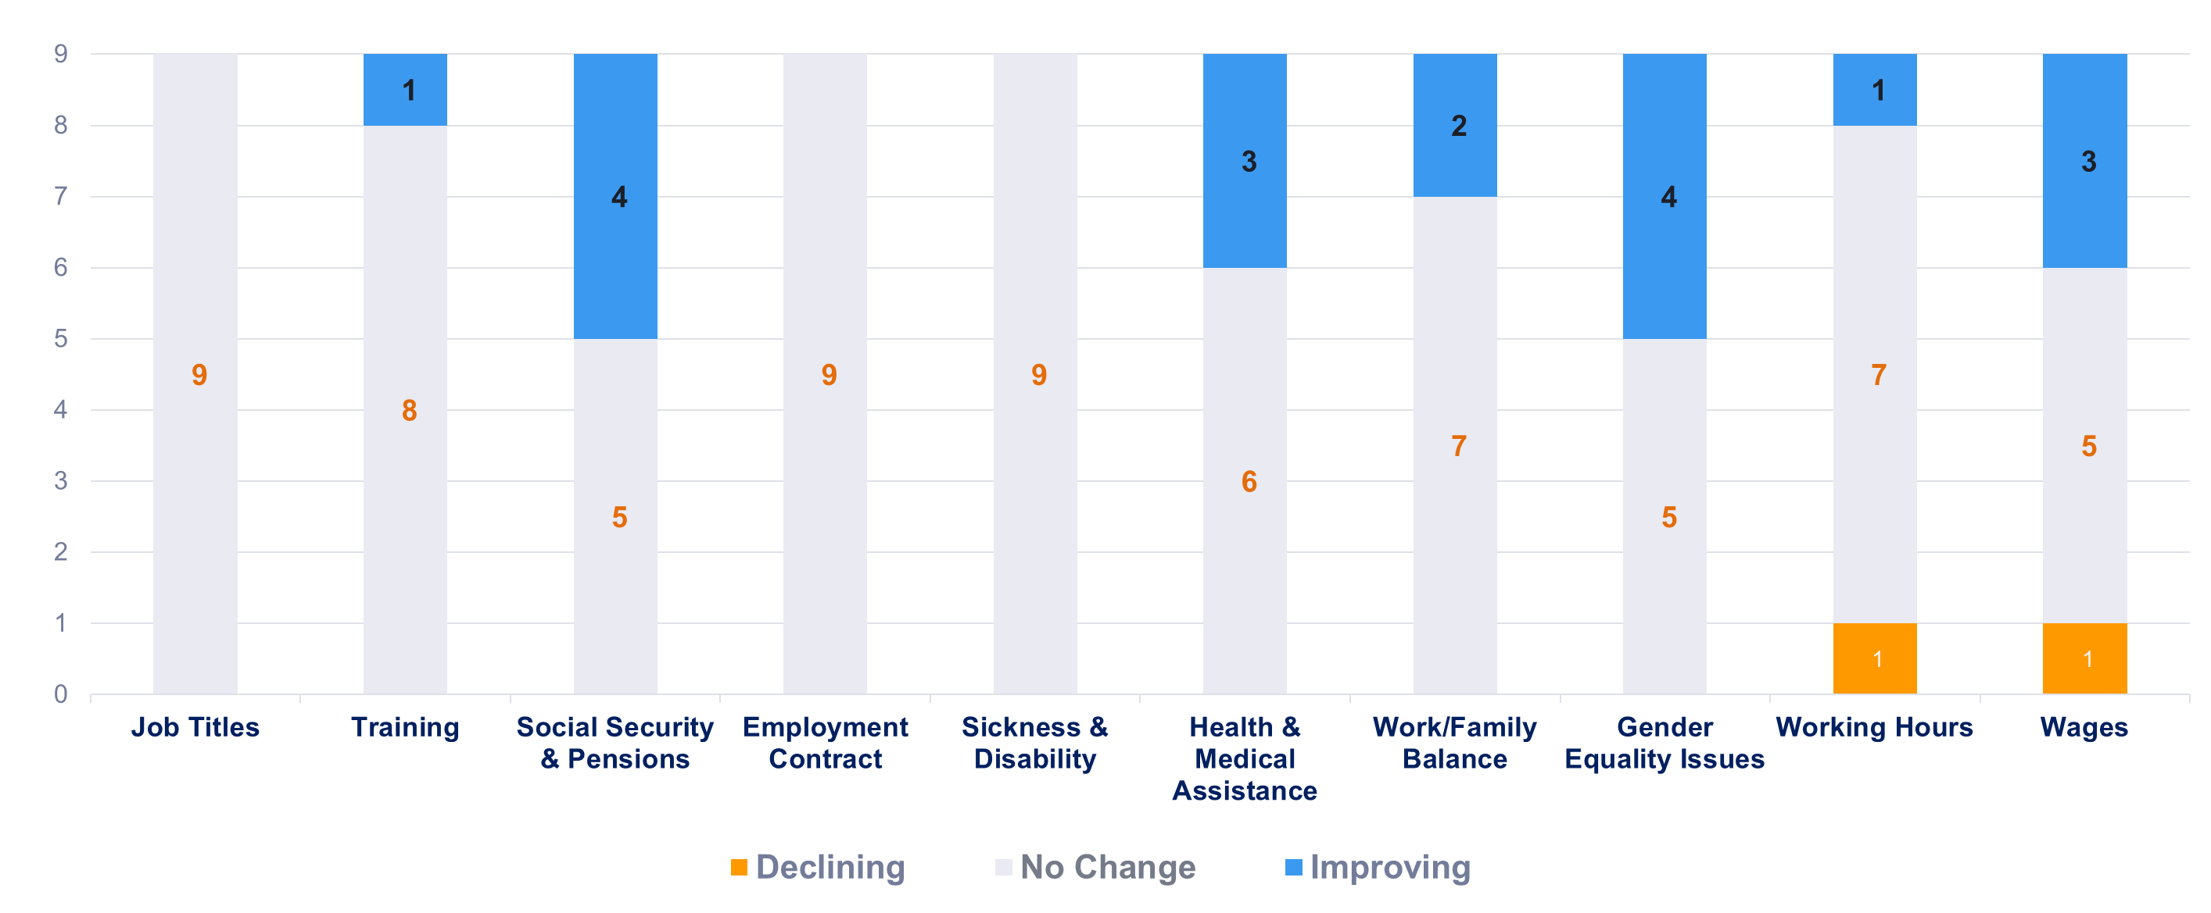
CBA Post Omnibus Law Number of companies that change the clauses and/or provision in their Collective Bargaining Agreement post Omnibus Law, categorized by coded main topics
1 company's CBA clauses/provisions decreased in the working hours and wages topics. However, 1 company improved working hours and 3 improved wages. 4 company enhanced gender equality, social security, and pension CBA clauses
Gender equality – adding clauses on discrimination, sexual harassment, and workplace violence, into their collective bargaining agreements
Health & medical assistance – adding clauses on COVID-19 pandemic, improve provision in protective clothing/gear and health insurance
Trade unions are negotiating for improvements to other clauses unaffected by the Omnibus Law in order to compensate the loss of other clauses

Slide 8
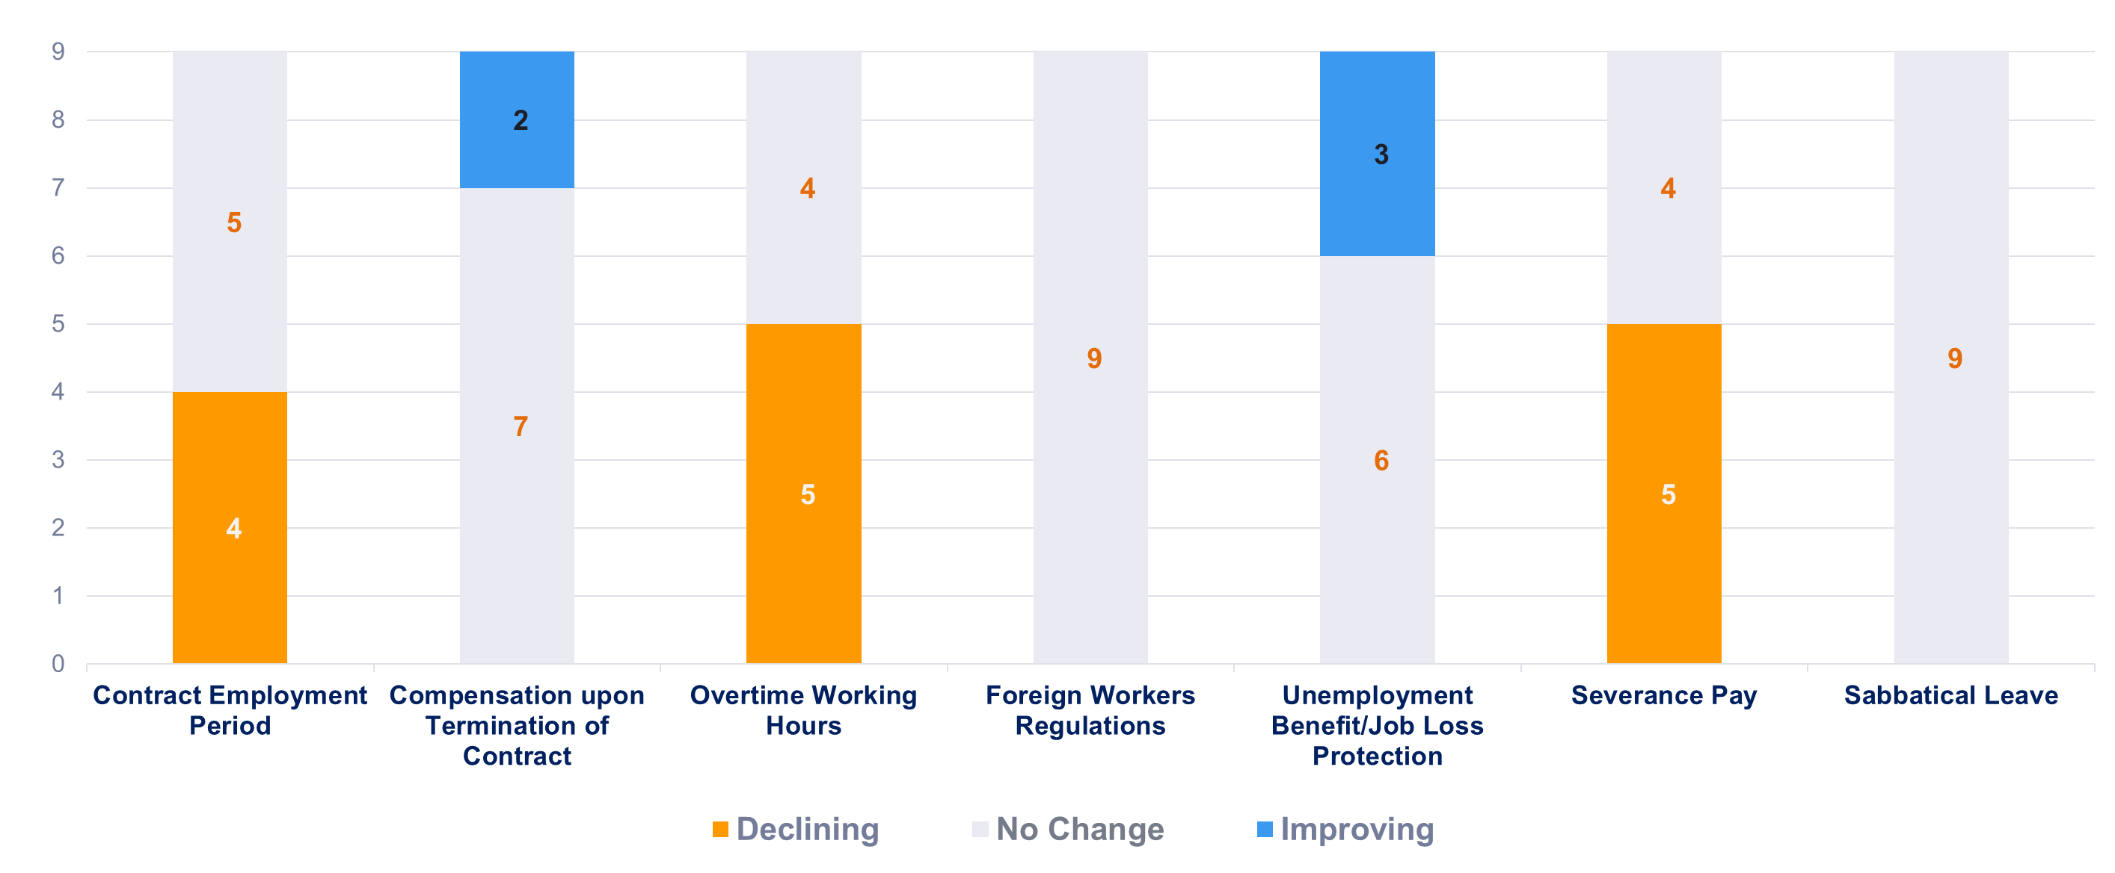
Impact of the amendment’s articles in the Omnibus Law on the content of CBA
Improving Articles in Omnibus Law
Only 2 of 9 companies CBA included contract worker termination compensation clauses in their CBAs
3 companies have included new clauses on unemployment benefits/job loss protection into their CBAs
Declining Articles in Omnibus Law
4 companies revised their CBA to comply with the Omnibus Law, which extends fixed-term contracts to five years
5 companies changed their CBAs to enable 4 hours of overtime per day and 18 hours per week instead of 14 hours per week
5 companies have decreased their CBA severance pay provision to comply with Omnibus Law

Slide 9
Conclusion
What is the impact of Omnibus Law on the content of
Collective Bargaining Agreement in Indonesia?
Omnibus Law has reduced CBA protections in companies, resulting longer overtime hours, less severance pay, and longer employment contract period
Companies with lower starting positions in their pre-Omnibus Law CBA had a substantial increase in their latest CBA clauses/provision compared to those in top positions
Trade unions are using gender equality, work-family, and other agreements to prevent Omnibus Law revisions from lowering their CBA clauses/provision
Shift in the interpretation of the CBA essence, national labor law serves as the normative legal basis as an upper provision
As a result of the Omnibus Law, CBA negotiations become difficult and take longer period due to trade unions' reliance on national labor law

Slide 10
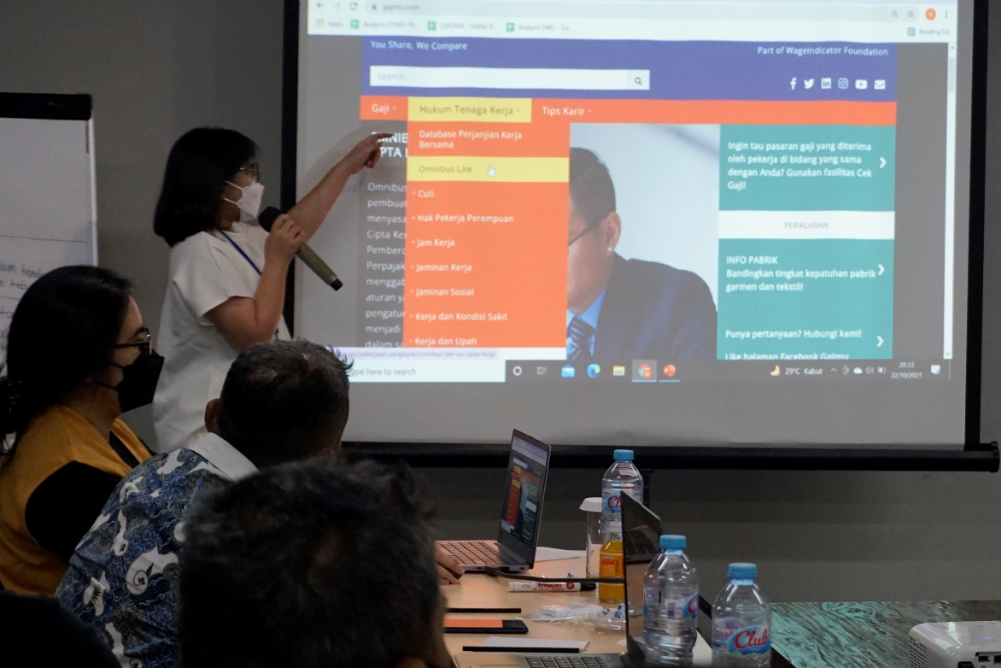
Contact Us
To learn more
www.gajimu.com/garment
Contact: gajimu@wageindicator.org

