Slide 1
Evaluating Fair Pay in the Platform Economy: Insights from the Fairwork Project
Gig Work: Grip on Pay
Dr. Alessio Bertolini
University of Oxford
25 March 2022
Ross Sneddon / Unsplash

Slide 2
Fairwork Principles for Gig Work
Fair Pay​
Workers, irrespective of their employment classification, should earn a decent income in their home jurisdiction after taking account of work-related costs.
Fair Conditions​
Platforms should have policies in place to protect workers from foundational risks arising from the processes of work and should take proactive measures to protect and promote the health and safety of workers.​
Fair Contracts​
Platforms provide clear and transparent terms and conditions and they do not impose unfair contract terms.
Fair Management ​
There should be a documented process through which workers can be heard, can appeal decisions affecting them and be informed of the reasons behind those decisions.
Fair Representation ​
Platforms should provide a documented process through which worker voice can be
expressed. Irrespective of their employment classification, workers should have the right to
organise in collective bodies, and platforms should be prepared to cooperate and negotiate with them.

Slide 3
Methods: Data Collection
Desk research
+
Worker interviews
+
Manager interviews
Map the largest and most influential platforms operating in each country, as well as identifying points of contact or ways to access workers
Interview 6-10 workers per platform. This allows us to understand the process of work and the ways it is carried out and managed, as well as confirm that policies are really in place on the platform
Interview platform managers and request evidence for each of the Fairwork principles. This provides insights into the operation and business model of the platform.
Putting it all together
Final scores are collectively decided by the Fairwork team based on all three forms of evidence. The scores are peer-reviewed by the country team, the Oxford team, and two reviewers from other Fairwork country teams.

Slide 4
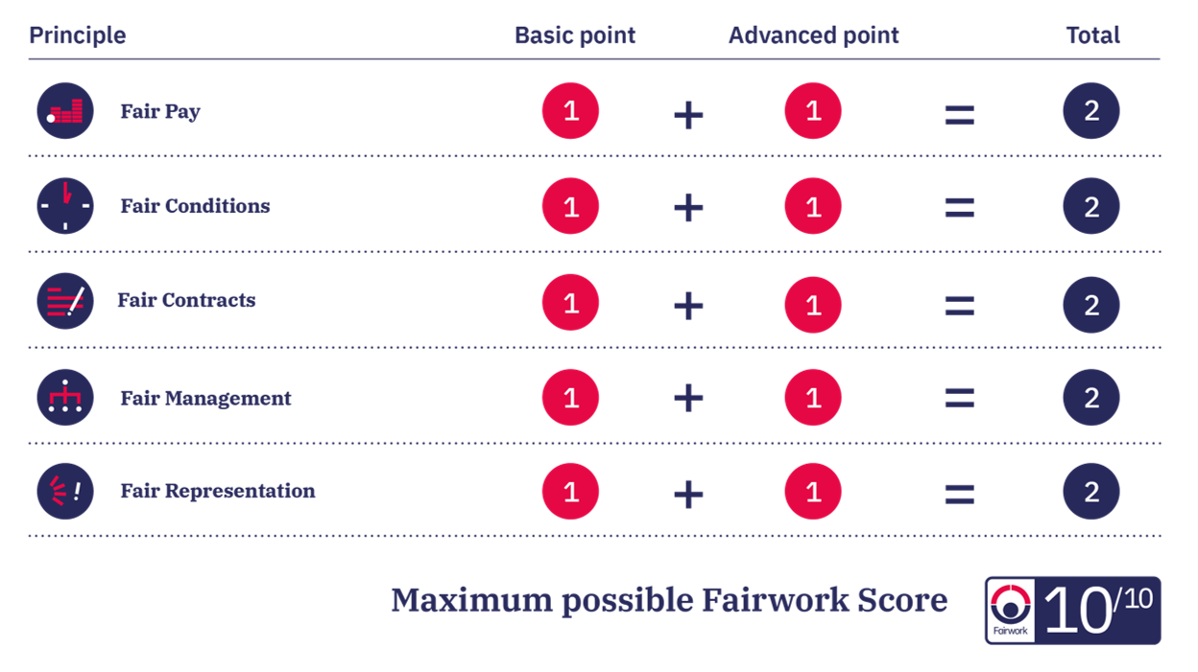
Methods: Scoring System

Slide 5
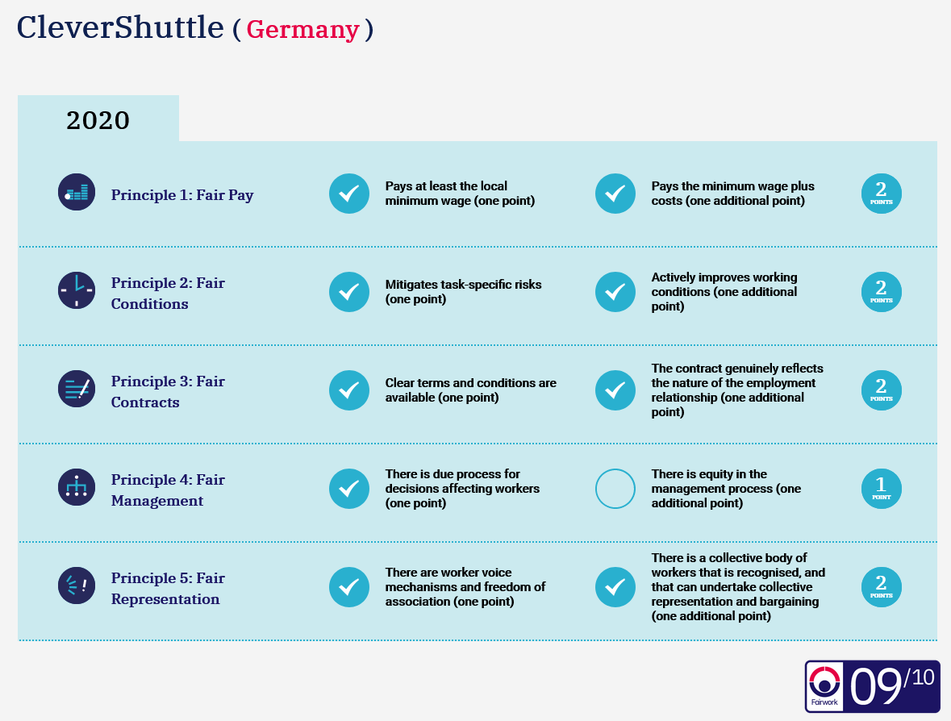
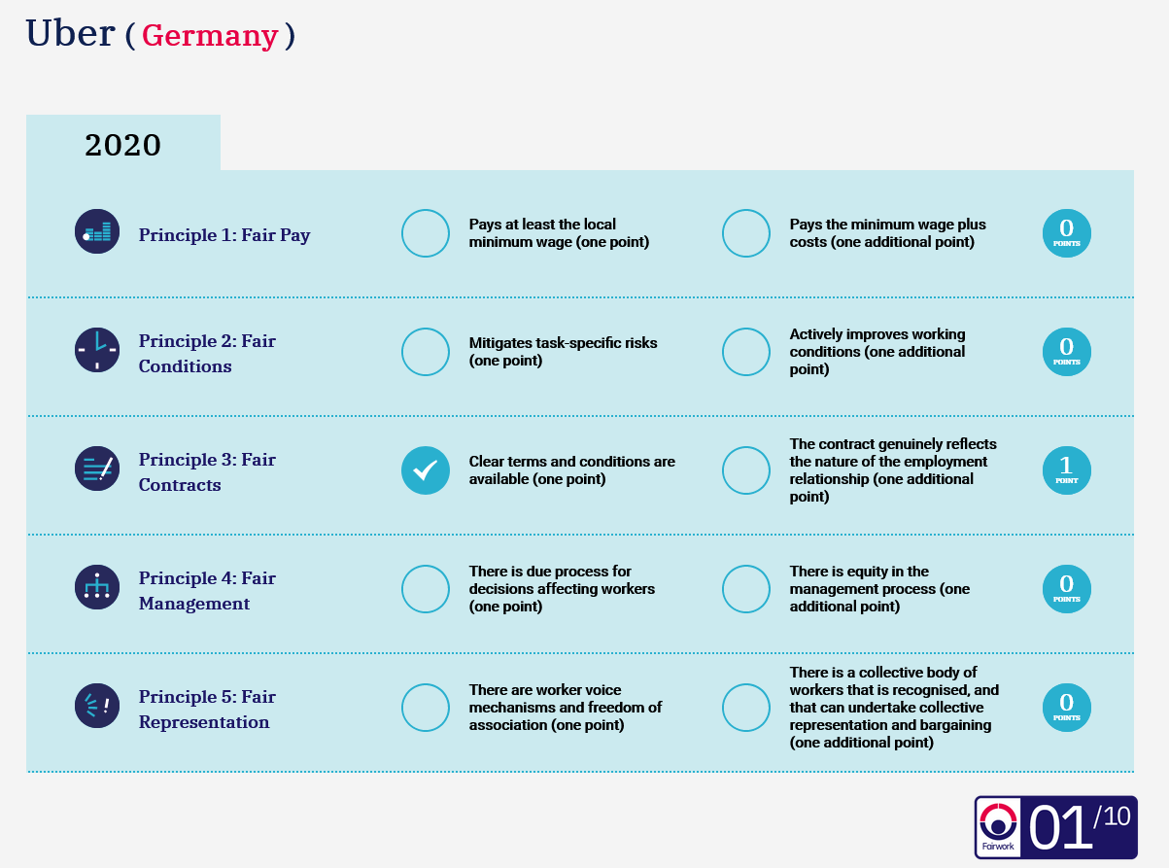
Germany Scores 2020: Examples

Slide 6
Evaluating Fair Pay

Slide 7
Principle 1: Fair Pay​
Fair practice means workers, irrespective of their employment classification, should earn a decent income in their home jurisdiction after taking account of work-related costs.
1.1 - Pays at least the local minimum wage after costs (one point)​
​
1.2 - Pays at least a local living wage after costs (one additional point)

Slide 8
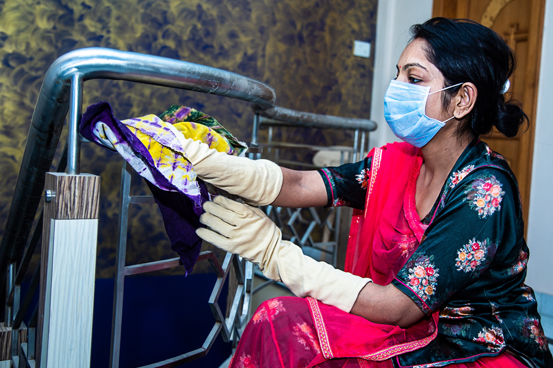
Working Time
The way working time is calculated makes an important difference on the ‘hourly’ pay. In the gig economy, working time should not just be the actual time spent doing a gig
- Waiting time
Transport ​
Log-in time
What about multi-apping?

Slide 9
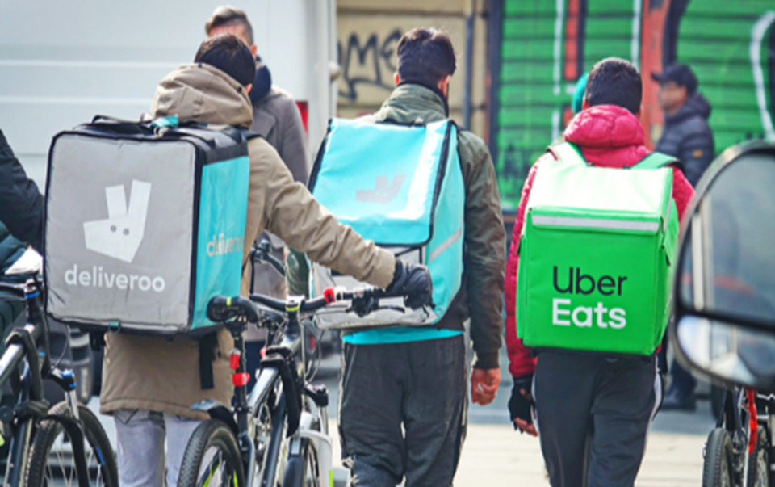
Costs
As many platforms operate on an independent contractor model, most costs are b​orne by the worker. What costs should be included?
-Fuel
-Repairs and Maintenance
-Work equipment
-Insurance
-Vehicle Rental
-But how are these costs calculated?

Slide 10
Payment delays and withholding
The power asymmetry between the platform and the worker means the worker has limited ability to contest non-payment.
-Platforms may not take responsibility for non-payment by clients
-Platform is biased towards customers
-Payment structures are often non-transparent

Slide 11
Evaluating Minimum and Living Wages

Slide 12
Minimum wage is often really below minimum​
In many countries, the minimum wage is extremely, often not having been updated for years and years, and set below poverty levels.
-Even platforms which guarantee workers to be paid the minimum wage might be paying very poorly
-Platforms might claim to be paying workers above the minimum wage, but only by taking into account of
some of the costs

Slide 13
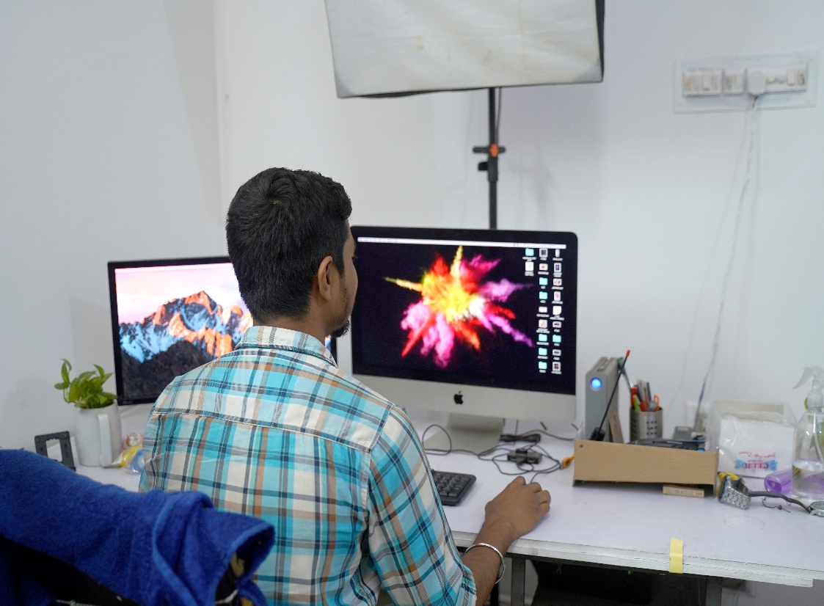
Living Wage as a solution?
Living wage as a more accurate measure of fair pay
But…
It should fully take into account of living costs
It should be adapted to local and individual circumstances
- It should be regularly updated

Slide 14
…Beyond the Living Wage
Even workers who are paid the living wage after costs might not earn enough
-Too few ‘gigs’
-Unpredictability of income
-Irregularity of income
Fighting precarity and insecurity requires more than just living wages

Slide 15
Thank you
fair.work
@towardsfairwork
@towardsfairwork
@towards_fairwork
The Fairwork team in late 2020. For a current list, visit fair.work

