Slide 1
REPUBLIC OF BULGARIA
Ministry of Labour and Social Policy
National Institute for Conciliation and Arbitration
www.nipa.bg
NICA’S DATABASE ON COLLECTIVE LABOUR AGREEMENTS
Legally regulated by Labour Code (am. Dec 2008) provision – Art. 53, para 5 ‘’Copies of the registered employment contracts shall be provided ex officio, under order determined by the Minister of Labour and Social Policy, to the National Institute for Conciliation and Arbitration, which shall create and maintain an information system for the collective employment contracts’’
Common decision by the Ministry & Social Partners (NICA’s Supervisory Board) to create and develop an information resource for collective bargaining based at NICA to provide ”promotion of collective bargaining” – point (e) of the ILO Convention 154 “bodies and procedures for the settlement of labour disputes should be so conceived as to contribute to the promotion of collective bargaining’’.
EUROFOUND Webinar on Collective Agreements, December 3, 2021

Slide 2
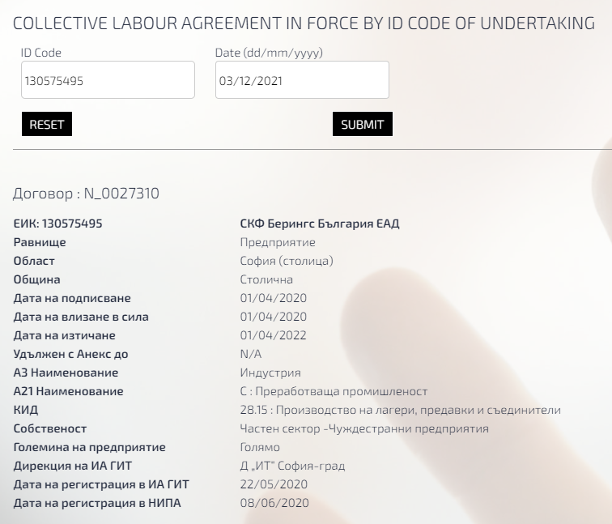
www.nipa.bg
CLA DATA PROCESSING 1
Copies of CLA & Annexes received from GLI (on paper; files - *.pdf or *.doc; or directly downloaded from GLI’s internal register)
Input the information from CLA in NICA’s information system using MS ACCESS (two chapters):
First - Functional data, e.g. in CLA on company level - size of companies, ownership (public/private; real sector/administration; national/foreign), regional distribution (by municipalities, administrative districts & statistical regions), etc.
The visual output of this information on NICA’s web page, using searching tools by ID number is:
Searching tool using the ID
No of CBA as it registered in NICA
Company’s ID
Level of Bargaining
Type of CBA
Administrative District
Municipality
Signing date
Start date
End date
Extended by Annex to (date)
NACE Code A 3
NACE Code A 21 Full NACE Code
Ownership
Size
GLI registration unit
GLI date of registration
NICA date of registration

Slide 3
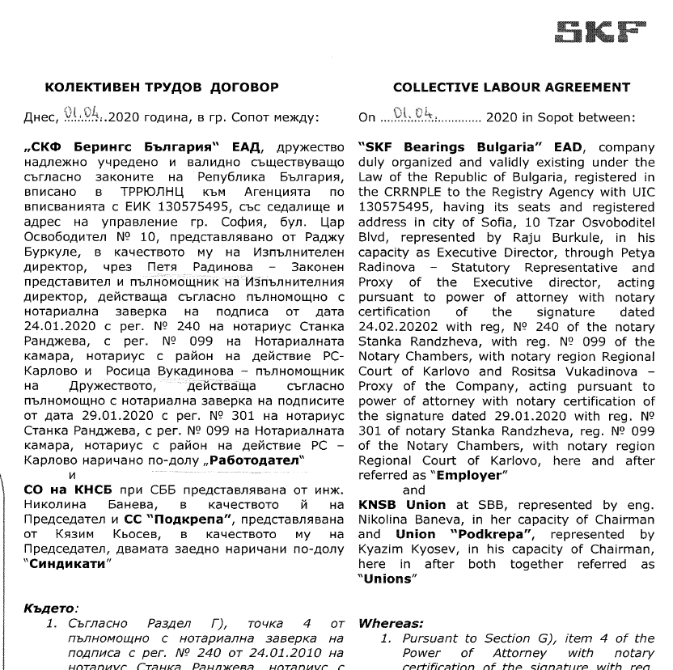
www.nipa.bg
CLA DATA PROCESSING 2
The first page of this CBA
Not for general public
Labour Code.
Obligation for Information
Art. 58. (amend. - SG, No 100/1992; amend. – SG 48/06, in force
From 01.07.2006) The employer shall be obliged to inform all workers and
employees of the collective contracts, with which he/she is bound,
Concluded at the enterprise, by sectors, branches or municipalities and
to keep the texts of the collective contract at the disposal of the workers
and employees.
SECOND - Data on what the signatories have agreed upon, after precise read and analysis by NICA’s experts, is imported in MS ACCESS through special questionnaire
THIRD – The information from MS ACCESS has transferred in IBM SPSS and processing after
Combined data on reached concrete agreements in CBA in force at 31.12.2020 are available on NICA’s web page by 7 groups as existed as chapters in CBA
General Provision Compensations benefits
Wages Health & Safety. Social security & Insurance. Social policy
Employment & Training. Working time Social Dialogue. Relationship between parties, Dispute settlement
Leaves

Slide 4
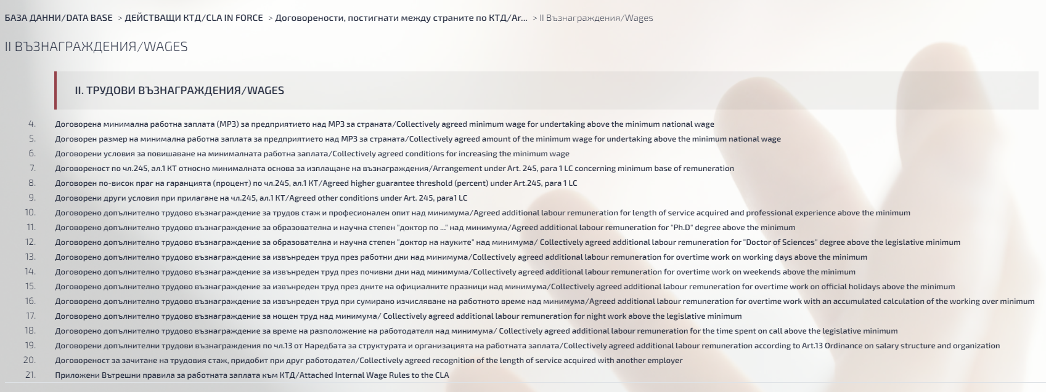
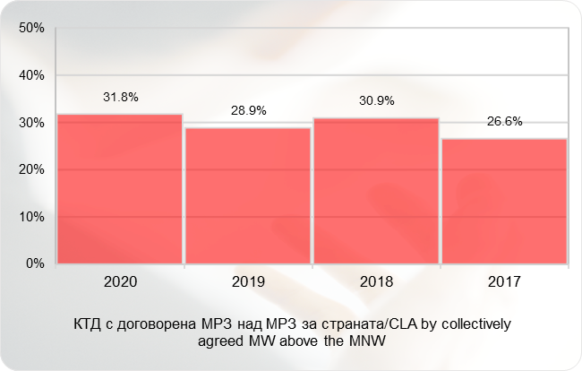
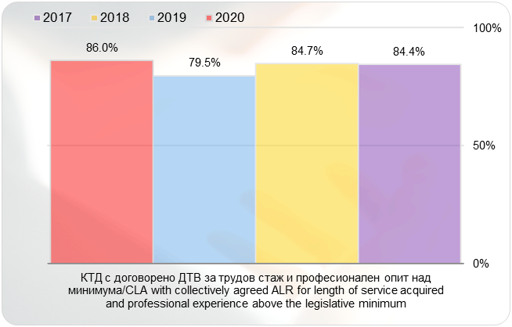
www.nipa.bg
CLA DATA PROCESSING 3
The Wage section is as shown:

Slide 5
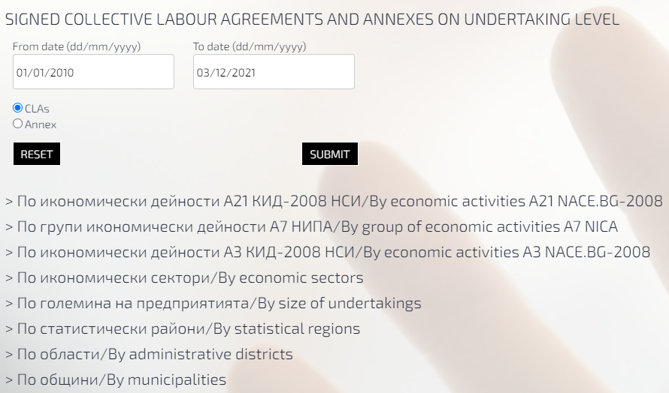
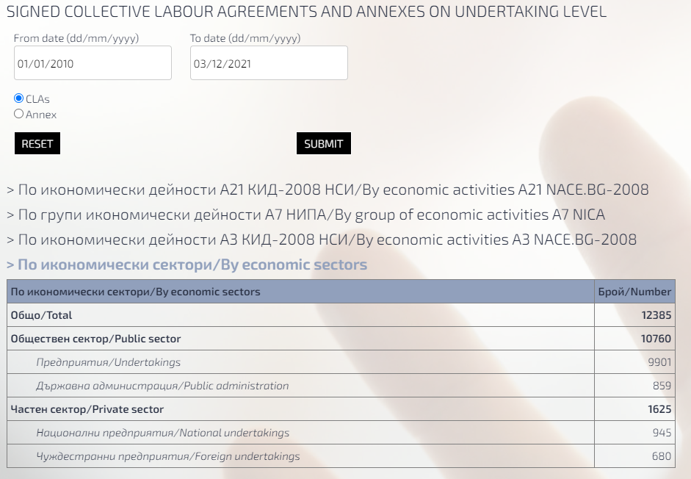
www.nipa.bg
CLA DATA ON SIGNED CBAs
From October 2021 NICA has developed a special searching tool online for CBAs on company level in the web site, available also in English.
The goal is to show the number of signed CBAs and the annexes to them for a certain period of time, and its structure by NACE economic activities, ownership, size, etc.
NICA holds CBAs on Industry/Branch = Sectoral level & Municipality level.
The Sectoral CBAs have published in full text on the web page, as they received from GLI

Slide 6
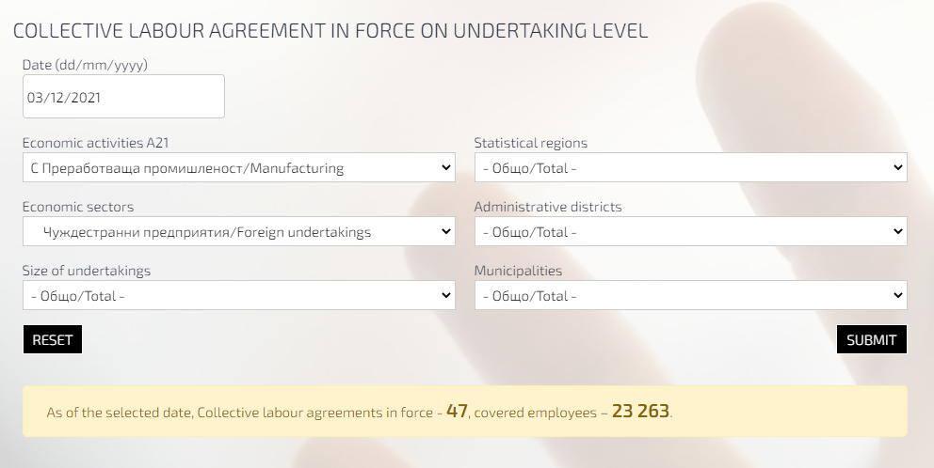
www.nipa.bg
CLA DATA ON CBAs IN FORCE
Last month NICA has developed a new searching tool online for CBAs in force on company level in the web site, available also in English.
The goal is to show the number and employees covered by CBAs in force at given date, and its structure by NACE economic activities, ownership, size, etc.
All NICA’s information is mainly for the social partners (Employers’ organization, Trade unions, employers and workers) to help them in a process of collective bargaining, and for state institutions to be informed when develop an industrial relation policy.

Slide 7
www.nipa.bg
NICA’s CLA DATA – NEXT STEPS
NICA is going to make future steps in following direction:
Migrate the DATABASE from MS ACCESS to SQL platform
Develop new indicators for analyzing
Assist GLI for digitalizing the process of CLA registering
Exchange good practice with other holders of CBA database
Thank you for you attention!
Vladimir Boyadjiev
Director
National Institute for Conciliation and Arbitration (NICA)
Phone: +359 242 537 70
Fax: +359 242 537 60
Mobile: +359 884 887 285
E-mail: director@nipa.bg, Web: www.nipa.bg

