Slide 1
KVSystem
The Austrian Collective Agreement Database

Slide 2
General information
Database for
union members (dating back to 1995)
legal advice
the public (since 2015)
Contains
~ 600 collective agreements
~ 27,000 documents (~ 800 documents added every year)

Slide 3
Metadata
Start and end date
Blue/White collar worker
Union
Name & ID

Slide 4
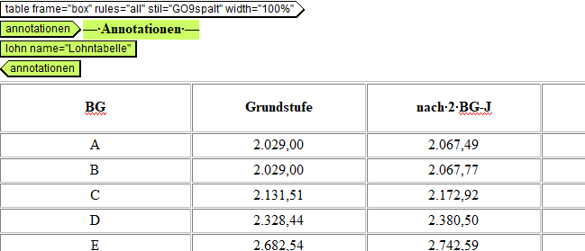
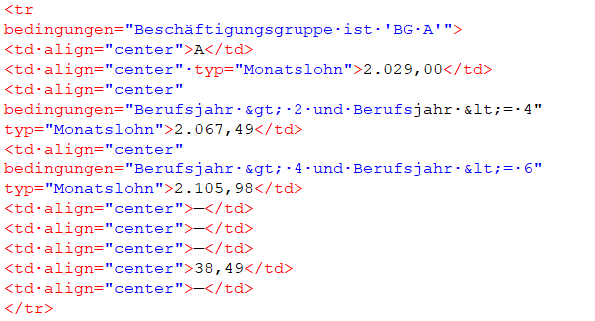
Annotations

Slide 5
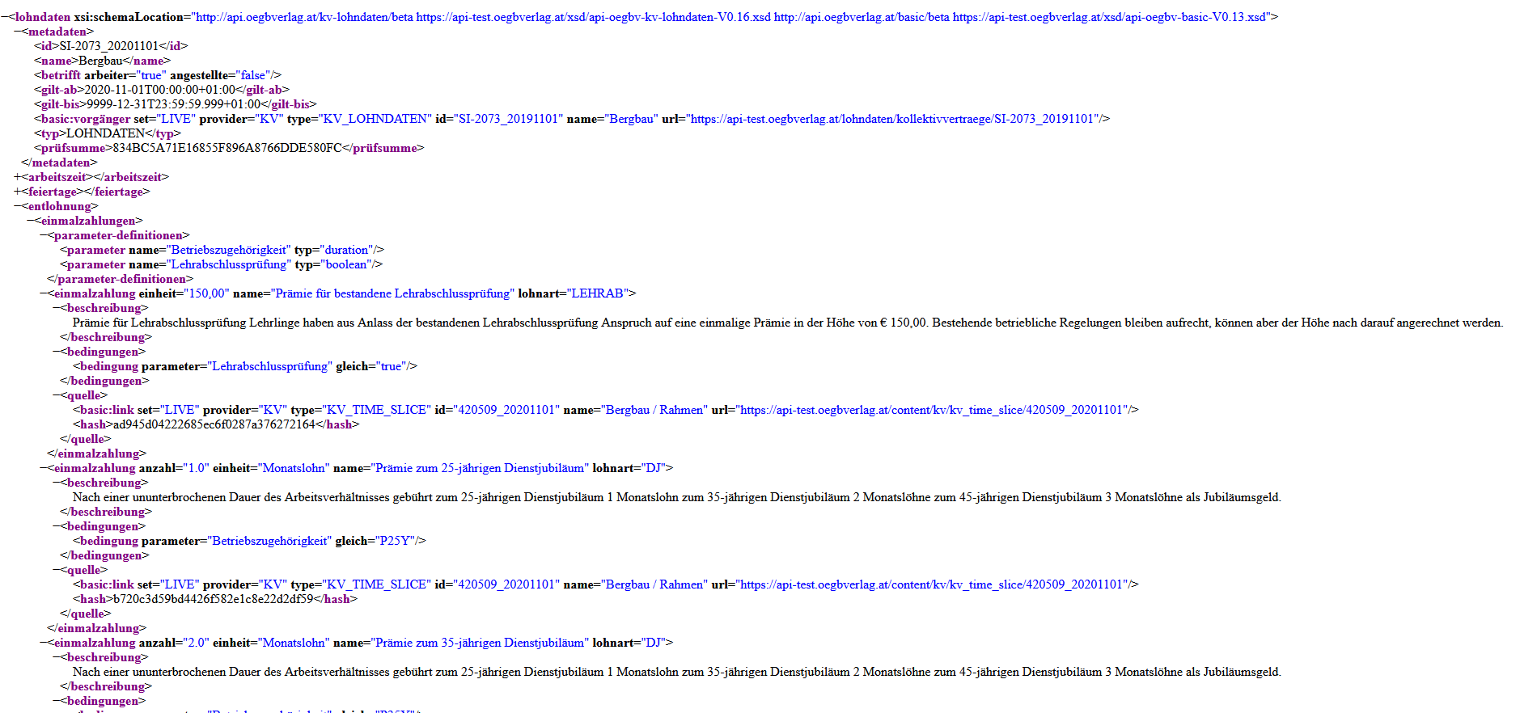
KV-API

Slide 6
Future improvements
Extension of annotated collective agreements (wage data)
Adding new metadata for statistical analysis
Yearly percentage increase
Annotation of every minimum wage
Adding a classification, properbly based on the NACE-code
Some improvements in the content

Slide 7
Thank you for your attention!

